Slide 1
Pins need grid access
A detailed route starts and ends at grid access points, integer cells the router can reach
learn_routing — 03 pin access
Notes:
A detailed route starts and ends at grid access points—integer cells the router can reach. Legal placement gives you x y coordinates; this module converts them with round-and-clamp and nudges off blockages when needed.

Slide 2
The idea
Pin_grid of x y returns column gx equals round of x clamped zero to nx minus one
Cell A at one comma one maps to one comma one
Cell E at five comma three sits near the blockage at five comma two
learn_routing — 03 pin access
Notes:
pin_grid of x y returns column gx equals round of x clamped zero to nx minus one, and row gy likewise. Cell A at one comma one maps to one comma one. Cell E at five comma three sits near the blockage at five comma two; nudge to a free neighbor if the pin lands inside the blocked rectangle.

Slide 3
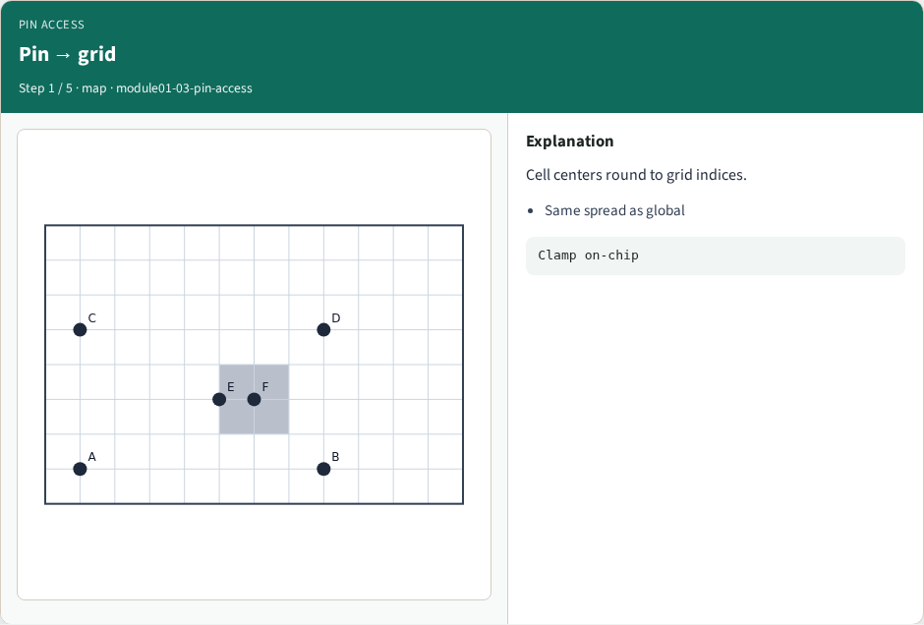
Pin → grid
Pin → grid
learn_routing — 03 pin access
Notes:
Cell centers round to grid indices.

Slide 4
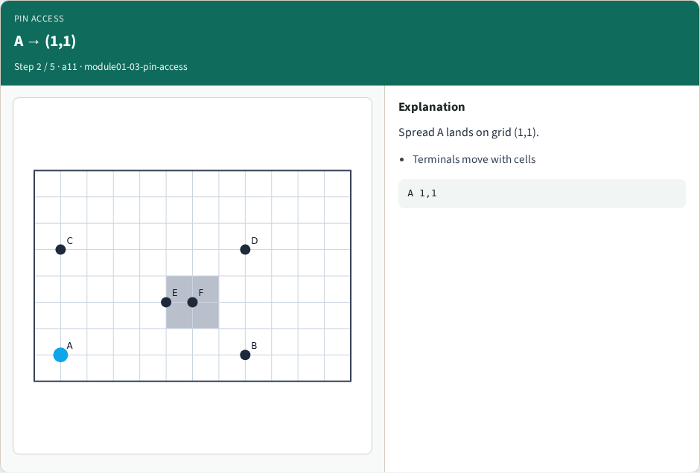
A → (1,1)
A → (1,1)
learn_routing — 03 pin access
Notes:
Spread A lands on grid (1,1).

Slide 5
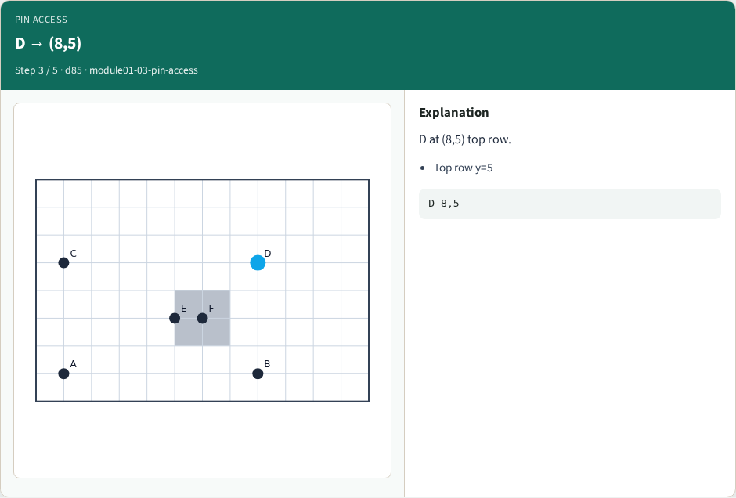
D → (8,5)
D → (8,5)
learn_routing — 03 pin access
Notes:
D at (8,5) top row.

Slide 6
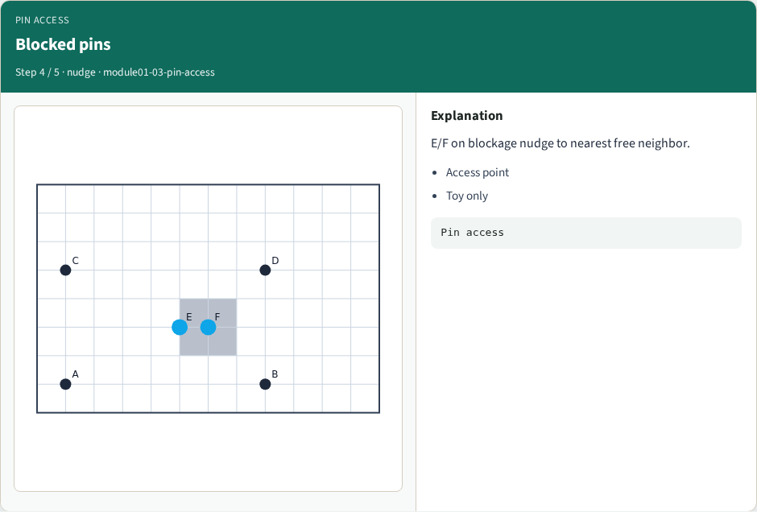
Blocked pins
Blocked pins
learn_routing — 03 pin access
Notes:
E/F on blockage nudge to nearest free neighbor.

Slide 7
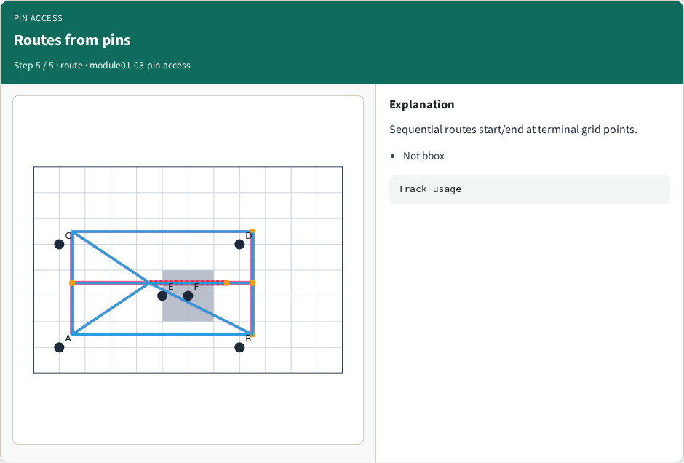
Routes from pins
Routes from pins
learn_routing — 03 pin access
Notes:
Sequential routes start/end at terminal grid points.

Slide 8
Browser lab track
Open pin-access
Hover each cell and read its access grid point
Move a pin across the blockage boundary and watch the access index shift
Confirm all six cells on tiny_dr match your Track A printout
learn_routing — 03 pin access
Notes:
Open **pin-access**. Hover each cell and read its access grid point. Move a pin across the blockage boundary and watch the access index shift. Confirm all six cells on tiny_dr match your Track A printout.

Slide 9
Implement track
Implement or call `terminals(positions, data)` in `common/drutil.py`
Assert A through F on spread placement
Print access points before any routing lab
learn_routing — 03 pin access
Notes:
Implement or call `terminals(positions, data)` in `common/drutil.py`. Assert A through F on spread placement. Print access points before any routing lab.

Slide 10
Pitfalls
Using GCell floor divide from global routing instead of per-grid rounding
Off-by-one at the chip edge without clamp
Ignoring blockages when assigning access
learn_routing — 03 pin access
Notes:
Using GCell floor divide from global routing instead of per-grid rounding. Off-by-one at the chip edge without clamp. Ignoring blockages when assigning access.

Slide 11
Your turn
Complete access points for all six cells
Next: Lee maze routing around the central blockage
learn_routing — 03 pin access
Notes:
Complete access points for all six cells. Next: Lee maze routing around the central blockage.

