Slide 1
Cell paths before layers
Lee maze finds a shortest path on grid cells ignoring track congestion
learn_routing — 01 lee maze
Notes:
Lee maze finds a shortest path on grid cells ignoring track congestion—ideal for teaching detours around blockages before A* adds capacity penalties.

Slide 2
The idea
Seed a BFS queue with start and path list
Pop, expand neighbors4 skipping blocked cells, return the first path that reaches the goal
If the queue empties, return None
Shortest cell hop count wins
learn_routing — 01 lee maze
Notes:
Seed a BFS queue with start and path list. Pop, expand neighbors4 skipping blocked cells, return the first path that reaches the goal. If the queue empties, return None. Shortest cell hop count wins.

Slide 3
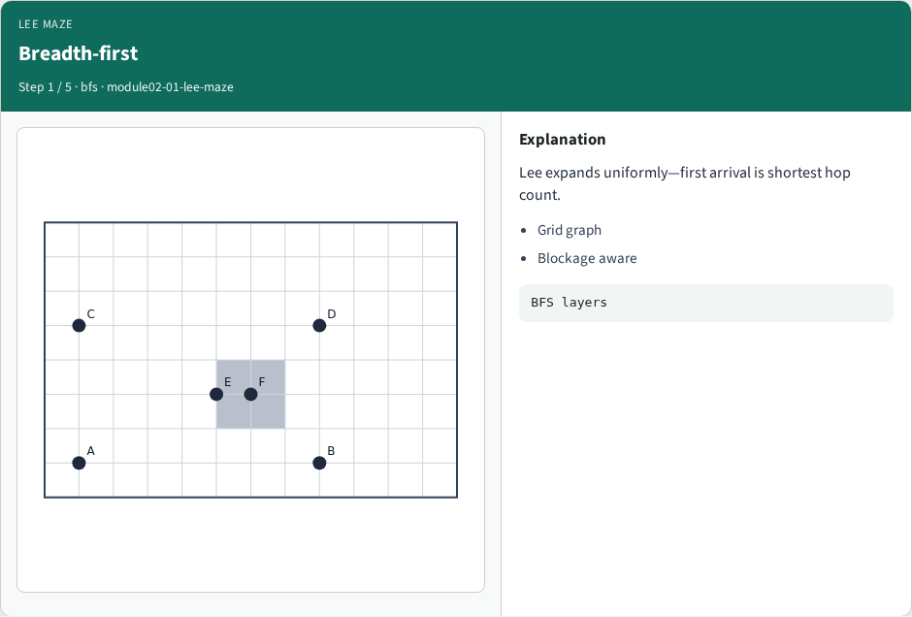
Breadth-first
Breadth-first
learn_routing — 01 lee maze
Notes:
Lee expands uniformly—first arrival is shortest hop count.

Slide 4
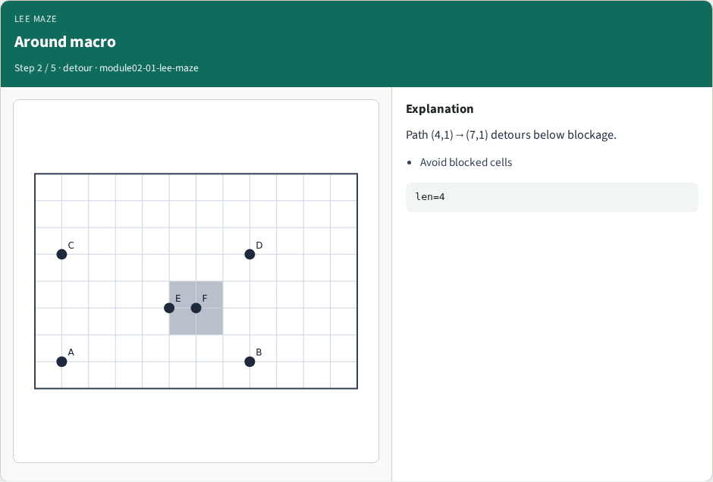
Around macro
Around macro
learn_routing — 01 lee maze
Notes:
Path (4,1)→(7,1) detours below blockage.

Slide 5
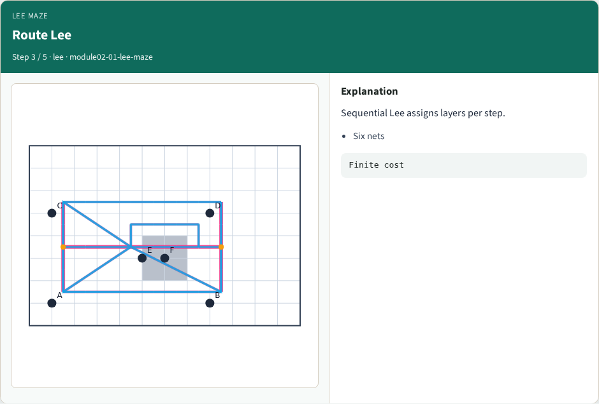
Route Lee
Route Lee
learn_routing — 01 lee maze
Notes:
Sequential Lee assigns layers per step.

Slide 6
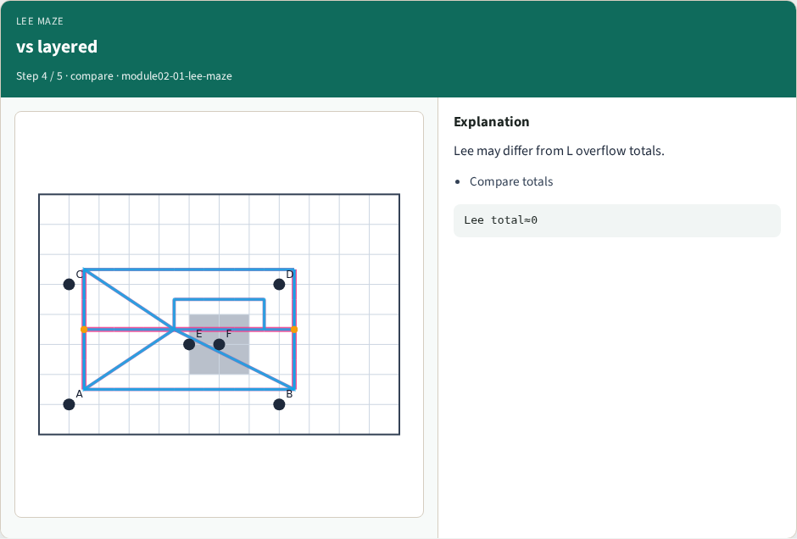
vs layered
vs layered
learn_routing — 01 lee maze
Notes:
Lee may differ from L overflow totals.

Slide 7
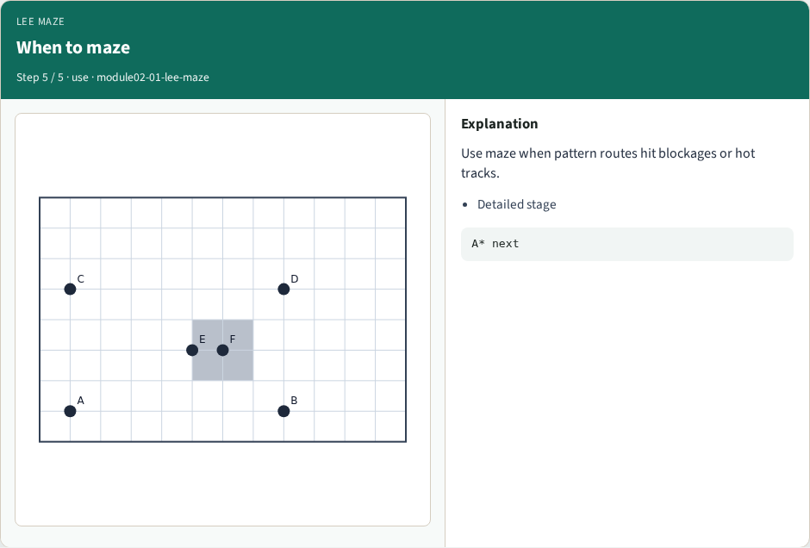
When to maze
When to maze
learn_routing — 01 lee maze
Notes:
Use maze when pattern routes hit blockages or hot tracks.

Slide 8
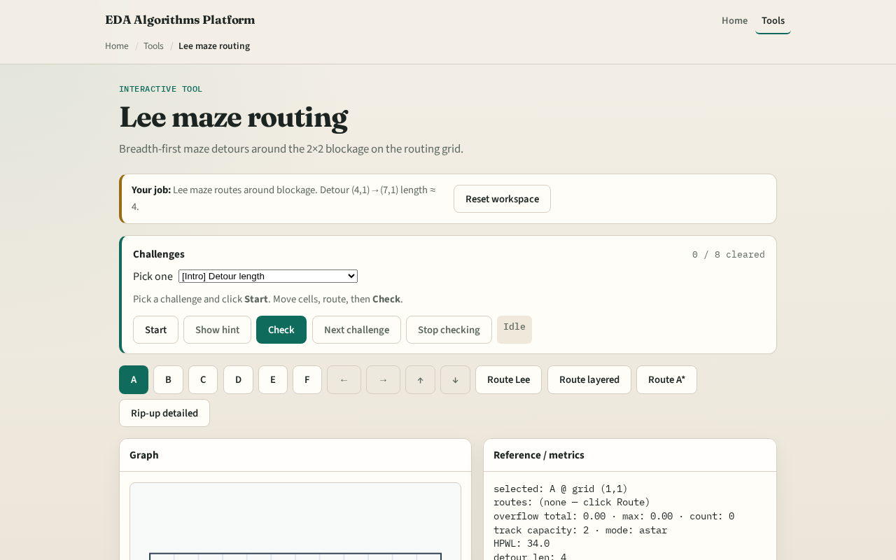
Browser lab track
Browser lab starter
learn_routing — 01 lee maze
Notes:
Open **lee-maze**. Route from four comma one to seven comma one with the blockage at five comma two visible. Watch maze pick a longer detour above or below the blocked rectangle.

Slide 9
Implement track
Implement `lee_maze(start, goal, blocked, nx, ny)`
Block cells inside five comma two two by two and show the path avoids them
Match the browser overlay
learn_routing — 01 lee maze
Notes:
Implement `lee_maze(start, goal, blocked, nx, ny)`. Block cells inside five comma two two by two and show the path avoids them. Match the browser overlay.

Slide 10
Pitfalls
Treating blockages as track usage instead of forbidden cells
Forgetting BFS needs visited on cells not edges
Returning a path through a blocked cell because neighbor checks were skipped
learn_routing — 01 lee maze
Notes:
Treating blockages as track usage instead of forbidden cells. Forgetting BFS needs visited on cells not edges. Returning a path through a blocked cell because neighbor checks were skipped.

Slide 11
Your turn
Pass Lee maze goldens
Next: A* routing that respects track capacity
learn_routing — 01 lee maze
Notes:
Pass Lee maze goldens. Next: A* routing that respects track capacity.

