Slide 1
Congestion-aware search
Lee ignores other nets
learn_routing — 03 astar route
Notes:
Lee ignores other nets. Production detailed routers penalize hot tracks. Our A* adds a heavy step cost when usage is already at capacity so routes detour around congested M1 or M2 edges.

Slide 2
The idea
Maintain open heap ordered by f equals g plus Manhattan distance to goal
Expand four neighbors on M1 for horizontal steps and M2 for vertical
Step cost is one plus ten times overflow penalty when usage meets capacity
First time you pop the goal, return the path
learn_routing — 03 astar route
Notes:
Maintain open heap ordered by f equals g plus Manhattan distance to goal. Expand four neighbors on M1 for horizontal steps and M2 for vertical. Step cost is one plus ten times overflow penalty when usage meets capacity. First time you pop the goal, return the path.

Slide 3
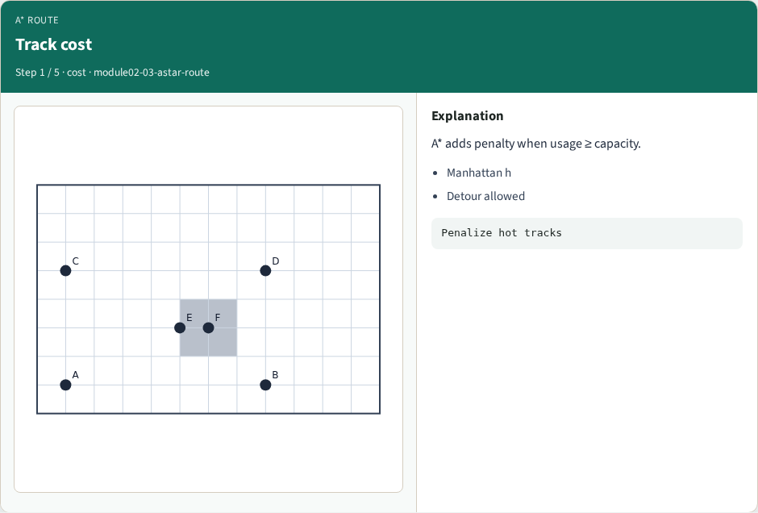
Track cost
Track cost
learn_routing — 03 astar route
Notes:
A* adds penalty when usage ≥ capacity.

Slide 4
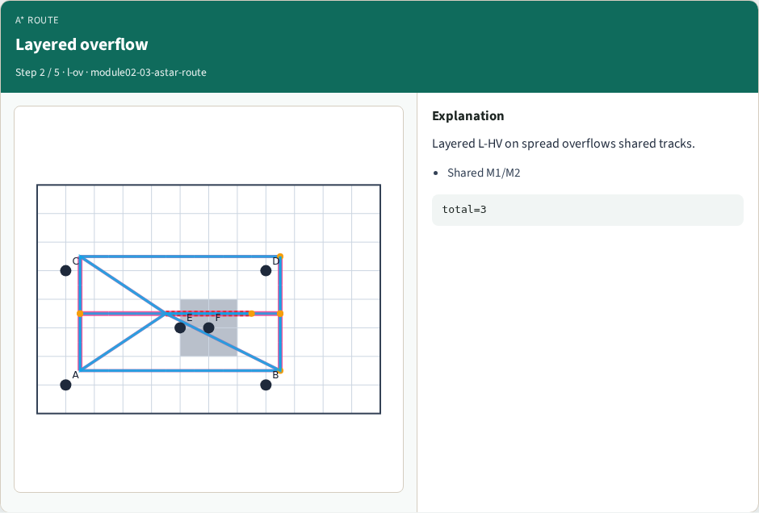
Layered overflow
Layered overflow
learn_routing — 03 astar route
Notes:
Layered L-HV on spread overflows shared tracks.

Slide 5
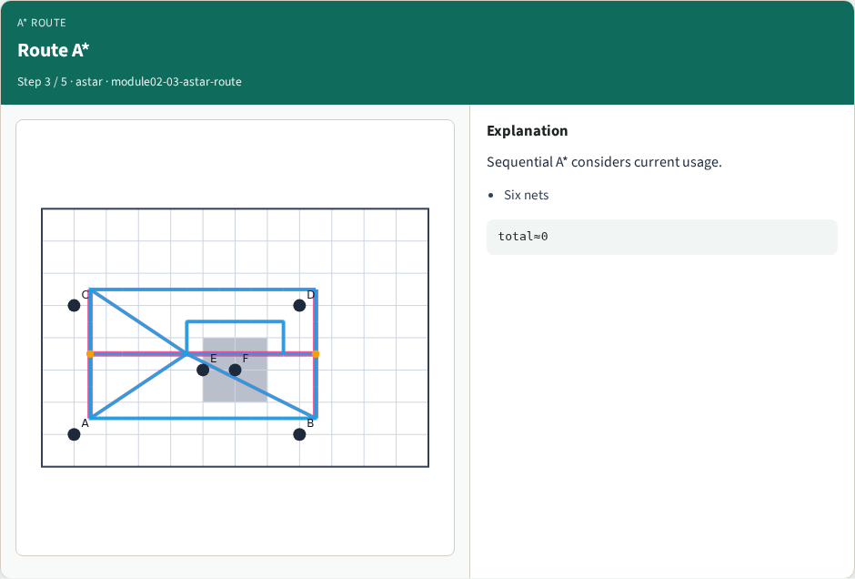
Route A*
Route A*
learn_routing — 03 astar route
Notes:
Sequential A* considers current usage.

Slide 6
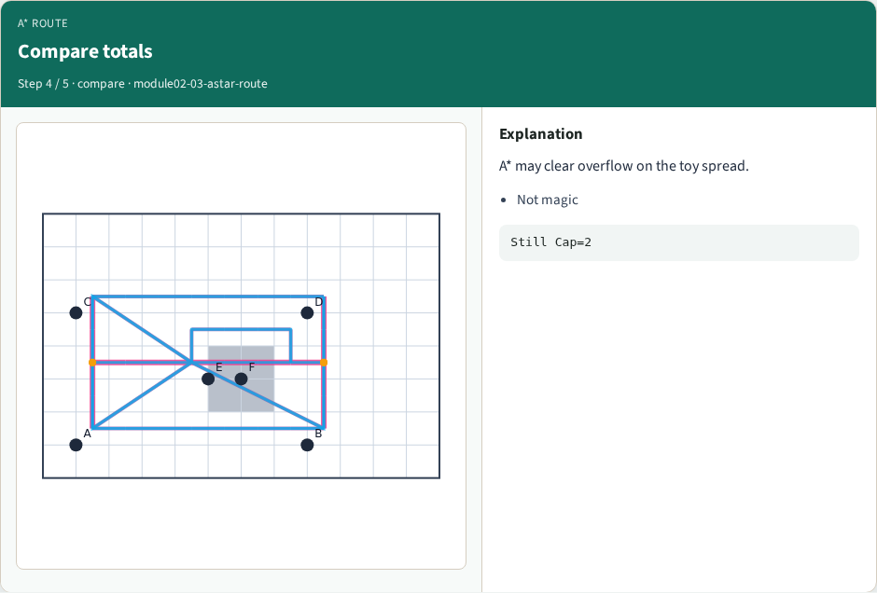
Compare totals
Compare totals
learn_routing — 03 astar route
Notes:
A* may clear overflow on the toy spread.

Slide 7
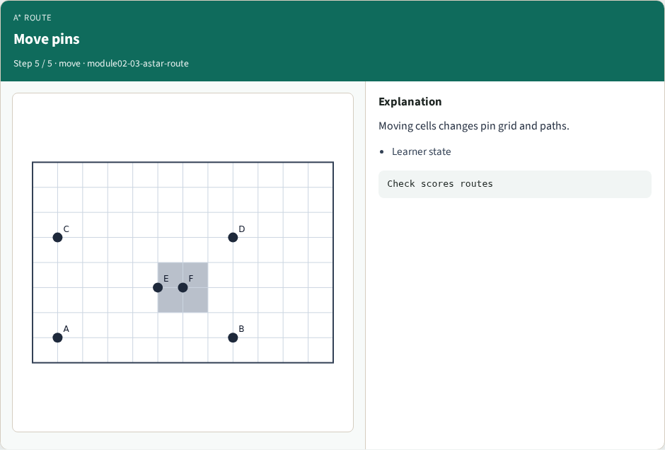
Move pins
Move pins
learn_routing — 03 astar route
Notes:
Moving cells changes pin grid and paths.

Slide 8
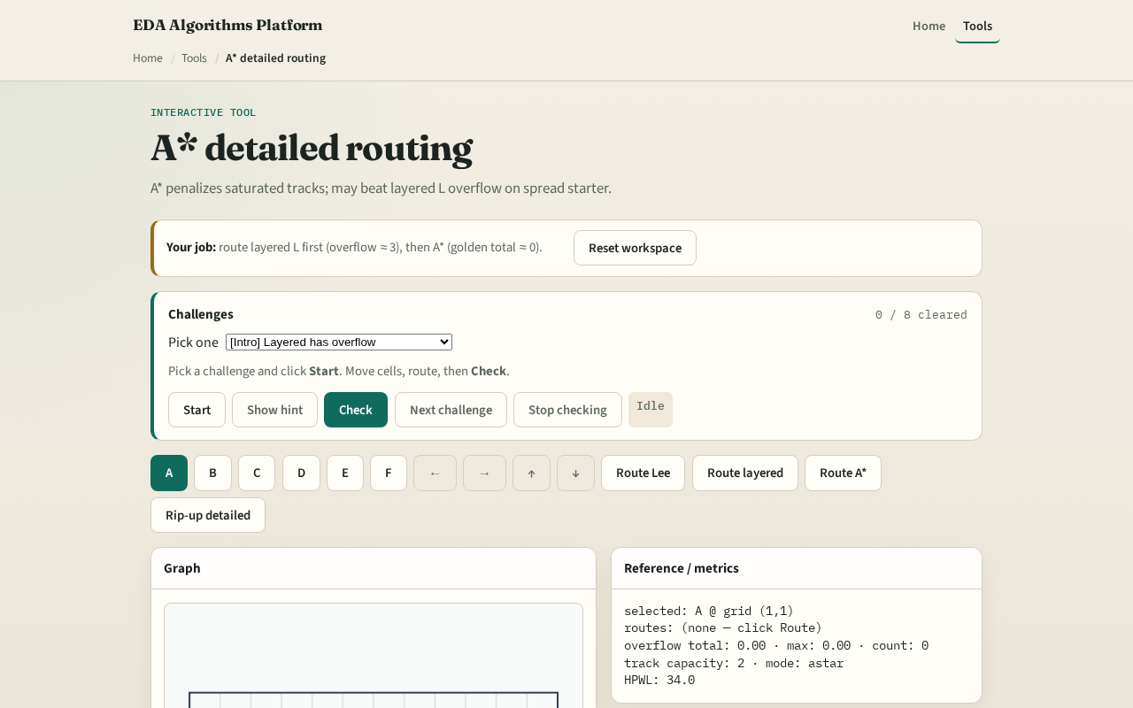
Browser lab track
Browser lab starter
learn_routing — 03 astar route
Notes:
Open **astar-route**. Pre-fill M1 edge one comma one to two comma one at capacity one and watch A* pick a longer detour. Clear the block and confirm the shortest path returns.

Slide 9
Implement track
Implement or call `astar_route(start, goal, usage, cap, nx, ny, blocks)`
Block the hot edge and show A* cannot go direct; unblock a vertical detour path exists
learn_routing — 03 astar route
Notes:
Implement or call `astar_route(start, goal, usage, cap, nx, ny, blocks)`. Block the hot edge and show A* cannot go direct; unblock a vertical detour path exists.

Slide 10
Pitfalls
Using undirected track keys inconsistently
Checking capacity on the wrong layer for a move
Forgetting blockages still forbid cells even when tracks are free
learn_routing — 03 astar route
Notes:
Using undirected track keys inconsistently. Checking capacity on the wrong layer for a move. Forgetting blockages still forbid cells even when tracks are free.

Slide 11
Your turn
Clear A* challenges
Next: deposit segments on tracks and measure overflow
learn_routing — 03 astar route
Notes:
Clear A* challenges. Next: deposit segments on tracks and measure overflow.

