Slide 1
When usage exceeds capacity
Each directed M1 or M2 track has capacity one on tiny_dr
learn_routing — 05 track usage
Notes:
Each directed M1 or M2 track has capacity one on tiny_dr. Every routed net deposits plus one on each track its segments traverse. Overflow is how far usage exceeds capacity—summed, maxed, and counted per track.

Slide 2
The idea
Path_track_usage walks consecutive segment pairs
Track_overflow computes max of zero and usage minus capacity per track
Sequential L-HV on all six nets should yield positive total overflow at cap one
learn_routing — 05 track usage
Notes:
path_track_usage walks consecutive segment pairs, maps horizontal moves to h_edge and vertical to v_edge, increments usage. track_overflow computes max of zero and usage minus capacity per track. Sequential L-HV on all six nets should yield positive total overflow at cap one.

Slide 3
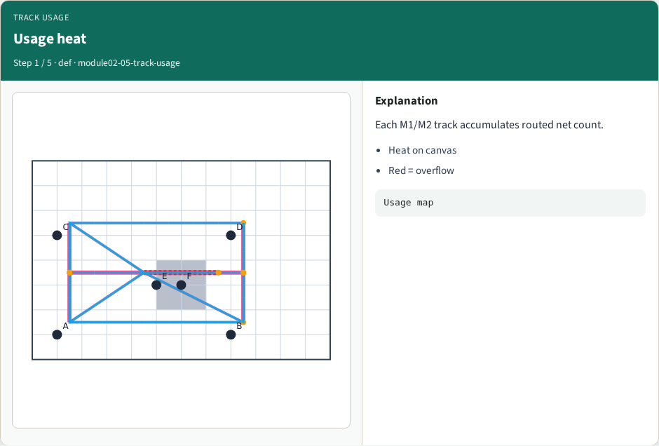
Usage heat
Usage heat
learn_routing — 05 track usage
Notes:
Each M1/M2 track accumulates routed net count.

Slide 4
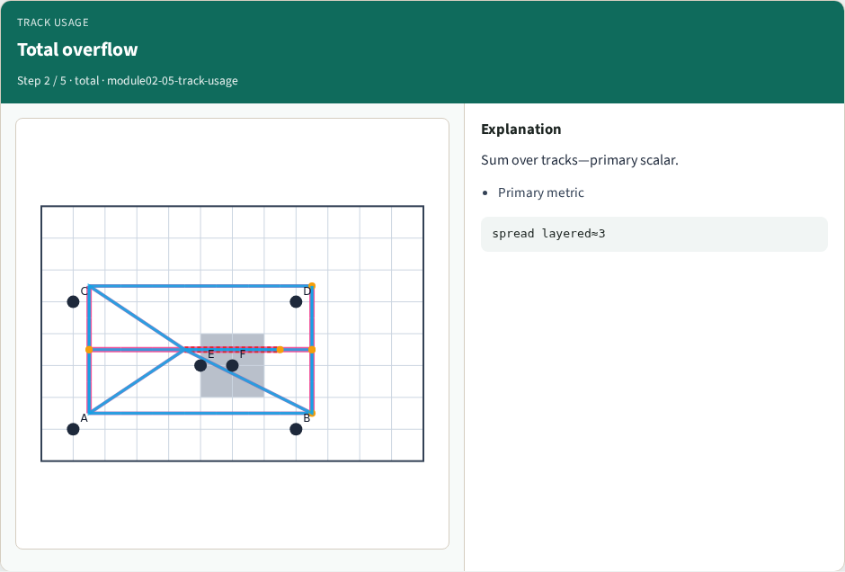
Total overflow
Total overflow
learn_routing — 05 track usage
Notes:
Sum over tracks—primary scalar.

Slide 5
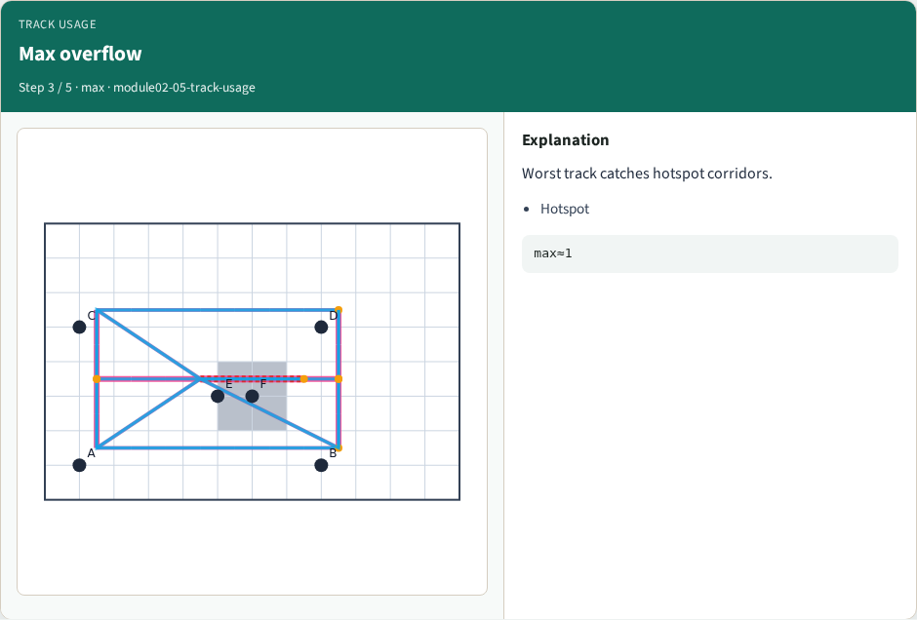
Max overflow
Max overflow
learn_routing — 05 track usage
Notes:
Worst track catches hotspot corridors.

Slide 6
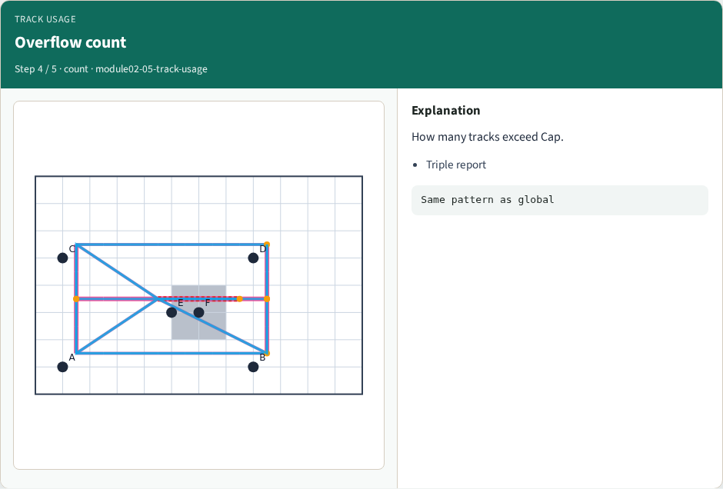
Overflow count
Overflow count
learn_routing — 05 track usage
Notes:
How many tracks exceed Cap.

Slide 7
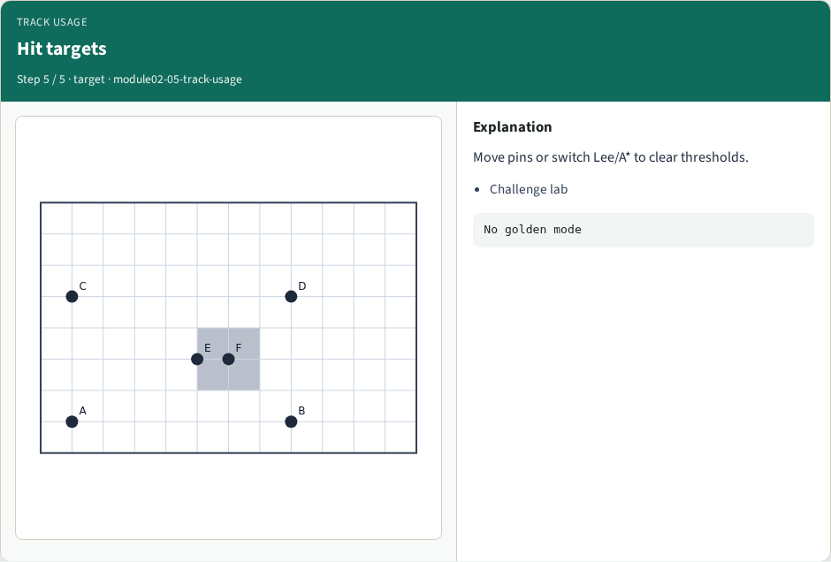
Hit targets
Hit targets
learn_routing — 05 track usage
Notes:
Move pins or switch Lee/A* to clear thresholds.

Slide 8
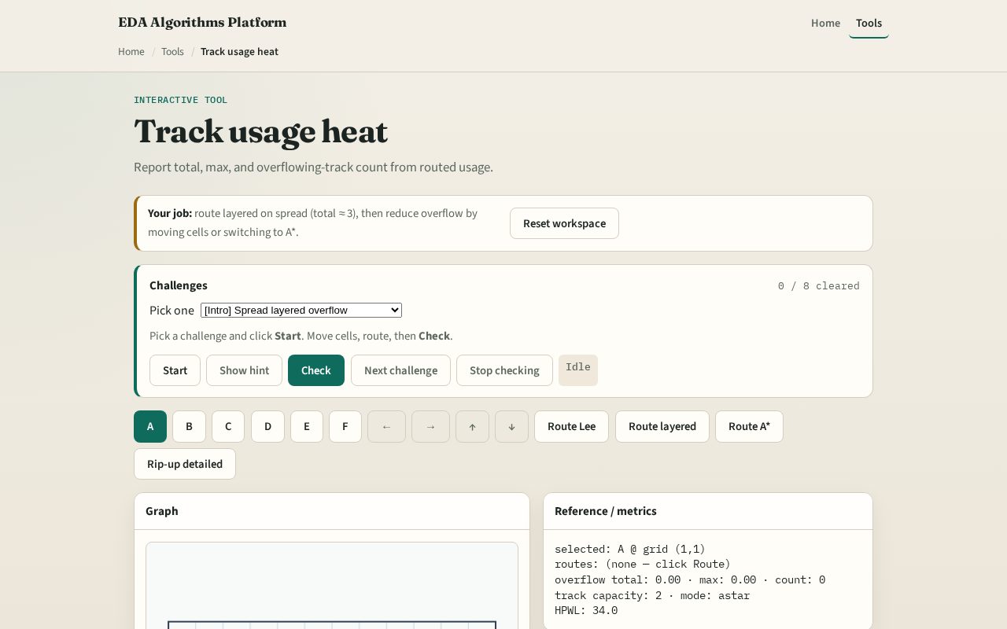
Browser lab track
Browser lab starter
learn_routing — 05 track usage
Notes:
Open **track-usage**. Run sequential L routes and read the triple total max count. Heat-map the worst track.

Slide 9
Implement track
Implement `path_track_usage` and `track_overflow`
Call sequential_detailed with mode l_hv on tiny_dr and assert total overflow is greater
learn_routing — 05 track usage
Notes:
Implement `path_track_usage` and `track_overflow`. Call sequential_detailed with mode l_hv on tiny_dr and assert total overflow is greater than zero.

Slide 10
Pitfalls
Computing overflow before summing all nets
Using GCell edge usage from global routing instead of directed tracks
Reporting negative overflow values
learn_routing — 05 track usage
Notes:
Computing overflow before summing all nets. Using GCell edge usage from global routing instead of directed tracks. Reporting negative overflow values.

Slide 11
Your turn
Hit overflow targets
Next: assign vias on two-layer L paths
learn_routing — 05 track usage
Notes:
Hit overflow targets. Next: assign vias on two-layer L paths.

