Slide 1
Layer changes at bends
Real detailed routes switch between M1 and M2 at vias
learn_routing — 07 via assignment
Notes:
Real detailed routes switch between M1 and M2 at vias. Our L-route with layers walks horizontal on M1 and vertical on M2—or the VH variant—and marks via equals true at the bend cell.

Slide 2
The idea
Given start and goal
L_route_layers returns segment dicts with x y layer and optional via flag
A path from one comma one to five comma four in HV includes at least one via
learn_routing — 07 via assignment
Notes:
Given start and goal, prefer HV walks horizontal on M1 to align columns, inserts a via segment at the bend, then walks vertical on M2. l_route_layers returns segment dicts with x y layer and optional via flag. A path from one comma one to five comma four in HV includes at least one via.

Slide 3
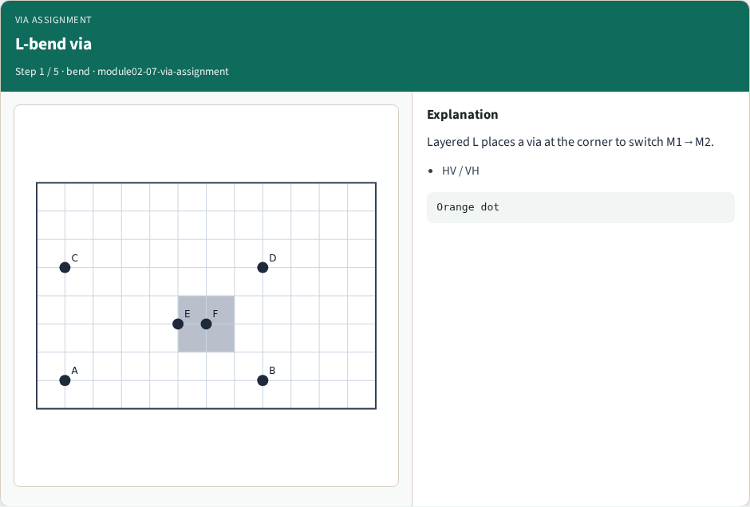
L-bend via
L-bend via
learn_routing — 07 via assignment
Notes:
Layered L places a via at the corner to switch M1→M2.

Slide 4
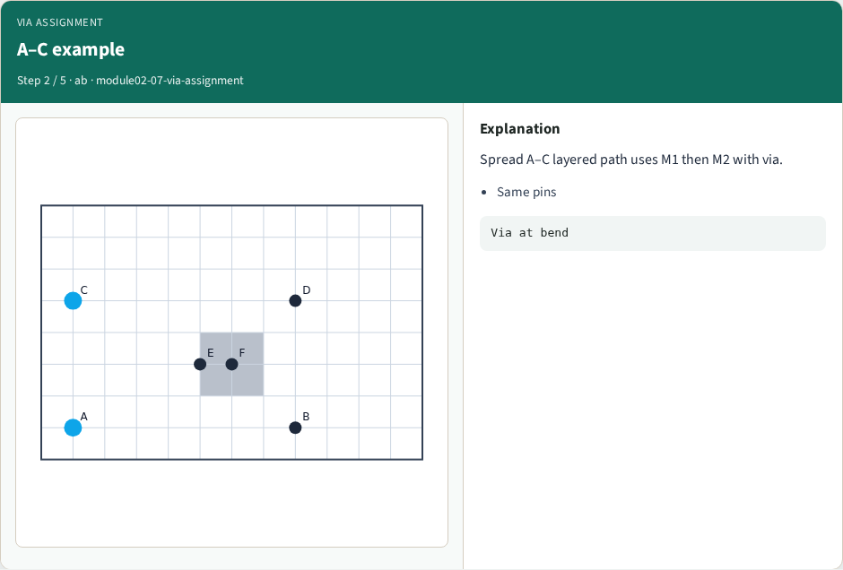
A–C example
A–C example
learn_routing — 07 via assignment
Notes:
Spread A–C layered path uses M1 then M2 with via.

Slide 5
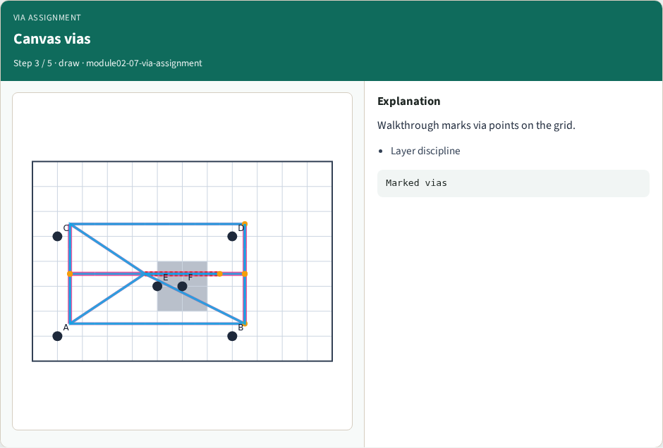
Canvas vias
Canvas vias
learn_routing — 07 via assignment
Notes:
Walkthrough marks via points on the grid.

Slide 6
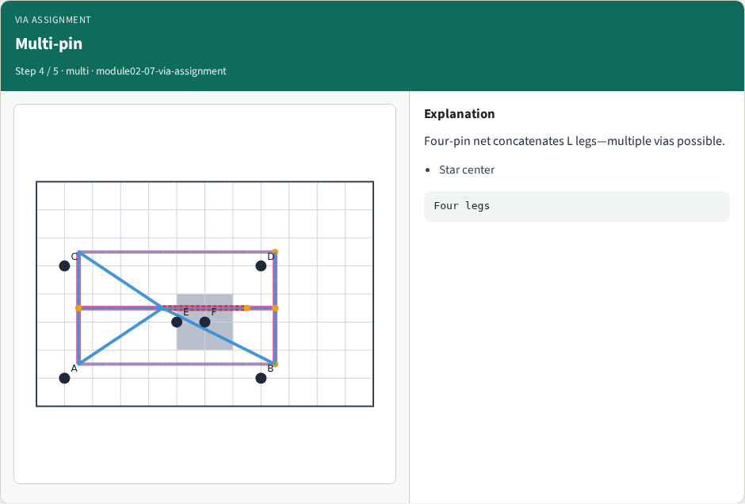
Multi-pin
Multi-pin
learn_routing — 07 via assignment
Notes:
Four-pin net concatenates L legs—multiple vias possible.

Slide 7
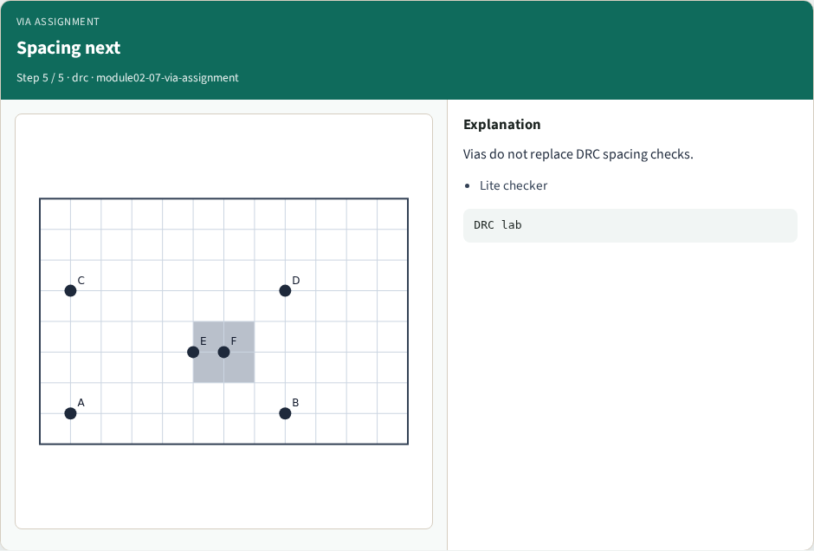
Spacing next
Spacing next
learn_routing — 07 via assignment
Notes:
Vias do not replace DRC spacing checks.

Slide 8
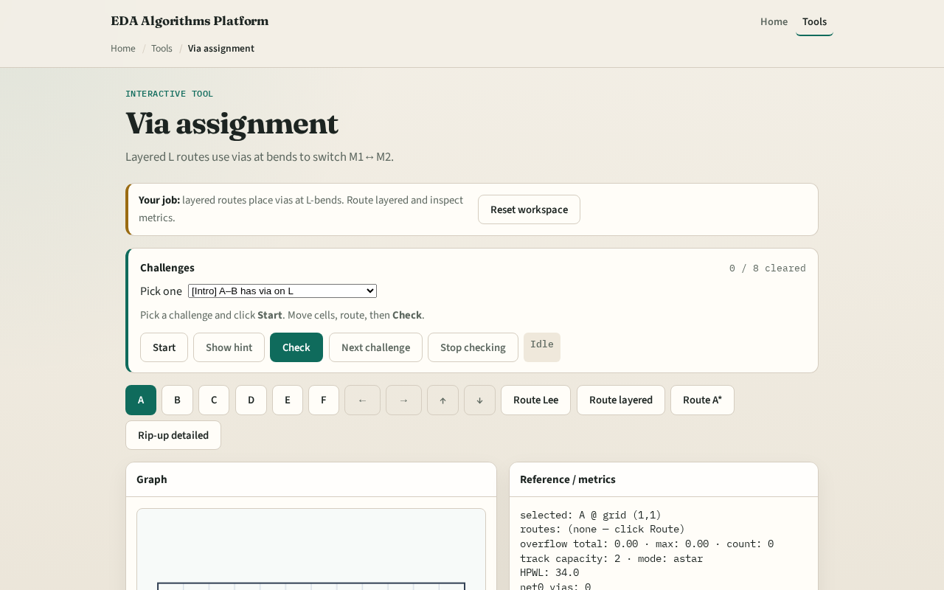
Browser lab track
Browser lab starter
learn_routing — 07 via assignment
Notes:
Open **via-assignment**. Route A to B with HV and read via markers in the segment list. Toggle VH on the same pair and compare the bend cell and layers.

Slide 9
Implement track
Implement `l_route_layers(a, b, prefer)`
Route net A–B on tiny_dr and print segments with via flags
Match the browser overlay
learn_routing — 07 via assignment
Notes:
Implement `l_route_layers(a, b, prefer)`. Route net A–B on tiny_dr and print segments with via flags. Match the browser overlay.

Slide 10
Pitfalls
Skipping the via marker at the bend
Putting horizontal motion on M2 or vertical on M1
Forgetting the final segment must land on the goal coordinates
learn_routing — 07 via assignment
Notes:
Skipping the via marker at the bend. Putting horizontal motion on M2 or vertical on M1. Forgetting the final segment must land on the goal coordinates.

Slide 11
Your turn
Ship Track A layer routes with vias
Next: DRC spacing lite on parallel tracks
learn_routing — 07 via assignment
Notes:
Ship Track A layer routes with vias. Next: DRC spacing lite on parallel tracks.

