Slide 1
Geometry rules matter
Signoff DRC is vast; spacing lite teaches the idea
learn_routing — 01 drc spacing
Notes:
Signoff DRC is vast; spacing lite teaches the idea: same-layer parallel segments too close fail even when tracks are logically free.

Slide 2
The idea
Group segment points by layer
For M1 pairs on the same row y
Likewise for M2 pairs on the same column x
Otherwise pass
learn_routing — 01 drc spacing
Notes:
Group segment points by layer. For M1 pairs on the same row y, if horizontal distance is greater than zero but less than or equal to min_dist, return fail with violation coordinates. Likewise for M2 pairs on the same column x. Otherwise pass.

Slide 3
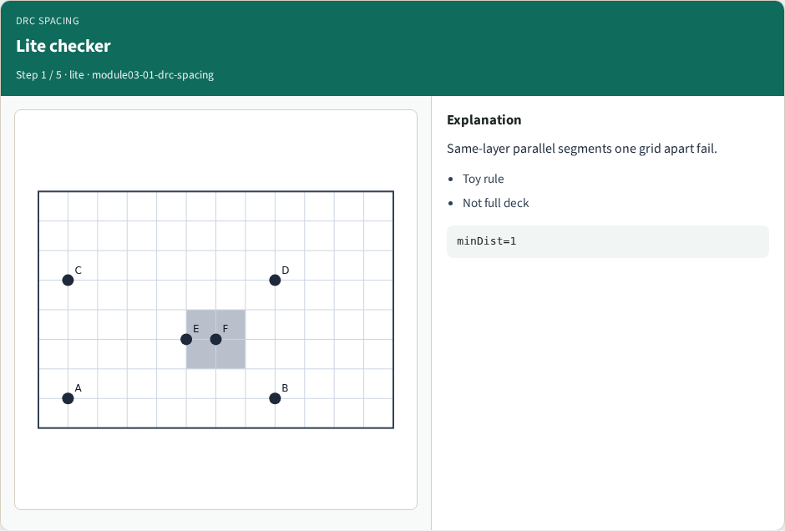
Lite checker
Lite checker
learn_routing — 01 drc spacing
Notes:
Same-layer parallel segments one grid apart fail.

Slide 4
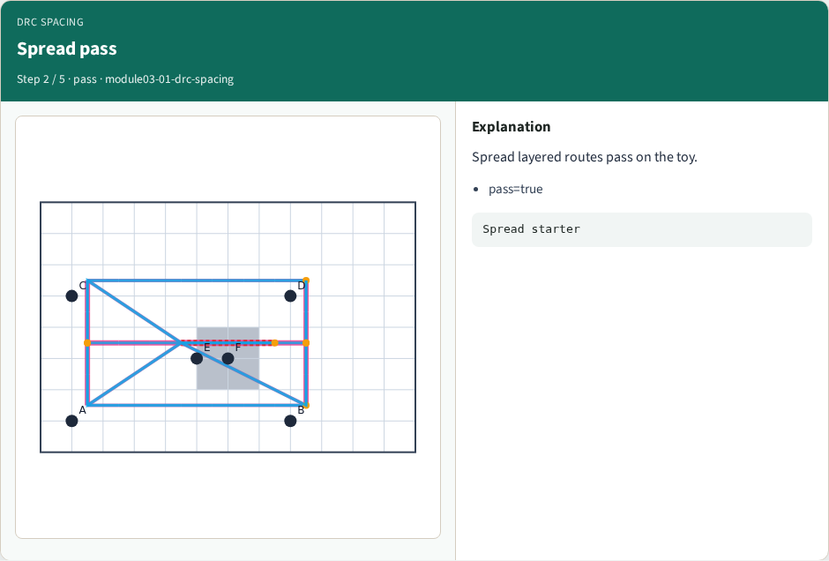
Spread pass
Spread pass
learn_routing — 01 drc spacing
Notes:
Spread layered routes pass on the toy.

Slide 5
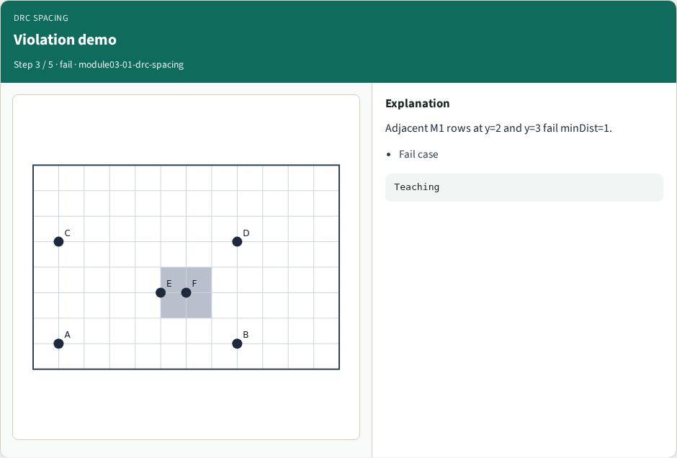
Violation demo
Violation demo
learn_routing — 01 drc spacing
Notes:
Adjacent M1 rows at y=2 and y=3 fail minDist=1.

Slide 6

After route
After route
learn_routing — 01 drc spacing
Notes:
Run checker on learner sequential routes.

Slide 7
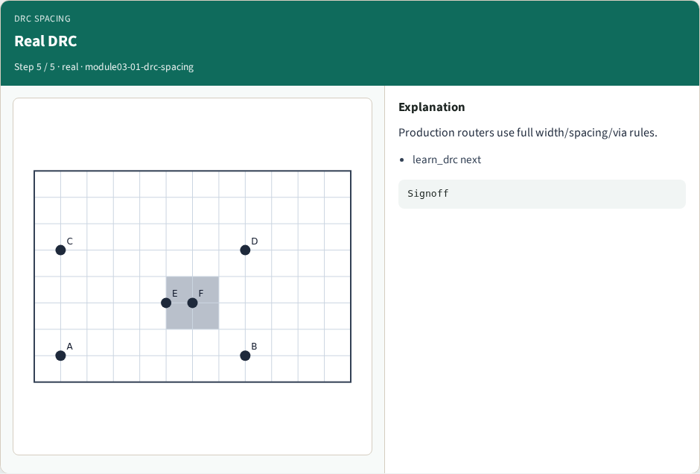
Real DRC
Real DRC
learn_routing — 01 drc spacing
Notes:
Production routers use full width/spacing/via rules.

Slide 8
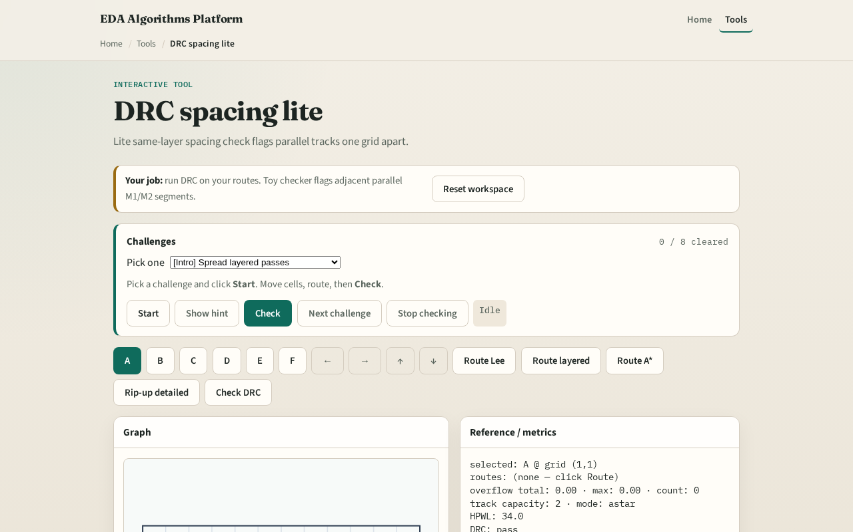
Browser lab track
Browser lab starter
learn_routing — 01 drc spacing
Notes:
Open **drc-spacing**. Place parallel M1 segments one track apart on adjacent rows and read the violation panel. Widen spacing and confirm pass.

Slide 9
Implement track
Implement `drc_spacing_lite(segments, min_dist)`
Feed the golden failing segment set from test_solvers and assert pass is false
learn_routing — 01 drc spacing
Notes:
Implement `drc_spacing_lite(segments, min_dist)`. Feed the golden failing segment set from test_solvers and assert pass is false.

Slide 10
Pitfalls
Checking cross-layer pairs, this lite rule is same-layer only
Using Manhattan grid distance across rows for M1 horizontal segments
Treating DRC pass as proof of tape-out readiness
learn_routing — 01 drc spacing
Notes:
Checking cross-layer pairs—this lite rule is same-layer only. Using Manhattan grid distance across rows for M1 horizontal segments. Treating DRC pass as proof of tape-out readiness.

Slide 11
Your turn
Clear DRC spacing challenges
Next: rip-up the hottest net and A* reroute
learn_routing — 01 drc spacing
Notes:
Clear DRC spacing challenges. Next: rip-up the hottest net and A* reroute.

