Slide 1
Relieve track hotspots
When track overflow appears, detailed routers rip up contributing nets and reroute around congested tracks
learn_routing — 03 ripup detailed
Notes:
When track overflow appears, detailed routers rip up contributing nets and reroute around congested tracks. Our toy pass picks the net whose route contributes the most overflow, removes its usage, then A*-reroutes.

Slide 2
The idea
Score each net by track overflow on its segments
Subtract its route from usage
Run astar_route between its pins with the remaining usage map
Add the new segment track usage back
Total overflow should not rise; ideally it drops versus the pre-rip state
learn_routing — 03 ripup detailed
Notes:
Score each net by track overflow on its segments. Subtract its route from usage. Run astar_route between its pins with the remaining usage map. Add the new segment track usage back. Total overflow should not rise; ideally it drops versus the pre-rip state.

Slide 3
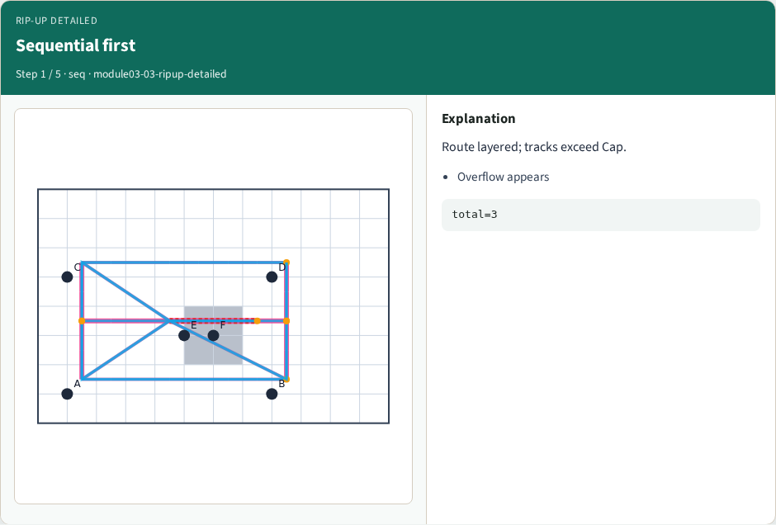
Sequential first
Sequential first
learn_routing — 03 ripup detailed
Notes:
Route layered; tracks exceed Cap.

Slide 4
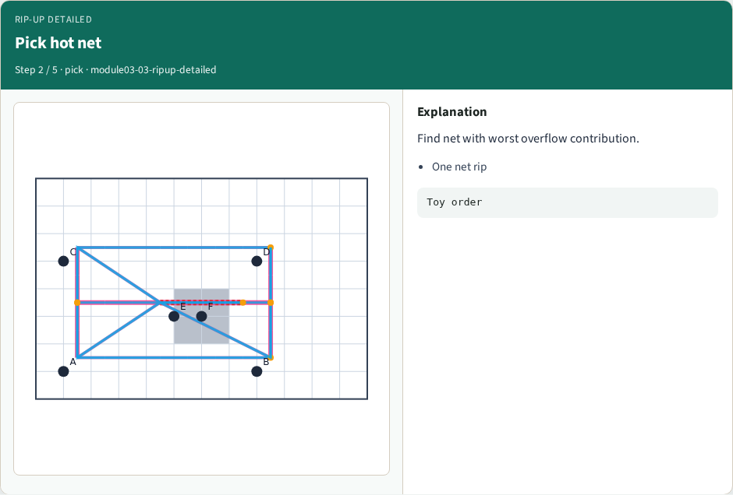
Pick hot net
Pick hot net
learn_routing — 03 ripup detailed
Notes:
Find net with worst overflow contribution.

Slide 5
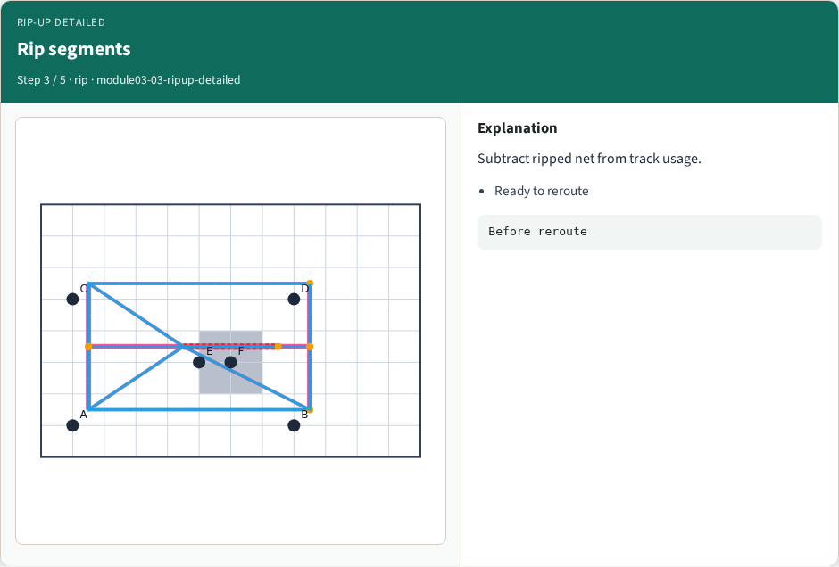
Rip segments
Rip segments
learn_routing — 03 ripup detailed
Notes:
Subtract ripped net from track usage.

Slide 6
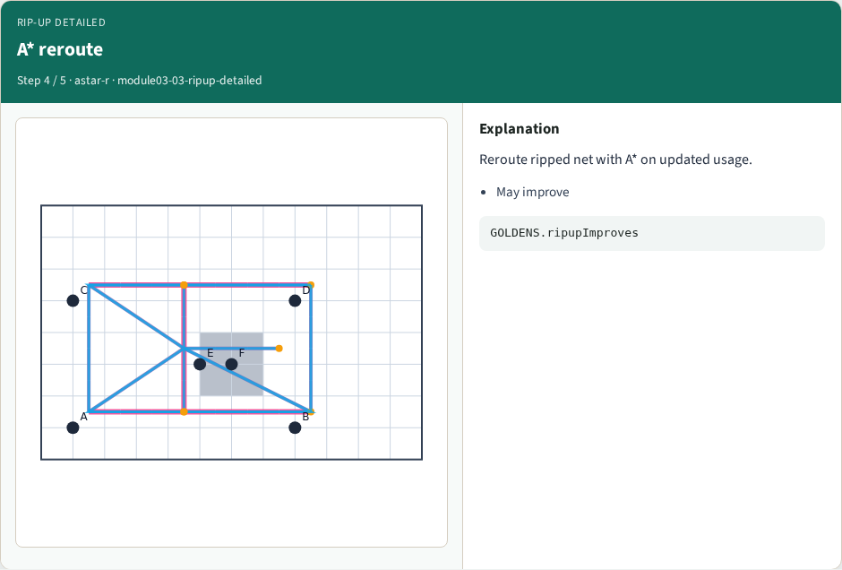
A* reroute
A* reroute
learn_routing — 03 ripup detailed
Notes:
Reroute ripped net with A* on updated usage.

Slide 7
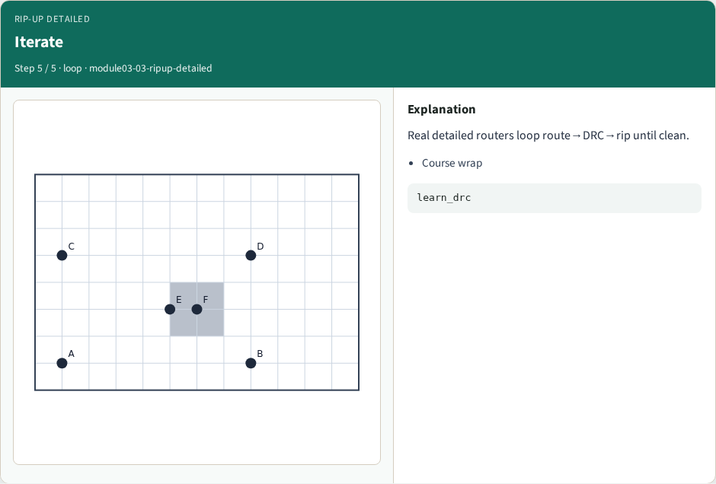
Iterate
Iterate
learn_routing — 03 ripup detailed
Notes:
Real detailed routers loop route→DRC→rip until clean.

Slide 8
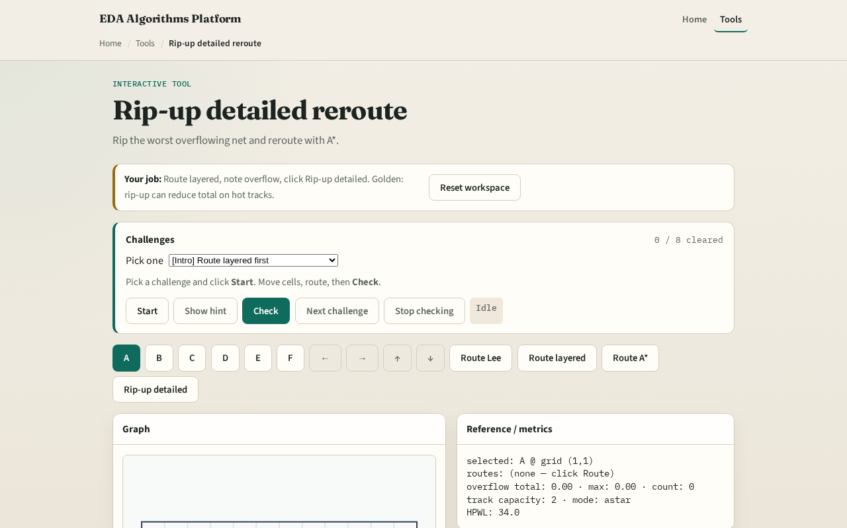
Browser lab track
Browser lab starter
learn_routing — 03 ripup detailed
Notes:
Open **ripup-detailed**. Run sequential L to create overflow, then one rip-up pass. Watch total overflow fall on the metrics panel.

Slide 9
Implement track
Implement `ripup_detailed(routes, usage, cap, terminals_map, nets, nx, ny, blocks)`
Assert total overflow after is less than or equal to before on tiny_dr sequential L seed
learn_routing — 03 ripup detailed
Notes:
Implement `ripup_detailed(routes, usage, cap, terminals_map, nets, nx, ny, blocks)`. Assert total overflow after is less than or equal to before on tiny_dr sequential L seed.

Slide 10
Pitfalls
Ripping a net but leaving ghost usage on its old tracks
Rerouting with pattern L through the same hot track
Picking the wrong net to rip, use overflow contribution not HPWL
learn_routing — 03 ripup detailed
Notes:
Ripping a net but leaving ghost usage on its old tracks. Rerouting with pattern L through the same hot track. Picking the wrong net to rip—use overflow contribution not HPWL.

Slide 11
Your turn
Clear rip-up challenges
Next: tie it together with full sequential detailed routing
learn_routing — 03 ripup detailed
Notes:
Clear rip-up challenges. Next: tie it together with full sequential detailed routing.

