Slide 1
Order matters on tracks
Production detailed routers process nets in an order
learn_routing — 01 sequential detailed
Notes:
Production detailed routers process nets in an order. Each net deposits usage on directed tracks; later nets see a more congested grid. Sequential L-HV on tiny_dr is our baseline stress test; A* mode shows congestion-aware ordering effects.

Slide 2
The idea
Initialize empty usage
Increment usage on every track key in the route
Report final usage and track_overflow summary
learn_routing — 01 sequential detailed
Notes:
Initialize empty usage. For each net in list order, compute terminals, route with the chosen mode—l_hv for layer L, lee for cell maze, astar for congestion-aware—and increment usage on every track key in the route. Report final usage and track_overflow summary.

Slide 3
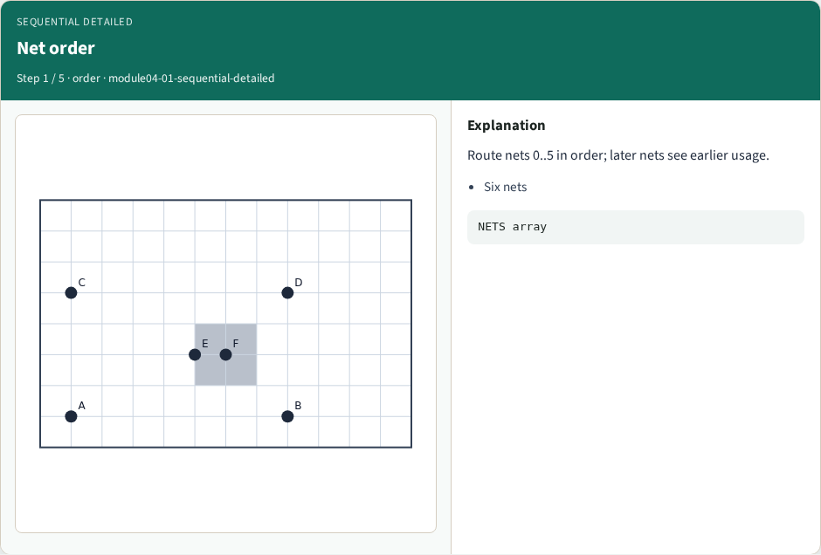
Net order
Net order
learn_routing — 01 sequential detailed
Notes:
Route nets 0..5 in order; later nets see earlier usage.

Slide 4
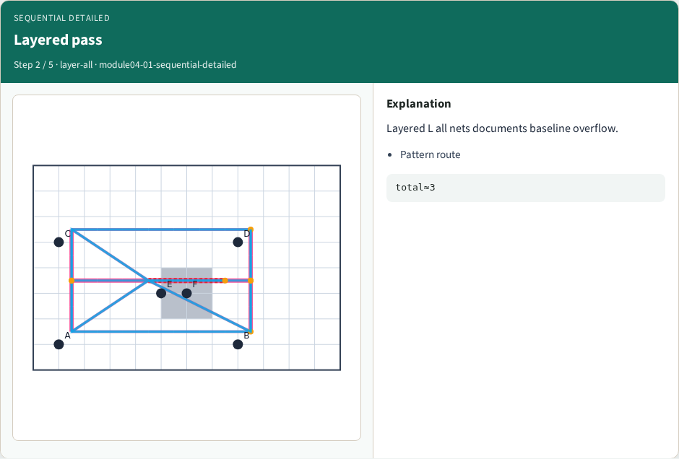
Layered pass
Layered pass
learn_routing — 01 sequential detailed
Notes:
Layered L all nets documents baseline overflow.

Slide 5
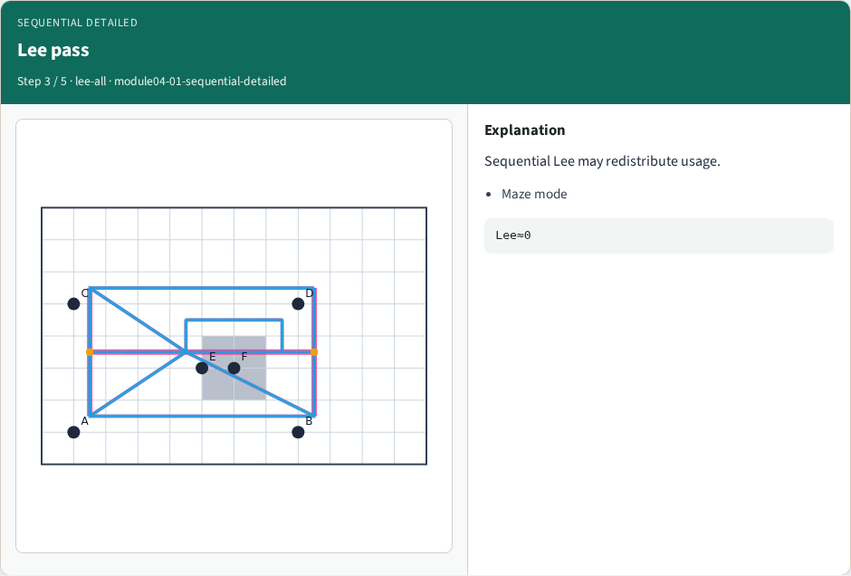
Lee pass
Lee pass
learn_routing — 01 sequential detailed
Notes:
Sequential Lee may redistribute usage.

Slide 6
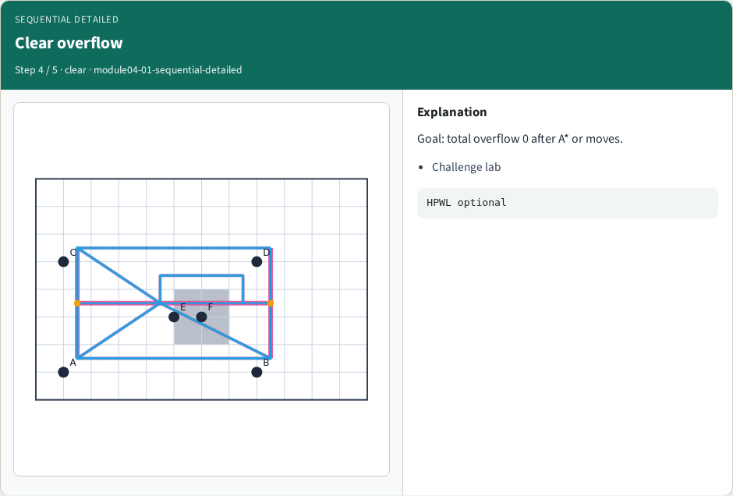
Clear overflow
Clear overflow
learn_routing — 01 sequential detailed
Notes:
Goal: total overflow 0 after A* or moves.

Slide 7
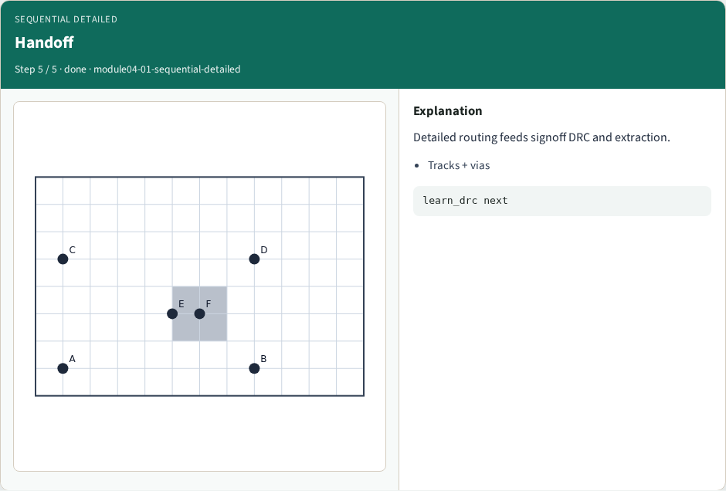
Handoff
Handoff
learn_routing — 01 sequential detailed
Notes:
Detailed routing feeds signoff DRC and extraction.

Slide 8
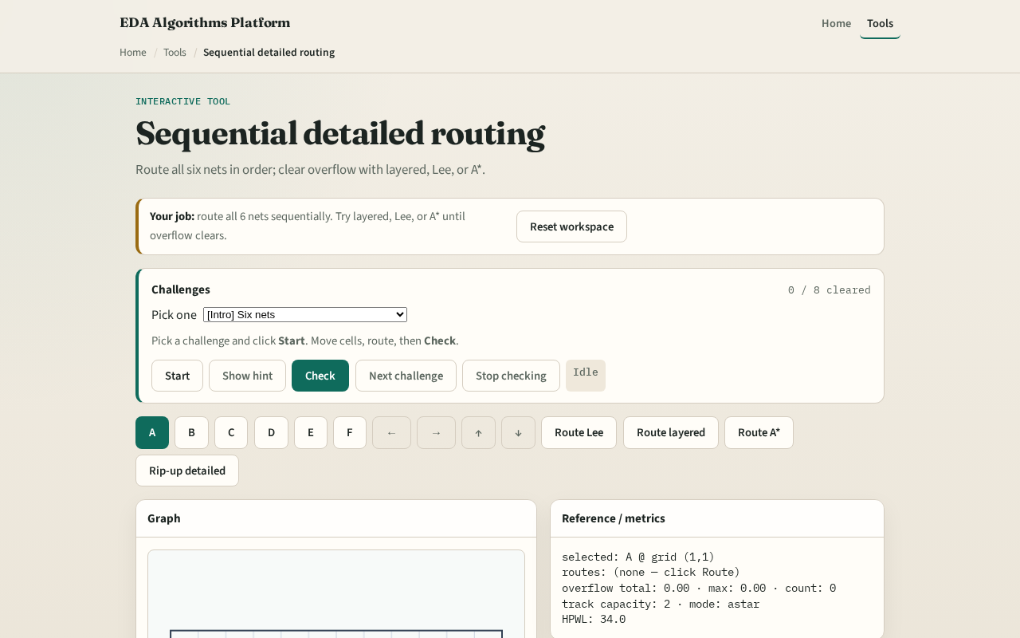
Browser lab track
Browser lab starter
learn_routing — 01 sequential detailed
Notes:
Open **sequential-detailed**. Route all nets in default order. Reorder mentally: would routing the four-pin net last change the hottest track?

Slide 9
Implement track
Implement `sequential_detailed` and `route_from_data`
Print usage and overflow after routing all six nets
Compare astar mode with l_hv on total overflow
learn_routing — 01 sequential detailed
Notes:
Implement `sequential_detailed` and `route_from_data`. Print usage and overflow after routing all six nets. Compare astar mode with l_hv on total overflow.

Slide 10
Pitfalls
Parallel deposit without order, hides rip-up motivation
Ignoring multi-pin net in order list
Resetting usage between nets accidentally
learn_routing — 01 sequential detailed
Notes:
Parallel deposit without order— hides rip-up motivation. Ignoring multi-pin net in order list. Resetting usage between nets accidentally.

Slide 11
Your turn
Complete sequential detailed routing
Offline compare and wrap come next
learn_routing — 01 sequential detailed
Notes:
Complete sequential detailed routing. Offline compare and wrap come next.

