Slide 1
Fixed-outline constraints
Floorplanning on this course uses a fixed outline ten by eight
learn_floorplanning — 01 fixed outline
Notes:
Floorplanning on this course uses a fixed outline ten by eight. Modules A through E must pack inside—no growing the chip. In this lab you’ll reject illegal packings before you ever talk about density.

Slide 2
Pseudocode
Fixed-outline legality is two loops in pseudocode
Open this module's examples file and find the Pseudocode section
That written sketch is what you implement on the implement track and what the browser
learn_floorplanning — 01 fixed outline
Notes:
Fixed-outline legality is two loops in pseudocode: each module must sit inside the outline, and every pair must not have positive-area overlap.
Open this module's examples file and find the Pseudocode section. That written sketch is what you implement on the implement track and what the browser challenges measure.

Slide 3
Algorithm sketch
Outline is ten by eight
Golden packing of A through E is legal
Bad seed with E at x nine overflows
Overlap of C and E is the other failure mode
learn_floorplanning — 01 fixed outline
Notes:
Outline is ten by eight. Golden packing of A through E is legal. Bad seed with E at x nine overflows. Overlap of C and E is the other failure mode.

Slide 4
Algorithm sketch — try these
INPUT: outline W×H, modules (x,y,w,h)
OUTPUT: legal? / failure reason
for each m: fail if outside [0,W]×[0,H]
for each pair: fail if interior overlap
edge-touch OK; positive-area overlap not
GOLDEN pack legal; E@x=9 overflow illegal
outline 10×8 (area 80); modules A–E
learn_floorplanning — 01 fixed outline

Slide 5
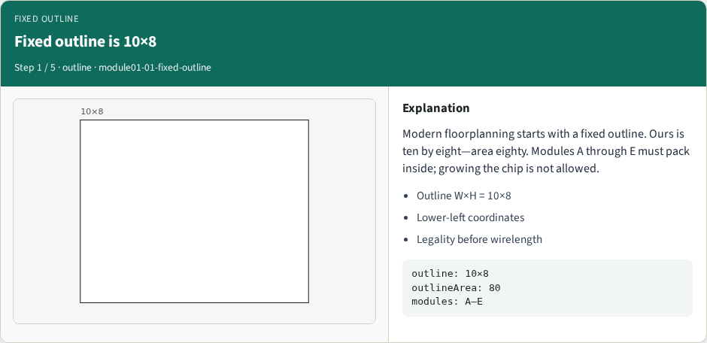
Fixed outline is 10×8
Fixed outline is 10×8
learn_floorplanning — 01 fixed outline
Notes:
Modern floorplanning starts with a fixed outline. Ours is ten by eight—area eighty. Modules A through E must pack inside; growing the chip is not allowed.

Slide 6
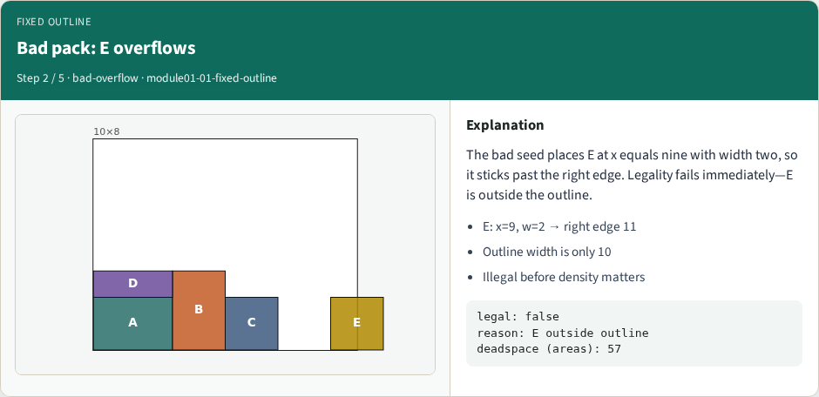
Bad pack: E overflows
Bad pack: E overflows
learn_floorplanning — 01 fixed outline
Notes:
The bad seed places E at x equals nine with width two, so it sticks past the right edge. Legality fails immediately—E is outside the outline.

Slide 7
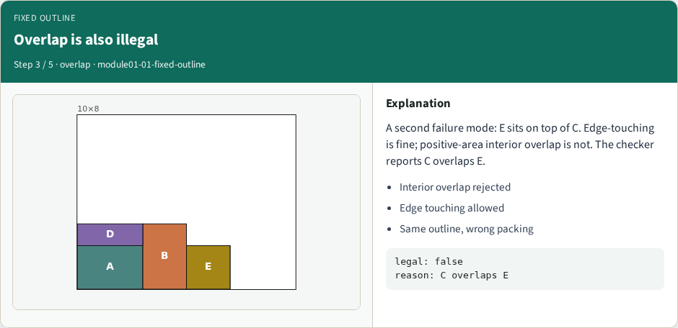
Overlap is also illegal
Overlap is also illegal
learn_floorplanning — 01 fixed outline
Notes:
A second failure mode: E sits on top of C. Edge-touching is fine; positive-area interior overlap is not. The checker reports C overlaps E.

Slide 8
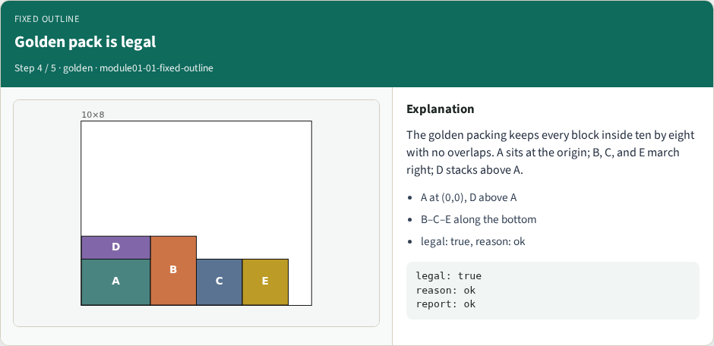
Golden pack is legal
Golden pack is legal
learn_floorplanning — 01 fixed outline
Notes:
The golden packing keeps every block inside ten by eight with no overlaps. A sits at the origin; B, C, and E march right; D stacks above A.

Slide 9
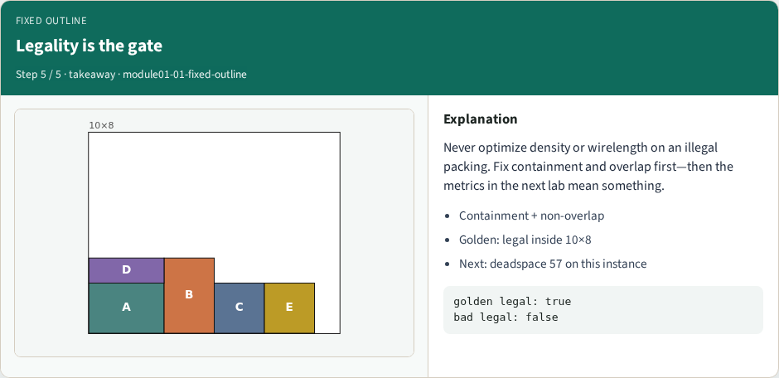
Legality is the gate
Legality is the gate
learn_floorplanning — 01 fixed outline
Notes:
Never optimize density or wirelength on an illegal packing. Fix containment and overlap first—then the metrics in the next lab mean something.

Slide 10
Browser lab track
Open the fixed-outline lab
Show the bad seed: E overflows past the right edge
Then show overlap, then golden
Watch legality flip from false to true when the golden packing loads
learn_floorplanning — 01 fixed outline
Notes:
Open the fixed-outline lab. Show the bad seed: E overflows past the right edge. Then show overlap, then golden. Watch legality flip from false to true when the golden packing loads.

Slide 11
Implement track
Parse tiny_modules.json, assign (x, y)
On the golden packing, legality must pass
learn_floorplanning — 01 fixed outline
Notes:
Parse tiny_modules.json, assign (x, y), and implement containment plus pairwise non-overlap. On the golden packing, legality must pass; on the bad seed with E at nine, it must fail with E outside the outline.

Slide 12
Pitfalls
Off-by-one edges, treating centers as rectangles
Edge-touching is allowed; interior overlap is not
learn_floorplanning — 01 fixed outline
Notes:
Off-by-one edges, treating centers as rectangles, and celebrating density on illegal layouts. Edge-touching is allowed; interior overlap is not.

Slide 13
Your turn
Get a legal packing of A through E inside ten by eight
Quiz checks the overflow failure and the golden pass
Next: deadspace fifty-seven on this same instance
learn_floorplanning — 01 fixed outline
Notes:
Get a legal packing of A through E inside ten by eight. Quiz checks the overflow failure and the golden pass. Next: deadspace fifty-seven on this same instance.

