Slide 1
Area, packing density, whitespace/deadspace
With a legal packing in hand, score the whitespace
learn_floorplanning — 03 area deadspace
Notes:
With a legal packing in hand, score the whitespace. Module areas sum to twenty-three; the outline is eighty; deadspace is fifty-seven; density is zero point two eight seven five.

Slide 2
Pseudocode
Deadspace pseudocode is arithmetic after legality
Sum module areas, subtract from outline area, and divide for density
Open this module's examples file and find the Pseudocode section
That written sketch is what you implement on the implement track and what the browser
learn_floorplanning — 03 area deadspace
Notes:
Deadspace pseudocode is arithmetic after legality. Sum module areas, subtract from outline area, and divide for density.
Open this module's examples file and find the Pseudocode section. That written sketch is what you implement on the implement track and what the browser challenges measure.

Slide 3
Algorithm sketch
On the golden packing area is twenty-three
Do not celebrate density on illegal packs
learn_floorplanning — 03 area deadspace
Notes:
On the golden packing area is twenty-three, outline eighty, deadspace fifty-seven, density about zero point two eight seven five. Do not celebrate density on illegal packs.

Slide 4
Algorithm sketch — try these
INPUT: outline W×H, modules areas
OUTPUT: area_sum, deadspace, density
area_sum ← Σ w[m]·h[m]
deadspace ← W·H − area_sum
density ← area_sum / (W·H)
only report density on legal packs
GOLDEN: area=23; outline=80; dead=57
density=0.2875
learn_floorplanning — 03 area deadspace

Slide 5
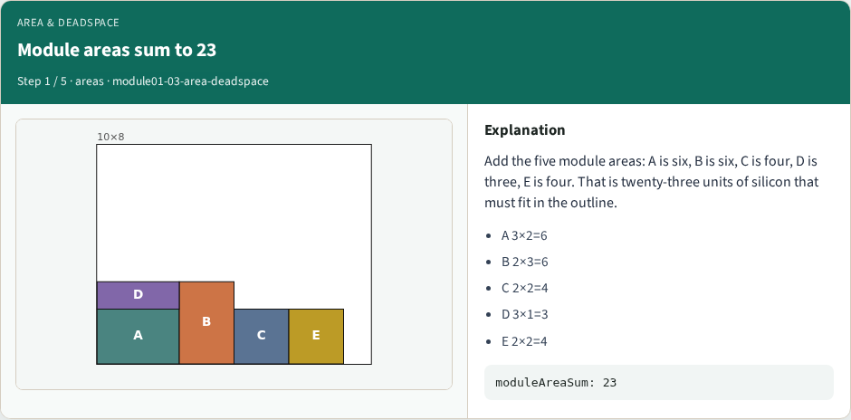
Module areas sum to 23
Module areas sum to 23
learn_floorplanning — 03 area deadspace
Notes:
Add the five module areas: A is six, B is six, C is four, D is three, E is four. That is twenty-three units of silicon that must fit in the outline.

Slide 6
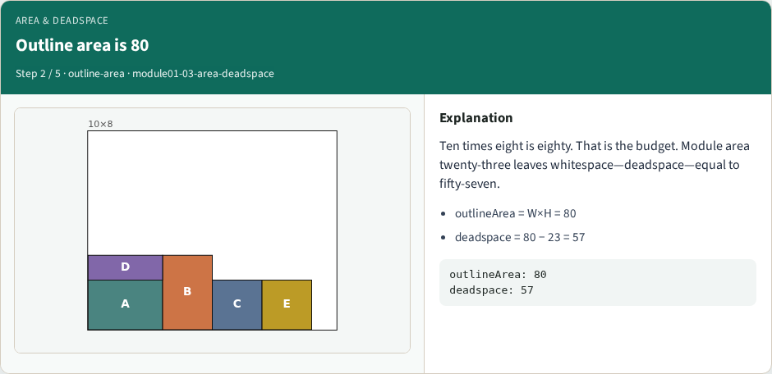
Outline area is 80
Outline area is 80
learn_floorplanning — 03 area deadspace
Notes:
Ten times eight is eighty. That is the budget. Module area twenty-three leaves whitespace—deadspace—equal to fifty-seven.

Slide 7
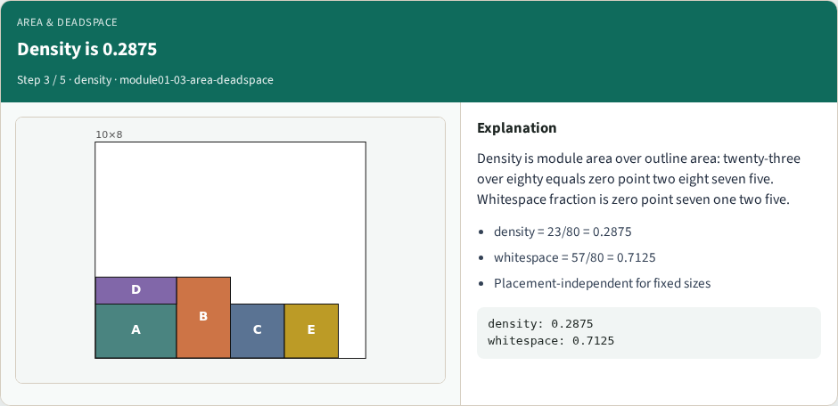
Density is 0.2875
Density is 0.2875
learn_floorplanning — 03 area deadspace
Notes:
Density is module area over outline area: twenty-three over eighty equals zero point two eight seven five. Whitespace fraction is zero point seven one two five.

Slide 8

Metrics need a legal pack
Metrics need a legal pack
learn_floorplanning — 03 area deadspace
Notes:
On the golden legal packing these numbers are honest. On an overflow packing the area math still computes, but the floorplan is invalid—do not celebrate density on illegal layouts.

Slide 9
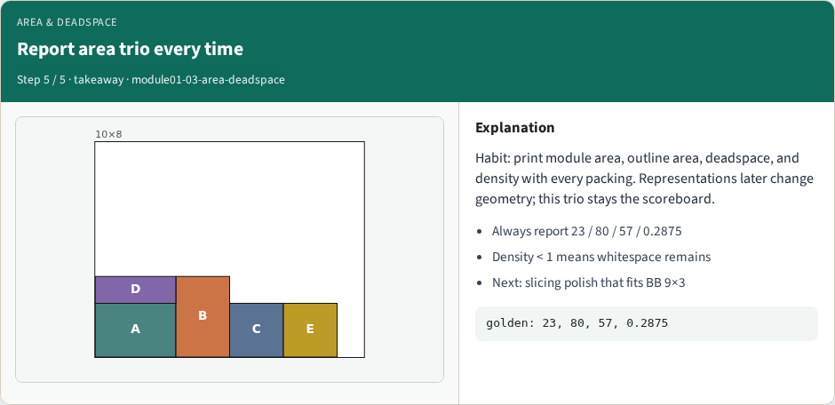
Report area trio every time
Report area trio every time
learn_floorplanning — 03 area deadspace
Notes:
Habit: print module area, outline area, deadspace, and density with every packing. Representations later change geometry; this trio stays the scoreboard.

Slide 10
Browser lab track
Open area-deadspace, load the golden packing, and read the metrics panel
learn_floorplanning — 03 area deadspace
Notes:
Open area-deadspace, load the golden packing, and read the metrics panel: module area twenty-three, outline eighty, deadspace fifty-seven, density zero point two eight seven five.

Slide 11
Implement track
Implement moduleAreaSum, outlineArea, deadspace, and density
Assert deadspace equals eighty minus twenty-three on the starter modules
learn_floorplanning — 03 area deadspace
Notes:
Implement moduleAreaSum, outlineArea, deadspace, and density. Assert deadspace equals eighty minus twenty-three on the starter modules—independent of placement when sizes are fixed.

Slide 12
Pitfalls
Reporting density on an illegal pack
learn_floorplanning — 03 area deadspace
Notes:
Reporting density on an illegal pack; mixing outline area with bounding-box area; forgetting soft A still contributes area six at three by two.

Slide 13
Your turn
Print the area trio on every run
Next lab builds a slicing polish whose bounding box is nine by three inside this outline
learn_floorplanning — 03 area deadspace
Notes:
Print the area trio on every run. Next lab builds a slicing polish whose bounding box is nine by three inside this outline.

