Slide 1
Slicing tree / polish expression packing
Slicing floorplans use through-cuts
learn_floorplanning — 01 slicing floorplan
Notes:
Slicing floorplans use through-cuts. The golden polish A D H B V C V E V stacks A under D, then attaches B, C, and E with vertical cuts—bounding box nine by three.

Slide 2
Pseudocode
Slicing polish is a postfix stack
Modules push rectangles; H stacks vertically; V places side by side
The sketch names the operators so evaluation stays deterministic
Open this module's examples file and find the Pseudocode section
That written sketch is what you implement on the implement track and what the browser
learn_floorplanning — 01 slicing floorplan
Notes:
Slicing polish is a postfix stack. Modules push rectangles; H stacks vertically; V places side by side. The sketch names the operators so evaluation stays deterministic.
Open this module's examples file and find the Pseudocode section. That written sketch is what you implement on the implement track and what the browser challenges measure.

Slide 3
Algorithm sketch
Golden tokens A D H B V C V E V pack to a nine by three bbox inside the ten by eight
learn_floorplanning — 01 slicing floorplan
Notes:
Golden tokens A D H B V C V E V pack to a nine by three bbox inside the ten by eight outline.

Slide 4
Algorithm sketch — try these
INPUT: polish tokens (modules + H/V)
OUTPUT: packing (x,y,w,h) per module
stack-eval postfix:
module → push rect
H: pop a,b; stack vertically
V: pop a,b; place side by side
GOLDEN: A D H B V C V E V
bbox 9×3; legal in 10×8
learn_floorplanning — 01 slicing floorplan

Slide 5
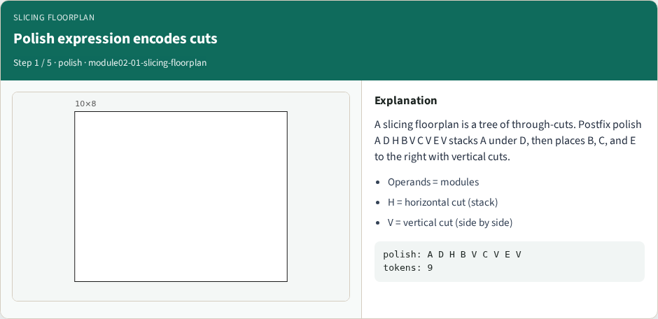
Polish expression encodes cuts
Polish expression encodes cuts
learn_floorplanning — 01 slicing floorplan
Notes:
A slicing floorplan is a tree of through-cuts. Postfix polish A D H B V C V E V stacks A under D, then places B, C, and E to the right with vertical cuts.

Slide 6
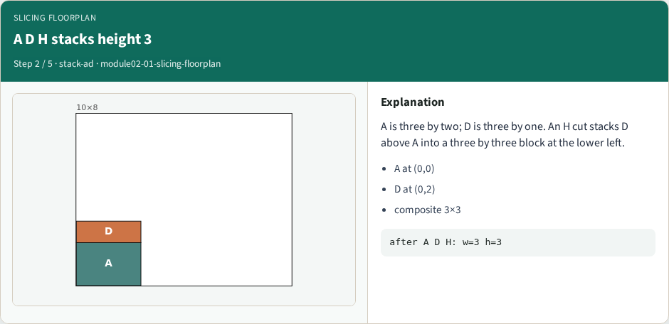
A D H stacks height 3
A D H stacks height 3
learn_floorplanning — 01 slicing floorplan
Notes:
A is three by two; D is three by one. An H cut stacks D above A into a three by three block at the lower left.

Slide 7
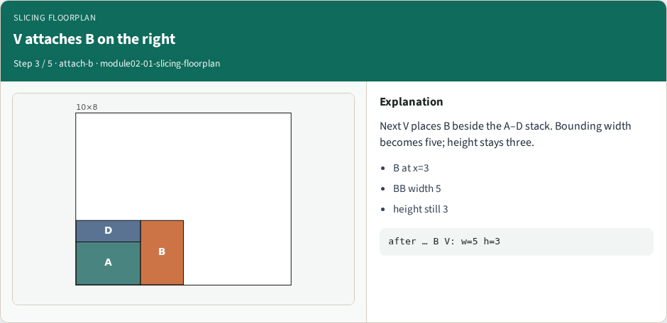
V attaches B on the right
V attaches B on the right
learn_floorplanning — 01 slicing floorplan
Notes:
Next V places B beside the A–D stack. Bounding width becomes five; height stays three.

Slide 8
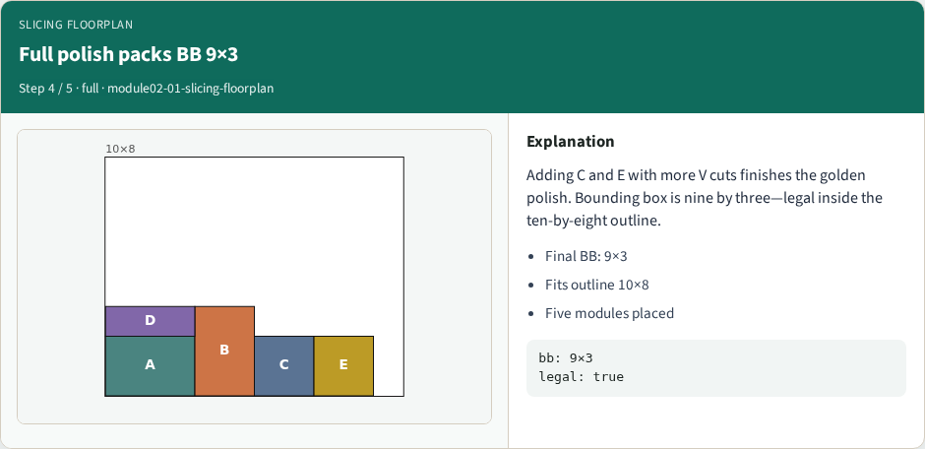
Full polish packs BB 9×3
Full polish packs BB 9×3
learn_floorplanning — 01 slicing floorplan
Notes:
Adding C and E with more V cuts finishes the golden polish. Bounding box is nine by three—legal inside the ten-by-eight outline.

Slide 9
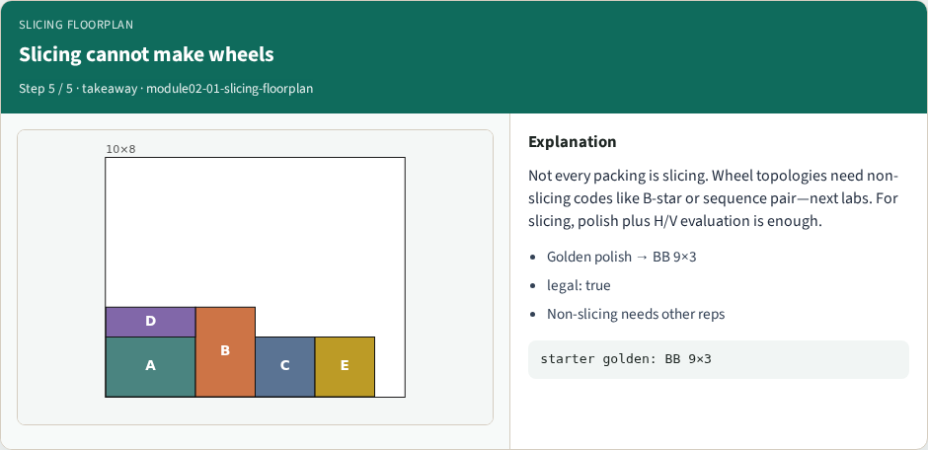
Slicing cannot make wheels
Slicing cannot make wheels
learn_floorplanning — 01 slicing floorplan
Notes:
Not every packing is slicing. Wheel topologies need non-slicing codes like B-star or sequence pair—next labs. For slicing, polish plus H/V evaluation is enough.

Slide 10
Browser lab track
Open slicing-floorplan and Evaluate polish
Confirm bounding width nine, height three, and a legal packing inside ten by eight
learn_floorplanning — 01 slicing floorplan
Notes:
Open slicing-floorplan and Evaluate polish. Confirm bounding width nine, height three, and a legal packing inside ten by eight.

Slide 11
Implement track
Implement postfix evaluation for H and V
On the golden token list, assert width nine, height three, and is_legal_packing true
learn_floorplanning — 01 slicing floorplan
Notes:
Implement postfix evaluation for H and V. On the golden token list, assert width nine, height three, and is_legal_packing true.

Slide 12
Pitfalls
Swapping H/V meanings
learn_floorplanning — 01 slicing floorplan
Notes:
Swapping H/V meanings; leaving polish operands on the stack; assuming every packing is slicing—wheels need other reps.

Slide 13
Your turn
Ship a legal polish pack with BB nine by three
Next: B-star trees for non-slicing adjacency
learn_floorplanning — 01 slicing floorplan
Notes:
Ship a legal polish pack with BB nine by three. Next: B-star trees for non-slicing adjacency.

