Slide 1
B*-tree floorplan representation
B-star stores packing adjacency: left child sits right-of the parent; right child sits above on a contour
learn_floorplanning — 03 bstar tree
Notes:
B-star stores packing adjacency: left child sits right-of the parent; right child sits above on a contour. Root A at the origin; left chain B then C then E; right child D above A.

Slide 2
Pseudocode
B-star packing walks the tree with a contour
Left child sits to the right of the parent
Open this module's examples file and find the Pseudocode section
That written sketch is what you implement on the implement track and what the browser
learn_floorplanning — 03 bstar tree
Notes:
B-star packing walks the tree with a contour. Left child sits to the right of the parent; right child sits above using the contour height.
Open this module's examples file and find the Pseudocode section. That written sketch is what you implement on the implement track and what the browser challenges measure.

Slide 3
Algorithm sketch
Golden tree roots A at the origin
B’s x equals A’s right edge; D’s y is at least A’s height
The packing must stay legal in the outline
learn_floorplanning — 03 bstar tree
Notes:
Golden tree roots A at the origin. B’s x equals A’s right edge; D’s y is at least A’s height. The packing must stay legal in the outline.

Slide 4
Algorithm sketch — try these
INPUT: binary tree (left=right-of, right=above)
OUTPUT: packed (x,y) via contour
root at (0,0)
left child: x ← parent.x + parent.w
right child: y ← above parent (contour)
update horizontal contour after each place
GOLDEN: A@0,0; B.x=A.x+A.w; D.y≥A.h; legal
learn_floorplanning — 03 bstar tree

Slide 5
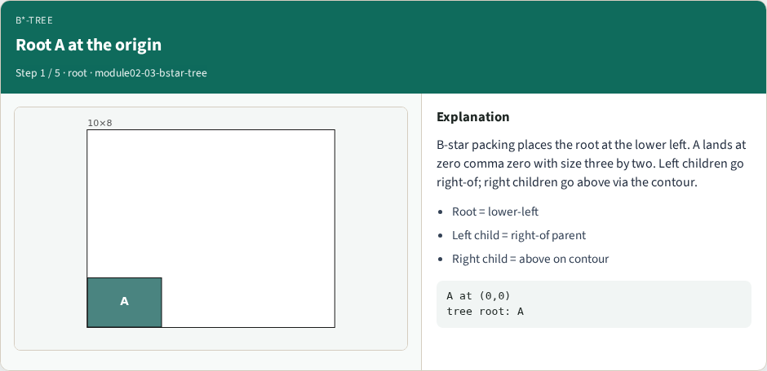
Root A at the origin
Root A at the origin
learn_floorplanning — 03 bstar tree
Notes:
B-star packing places the root at the lower left. A lands at zero comma zero with size three by two. Left children go right-of; right children go above via the contour.

Slide 6
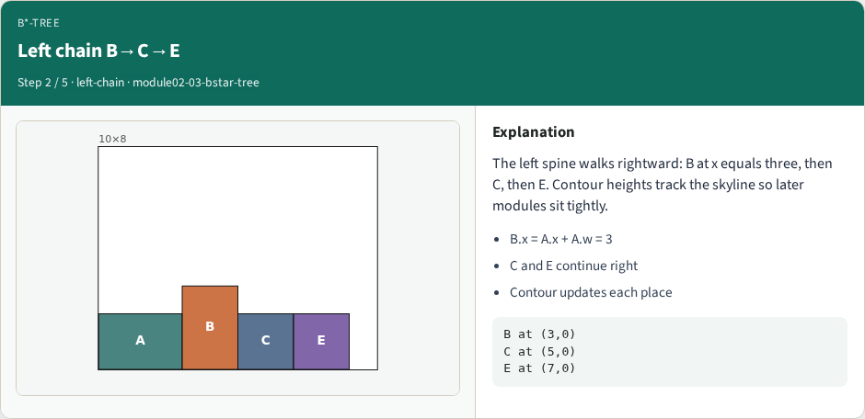
Left chain B→C→E
Left chain B→C→E
learn_floorplanning — 03 bstar tree
Notes:
The left spine walks rightward: B at x equals three, then C, then E. Contour heights track the skyline so later modules sit tightly.

Slide 7
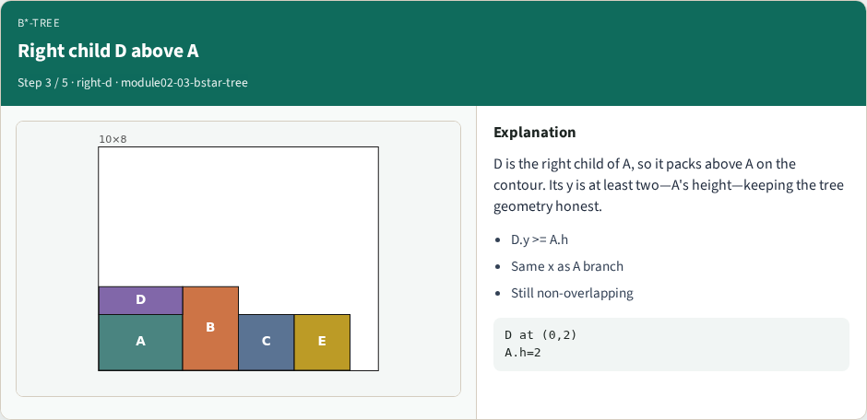
Right child D above A
Right child D above A
learn_floorplanning — 03 bstar tree
Notes:
D is the right child of A, so it packs above A on the contour. Its y is at least two—A's height—keeping the tree geometry honest.

Slide 8

Full B* pack is legal
Full B* pack is legal
learn_floorplanning — 03 bstar tree
Notes:
All five modules are placed. The packing is legal inside ten by eight. Perturbing the tree—swap, rotate, move—will feed simulated annealing later.

Slide 9
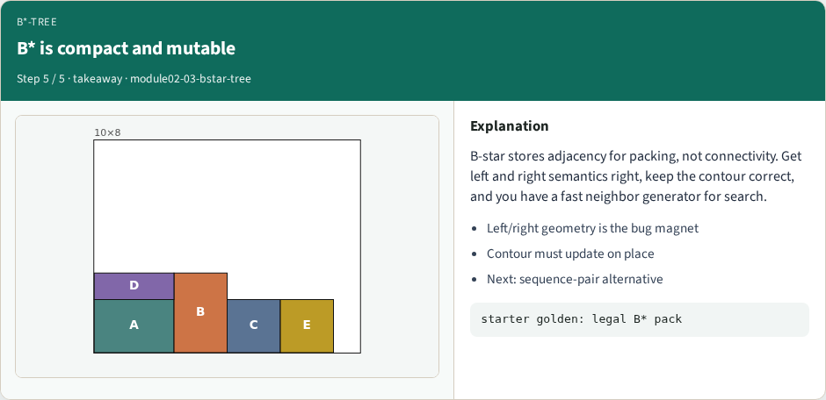
B* is compact and mutable
B* is compact and mutable
learn_floorplanning — 03 bstar tree
Notes:
B-star stores adjacency for packing, not connectivity. Get left and right semantics right, keep the contour correct, and you have a fast neighbor generator for search.

Slide 10
Browser lab track
Open bstar-tree and Pack B*-tree
Confirm A at zero comma zero, B at x equals three, D above A
learn_floorplanning — 03 bstar tree
Notes:
Open bstar-tree and Pack B*-tree. Confirm A at zero comma zero, B at x equals three, D above A, and a legal five-module packing.

Slide 11
Implement track
Build the golden tree and contour-pack it
Assert A at (0,0), B.x equals A.x plus A.w, D.y at least A.h, and legality true
learn_floorplanning — 03 bstar tree
Notes:
Build the golden tree and contour-pack it. Assert A at (0,0), B.x equals A.x plus A.w, D.y at least A.h, and legality true.

Slide 12
Pitfalls
Reversing left/right geometry; stale contour segments; treating the tree as a netlist
learn_floorplanning — 03 bstar tree
Notes:
Reversing left/right geometry; stale contour segments; treating the tree as a netlist.

Slide 13
Your turn
Produce the legal B-star packing
Next: sequence-pair permutations as another encoding
learn_floorplanning — 03 bstar tree
Notes:
Produce the legal B-star packing. Next: sequence-pair permutations as another encoding.

