Slide 1
Sequence-pair representation
Sequence pair uses positive permutation A B C E D and negative D A B C E
learn_floorplanning — 05 sequence pair
Notes:
Sequence pair uses positive permutation A B C E D and negative D A B C E. Longest-path packing from left-of and below constraints places all five modules legally.

Slide 2
Pseudocode
Sequence-pair pseudocode turns two permutations into horizontal and vertical constraints
Open this module's examples file and find the Pseudocode section
That written sketch is what you implement on the implement track and what the browser
learn_floorplanning — 05 sequence pair
Notes:
Sequence-pair pseudocode turns two permutations into horizontal and vertical constraints, then longest-path packs x and y.
Open this module's examples file and find the Pseudocode section. That written sketch is what you implement on the implement track and what the browser challenges measure.

Slide 3
Algorithm sketch
Golden pos is A B C E D and neg is D A B C E
Evaluation must place all five modules legally with non-negative coordinates
learn_floorplanning — 05 sequence pair
Notes:
Golden pos is A B C E D and neg is D A B C E. Evaluation must place all five modules legally with non-negative coordinates.

Slide 4
Algorithm sketch — try these
INPUT: pos[], neg[] permutations of modules
OUTPUT: (x,y) via constraint longest paths
pos/neg order ⇒ horizontal & vertical constraints
x ← longest path in H-graph; y ← V-graph
GOLDEN pos=A B C E D; neg=D A B C E
packs legally with non-negative coords
learn_floorplanning — 05 sequence pair

Slide 5
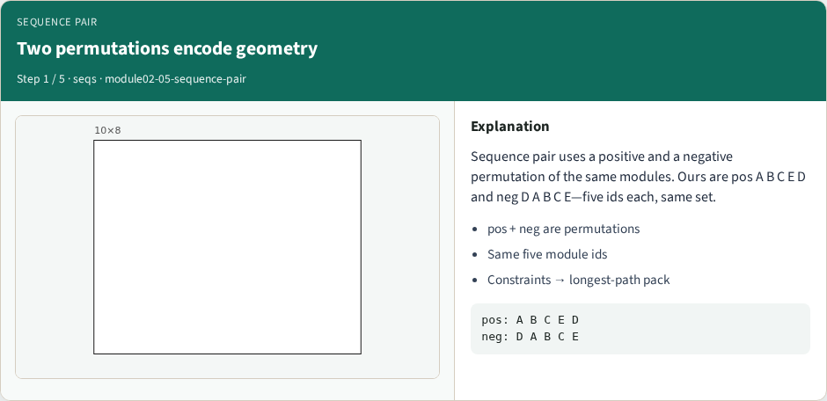
Two permutations encode geometry
Two permutations encode geometry
learn_floorplanning — 05 sequence pair
Notes:
Sequence pair uses a positive and a negative permutation of the same modules. Ours are pos A B C E D and neg D A B C E—five ids each, same set.

Slide 6
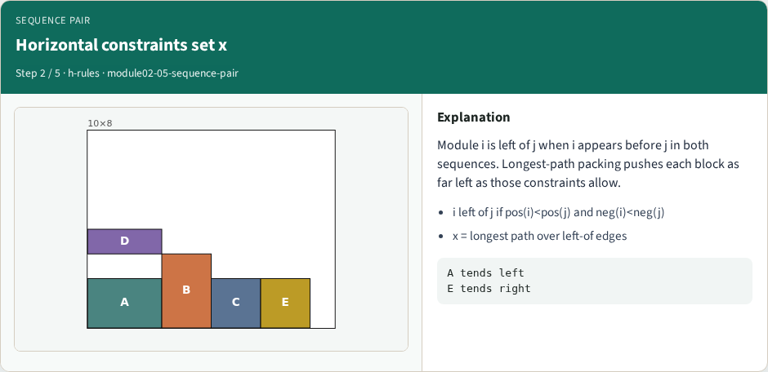
Horizontal constraints set x
Horizontal constraints set x
learn_floorplanning — 05 sequence pair
Notes:
Module i is left of j when i appears before j in both sequences. Longest-path packing pushes each block as far left as those constraints allow.

Slide 7
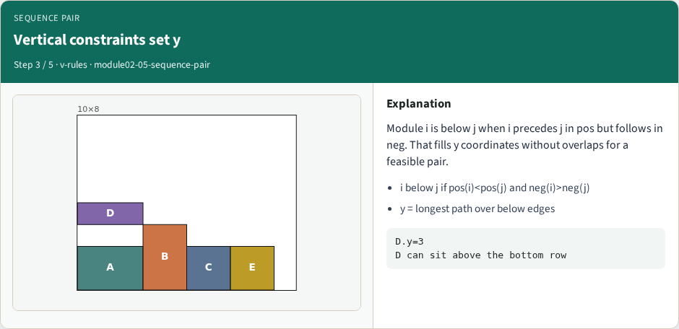
Vertical constraints set y
Vertical constraints set y
learn_floorplanning — 05 sequence pair
Notes:
Module i is below j when i precedes j in pos but follows in neg. That fills y coordinates without overlaps for a feasible pair.

Slide 8
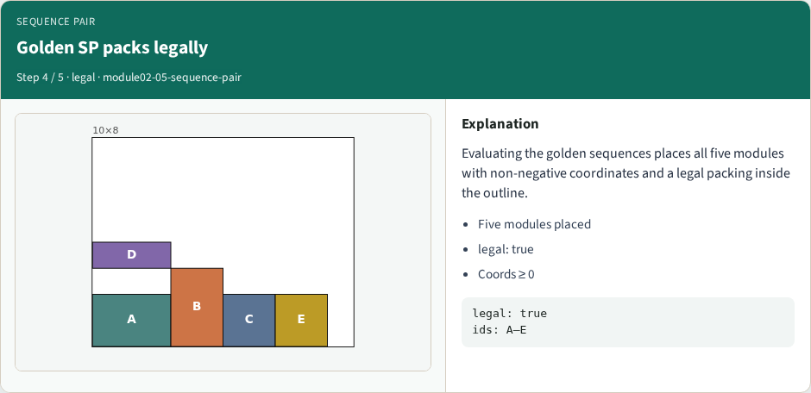
Golden SP packs legally
Golden SP packs legally
learn_floorplanning — 05 sequence pair
Notes:
Evaluating the golden sequences places all five modules with non-negative coordinates and a legal packing inside the outline.

Slide 9

SP neighbors are permutation moves
SP neighbors are permutation moves
learn_floorplanning — 05 sequence pair
Notes:
Annealing on sequence pair swaps or rotates entries in pos and neg. Feasibility stays geometric; cost can be deadspace plus wirelength.

Slide 10
Browser lab track
Open sequence-pair and Pack sequence pair
Confirm five modules, non-negative coordinates
learn_floorplanning — 05 sequence pair
Notes:
Open sequence-pair and Pack sequence pair. Confirm five modules, non-negative coordinates, and legality true on the golden permutations.

Slide 11
Implement track
Implement longest-path SP packing
Assert pos and neg are the same five ids, and the golden pair packs legally
learn_floorplanning — 05 sequence pair
Notes:
Implement longest-path SP packing. Assert pos and neg are the same five ids, and the golden pair packs legally.

Slide 12
Pitfalls
Mismatched id sets between pos and neg
learn_floorplanning — 05 sequence pair
Notes:
Mismatched id sets between pos and neg; swapping the horizontal/vertical rules; negative coordinates from a buggy DP.

Slide 13
Your turn
Pack the golden sequences legally
Next: simulated annealing that prefers legal low-cost neighbors
learn_floorplanning — 05 sequence pair
Notes:
Pack the golden sequences legally. Next: simulated annealing that prefers legal low-cost neighbors.

