Slide 1
Simulated annealing floorplan search
Toy cost adds one thousand when a packing is illegal
learn_floorplanning — 01 simulated annealing fp
Notes:
Toy cost adds one thousand when a packing is illegal. The bad overflow seed sits near one thousand forty-four; the golden legal packing scores about thirty-six. Annealing should move toward legal, lower cost.

Slide 2
Pseudocode
Floorplan annealing uses a cost that heavily penalizes illegality
Pseudocode proposes neighbors, accepts by Metropolis, and keeps the best legal iterate
Open this module's examples file and find the Pseudocode section
That written sketch is what you implement on the implement track and what the browser
learn_floorplanning — 01 simulated annealing fp
Notes:
Floorplan annealing uses a cost that heavily penalizes illegality. Pseudocode proposes neighbors, accepts by Metropolis, and keeps the best legal iterate.
Open this module's examples file and find the Pseudocode section. That written sketch is what you implement on the implement track and what the browser challenges measure.

Slide 3
Algorithm sketch
Bad overflow seed costs about one thousand forty-four
Golden legal packing is about thirty-six
One teaching improve step replaces bad with golden
learn_floorplanning — 01 simulated annealing fp
Notes:
Bad overflow seed costs about one thousand forty-four. Golden legal packing is about thirty-six. One teaching improve step replaces bad with golden.

Slide 4
Algorithm sketch — try these
INPUT: pack / representation, T schedule
OUTPUT: best legal low-cost pack
cost ← 1000·¬legal + deadspace + α·HPWL
propose neighbor (swap/move/perturb)
accept if Δ<0 or rand < e^(−Δ/T)
keep best; cool T
GOLDEN legal cost≈36; bad≈1044
learn_floorplanning — 01 simulated annealing fp

Slide 5
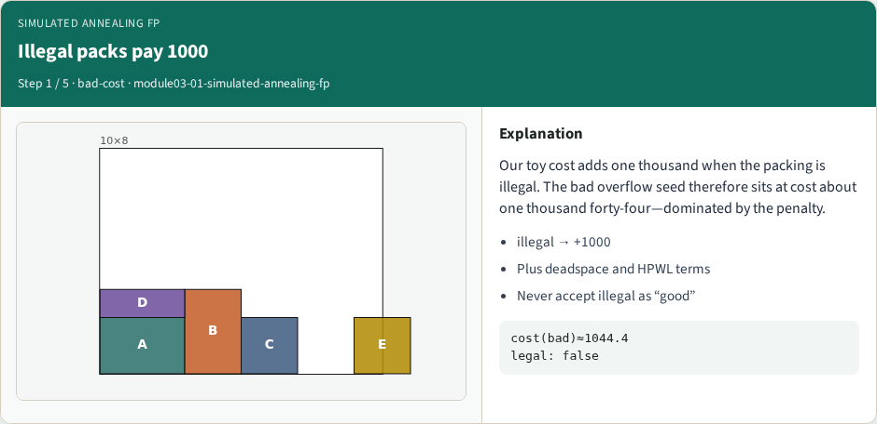
Illegal packs pay 1000
Illegal packs pay 1000
learn_floorplanning — 01 simulated annealing fp
Notes:
Our toy cost adds one thousand when the packing is illegal. The bad overflow seed therefore sits at cost about one thousand forty-four—dominated by the penalty.

Slide 6
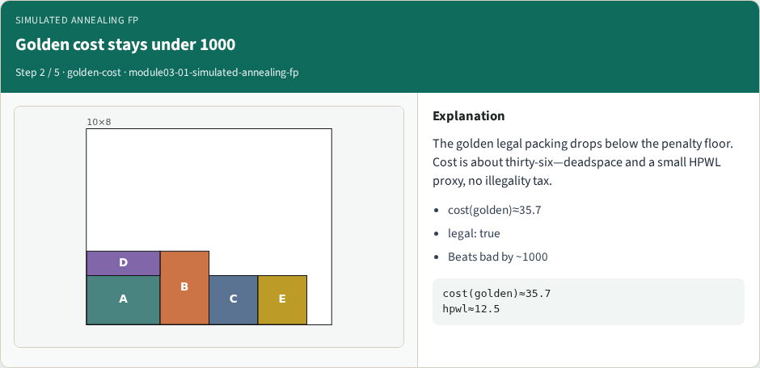
Golden cost stays under 1000
Golden cost stays under 1000
learn_floorplanning — 01 simulated annealing fp
Notes:
The golden legal packing drops below the penalty floor. Cost is about thirty-six—deadspace and a small HPWL proxy, no illegality tax.

Slide 7
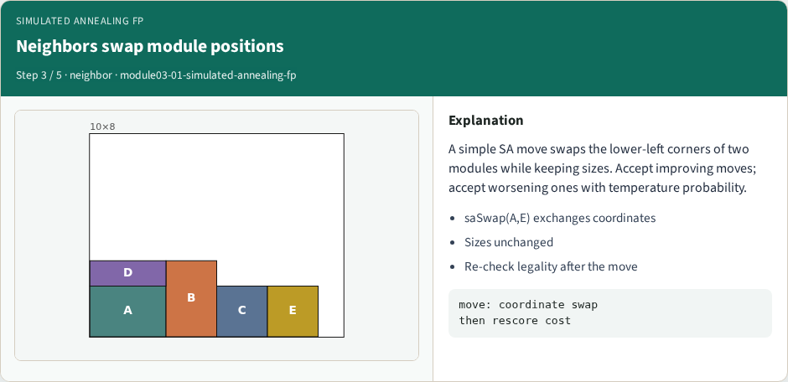
Neighbors swap module positions
Neighbors swap module positions
learn_floorplanning — 01 simulated annealing fp
Notes:
A simple SA move swaps the lower-left corners of two modules while keeping sizes. Accept improving moves; accept worsening ones with temperature probability.

Slide 8
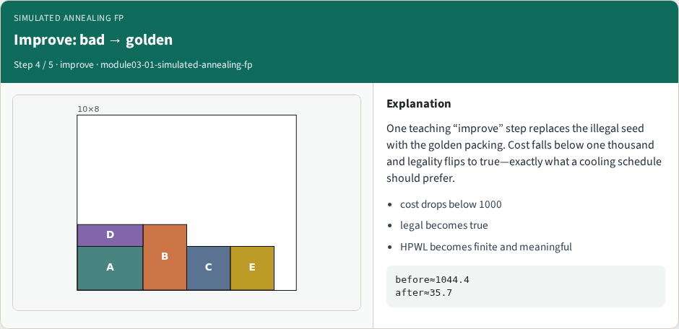
Improve: bad → golden
Improve: bad → golden
learn_floorplanning — 01 simulated annealing fp
Notes:
One teaching “improve” step replaces the illegal seed with the golden packing. Cost falls below one thousand and legality flips to true—exactly what a cooling schedule should prefer.

Slide 9
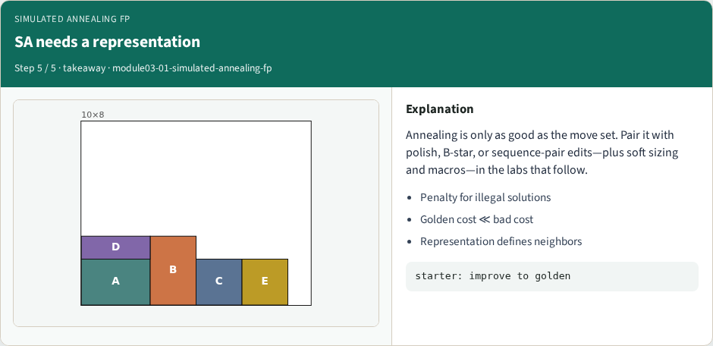
SA needs a representation
SA needs a representation
learn_floorplanning — 01 simulated annealing fp
Notes:
Annealing is only as good as the move set. Pair it with polish, B-star, or sequence-pair edits—plus soft sizing and macros—in the labs that follow.

Slide 10
Browser lab track
Open simulated-annealing-fp
Show bad, note cost at least one thousand
Show golden or Improve, cost drops below one thousand and legality becomes true
learn_floorplanning — 01 simulated annealing fp
Notes:
Open simulated-annealing-fp. Show bad, note cost at least one thousand. Show golden or Improve—cost drops below one thousand and legality becomes true.

Slide 11
Implement track
Implement cost with an illegality penalty, plus deadspace and HPWL terms
Assert cost(golden) is less than cost(bad), and saSwap only exchanges coordinates
learn_floorplanning — 01 simulated annealing fp
Notes:
Implement cost with an illegality penalty, plus deadspace and HPWL terms. Assert cost(golden) is less than cost(bad), and saSwap only exchanges coordinates.

Slide 12
Pitfalls
Accepting illegal states without penalty
learn_floorplanning — 01 simulated annealing fp
Notes:
Accepting illegal states without penalty; forgetting to rescore after a swap; cooling so fast you never escape the bad seed.

Slide 13
Your turn
Demonstrate one improve step from bad to golden
Next: soft module A reshaped from three by two to two by three
learn_floorplanning — 01 simulated annealing fp
Notes:
Demonstrate one improve step from bad to golden. Next: soft module A reshaped from three by two to two by three.

