Slide 1
Soft module aspect sizing
Soft module A keeps area six but may reshape between aspect one half and two
learn_floorplanning — 03 soft module sizing
Notes:
Soft module A keeps area six but may reshape between aspect one half and two. Reshape three by two into two by three, then pack legally—still area six.

Slide 2
Pseudocode
Soft sizing picks width and height for A under a fixed area and aspect bounds
Open this module's examples file and find the Pseudocode section
That written sketch is what you implement on the implement track and what the browser
learn_floorplanning — 03 soft module sizing
Notes:
Soft sizing picks width and height for A under a fixed area and aspect bounds, then re-packs the hard modules around it.
Open this module's examples file and find the Pseudocode section. That written sketch is what you implement on the implement track and what the browser challenges measure.

Slide 3
Algorithm sketch
Hard golden keeps A at three by two
Soft teaching pack uses two by three
Area stays six; deadspace shape changes
learn_floorplanning — 03 soft module sizing
Notes:
Hard golden keeps A at three by two. Soft teaching pack uses two by three. Area stays six; deadspace shape changes.

Slide 4
Algorithm sketch — try these
INPUT: soft A area=6, aspect∈[0.5,2]
OUTPUT: (w,h) with w·h=area; pack rest
choose aspect; set w,h; re-pack / legalize
hard modules keep fixed w×h
GOLDEN hard A 3×2 vs soft A 2×3 pack
both area 6; whitespace shape differs
learn_floorplanning — 03 soft module sizing

Slide 5
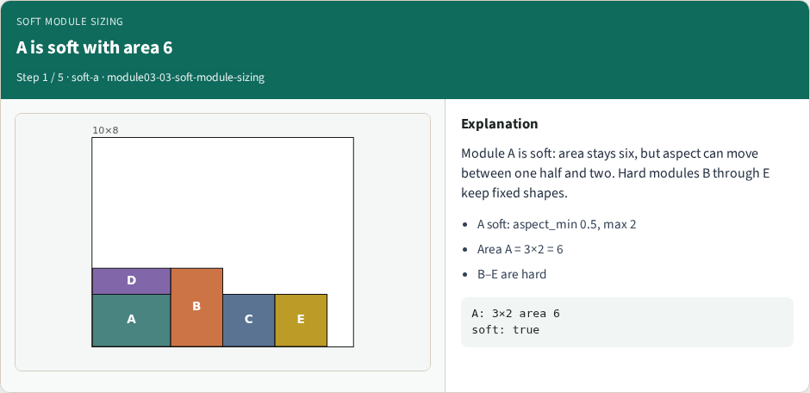
A is soft with area 6
A is soft with area 6
learn_floorplanning — 03 soft module sizing
Notes:
Module A is soft: area stays six, but aspect can move between one half and two. Hard modules B through E keep fixed shapes.

Slide 6
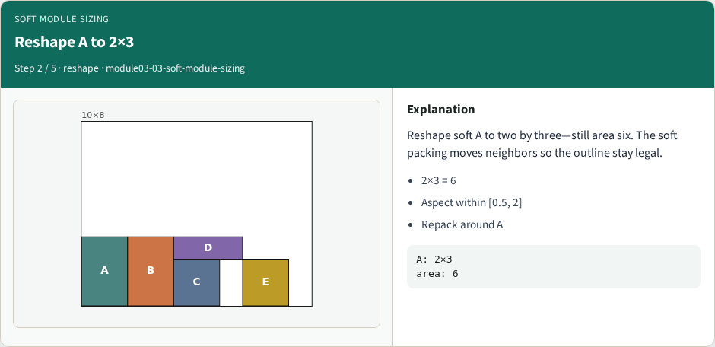
Reshape A to 2×3
Reshape A to 2×3
learn_floorplanning — 03 soft module sizing
Notes:
Reshape soft A to two by three—still area six. The soft packing moves neighbors so the outline stay legal.

Slide 7
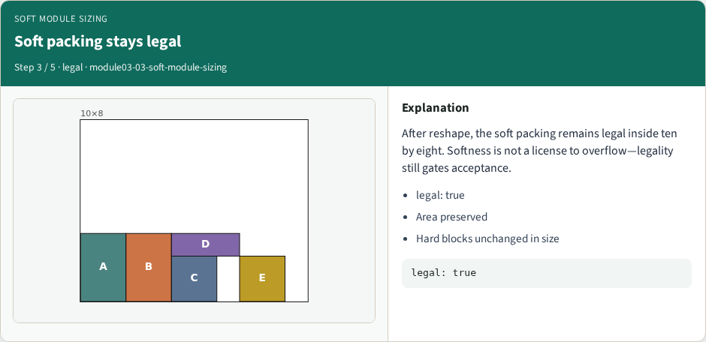
Soft packing stays legal
Soft packing stays legal
learn_floorplanning — 03 soft module sizing
Notes:
After reshape, the soft packing remains legal inside ten by eight. Softness is not a license to overflow—legality still gates acceptance.

Slide 8
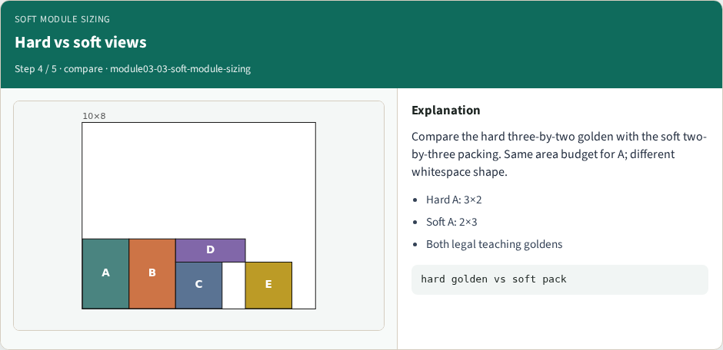
Hard vs soft views
Hard vs soft views
learn_floorplanning — 03 soft module sizing
Notes:
Compare the hard three-by-two golden with the soft two-by-three packing. Same area budget for A; different whitespace shape.

Slide 9
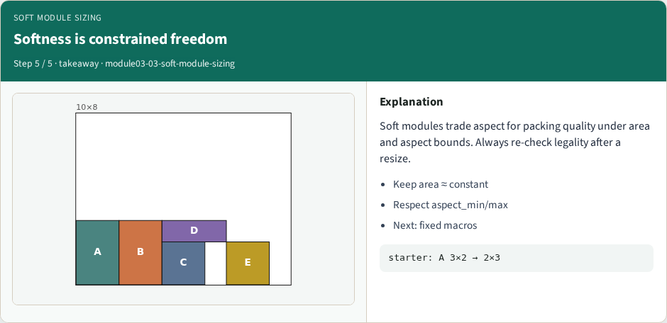
Softness is constrained freedom
Softness is constrained freedom
learn_floorplanning — 03 soft module sizing
Notes:
Soft modules trade aspect for packing quality under area and aspect bounds. Always re-check legality after a resize.

Slide 10
Browser lab track
Open soft-module-sizing
Show hard three-by-two, then Reshape A to two by three
Confirm area six and legality true on the soft packing
learn_floorplanning — 03 soft module sizing
Notes:
Open soft-module-sizing. Show hard three-by-two, then Reshape A to two by three. Confirm area six and legality true on the soft packing.

Slide 11
Implement track
Implement resize_soft that preserves area, then pack
Assert soft A ends at two by three with area six and a legal outline fit
learn_floorplanning — 03 soft module sizing
Notes:
Implement resize_soft that preserves area, then pack. Assert soft A ends at two by three with area six and a legal outline fit.

Slide 12
Pitfalls
Changing area when reshaping; ignoring aspect bounds; leaving hard modules soft by mistake
learn_floorplanning — 03 soft module sizing
Notes:
Changing area when reshaping; ignoring aspect bounds; leaving hard modules soft by mistake.

Slide 13
Your turn
Accept a legal soft packing with A at two by three
Next: fix macro D at the origin
learn_floorplanning — 03 soft module sizing
Notes:
Accept a legal soft packing with A at two by three. Next: fix macro D at the origin.

