Slide 1
Hard macro / fixed-block placement
Macros are hard fixed rectangles
learn_floorplanning — 05 macro placement
Notes:
Macros are hard fixed rectangles. In macro mode, D is pinned at zero comma zero with macro true, size three by one. A stacks above; B, C, and E pack to the right—still legal.

Slide 2
Pseudocode
Macro placement locks hard blocks first
Free modules pack around those obstacles; legality fails if a macro drifts
Open this module's examples file and find the Pseudocode section
That written sketch is what you implement on the implement track and what the browser
learn_floorplanning — 05 macro placement
Notes:
Macro placement locks hard blocks first. Free modules pack around those obstacles; legality fails if a macro drifts.
Open this module's examples file and find the Pseudocode section. That written sketch is what you implement on the implement track and what the browser challenges measure.

Slide 3
Algorithm sketch
Free golden has movable D at zero comma two
Macro teaching pack pins D at zero comma zero with macro true and the rest legal
learn_floorplanning — 05 macro placement
Notes:
Free golden has movable D at zero comma two. Macro teaching pack pins D at zero comma zero with macro true and the rest legal.

Slide 4
Algorithm sketch — try these
INPUT: macros F locked (x,y), free modules
OUTPUT: legal pack; macros never move
place each f∈F at locked pose (macro flag)
pack free modules around F obstacles
fail if any macro drifts
GOLDEN free: D@(0,2); macro: D@(0,0)
learn_floorplanning — 05 macro placement

Slide 5
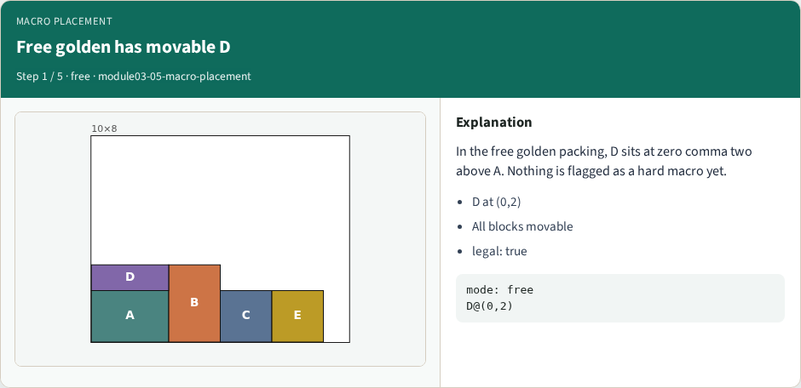
Free golden has movable D
Free golden has movable D
learn_floorplanning — 05 macro placement
Notes:
In the free golden packing, D sits at zero comma two above A. Nothing is flagged as a hard macro yet.

Slide 6
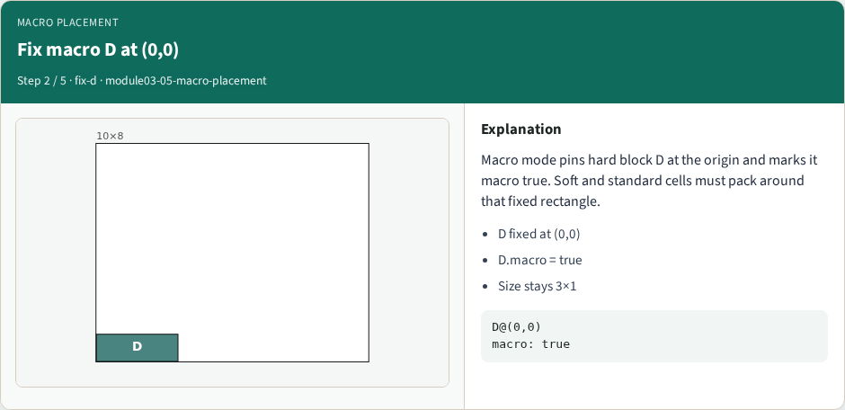
Fix macro D at (0,0)
Fix macro D at (0,0)
learn_floorplanning — 05 macro placement
Notes:
Macro mode pins hard block D at the origin and marks it macro true. Soft and standard cells must pack around that fixed rectangle.

Slide 7
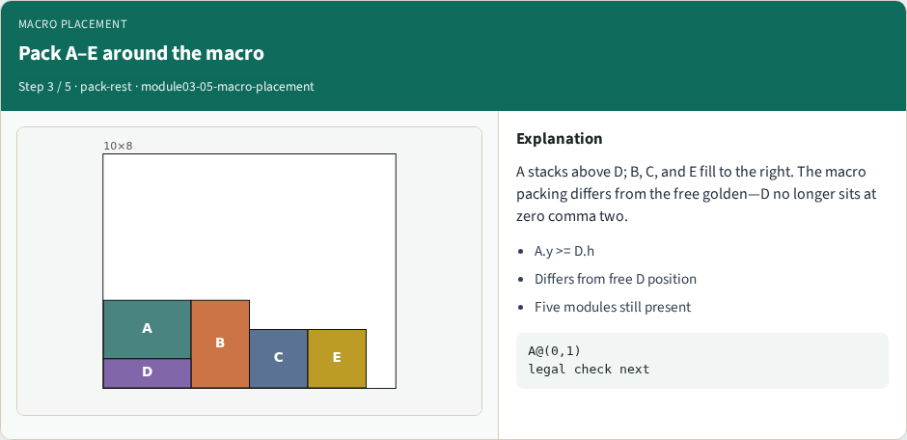
Pack A–E around the macro
Pack A–E around the macro
learn_floorplanning — 05 macro placement
Notes:
A stacks above D; B, C, and E fill to the right. The macro packing differs from the free golden—D no longer sits at zero comma two.

Slide 8
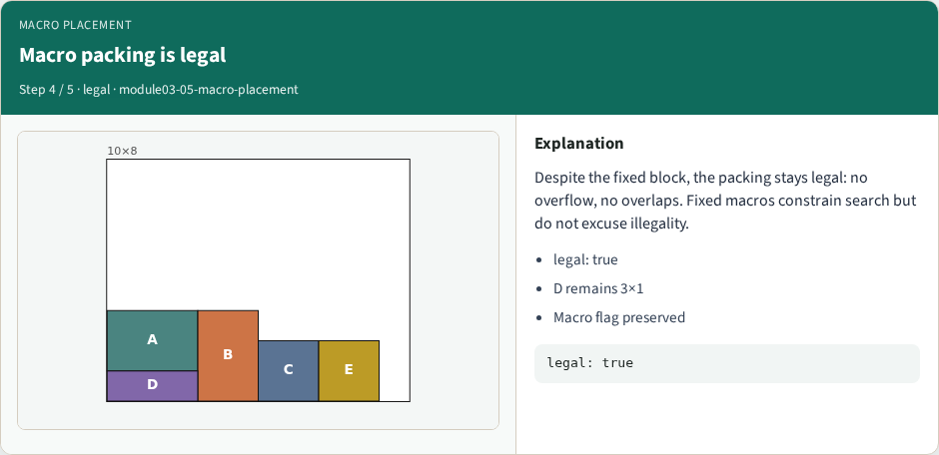
Macro packing is legal
Macro packing is legal
learn_floorplanning — 05 macro placement
Notes:
Despite the fixed block, the packing stays legal: no overflow, no overlaps. Fixed macros constrain search but do not excuse illegality.

Slide 9

Macros first, then cells
Macros first, then cells
learn_floorplanning — 05 macro placement
Notes:
Industrial flows often place large macros before standard cells. Treat fixed rectangles as hard constraints, then optimize the rest.

Slide 10
Browser lab track
Open macro-placement
Compare free golden D at zero comma two with Place macros: D at zero comma zero
Confirm legality and the macro flag
learn_floorplanning — 05 macro placement
Notes:
Open macro-placement. Compare free golden D at zero comma two with Place macros: D at zero comma zero. Confirm legality and the macro flag.

Slide 11
Implement track
Fix D, pack the rest, assert D at (0,0), D.macro true, and is_legal_packing true
Note the free golden differs
learn_floorplanning — 05 macro placement
Notes:
Fix D, pack the rest, assert D at (0,0), D.macro true, and is_legal_packing true. Note the free golden differs.

Slide 12
Pitfalls
Moving macros after fixing them
learn_floorplanning — 05 macro placement
Notes:
Moving macros after fixing them; shrinking macro size; allowing overlaps against the fixed block.

Slide 13
Your turn
Ship the legal macro packing
Next: hierarchical AB left and CDE right at offset five
learn_floorplanning — 05 macro placement
Notes:
Ship the legal macro packing. Next: hierarchical AB left and CDE right at offset five.

