Slide 1
Hierarchical floorplanning
Hierarchy packs cluster AB on the left and cluster CDE on the right with x offset five
learn_floorplanning — 01 hierarchical floorplan
Notes:
Hierarchy packs cluster AB on the left and cluster CDE on the right with x offset five. Local pack, then place clusters—legal overall with clusters separated in x.

Slide 2
Pseudocode
Hierarchical floorplan packs inside clusters first
Open this module's examples file and find the Pseudocode section
That written sketch is what you implement on the implement track and what the browser
learn_floorplanning — 01 hierarchical floorplan
Notes:
Hierarchical floorplan packs inside clusters first, then packs the cluster bounding boxes in the outline.
Open this module's examples file and find the Pseudocode section. That written sketch is what you implement on the implement track and what the browser challenges measure.

Slide 3
Algorithm sketch
Teaching golden places cluster A B on the left and C D E on the right starting at x equals
learn_floorplanning — 01 hierarchical floorplan
Notes:
Teaching golden places cluster A B on the left and C D E on the right starting at x equals five.

Slide 4
Algorithm sketch — try these
INPUT: clusters of modules
OUTPUT: top-level pack of cluster bboxes
pack each cluster internally (slice/B*/SA)
pack cluster bboxes in outline
GOLDEN teaching: AB left; CDE right @x=5
learn_floorplanning — 01 hierarchical floorplan

Slide 5
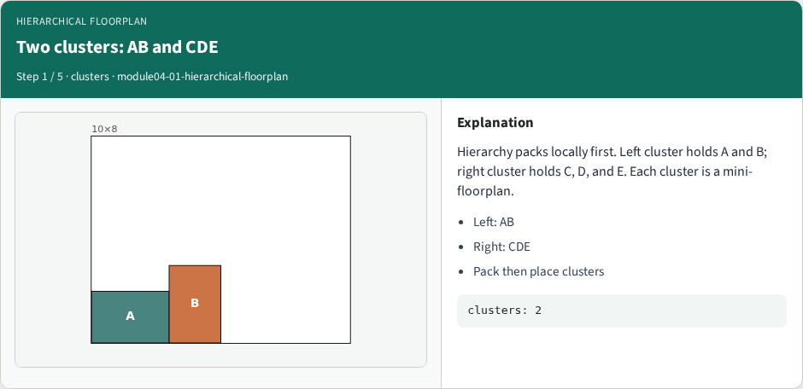
Two clusters: AB and CDE
Two clusters: AB and CDE
learn_floorplanning — 01 hierarchical floorplan
Notes:
Hierarchy packs locally first. Left cluster holds A and B; right cluster holds C, D, and E. Each cluster is a mini-floorplan.

Slide 6

Left cluster packs at x<5
Left cluster packs at x<5
learn_floorplanning — 01 hierarchical floorplan
Notes:
AB occupies the left side with A at the origin and B at x equals three. Everything in this cluster stays left of x equals five.

Slide 7
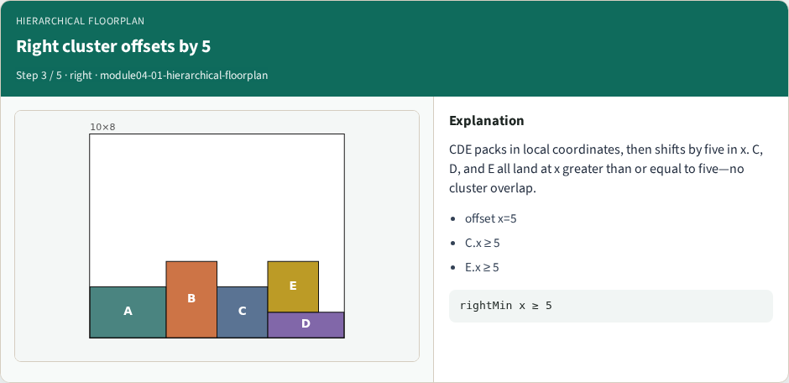
Right cluster offsets by 5
Right cluster offsets by 5
learn_floorplanning — 01 hierarchical floorplan
Notes:
CDE packs in local coordinates, then shifts by five in x. C, D, and E all land at x greater than or equal to five—no cluster overlap.

Slide 8
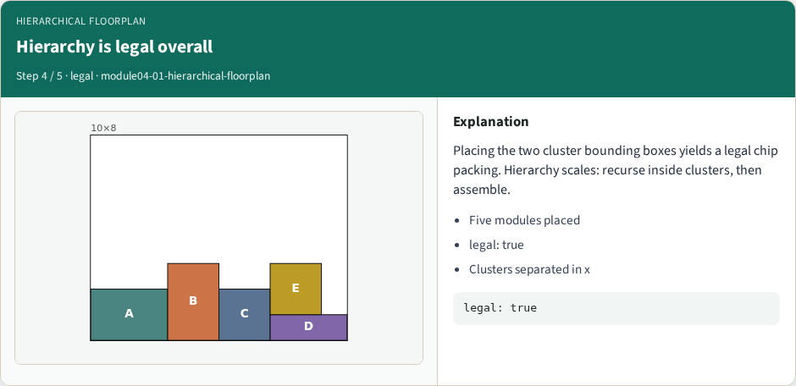
Hierarchy is legal overall
Hierarchy is legal overall
learn_floorplanning — 01 hierarchical floorplan
Notes:
Placing the two cluster bounding boxes yields a legal chip packing. Hierarchy scales: recurse inside clusters, then assemble.

Slide 9
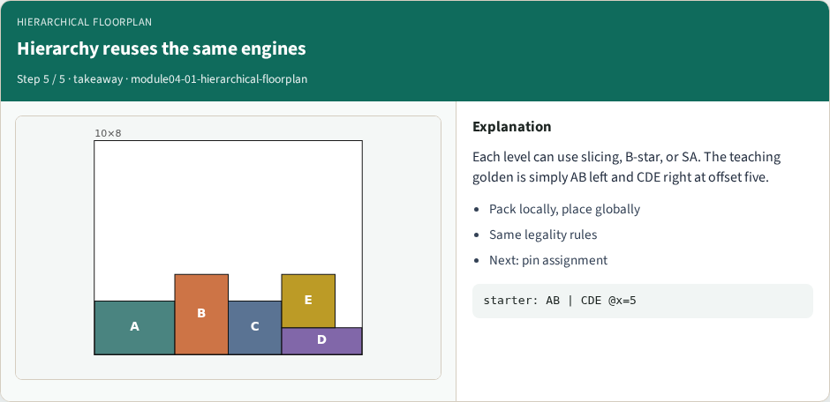
Hierarchy reuses the same engines
Hierarchy reuses the same engines
learn_floorplanning — 01 hierarchical floorplan
Notes:
Each level can use slicing, B-star, or SA. The teaching golden is simply AB left and CDE right at offset five.

Slide 10
Browser lab track
Open hierarchical-floorplan and Pack hierarchy
Confirm A and B have x less than five, C D E have x at least five, and legality true
learn_floorplanning — 01 hierarchical floorplan
Notes:
Open hierarchical-floorplan and Pack hierarchy. Confirm A and B have x less than five, C D E have x at least five, and legality true.

Slide 11
Implement track
Implement pack_hierarchical
Assert leftMax x+w is at most rightMin x, five modules present, and legality true
learn_floorplanning — 01 hierarchical floorplan
Notes:
Implement pack_hierarchical. Assert leftMax x+w is at most rightMin x, five modules present, and legality true.

Slide 12
Pitfalls
Overlapping cluster bounding boxes
learn_floorplanning — 01 hierarchical floorplan
Notes:
Overlapping cluster bounding boxes; forgetting the offset; applying different legality rules at each level.

Slide 13
Your turn
Accept the AB | CDE packing
Next: assign pins P0 through P3 on all four outline sides
learn_floorplanning — 01 hierarchical floorplan
Notes:
Accept the AB | CDE packing. Next: assign pins P0 through P3 on all four outline sides.

