Slide 1
Cutsize and balance
Cutsize adds the weights of edges that cross the cut
learn_partitioning — 01 cutsize balance
Notes:
Cutsize adds the weights of edges that cross the cut. Balance asks whether the two parts are roughly the same size. On the starter graph, the bad seed AE versus BCD cuts both heavy edges and scores cutsize twelve with sizes two and three. The golden ABC versus DE drops the cut to three with sizes three and two. You will compute both numbers every time you look at a bipartition.

Slide 2
The idea
For every edge, if the endpoints sit in different parts, add its weight to the cut
Balance ratio is the smaller part size over the larger
Never celebrate a zero cut that parks every node on one side
learn_partitioning — 01 cutsize balance
Notes:
For every edge, if the endpoints sit in different parts, add its weight to the cut. Balance ratio is the smaller part size over the larger. Never celebrate a zero cut that parks every node on one side—that is not a usable partition.

Slide 3
Pseudocode
Before any refinement, write the metrics
Pseudocode sums cut edges for cutsize and part sizes for balance
Imbalance is the absolute size gap over total size
Open this module's examples file and find the Pseudocode section
That written sketch is what you implement on the implement track and what the browser
learn_partitioning — 01 cutsize balance
Notes:
Before any refinement, write the metrics. Pseudocode sums cut edges for cutsize and part sizes for balance. Imbalance is the absolute size gap over total size.
Open this module's examples file and find the Pseudocode section. That written sketch is what you implement on the implement track and what the browser challenges measure.

Slide 4
Algorithm sketch
Bad seed AE versus BCD cuts both heavy edges for cutsize twelve
Golden ABC versus DE drops the cut to three with sizes three and two
learn_partitioning — 01 cutsize balance
Notes:
Bad seed AE versus BCD cuts both heavy edges for cutsize twelve. Golden ABC versus DE drops the cut to three with sizes three and two.

Slide 5
Algorithm sketch — try these
INPUT: assignment side[v], weighted edges
OUTPUT: cutsize, sizes, imbalance
cut ← Σ w(u,v) where side[u]≠side[v]
size[p] ← Σ node_size on side p
imbalance ← |s0−s1| / (s0+s1)
GOLDEN bad AE|BCD: cut=12, sizes 2|3
GOLDEN ABC|DE: cut=3, sizes 3|2
learn_partitioning — 01 cutsize balance

Slide 6
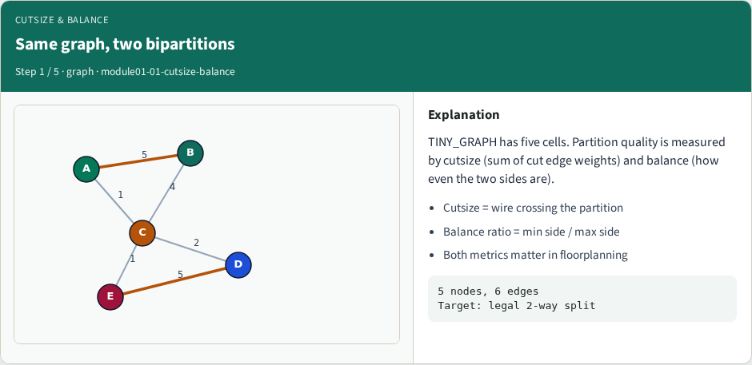
Same graph, two bipartitions
Same graph, two bipartitions
learn_partitioning — 01 cutsize balance
Notes:
TINY_GRAPH has five cells. Partition quality is measured by cutsize (sum of cut edge weights) and balance (how even the two sides are).

Slide 7
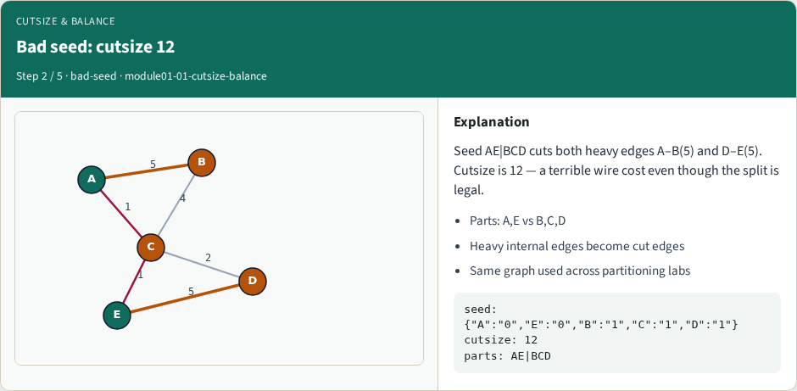
Bad seed: cutsize 12
Bad seed: cutsize 12
learn_partitioning — 01 cutsize balance
Notes:
Seed AE|BCD cuts both heavy edges A–B(5) and D–E(5). Cutsize is 12 — a terrible wire cost even though the split is legal.

Slide 8
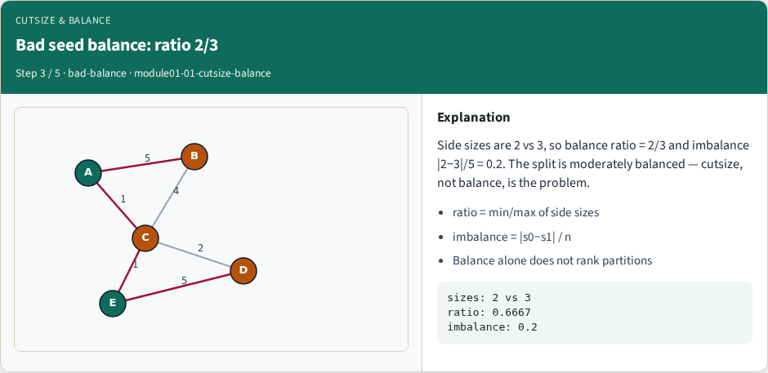
Bad seed balance: ratio 2/3
Bad seed balance: ratio 2/3
learn_partitioning — 01 cutsize balance
Notes:
Side sizes are 2 vs 3, so balance ratio = 2/3 and imbalance |2−3|/5 = 0.2. The split is moderately balanced — cutsize, not balance, is the problem.

Slide 9
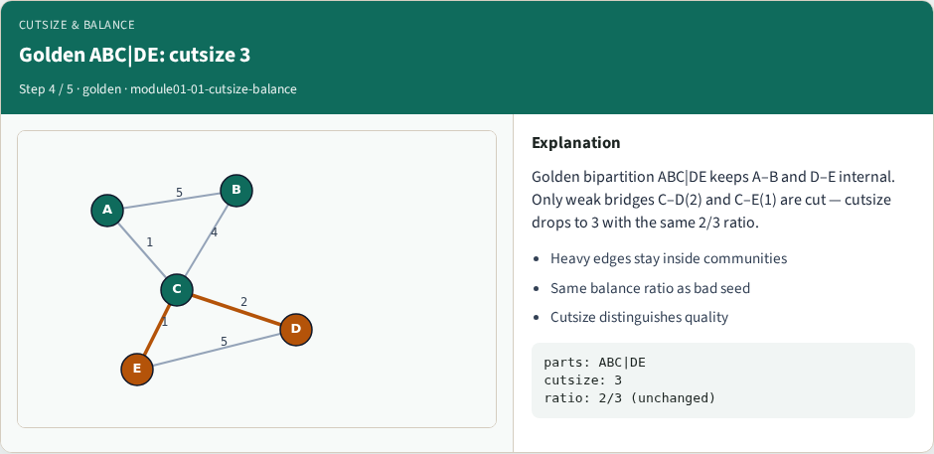
Golden ABC|DE: cutsize 3
Golden ABC|DE: cutsize 3
learn_partitioning — 01 cutsize balance
Notes:
Golden bipartition ABC|DE keeps A–B and D–E internal. Only weak bridges C–D(2) and C–E(1) are cut — cutsize drops to 3 with the same 2/3 ratio.

Slide 10
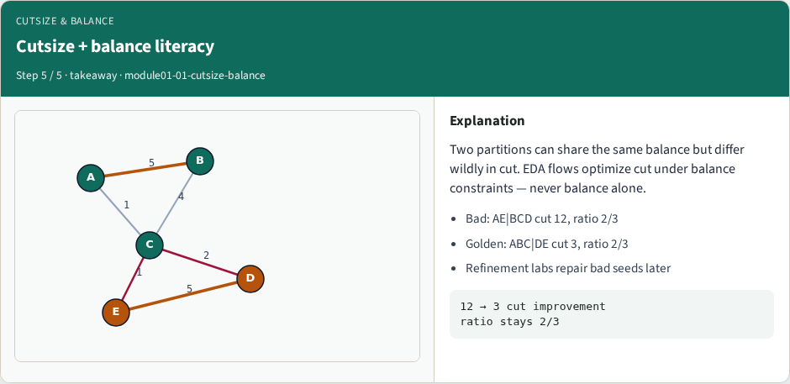
Cutsize + balance literacy
Cutsize + balance literacy
learn_partitioning — 01 cutsize balance
Notes:
Two partitions can share the same balance but differ wildly in cut. EDA flows optimize cut under balance constraints — never balance alone.

Slide 11
Browser lab track
In the browser lab track, open the cutsize-balance lab from the tools shelf
Load the starter graph, run the algorithm once
Work the challenges that lock the goldens
learn_partitioning — 01 cutsize balance
Notes:
In the browser lab track, open the **cutsize-balance** lab from the tools shelf. Load the starter graph, run the algorithm once, and read cutsize and balance in the metrics panel. Work the challenges that lock the goldens, then come back to implement the same loop yourself.

Slide 12
Implement track
In the implement track
Parse the tiny graph, run the algorithm with a deterministic seed
Match the browser goldens before you claim the checklist
learn_partitioning — 01 cutsize balance
Notes:
In the implement track, open this module's EXAMPLES.md Pseudocode section and the course common solvers. Parse the tiny graph, run the algorithm with a deterministic seed, and print the assignment plus cutsize and balance. Match the browser goldens before you claim the checklist.

Slide 13
Pitfalls
Common traps
For multilevel flows, verify coarsening before you blame the refiner
learn_partitioning — 01 cutsize balance
Notes:
Common traps: optimizing cut while ignoring balance; reporting pairwise cut when the instance is a hypergraph; flipping locked terminals; and stopping before rollback to the best KL or FM prefix. For multilevel flows, verify coarsening before you blame the refiner.

Slide 14
Your turn
Complete the checklist for at least one track, preferably both
Implement until your metrics match the starter goldens
When you’re ready, take the short quiz, then continue to the next module
learn_partitioning — 01 cutsize balance
Notes:
Complete the checklist for at least one track—preferably both. Implement until your metrics match the starter goldens. When you’re ready, take the short quiz, then continue to the next module.

