Slide 1
Initial bipartition
Refinement needs a legal starting cut
learn_partitioning — 03 initial bipartition
Notes:
Refinement needs a legal starting cut. In this module you build an initial bipartition—random with a fixed seed, greedy by heaviest edges, or grow from a seed node—before KL or FM ever runs. On the tiny graph, seed seven’s random bipartition matches the familiar bad seed shape AE versus BCD with cutsize twelve.

Slide 2
The idea
Random shuffles then splits by half
Greedy prefers keeping heavy edges internal when it can
Grow expands a frontier from a seed until the part hits its size budget
All three must report cutsize and balance so you can compare seeds fairly
learn_partitioning — 03 initial bipartition
Notes:
Random shuffles then splits by half. Greedy prefers keeping heavy edges internal when it can. Grow expands a frontier from a seed until the part hits its size budget. All three must report cutsize and balance so you can compare seeds fairly.

Slide 3
Pseudocode
Initial bipartition is three named constructors in pseudocode
Open this module's examples file and find the Pseudocode section
That written sketch is what you implement on the implement track and what the browser
learn_partitioning — 03 initial bipartition
Notes:
Initial bipartition is three named constructors in pseudocode: random split, greedy heavy-edge keep, and grow from a seed until the size budget.
Open this module's examples file and find the Pseudocode section. That written sketch is what you implement on the implement track and what the browser challenges measure.

Slide 4
Algorithm sketch
Grow from D yields DE versus ABC at cut three
Random seed seven recovers the bad AE versus BCD cut of twelve
Always print cutsize and balance before KL or FM
learn_partitioning — 03 initial bipartition
Notes:
Grow from D yields DE versus ABC at cut three. Random seed seven recovers the bad AE versus BCD cut of twelve. Always print cutsize and balance before KL or FM.

Slide 5
Algorithm sketch — try these
INPUT: graph G, method ∈ {random,greedy,grow}
OUTPUT: legal side[v] ∈ {0,1}
random(seed): shuffle; split by half
greedy: keep heaviest edges internal when able
grow(seed): expand frontier until size budget
report cutsize + balance for every seed
GOLDEN: grow(D)→DE|ABC cut=3
random(7)→AE|BCD cut=12
learn_partitioning — 03 initial bipartition

Slide 6
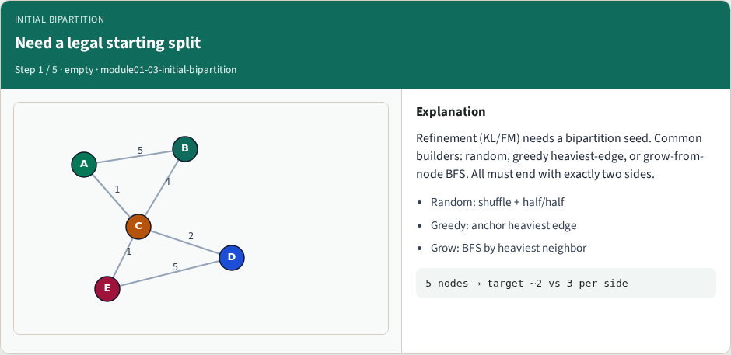
Need a legal starting split
Need a legal starting split
learn_partitioning — 03 initial bipartition
Notes:
Refinement (KL/FM) needs a bipartition seed. Common builders: random, greedy heaviest-edge, or grow-from-node BFS. All must end with exactly two sides.

Slide 7
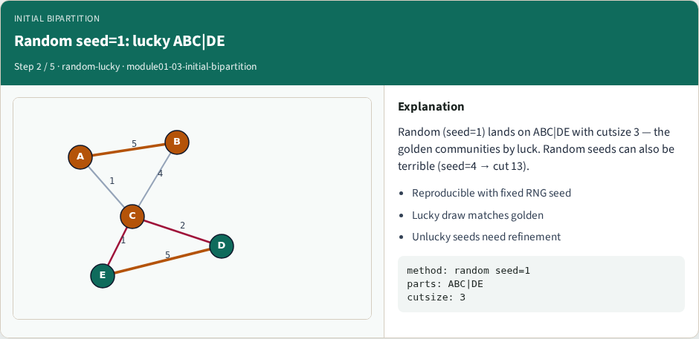
Random seed=1: lucky ABC|DE
Random seed=1: lucky ABC|DE
learn_partitioning — 03 initial bipartition
Notes:
Random (seed=1) lands on ABC|DE with cutsize 3 — the golden communities by luck. Random seeds can also be terrible (seed=4 → cut 13).

Slide 8
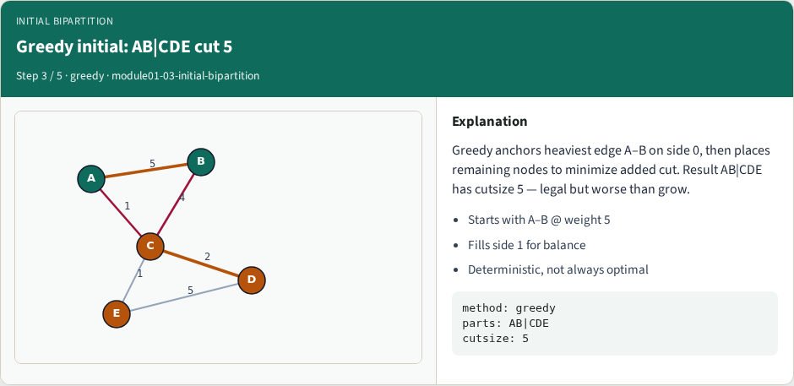
Greedy initial: AB|CDE cut 5
Greedy initial: AB|CDE cut 5
learn_partitioning — 03 initial bipartition
Notes:
Greedy anchors heaviest edge A–B on side 0, then places remaining nodes to minimize added cut. Result AB|CDE has cutsize 5 — legal but worse than grow.

Slide 9
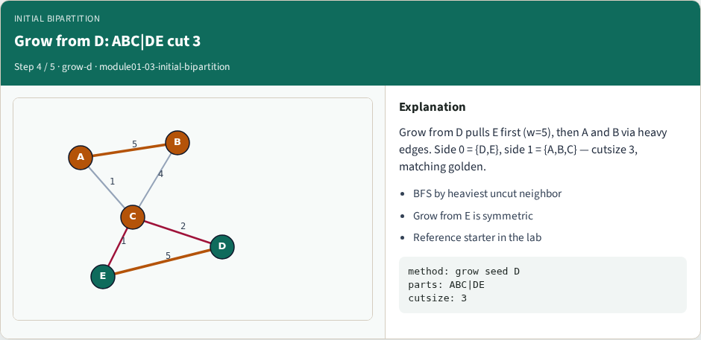
Grow from D: ABC|DE cut 3
Grow from D: ABC|DE cut 3
learn_partitioning — 03 initial bipartition
Notes:
Grow from D pulls E first (w=5), then A and B via heavy edges. Side 0 = {D,E}, side 1 = {A,B,C} — cutsize 3, matching golden.

Slide 10
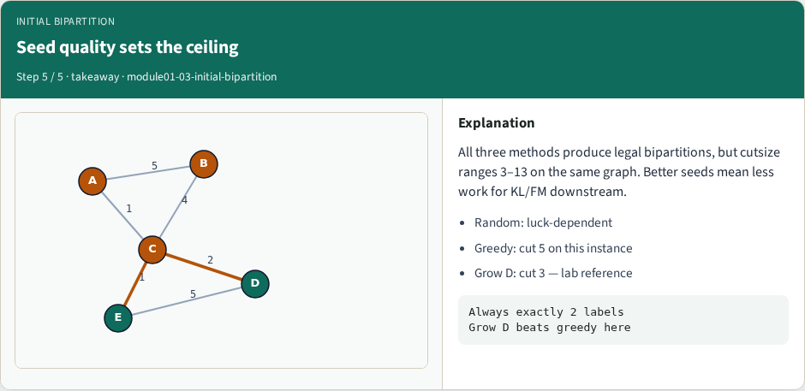
Seed quality sets the ceiling
Seed quality sets the ceiling
learn_partitioning — 03 initial bipartition
Notes:
All three methods produce legal bipartitions, but cutsize ranges 3–13 on the same graph. Better seeds mean less work for KL/FM downstream.

Slide 11
Browser lab track
In the browser lab track, open the initial-bipartition lab from the tools shelf
Load the starter graph, run the algorithm once
Work the challenges that lock the goldens
learn_partitioning — 03 initial bipartition
Notes:
In the browser lab track, open the **initial-bipartition** lab from the tools shelf. Load the starter graph, run the algorithm once, and read cutsize and balance in the metrics panel. Work the challenges that lock the goldens, then come back to implement the same loop yourself.

Slide 12
Implement track
In the implement track
Parse the tiny graph, run the algorithm with a deterministic seed
Match the browser goldens before you claim the checklist
learn_partitioning — 03 initial bipartition
Notes:
In the implement track, open this module's EXAMPLES.md Pseudocode section and the course common solvers. Parse the tiny graph, run the algorithm with a deterministic seed, and print the assignment plus cutsize and balance. Match the browser goldens before you claim the checklist.

Slide 13
Pitfalls
Common traps
For multilevel flows, verify coarsening before you blame the refiner
learn_partitioning — 03 initial bipartition
Notes:
Common traps: optimizing cut while ignoring balance; reporting pairwise cut when the instance is a hypergraph; flipping locked terminals; and stopping before rollback to the best KL or FM prefix. For multilevel flows, verify coarsening before you blame the refiner.

Slide 14
Your turn
Complete the checklist for at least one track, preferably both
Implement until your metrics match the starter goldens
When you’re ready, take the short quiz, then continue to the next module
learn_partitioning — 03 initial bipartition
Notes:
Complete the checklist for at least one track—preferably both. Implement until your metrics match the starter goldens. When you’re ready, take the short quiz, then continue to the next module.

