Slide 1
Kernighan–Lin bipartition
Kernighan–Lin improves an existing bipartition by swapping pairs across the cut
learn_partitioning — 01 kl partition
Notes:
Kernighan–Lin improves an existing bipartition by swapping pairs across the cut. You’ll watch a full pass—gains, locking, a swap sequence, and rollback to the best prefix. On the starter seed that cuts both heavy edges, KL drives the cut from twelve down to three.

Slide 2
The idea
Score each unlocked pair by swap gain
Here the winning prefix is one swap: A with D, gain nine
Pass one then finds nothing and KL stops at a local optimum for swap moves
learn_partitioning — 01 kl partition
Notes:
Score each unlocked pair by swap gain, lock pairs as you go, then keep only the prefix with best cumulative gain. Here the winning prefix is one swap: A with D, gain nine. Pass one then finds nothing and KL stops at a local optimum for swap moves.

Slide 3
Pseudocode
KL pseudocode builds a locked swap sequence each pass
Pair gain uses D-values minus twice the edge between the pair
Open this module's examples file and find the Pseudocode section
That written sketch is what you implement on the implement track and what the browser
learn_partitioning — 01 kl partition
Notes:
KL pseudocode builds a locked swap sequence each pass, then rolls back to the best positive prefix. Pair gain uses D-values minus twice the edge between the pair.
Open this module's examples file and find the Pseudocode section. That written sketch is what you implement on the implement track and what the browser challenges measure.

Slide 4
Algorithm sketch
From the cutsize-twelve bad seed the winning prefix is one swap, A with D
The sketch lands on ABC versus DE at cut three, then the next pass stops
learn_partitioning — 01 kl partition
Notes:
From the cutsize-twelve bad seed the winning prefix is one swap, A with D. The sketch lands on ABC versus DE at cut three, then the next pass stops.

Slide 5
Algorithm sketch — try these
INPUT: bipartition side[], max_passes
OUTPUT: refined side[]
each pass: unlock all; compute D-values
repeat |V|/2: pick unlocked pair max swap gain
lock pair; update working sides + D
keep prefix with best cumulative gain (>0)
apply prefix; stop if no improving pass
GOLDEN BAD_SEED cut 12 → ABC|DE cut 3
learn_partitioning — 01 kl partition

Slide 6
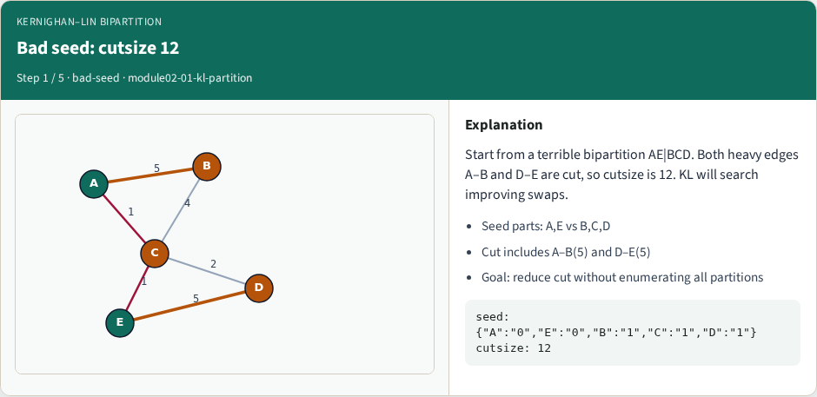
Bad seed: cutsize 12
Bad seed: cutsize 12
learn_partitioning — 01 kl partition
Notes:
Start from a terrible bipartition AE|BCD. Both heavy edges A–B and D–E are cut, so cutsize is 12. KL will search improving swaps.

Slide 7
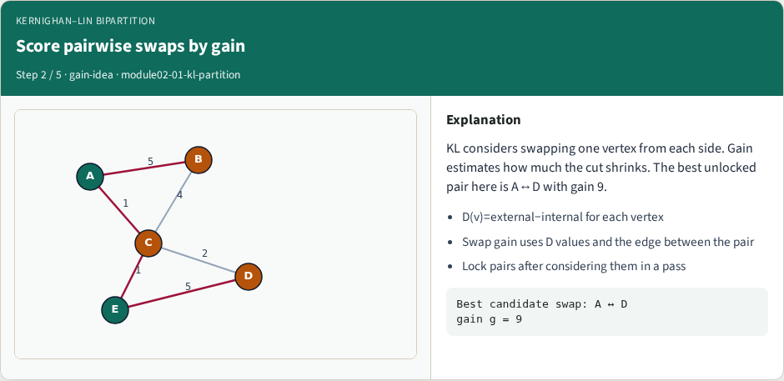
Score pairwise swaps by gain
Score pairwise swaps by gain
learn_partitioning — 01 kl partition
Notes:
KL considers swapping one vertex from each side. Gain estimates how much the cut shrinks. The best unlocked pair here is A↔D with gain 9.

Slide 8
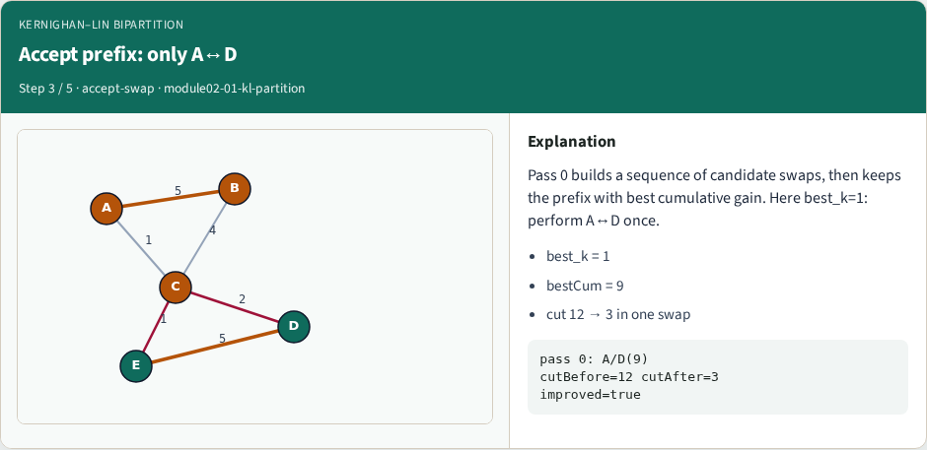
Accept prefix: only A↔D
Accept prefix: only A↔D
learn_partitioning — 01 kl partition
Notes:
Pass 0 builds a sequence of candidate swaps, then keeps the prefix with best cumulative gain. Here best_k=1: perform A↔D once.

Slide 9
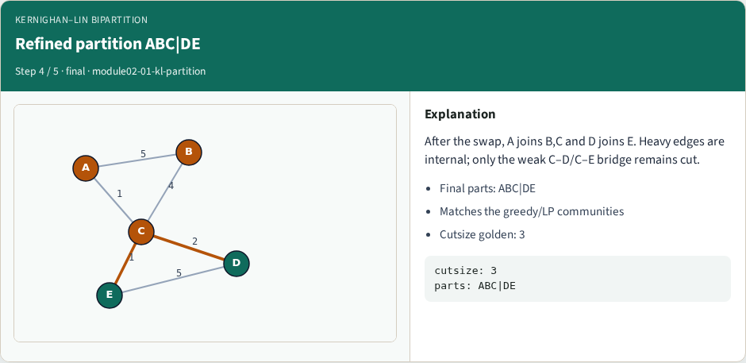
Refined partition ABC|DE
Refined partition ABC|DE
learn_partitioning — 01 kl partition
Notes:
After the swap, A joins B,C and D joins E. Heavy edges are internal; only the weak C–D/C–E bridge remains cut.

Slide 10
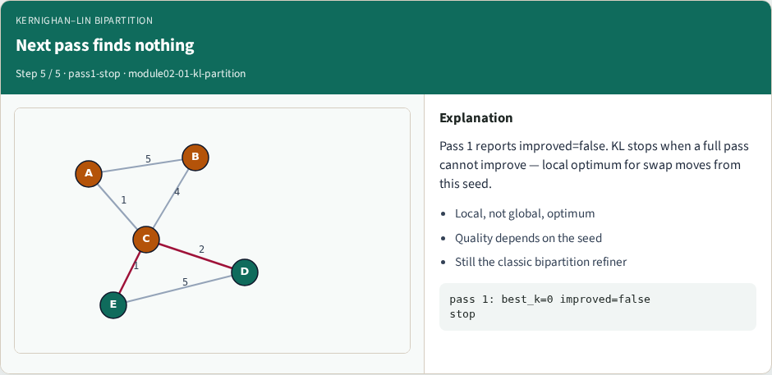
Next pass finds nothing
Next pass finds nothing
learn_partitioning — 01 kl partition
Notes:
Pass 1 reports improved=false. KL stops when a full pass cannot improve — local optimum for swap moves from this seed.

Slide 11
Browser lab track
In the browser lab track, open the kl-partition lab from the tools shelf
Load the starter graph, run the algorithm once
Work the challenges that lock the goldens
learn_partitioning — 01 kl partition
Notes:
In the browser lab track, open the **kl-partition** lab from the tools shelf. Load the starter graph, run the algorithm once, and read cutsize and balance in the metrics panel. Work the challenges that lock the goldens, then come back to implement the same loop yourself.

Slide 12
Implement track
In the implement track
Parse the tiny graph, run the algorithm with a deterministic seed
Match the browser goldens before you claim the checklist
learn_partitioning — 01 kl partition
Notes:
In the implement track, open this module's EXAMPLES.md Pseudocode section and the course common solvers. Parse the tiny graph, run the algorithm with a deterministic seed, and print the assignment plus cutsize and balance. Match the browser goldens before you claim the checklist.

Slide 13
Pitfalls
Common traps
For multilevel flows, verify coarsening before you blame the refiner
learn_partitioning — 01 kl partition
Notes:
Common traps: optimizing cut while ignoring balance; reporting pairwise cut when the instance is a hypergraph; flipping locked terminals; and stopping before rollback to the best KL or FM prefix. For multilevel flows, verify coarsening before you blame the refiner.

Slide 14
Your turn
Complete the checklist for at least one track, preferably both
Implement until your metrics match the starter goldens
When you’re ready, take the short quiz, then continue to the next module
learn_partitioning — 01 kl partition
Notes:
Complete the checklist for at least one track—preferably both. Implement until your metrics match the starter goldens. When you’re ready, take the short quiz, then continue to the next module.

