Slide 1
Fiduccia–Mattheyses bipartition
Fiduccia–Mattheyses moves one vertex at a time instead of swapping a pair
learn_partitioning — 03 fm partition
Notes:
Fiduccia–Mattheyses moves one vertex at a time instead of swapping a pair. From the same cutsize-twelve seed, FM flips D then A, keeps the best prefix of two moves, and lands on the same ABC versus DE cut of three that KL found.

Slide 2
The idea
Bucketed single-vertex gains, lock after each move
Two legal flips can equal one KL swap’s total gain on this instance
learn_partitioning — 03 fm partition
Notes:
Bucketed single-vertex gains, lock after each move, and enforce a balance tolerance so parts cannot empty. Two legal flips can equal one KL swap’s total gain on this instance—different move set, same destination quality.

Slide 3
Pseudocode
FM moves one vertex at a time
Pseudocode ranks unlocked legal flips by gain
Open this module's examples file and find the Pseudocode section
That written sketch is what you implement on the implement track and what the browser
learn_partitioning — 03 fm partition
Notes:
FM moves one vertex at a time. Pseudocode ranks unlocked legal flips by gain, locks them into a sequence, then keeps the best positive prefix under a balance filter.
Open this module's examples file and find the Pseudocode section. That written sketch is what you implement on the implement track and what the browser challenges measure.

Slide 4
Algorithm sketch
Same bad seed as KL
learn_partitioning — 03 fm partition
Notes:
Same bad seed as KL: FM flips D then A, keeps a prefix of two, and reaches ABC versus DE at cut three.

Slide 5
Algorithm sketch — try these
INPUT: side[], balance_tol, max_passes
OUTPUT: refined side[]
each pass: while unlocked legal moves exist:
pick v with max gain among balance-ok flips
lock v; flip on working copy
keep best positive-gain prefix; apply
stop when a pass cannot improve
GOLDEN BAD_SEED → flip D then A → cut 3
learn_partitioning — 03 fm partition

Slide 6
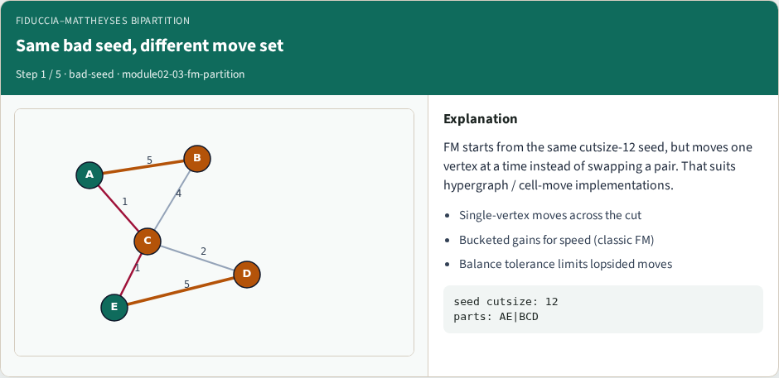
Same bad seed, different move set
Same bad seed, different move set
learn_partitioning — 03 fm partition
Notes:
FM starts from the same cutsize-12 seed, but moves one vertex at a time instead of swapping a pair. That suits hypergraph / cell-move implementations.

Slide 7
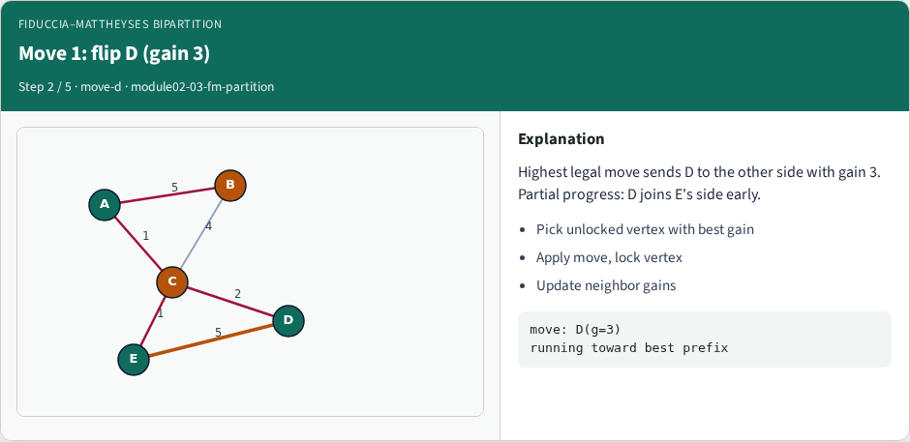
Move 1: flip D (gain 3)
Move 1: flip D (gain 3)
learn_partitioning — 03 fm partition
Notes:
Highest legal move sends D to the other side with gain 3. Partial progress: D joins E's side early.

Slide 8
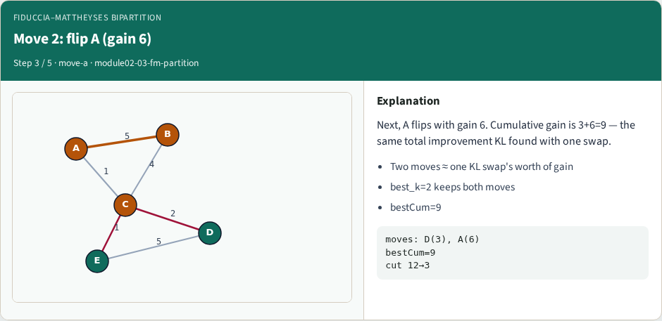
Move 2: flip A (gain 6)
Move 2: flip A (gain 6)
learn_partitioning — 03 fm partition
Notes:
Next, A flips with gain 6. Cumulative gain is 3+6=9 — the same total improvement KL found with one swap.

Slide 9
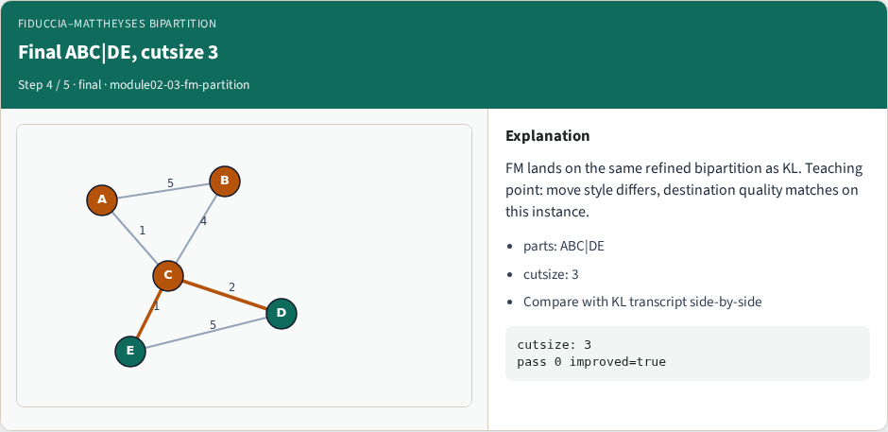
Final ABC|DE, cutsize 3
Final ABC|DE, cutsize 3
learn_partitioning — 03 fm partition
Notes:
FM lands on the same refined bipartition as KL. Teaching point: move style differs, destination quality matches on this instance.

Slide 10
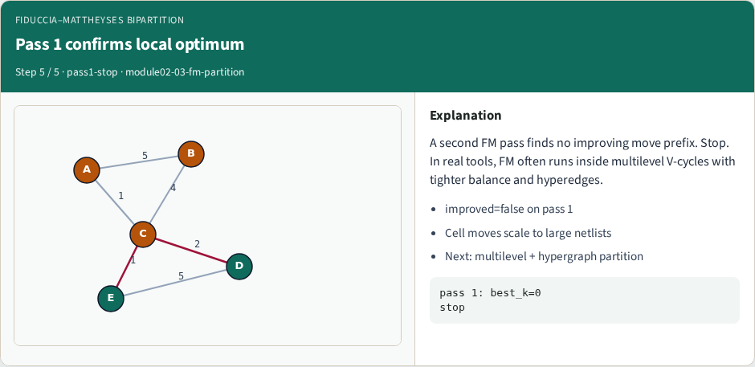
Pass 1 confirms local optimum
Pass 1 confirms local optimum
learn_partitioning — 03 fm partition
Notes:
A second FM pass finds no improving move prefix. Stop. In real tools, FM often runs inside multilevel V-cycles with tighter balance and hyperedges.

Slide 11
Browser lab track
In the browser lab track, open the fm-partition lab from the tools shelf
Load the starter graph, run the algorithm once
Work the challenges that lock the goldens
learn_partitioning — 03 fm partition
Notes:
In the browser lab track, open the **fm-partition** lab from the tools shelf. Load the starter graph, run the algorithm once, and read cutsize and balance in the metrics panel. Work the challenges that lock the goldens, then come back to implement the same loop yourself.

Slide 12
Implement track
In the implement track
Parse the tiny graph, run the algorithm with a deterministic seed
Match the browser goldens before you claim the checklist
learn_partitioning — 03 fm partition
Notes:
In the implement track, open this module's EXAMPLES.md Pseudocode section and the course common solvers. Parse the tiny graph, run the algorithm with a deterministic seed, and print the assignment plus cutsize and balance. Match the browser goldens before you claim the checklist.

Slide 13
Pitfalls
Common traps
For multilevel flows, verify coarsening before you blame the refiner
learn_partitioning — 03 fm partition
Notes:
Common traps: optimizing cut while ignoring balance; reporting pairwise cut when the instance is a hypergraph; flipping locked terminals; and stopping before rollback to the best KL or FM prefix. For multilevel flows, verify coarsening before you blame the refiner.

Slide 14
Your turn
Complete the checklist for at least one track, preferably both
Implement until your metrics match the starter goldens
When you’re ready, take the short quiz, then continue to the next module
learn_partitioning — 03 fm partition
Notes:
Complete the checklist for at least one track—preferably both. Implement until your metrics match the starter goldens. When you’re ready, take the short quiz, then continue to the next module.

