Slide 1
Spectral bipartition
Spectral bipartition reads connectivity from the graph Laplacian
learn_partitioning — 05 spectral partition
Notes:
Spectral bipartition reads connectivity from the graph Laplacian. The Fiedler vector gives a soft ordering of nodes; a balanced sweep of that order picks the cut. On the starter graph the winning split is DE versus ABC with cutsize three.

Slide 2
The idea
Build L equals D minus A, take the second eigenvector, sort nodes
Reject lopsided splits
The continuous membership becomes a hard bipartition only after the sweep chooses the best
learn_partitioning — 05 spectral partition
Notes:
Build L equals D minus A, take the second eigenvector, sort nodes, and try balanced prefixes. Reject lopsided splits. The continuous membership becomes a hard bipartition only after the sweep chooses the best legal cut.

Slide 3
Pseudocode
Spectral bipartition reads the Fiedler vector of the Laplacian
Open this module's examples file and find the Pseudocode section
That written sketch is what you implement on the implement track and what the browser
learn_partitioning — 05 spectral partition
Notes:
Spectral bipartition reads the Fiedler vector of the Laplacian, sorts nodes, then sweeps balanced prefixes for the cheapest cut.
Open this module's examples file and find the Pseudocode section. That written sketch is what you implement on the implement track and what the browser challenges measure.

Slide 4
Algorithm sketch
On the starter graph the winning split is D E versus A B C with cutsize three
learn_partitioning — 05 spectral partition
Notes:
On the starter graph the winning split is D E versus A B C with cutsize three—the same golden communities KL and FM refine toward.

Slide 5
Algorithm sketch — try these
INPUT: weighted undirected G
OUTPUT: side[] bipartition
L ← Laplacian; take Fiedler eigenvector
order ← nodes sorted by Fiedler value
sweep balanced prefixes; pick min cutsize
GOLDEN: DE|ABC (or ABC|DE) cut=3
learn_partitioning — 05 spectral partition

Slide 6
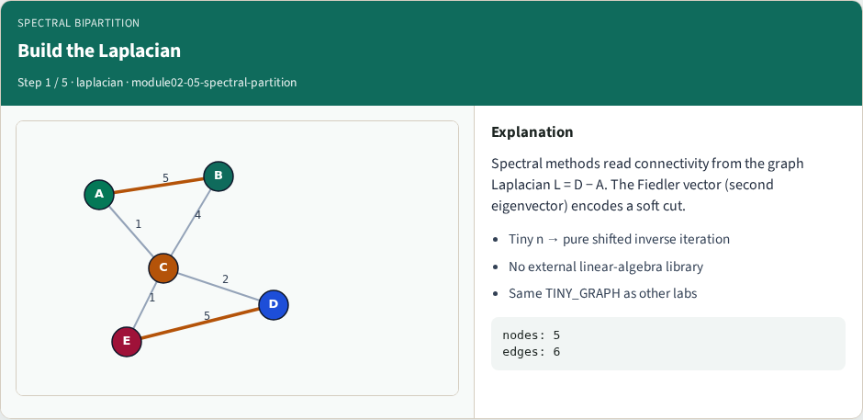
Build the Laplacian
Build the Laplacian
learn_partitioning — 05 spectral partition
Notes:
Spectral methods read connectivity from the graph Laplacian L = D − A. The Fiedler vector (second eigenvector) encodes a soft cut.

Slide 7
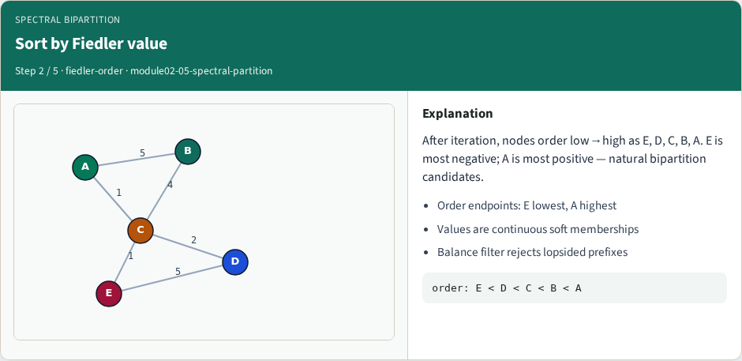
Sort by Fiedler value
Sort by Fiedler value
learn_partitioning — 05 spectral partition
Notes:
After iteration, nodes order low→high as E, D, C, B, A. E is most negative; A is most positive — natural bipartition candidates.

Slide 8
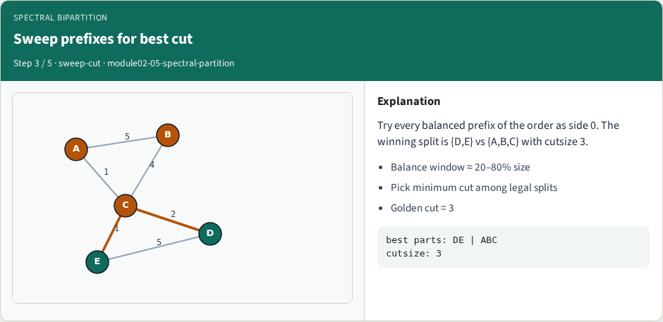
Sweep prefixes for best cut
Sweep prefixes for best cut
learn_partitioning — 05 spectral partition
Notes:
Try every balanced prefix of the order as side 0. The winning split is {D,E} vs {A,B,C} with cutsize 3.

Slide 9
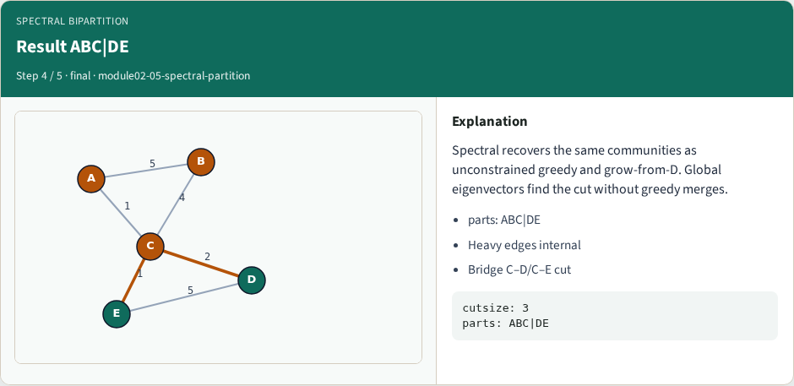
Result ABC|DE
Result ABC|DE
learn_partitioning — 05 spectral partition
Notes:
Spectral recovers the same communities as unconstrained greedy and grow-from-D. Global eigenvectors find the cut without greedy merges.

Slide 10
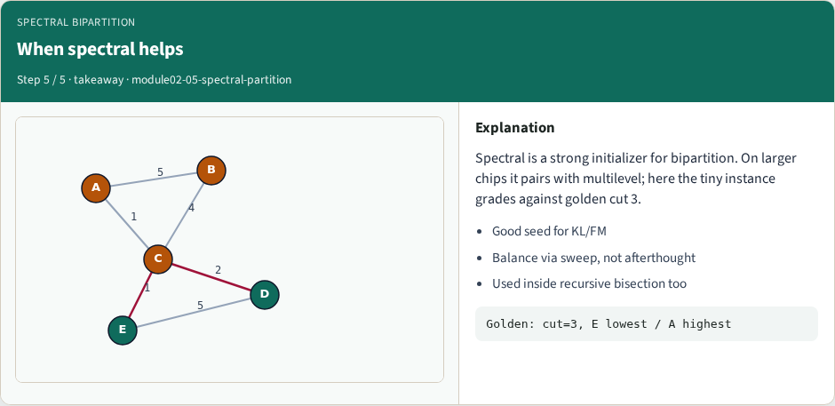
When spectral helps
When spectral helps
learn_partitioning — 05 spectral partition
Notes:
Spectral is a strong initializer for bipartition. On larger chips it pairs with multilevel; here the tiny instance grades against golden cut 3.

Slide 11
Browser lab track
In the browser lab track, open the spectral-partition lab from the tools shelf
Load the starter graph, run the algorithm once
Work the challenges that lock the goldens
learn_partitioning — 05 spectral partition
Notes:
In the browser lab track, open the **spectral-partition** lab from the tools shelf. Load the starter graph, run the algorithm once, and read cutsize and balance in the metrics panel. Work the challenges that lock the goldens, then come back to implement the same loop yourself.

Slide 12
Implement track
In the implement track
Parse the tiny graph, run the algorithm with a deterministic seed
Match the browser goldens before you claim the checklist
learn_partitioning — 05 spectral partition
Notes:
In the implement track, open this module's EXAMPLES.md Pseudocode section and the course common solvers. Parse the tiny graph, run the algorithm with a deterministic seed, and print the assignment plus cutsize and balance. Match the browser goldens before you claim the checklist.

Slide 13
Pitfalls
Common traps
For multilevel flows, verify coarsening before you blame the refiner
learn_partitioning — 05 spectral partition
Notes:
Common traps: optimizing cut while ignoring balance; reporting pairwise cut when the instance is a hypergraph; flipping locked terminals; and stopping before rollback to the best KL or FM prefix. For multilevel flows, verify coarsening before you blame the refiner.

Slide 14
Your turn
Complete the checklist for at least one track, preferably both
Implement until your metrics match the starter goldens
When you’re ready, take the short quiz, then continue to the next module
learn_partitioning — 05 spectral partition
Notes:
Complete the checklist for at least one track—preferably both. Implement until your metrics match the starter goldens. When you’re ready, take the short quiz, then continue to the next module.

