Slide 1
Recursive bisection
Recursive bisection builds a multiway partition by repeatedly bipartitioning the largest part until you reach k parts
learn_partitioning — 07 recursive bisection
Notes:
Recursive bisection builds a multiway partition by repeatedly bipartitioning the largest part until you reach k parts. Start from a bipartition, then cut again. On the tiny graph aiming for four parts you will see how early cuts constrain later ones.

Slide 2
The idea
Each step is an ordinary bipartition on an induced subgraph
Quality compounds: a weak first cut leaves later bisectors fewer good options
Always report total cut across all part boundaries and the part-size vector
learn_partitioning — 07 recursive bisection
Notes:
Each step is an ordinary bipartition on an induced subgraph. Quality compounds: a weak first cut leaves later bisectors fewer good options. Always report total cut across all part boundaries and the part-size vector.

Slide 3
Pseudocode
Recursive bisection is a loop over parts
Open this module's examples file and find the Pseudocode section
That written sketch is what you implement on the implement track and what the browser
learn_partitioning — 07 recursive bisection
Notes:
Recursive bisection is a loop over parts: while you have fewer than k parts, split the largest with a bipartitioner and replace it by the two halves.
Open this module's examples file and find the Pseudocode section. That written sketch is what you implement on the implement track and what the browser challenges measure.

Slide 4
Algorithm sketch
First split yields ABC versus DE at cut three
For k equals three the sketch bisects ABC next into A B versus C with D E untouched
learn_partitioning — 07 recursive bisection
Notes:
First split yields ABC versus DE at cut three. For k equals three the sketch bisects ABC next into A B versus C with D E untouched.

Slide 5
Algorithm sketch — try these
INPUT: G, target k parts
OUTPUT: side[v] ∈ {0..k−1}
parts ← {all nodes}
while |parts| < k:
pick largest part P
bipartition P (spectral/KL/FM)
replace P with the two halves
GOLDEN k=2: ABC|DE cut=3
k=3 continues on ABC → AB|C|DE
learn_partitioning — 07 recursive bisection

Slide 6
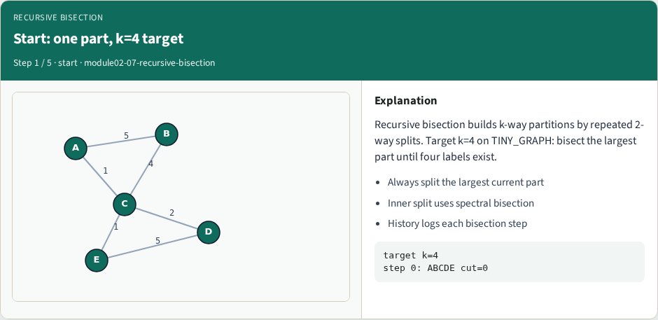
Start: one part, k=4 target
Start: one part, k=4 target
learn_partitioning — 07 recursive bisection
Notes:
Recursive bisection builds k-way partitions by repeated 2-way splits. Target k=4 on TINY_GRAPH: bisect the largest part until four labels exist.

Slide 7
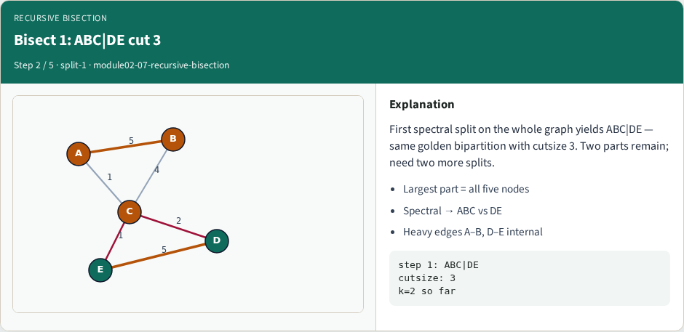
Bisect 1: ABC|DE cut 3
Bisect 1: ABC|DE cut 3
learn_partitioning — 07 recursive bisection
Notes:
First spectral split on the whole graph yields ABC|DE — same golden bipartition with cutsize 3. Two parts remain; need two more splits.

Slide 8
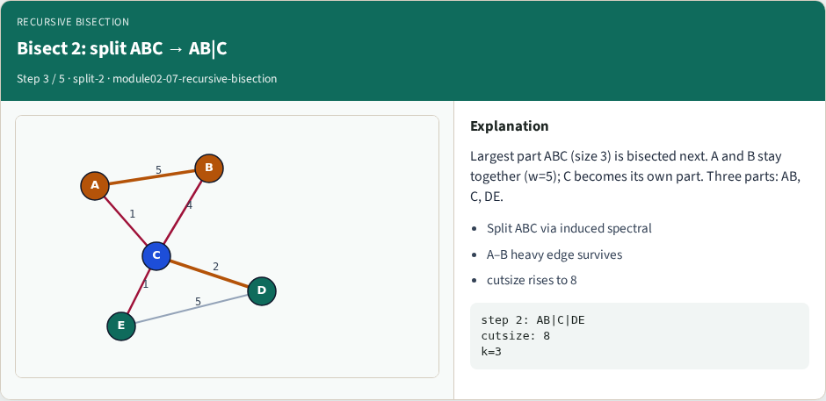
Bisect 2: split ABC → AB|C
Bisect 2: split ABC → AB|C
learn_partitioning — 07 recursive bisection
Notes:
Largest part ABC (size 3) is bisected next. A and B stay together (w=5); C becomes its own part. Three parts: AB, C, DE.

Slide 9
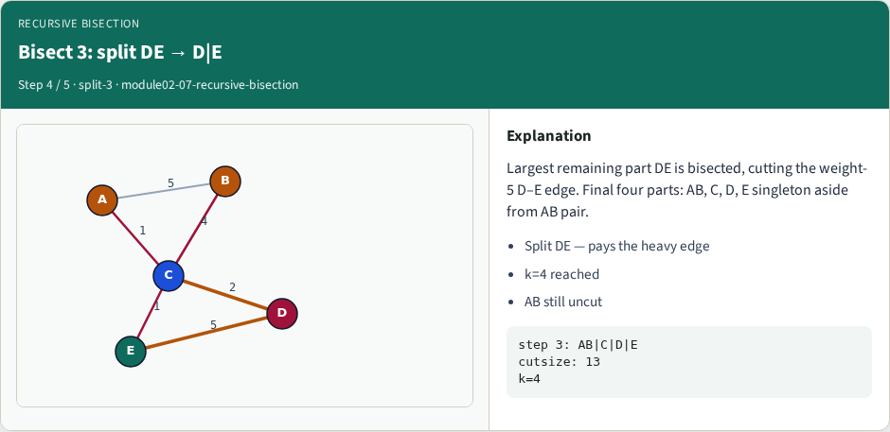
Bisect 3: split DE → D|E
Bisect 3: split DE → D|E
learn_partitioning — 07 recursive bisection
Notes:
Largest remaining part DE is bisected, cutting the weight-5 D–E edge. Final four parts: AB, C, D, E singleton aside from AB pair.

Slide 10
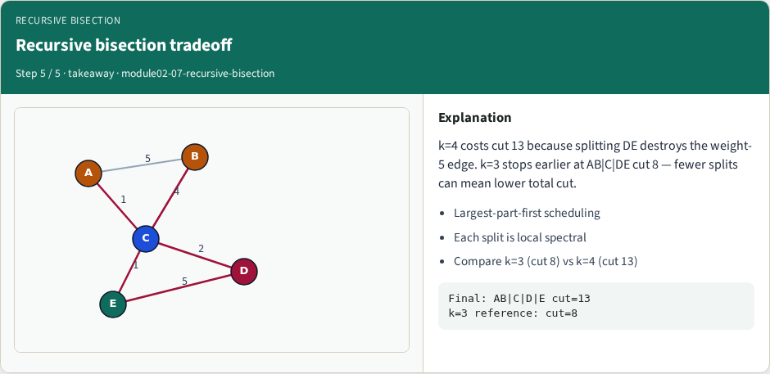
Recursive bisection tradeoff
Recursive bisection tradeoff
learn_partitioning — 07 recursive bisection
Notes:
k=4 costs cut 13 because splitting DE destroys the weight-5 edge. k=3 stops earlier at AB|C|DE cut 8 — fewer splits can mean lower total cut.

Slide 11
Browser lab track
In the browser lab track, open the recursive-bisection lab from the tools shelf
Load the starter graph, run the algorithm once
Work the challenges that lock the goldens
learn_partitioning — 07 recursive bisection
Notes:
In the browser lab track, open the **recursive-bisection** lab from the tools shelf. Load the starter graph, run the algorithm once, and read cutsize and balance in the metrics panel. Work the challenges that lock the goldens, then come back to implement the same loop yourself.

Slide 12
Implement track
In the implement track
Parse the tiny graph, run the algorithm with a deterministic seed
Match the browser goldens before you claim the checklist
learn_partitioning — 07 recursive bisection
Notes:
In the implement track, open this module's EXAMPLES.md Pseudocode section and the course common solvers. Parse the tiny graph, run the algorithm with a deterministic seed, and print the assignment plus cutsize and balance. Match the browser goldens before you claim the checklist.

Slide 13
Pitfalls
Common traps
For multilevel flows, verify coarsening before you blame the refiner
learn_partitioning — 07 recursive bisection
Notes:
Common traps: optimizing cut while ignoring balance; reporting pairwise cut when the instance is a hypergraph; flipping locked terminals; and stopping before rollback to the best KL or FM prefix. For multilevel flows, verify coarsening before you blame the refiner.

Slide 14
Your turn
Complete the checklist for at least one track, preferably both
Implement until your metrics match the starter goldens
When you’re ready, take the short quiz, then continue to the next module
learn_partitioning — 07 recursive bisection
Notes:
Complete the checklist for at least one track—preferably both. Implement until your metrics match the starter goldens. When you’re ready, take the short quiz, then continue to the next module.

