Slide 1
Multiway partitioning
Direct multiway partitioning assigns nodes to k parts without forcing a binary tree of cuts
learn_partitioning — 01 multiway partition
Notes:
Direct multiway partitioning assigns nodes to k parts without forcing a binary tree of cuts. Compare it to recursive bisection on the same graph and the same k. Round-robin or seed-based k-way starts are legal but often need refinement.

Slide 2
The idea
Multiway objectives count every edge that leaves its part
Balance becomes a k-way size vector
Teaching point
learn_partitioning — 01 multiway partition
Notes:
Multiway objectives count every edge that leaves its part. Balance becomes a k-way size vector. Teaching point: recursive and direct multiway can disagree on cut even when both look balanced.

Slide 3
Pseudocode
Multiway compares two constructors in pseudocode
Both must report the same cutsize metric
Open this module's examples file and find the Pseudocode section
That written sketch is what you implement on the implement track and what the browser
learn_partitioning — 01 multiway partition
Notes:
Multiway compares two constructors in pseudocode: recursive bisection to k, versus a naive round-robin labeling. Both must report the same cutsize metric.
Open this module's examples file and find the Pseudocode section. That written sketch is what you implement on the implement track and what the browser challenges measure.

Slide 4
Algorithm sketch
Recursive k equals three lands A B, C, and D E with cut eight
Alphabetical round-robin shreds heavy edges and scores about eighteen
learn_partitioning — 01 multiway partition
Notes:
Recursive k equals three lands A B, C, and D E with cut eight. Alphabetical round-robin shreds heavy edges and scores about eighteen.

Slide 5
Algorithm sketch — try these
INPUT: G, k
OUTPUT: k-way assignment + cutsize
method A: recursive_bisection(G,k)
method B: round-robin / block assign labels
cut ← Σ w where side[u]≠side[v]
GOLDEN k=3 recursive: AB|C|DE cut=8
round-robin alphabetic: cut≈18 (worse)
learn_partitioning — 01 multiway partition

Slide 6
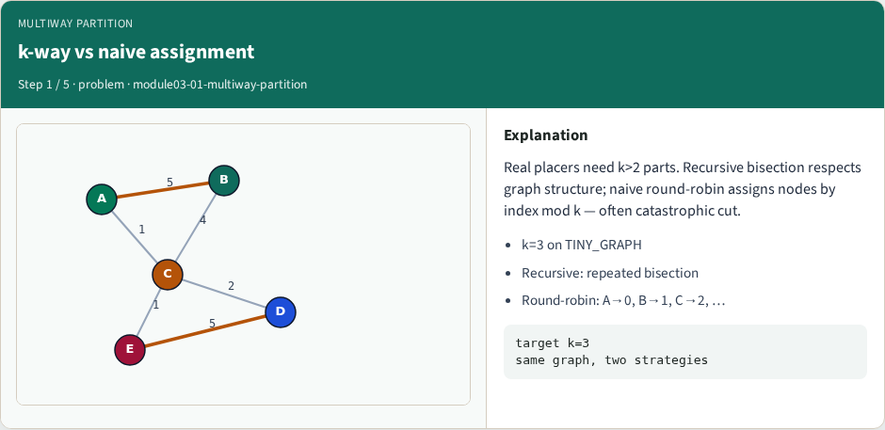
k-way vs naive assignment
k-way vs naive assignment
learn_partitioning — 01 multiway partition
Notes:
Real placers need k>2 parts. Recursive bisection respects graph structure; naive round-robin assigns nodes by index mod k — often catastrophic cut.

Slide 7
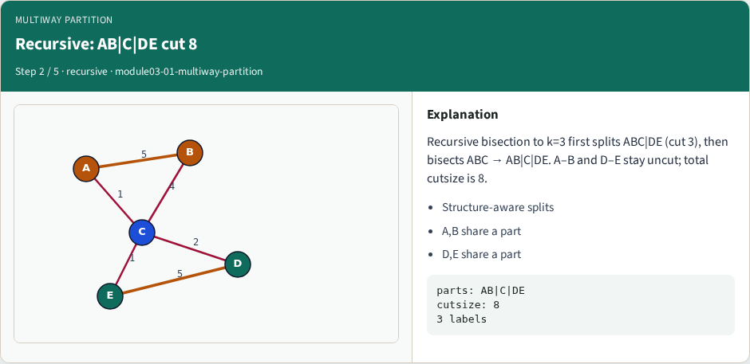
Recursive: AB|C|DE cut 8
Recursive: AB|C|DE cut 8
learn_partitioning — 01 multiway partition
Notes:
Recursive bisection to k=3 first splits ABC|DE (cut 3), then bisects ABC → AB|C|DE. A–B and D–E stay uncut; total cutsize is 8.

Slide 8
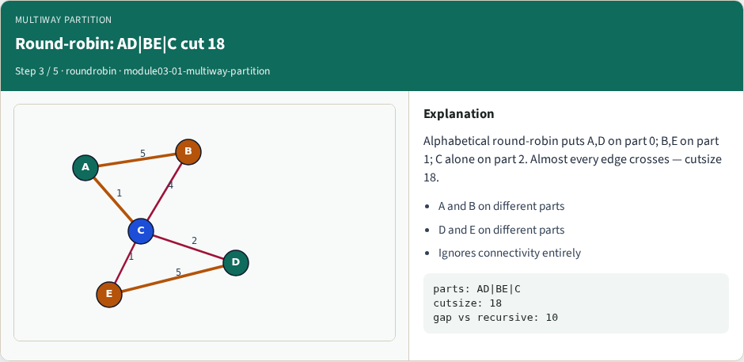
Round-robin: AD|BE|C cut 18
Round-robin: AD|BE|C cut 18
learn_partitioning — 01 multiway partition
Notes:
Alphabetical round-robin puts A,D on part 0; B,E on part 1; C alone on part 2. Almost every edge crosses — cutsize 18.

Slide 9
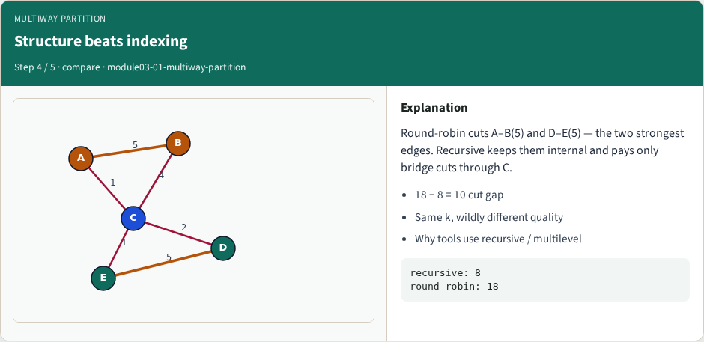
Structure beats indexing
Structure beats indexing
learn_partitioning — 01 multiway partition
Notes:
Round-robin cuts A–B(5) and D–E(5) — the two strongest edges. Recursive keeps them internal and pays only bridge cuts through C.

Slide 10
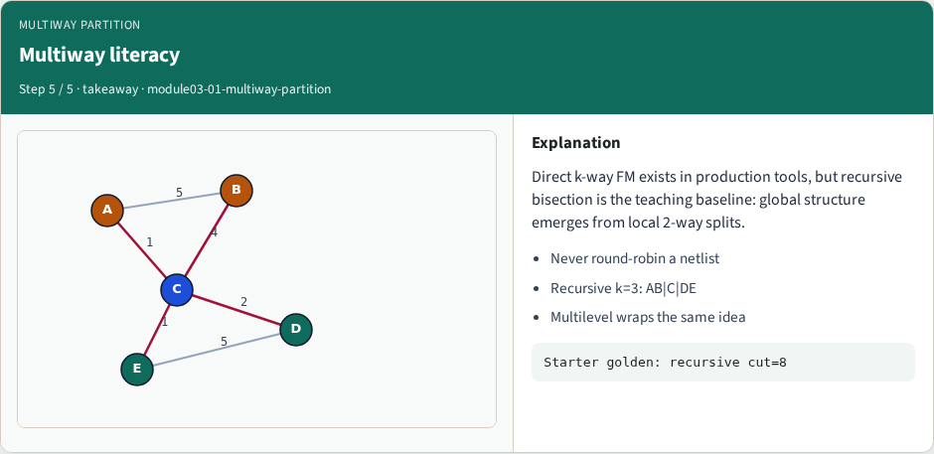
Multiway literacy
Multiway literacy
learn_partitioning — 01 multiway partition
Notes:
Direct k-way FM exists in production tools, but recursive bisection is the teaching baseline: global structure emerges from local 2-way splits.

Slide 11
Browser lab track
In the browser lab track, open the multiway-partition lab from the tools shelf
Load the starter graph, run the algorithm once
Work the challenges that lock the goldens
learn_partitioning — 01 multiway partition
Notes:
In the browser lab track, open the **multiway-partition** lab from the tools shelf. Load the starter graph, run the algorithm once, and read cutsize and balance in the metrics panel. Work the challenges that lock the goldens, then come back to implement the same loop yourself.

Slide 12
Implement track
In the implement track
Parse the tiny graph, run the algorithm with a deterministic seed
Match the browser goldens before you claim the checklist
learn_partitioning — 01 multiway partition
Notes:
In the implement track, open this module's EXAMPLES.md Pseudocode section and the course common solvers. Parse the tiny graph, run the algorithm with a deterministic seed, and print the assignment plus cutsize and balance. Match the browser goldens before you claim the checklist.

Slide 13
Pitfalls
Common traps
For multilevel flows, verify coarsening before you blame the refiner
learn_partitioning — 01 multiway partition
Notes:
Common traps: optimizing cut while ignoring balance; reporting pairwise cut when the instance is a hypergraph; flipping locked terminals; and stopping before rollback to the best KL or FM prefix. For multilevel flows, verify coarsening before you blame the refiner.

Slide 14
Your turn
Complete the checklist for at least one track, preferably both
Implement until your metrics match the starter goldens
When you’re ready, take the short quiz, then continue to the next module
learn_partitioning — 01 multiway partition
Notes:
Complete the checklist for at least one track—preferably both. Implement until your metrics match the starter goldens. When you’re ready, take the short quiz, then continue to the next module.

