Slide 1
Terminal propagation
Pads and fixed I/O pin nodes to sides before free cells move
learn_partitioning — 03 terminal propagation
Notes:
Pads and fixed I/O pin nodes to sides before free cells move. Terminal propagation carries those constraints into the partition so the cut respects the chip boundary. Pin A to one side and E to the other and watch which free nodes follow.

Slide 2
The idea
Fixed terminals never flip
Their neighbors inherit a pull toward the terminal’s part
Ignoring terminals produces pretty cuts that violate the floorplan interface
learn_partitioning — 03 terminal propagation
Notes:
Fixed terminals never flip. Their neighbors inherit a pull toward the terminal’s part. Ignoring terminals produces pretty cuts that violate the floorplan interface—illegal in real flows.

Slide 3
Pseudocode
Terminal propagation adds locked nodes to the bipartition sketch
Fixed terminals keep their sides and act as immovable anchors while free cells move
Open this module's examples file and find the Pseudocode section
That written sketch is what you implement on the implement track and what the browser
learn_partitioning — 03 terminal propagation
Notes:
Terminal propagation adds locked nodes to the bipartition sketch. Fixed terminals keep their sides and act as immovable anchors while free cells move.
Open this module's examples file and find the Pseudocode section. That written sketch is what you implement on the implement track and what the browser challenges measure.

Slide 4
Algorithm sketch
After locks are placed, run the same refiner on free cells only
Cutsize still counts every edge, including those that touch terminals
learn_partitioning — 03 terminal propagation
Notes:
After locks are placed, run the same refiner on free cells only. Cutsize still counts every edge, including those that touch terminals.

Slide 5
Algorithm sketch — try these
INPUT: G, fixed terminals T with side
OUTPUT: side for free cells
lock every t∈T at its side
partition free nodes (KL/FM/spectral)
treat T as immovable during moves
report cutsize with terminals included
GOLDEN: fixed terminals steer free cells
learn_partitioning — 03 terminal propagation

Slide 6
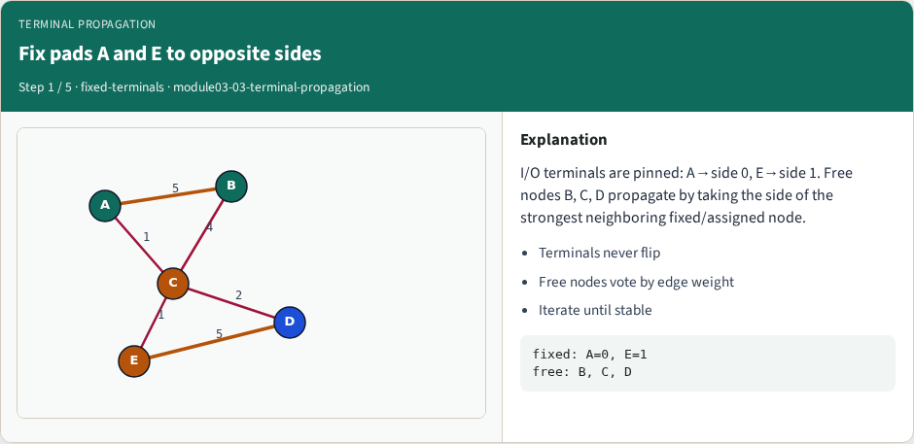
Fix pads A and E to opposite sides
Fix pads A and E to opposite sides
learn_partitioning — 03 terminal propagation
Notes:
I/O terminals are pinned: A→side 0, E→side 1. Free nodes B, C, D propagate by taking the side of the strongest neighboring fixed/assigned node.

Slide 7
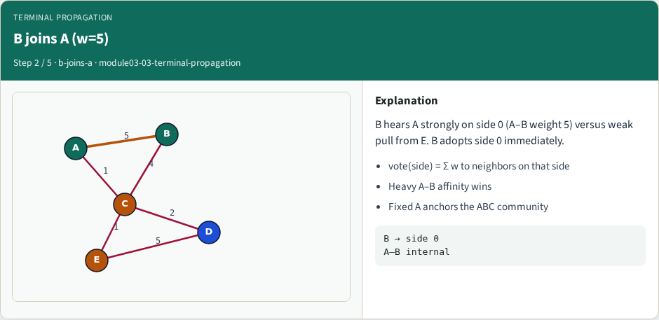
B joins A (w=5)
B joins A (w=5)
learn_partitioning — 03 terminal propagation
Notes:
B hears A strongly on side 0 (A–B weight 5) versus weak pull from E. B adopts side 0 immediately.

Slide 8
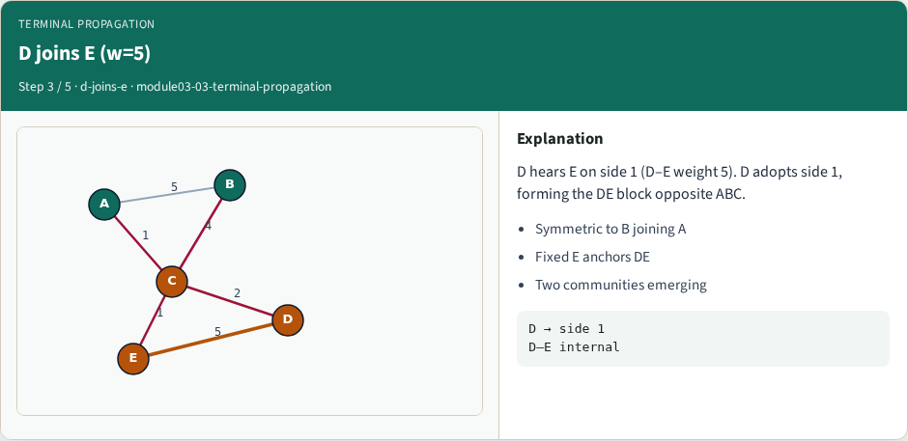
D joins E (w=5)
D joins E (w=5)
learn_partitioning — 03 terminal propagation
Notes:
D hears E on side 1 (D–E weight 5). D adopts side 1, forming the DE block opposite ABC.

Slide 9
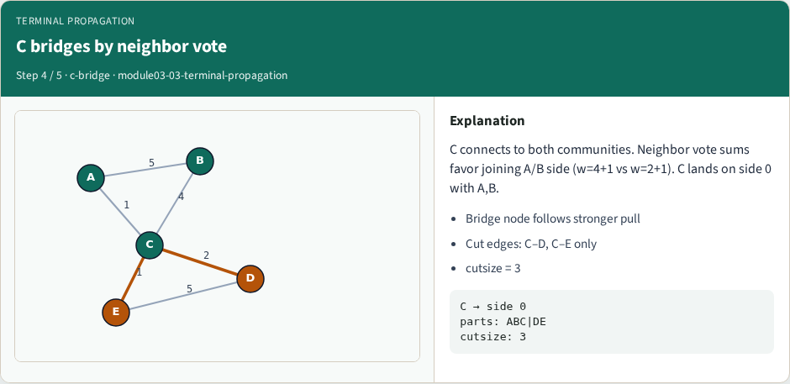
C bridges by neighbor vote
C bridges by neighbor vote
learn_partitioning — 03 terminal propagation
Notes:
C connects to both communities. Neighbor vote sums favor joining A/B side (w=4+1 vs w=2+1). C lands on side 0 with A,B.

Slide 10
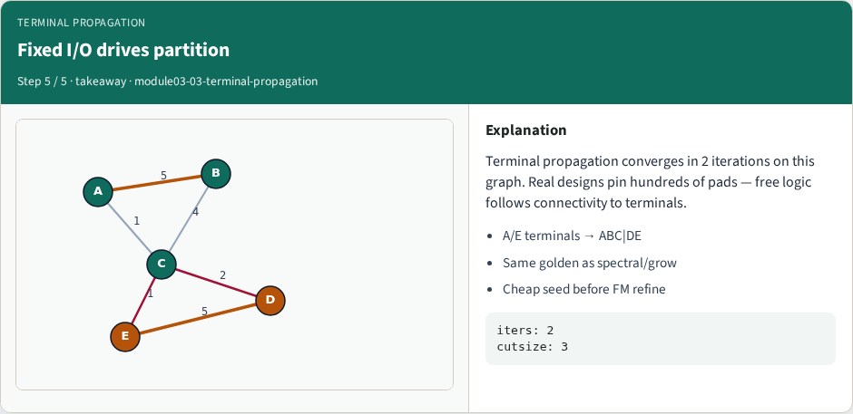
Fixed I/O drives partition
Fixed I/O drives partition
learn_partitioning — 03 terminal propagation
Notes:
Terminal propagation converges in 2 iterations on this graph. Real designs pin hundreds of pads — free logic follows connectivity to terminals.

Slide 11
Browser lab track
In the browser lab track, open the terminal-propagation lab from the tools shelf
Load the starter graph, run the algorithm once
Work the challenges that lock the goldens
learn_partitioning — 03 terminal propagation
Notes:
In the browser lab track, open the **terminal-propagation** lab from the tools shelf. Load the starter graph, run the algorithm once, and read cutsize and balance in the metrics panel. Work the challenges that lock the goldens, then come back to implement the same loop yourself.

Slide 12
Implement track
In the implement track
Parse the tiny graph, run the algorithm with a deterministic seed
Match the browser goldens before you claim the checklist
learn_partitioning — 03 terminal propagation
Notes:
In the implement track, open this module's EXAMPLES.md Pseudocode section and the course common solvers. Parse the tiny graph, run the algorithm with a deterministic seed, and print the assignment plus cutsize and balance. Match the browser goldens before you claim the checklist.

Slide 13
Pitfalls
Common traps
For multilevel flows, verify coarsening before you blame the refiner
learn_partitioning — 03 terminal propagation
Notes:
Common traps: optimizing cut while ignoring balance; reporting pairwise cut when the instance is a hypergraph; flipping locked terminals; and stopping before rollback to the best KL or FM prefix. For multilevel flows, verify coarsening before you blame the refiner.

Slide 14
Your turn
Complete the checklist for at least one track, preferably both
Implement until your metrics match the starter goldens
When you’re ready, take the short quiz, then continue to the next module
learn_partitioning — 03 terminal propagation
Notes:
Complete the checklist for at least one track—preferably both. Implement until your metrics match the starter goldens. When you’re ready, take the short quiz, then continue to the next module.

