Slide 1
Multilevel partitioning
A multilevel V-cycle coarsens the graph, partitions the tiny problem, projects the assignment back
learn_partitioning — 01 multilevel partition
Notes:
A multilevel V-cycle coarsens the graph, partitions the tiny problem, projects the assignment back, and refines at each finer level. You will walk coarsen, initial partition, project, and refine on the same starter instance.

Slide 2
The idea
Coarsening shrinks the search space
The coarse partition is cheap
Projection gives a feasible fine assignment that FM or KL can polish
A bug in coarsening poisons every finer level
learn_partitioning — 01 multilevel partition
Notes:
Coarsening shrinks the search space. The coarse partition is cheap. Projection gives a feasible fine assignment that FM or KL can polish. A bug in coarsening poisons every finer level—debug the hierarchy before tuning refine passes.

Slide 3
Pseudocode
Multilevel is a V-cycle in pseudocode
Open this module's examples file and find the Pseudocode section
That written sketch is what you implement on the implement track and what the browser
learn_partitioning — 01 multilevel partition
Notes:
Multilevel is a V-cycle in pseudocode: coarsen, partition the tiny graph, project labels upward, and refine at each level.
Open this module's examples file and find the Pseudocode section. That written sketch is what you implement on the implement track and what the browser challenges measure.

Slide 4
Algorithm sketch
On TINY_GRAPH the projected seed is already ABC versus DE at cut three
Refine keeps that cut, multilevel beats polishing the cut-twelve bad seed alone
learn_partitioning — 01 multilevel partition
Notes:
On TINY_GRAPH the projected seed is already ABC versus DE at cut three. Refine keeps that cut—multilevel beats polishing the cut-twelve bad seed alone.

Slide 5
Algorithm sketch — try these
INPUT: G, coarsen until tiny
OUTPUT: fine side[]
coarsen: match/cluster heavy edges
partition coarse (spectral/KL/FM)
project labels to finer level
refine with FM/KL at each uncoarsen
GOLDEN project ABC|DE cut=3; refine keeps 3
learn_partitioning — 01 multilevel partition

Slide 6
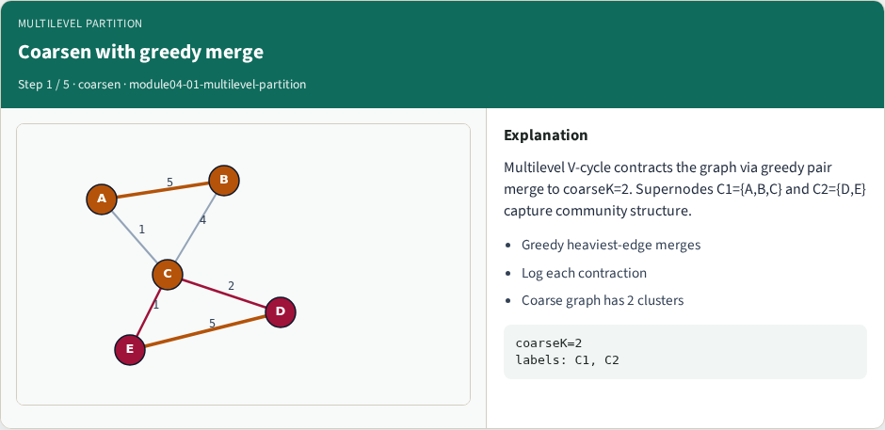
Coarsen with greedy merge
Coarsen with greedy merge
learn_partitioning — 01 multilevel partition
Notes:
Multilevel V-cycle contracts the graph via greedy pair merge to coarseK=2. Supernodes C1={A,B,C} and C2={D,E} capture community structure.

Slide 7
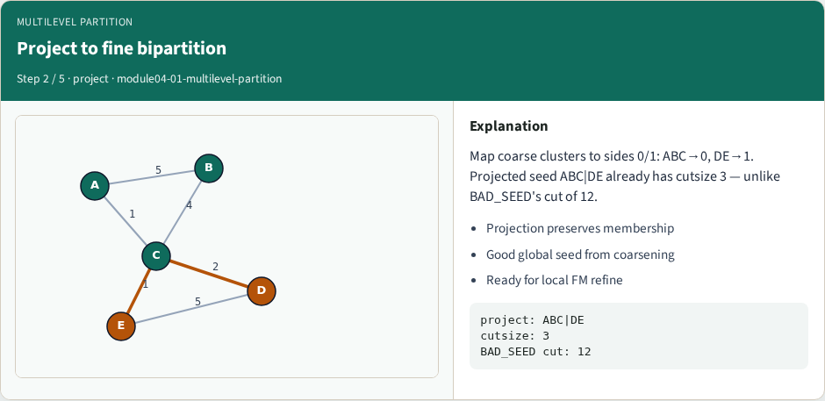
Project to fine bipartition
Project to fine bipartition
learn_partitioning — 01 multilevel partition
Notes:
Map coarse clusters to sides 0/1: ABC→0, DE→1. Projected seed ABC|DE already has cutsize 3 — unlike BAD_SEED's cut of 12.

Slide 8
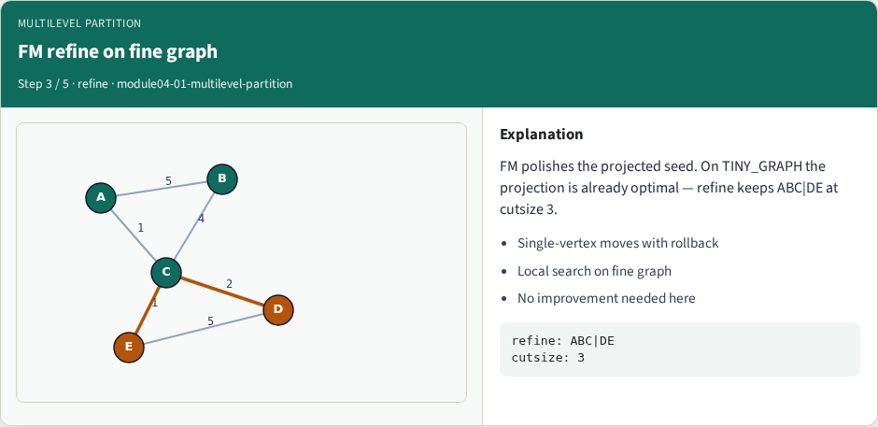
FM refine on fine graph
FM refine on fine graph
learn_partitioning — 01 multilevel partition
Notes:
FM polishes the projected seed. On TINY_GRAPH the projection is already optimal — refine keeps ABC|DE at cutsize 3.

Slide 9
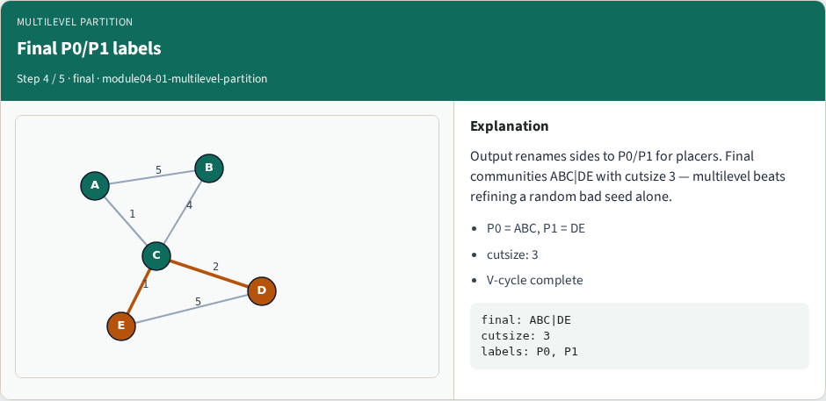
Final P0/P1 labels
Final P0/P1 labels
learn_partitioning — 01 multilevel partition
Notes:
Output renames sides to P0/P1 for placers. Final communities ABC|DE with cutsize 3 — multilevel beats refining a random bad seed alone.

Slide 10
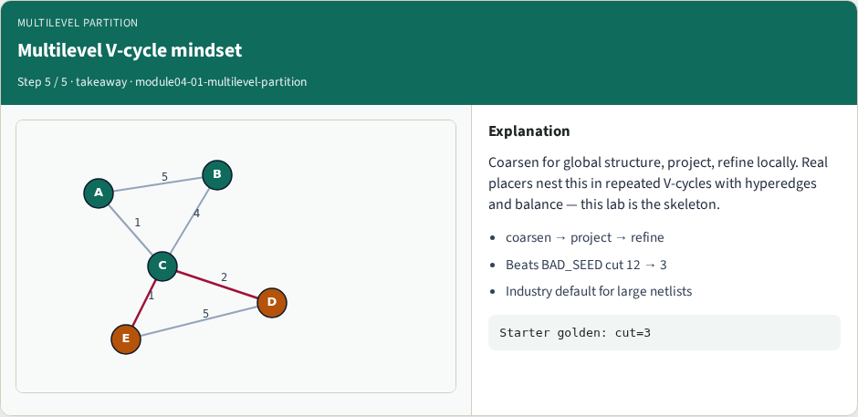
Multilevel V-cycle mindset
Multilevel V-cycle mindset
learn_partitioning — 01 multilevel partition
Notes:
Coarsen for global structure, project, refine locally. Real placers nest this in repeated V-cycles with hyperedges and balance — this lab is the skeleton.

Slide 11
Browser lab track
In the browser lab track, open the multilevel-partition lab from the tools shelf
Load the starter graph, run the algorithm once
Work the challenges that lock the goldens
learn_partitioning — 01 multilevel partition
Notes:
In the browser lab track, open the **multilevel-partition** lab from the tools shelf. Load the starter graph, run the algorithm once, and read cutsize and balance in the metrics panel. Work the challenges that lock the goldens, then come back to implement the same loop yourself.

Slide 12
Implement track
In the implement track
Parse the tiny graph, run the algorithm with a deterministic seed
Match the browser goldens before you claim the checklist
learn_partitioning — 01 multilevel partition
Notes:
In the implement track, open this module's EXAMPLES.md Pseudocode section and the course common solvers. Parse the tiny graph, run the algorithm with a deterministic seed, and print the assignment plus cutsize and balance. Match the browser goldens before you claim the checklist.

Slide 13
Pitfalls
Common traps
For multilevel flows, verify coarsening before you blame the refiner
learn_partitioning — 01 multilevel partition
Notes:
Common traps: optimizing cut while ignoring balance; reporting pairwise cut when the instance is a hypergraph; flipping locked terminals; and stopping before rollback to the best KL or FM prefix. For multilevel flows, verify coarsening before you blame the refiner.

Slide 14
Your turn
Complete the checklist for at least one track, preferably both
Implement until your metrics match the starter goldens
When you’re ready, take the short quiz, then continue to the next module
learn_partitioning — 01 multilevel partition
Notes:
Complete the checklist for at least one track—preferably both. Implement until your metrics match the starter goldens. When you’re ready, take the short quiz, then continue to the next module.

