Slide 1
Timing graph
Static timing starts with a directed timing graph
learn_sta — 01 timing graph
Notes:
Static timing starts with a directed timing graph. On our tiny chain, six pins and five arcs carry you from in through two cells to out. You will levelize the graph, name sources and sinks, and prove that a back-edge out to in makes levelize fail.

Slide 2
Goldens to remember
Goldens: six pins, five arcs, levels zero through five, path delay three point two
A cycle returns no levels
Keep these numbers handy, the browser challenges and Track A tests use the same instance
learn_sta — 01 timing graph
Notes:
Goldens: six pins, five arcs, levels zero through five, path delay three point two. A cycle returns no levels. Keep these numbers handy—the browser challenges and Track A tests use the same instance.

Slide 3
Pseudocode
Pseudocode for this lab is Kahn levelize on a pin and arc timing graph
Inputs are pins and delayed arcs
The loop peels indegree-zero pins and writes levels
Stop with failure if a cycle leaves pins unvisited
Open this module's examples file and find the Pseudocode section
That written sketch is what you implement on the implement track and what the browser
learn_sta — 01 timing graph
Notes:
Pseudocode for this lab is Kahn levelize on a pin and arc timing graph. Inputs are pins and delayed arcs. The loop peels indegree-zero pins and writes levels. Stop with failure if a cycle leaves pins unvisited.
Open this module's examples file and find the Pseudocode section. That written sketch is what you implement on the implement track and what the browser challenges measure.

Slide 4
Algorithm sketch
On the tiny chain the sketch returns levels zero through five with out at five
Six pins and five arcs are the shared instance
Adding out to in makes levelize fail, that is the cycle golden
learn_sta — 01 timing graph
Notes:
On the tiny chain the sketch returns levels zero through five with out at five. Six pins and five arcs are the shared instance. Adding out to in makes levelize fail—that is the cycle golden.

Slide 5
Algorithm sketch — try these
INPUT: pins, arcs (delay, kind cell|net)
OUTPUT: levels[] or FAIL(cycle)
indeg[v]←|preds|; Q←{v|indeg=0}; level[Q]=0
while Q:
u←pop; for v in succ(u):
indeg[v]−=1; level[v]←max(level[v],level[u]+1)
if indeg[v]=0: push v
FAIL if not all visited else return levels
GOLDEN: 6 pins, 5 arcs; in:0 … out:5
learn_sta — 01 timing graph

Slide 6
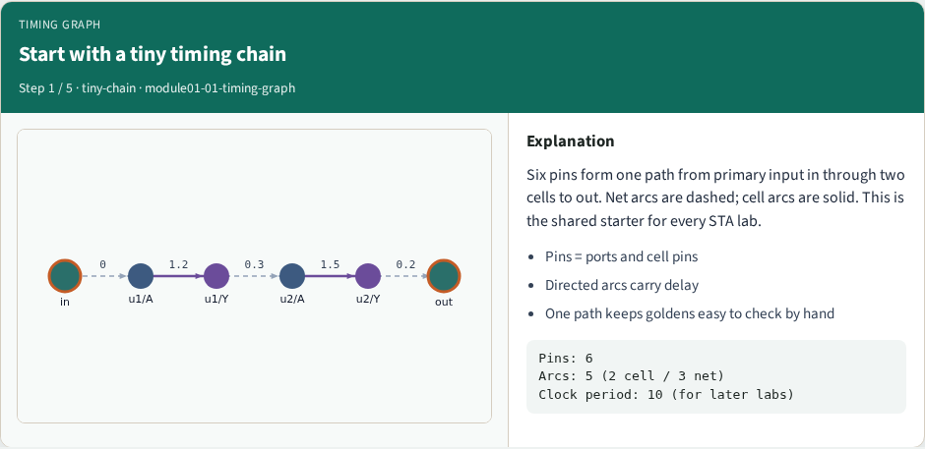
Start with a tiny timing chain
Start with a tiny timing chain
learn_sta — 01 timing graph
Notes:
Six pins form one path from primary input in through two cells to out. Net arcs are dashed; cell arcs are solid. This is the shared starter for every STA lab.

Slide 7
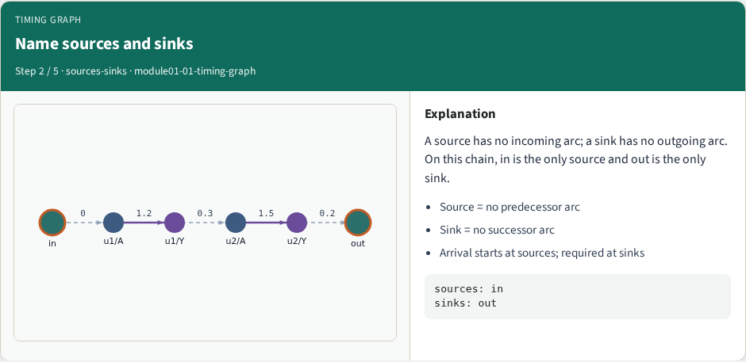
Name sources and sinks
Name sources and sinks
learn_sta — 01 timing graph
Notes:
A source has no incoming arc; a sink has no outgoing arc. On this chain, in is the only source and out is the only sink.

Slide 8
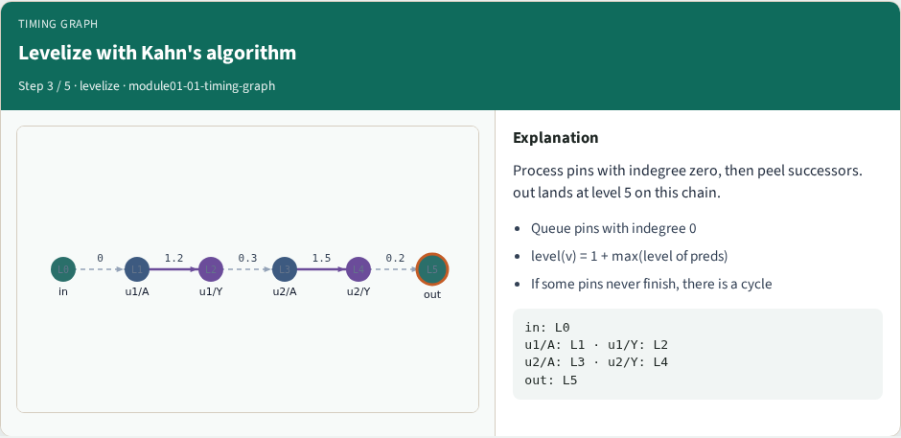
Levelize with Kahn's algorithm
Levelize with Kahn's algorithm
learn_sta — 01 timing graph
Notes:
Process pins with indegree zero, then peel successors. out lands at level 5 on this chain.

Slide 9
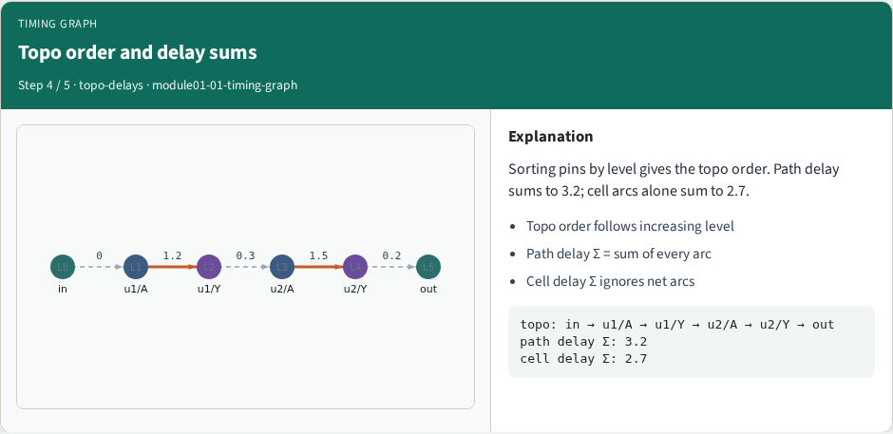
Topo order and delay sums
Topo order and delay sums
learn_sta — 01 timing graph
Notes:
Sorting pins by level gives the topo order. Path delay sums to 3.2; cell arcs alone sum to 2.7.

Slide 10
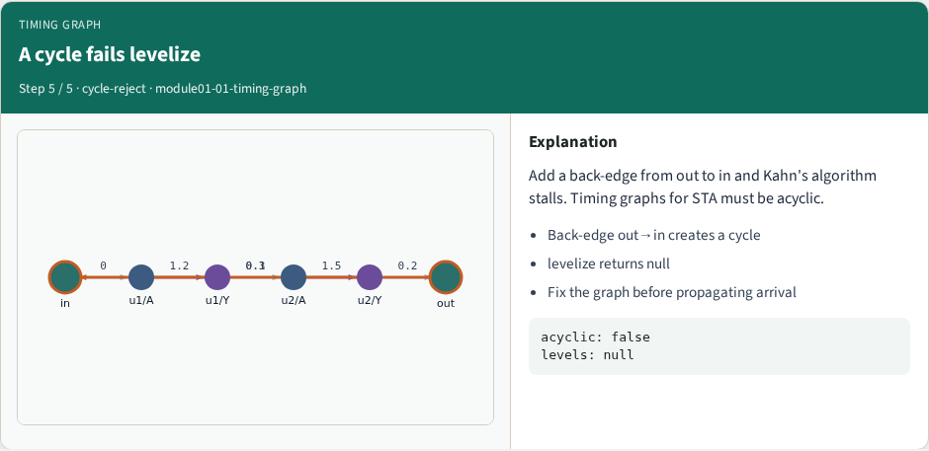
A cycle fails levelize
A cycle fails levelize
learn_sta — 01 timing graph
Notes:
Add a back-edge from out to in and Kahn's algorithm stalls. Timing graphs for STA must be acyclic.

Slide 11
Browser lab track
In the browser lab, open timing-graph
Load the starter, run the analysis once, and read the metrics panel
Orient yourself, challenge panel, canvas, Check, then mirror the same goldens in code
learn_sta — 01 timing graph
Notes:
In the browser lab, open **timing-graph**. Load the starter, run the analysis once, and read the metrics panel. Orient yourself—challenge panel, canvas, Check—then mirror the same goldens in code.

Slide 12
Implement track
In the implement track
Run `python3 common/test_propagate.py` (and the timing-graph test) until the goldens print
learn_sta — 01 timing graph
Notes:
In the implement track, use `common/tiny_timing.json` with the helpers in `common/graph.py` and `common/propagate.py`. Run `python3 common/test_propagate.py` (and the timing-graph test) until the goldens print ok.

Slide 13
Pitfall
Do not mix setup and hold required maps
Do not propagate before the graph is levelized
After an edit or exception, recompute, stale tags lie
learn_sta — 01 timing graph
Notes:
Do not mix setup and hold required maps. Do not propagate before the graph is levelized. After an edit or exception, recompute—stale tags lie.

Slide 14
Your turn
Finish the checklist on at least one track, preferably both
When your numbers match the goldens, take the quiz, then continue
learn_sta — 01 timing graph
Notes:
Finish the checklist on at least one track—preferably both. When your numbers match the goldens, take the quiz, then continue.

