Slide 1
Arrival and required times
Once the graph is levelized, you propagate tags
learn_sta — 03 arrival required
Notes:
Once the graph is levelized, you propagate tags. Arrival moves forward from sources; required moves backward from sinks. You will compute A(out)=3.2 and R(out)=10 on the starter chain with period ten.

Slide 2
Goldens to remember
Forward: A(in)=0, A(u1/Y)=1.2, A(out)=3.2
Backward setup: R(out)=10, R(in)=6.8
Keep these numbers handy, the browser challenges and Track A tests use the same instance
learn_sta — 03 arrival required
Notes:
Forward: A(in)=0, A(u1/Y)=1.2, A(out)=3.2. Backward setup: R(out)=10, R(in)=6.8. Keep these numbers handy—the browser challenges and Track A tests use the same instance.

Slide 3
Pseudocode
Arrival and required need two written passes
Forward topo takes a max over predecessors for arrival
Reverse topo takes a min over successors for setup required from the period at sinks
Open this module's examples file and find the Pseudocode section
That written sketch is what you implement on the implement track and what the browser
learn_sta — 03 arrival required
Notes:
Arrival and required need two written passes. Forward topo takes a max over predecessors for arrival. Reverse topo takes a min over successors for setup required from the period at sinks.
Open this module's examples file and find the Pseudocode section. That written sketch is what you implement on the implement track and what the browser challenges measure.

Slide 4
Algorithm sketch
Goldens on the chain
Arrival is latest; required is earliest
learn_sta — 03 arrival required
Notes:
Goldens on the chain: arrival at out is three point two, required at out is ten, and required at in is six point eight. Arrival is latest; required is earliest.

Slide 5
Algorithm sketch — try these
INPUT: DAG G, period, arrival seeds
OUTPUT: A[], R_setup[]
for p in topo(G):
A[p]← max over u→p of A[u]+delay (sources: seed/0)
for sinks: R[p]←period×cycles
for p in reverse_topo:
R[p]← min over p→v of R[v]−delay
GOLDEN: A[out]=3.2; R[out]=10; R[in]=6.8
learn_sta — 03 arrival required

Slide 6
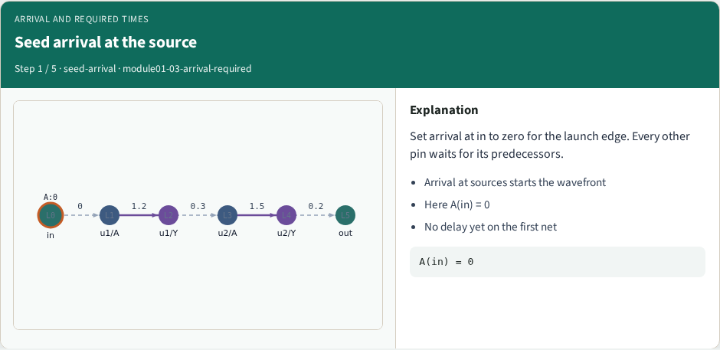
Seed arrival at the source
Seed arrival at the source
learn_sta — 03 arrival required
Notes:
Set arrival at in to zero for the launch edge. Every other pin waits for its predecessors.

Slide 7
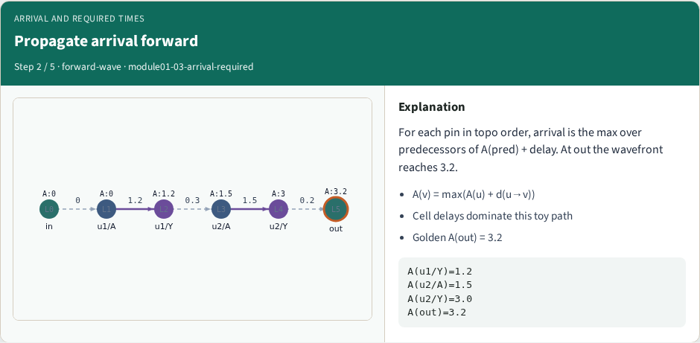
Propagate arrival forward
Propagate arrival forward
learn_sta — 03 arrival required
Notes:
For each pin in topo order, arrival is the max over predecessors of A(pred) + delay. At out the wavefront reaches 3.2.

Slide 8
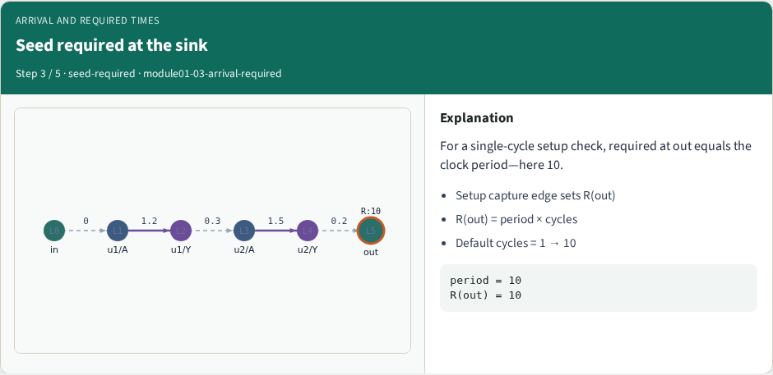
Seed required at the sink
Seed required at the sink
learn_sta — 03 arrival required
Notes:
For a single-cycle setup check, required at out equals the clock period—here 10.

Slide 9
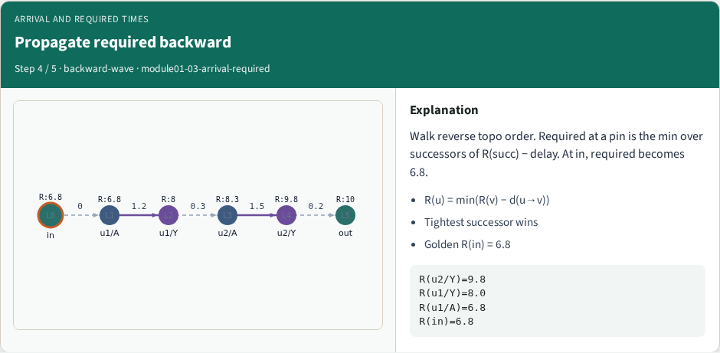
Propagate required backward
Propagate required backward
learn_sta — 03 arrival required
Notes:
Walk reverse topo order. Required at a pin is the min over successors of R(succ) − delay. At in, required becomes 6.8.

Slide 10
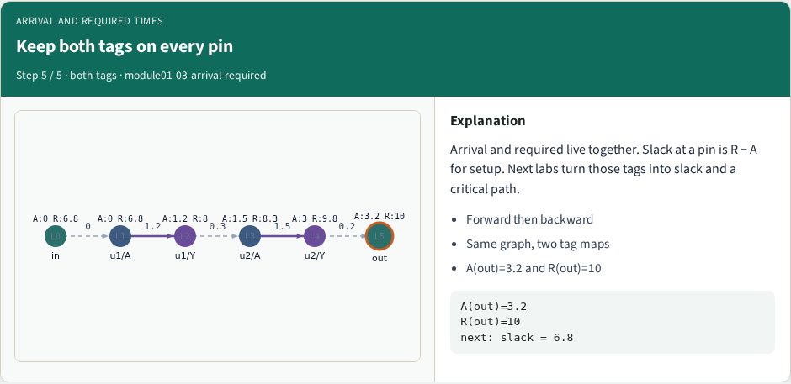
Keep both tags on every pin
Keep both tags on every pin
learn_sta — 03 arrival required
Notes:
Arrival and required live together. Slack at a pin is R − A for setup. Next labs turn those tags into slack and a critical path.

Slide 11
Browser lab track
In the browser lab, open arrival-required
Load the starter, run the analysis once, and read the metrics panel
Orient yourself, challenge panel, canvas, Check, then mirror the same goldens in code
learn_sta — 03 arrival required
Notes:
In the browser lab, open **arrival-required**. Load the starter, run the analysis once, and read the metrics panel. Orient yourself—challenge panel, canvas, Check—then mirror the same goldens in code.

Slide 12
Implement track
In the implement track
Run `python3 common/test_propagate.py` (and the timing-graph test) until the goldens print
learn_sta — 03 arrival required
Notes:
In the implement track, use `common/tiny_timing.json` with the helpers in `common/graph.py` and `common/propagate.py`. Run `python3 common/test_propagate.py` (and the timing-graph test) until the goldens print ok.

Slide 13
Pitfall
Do not mix setup and hold required maps
Do not propagate before the graph is levelized
After an edit or exception, recompute, stale tags lie
learn_sta — 03 arrival required
Notes:
Do not mix setup and hold required maps. Do not propagate before the graph is levelized. After an edit or exception, recompute—stale tags lie.

Slide 14
Your turn
Finish the checklist on at least one track, preferably both
When your numbers match the goldens, take the quiz, then continue
learn_sta — 03 arrival required
Notes:
Finish the checklist on at least one track—preferably both. When your numbers match the goldens, take the quiz, then continue.

