Slide 1
Slack, setup, and hold
Slack turns tags into a pass or fail
learn_sta — 01 slack setup hold
Notes:
Slack turns tags into a pass or fail. Setup slack is required minus arrival; hold uses a different required. You will get setup slack six point eight and hold slack three point two at out on the lite model.

Slide 2
Goldens to remember
Setup: R−A = 10−3.2 = 6.8
Hold lite: A−0 = 3.2
Positive means the check passes
Keep these numbers handy, the browser challenges and Track A tests use the same instance
learn_sta — 01 slack setup hold
Notes:
Setup: R−A = 10−3.2 = 6.8. Hold lite: A−0 = 3.2. Positive means the check passes. Keep these numbers handy—the browser challenges and Track A tests use the same instance.

Slide 3
Pseudocode
Slack pseudocode is arithmetic on tags you already have
Setup slack is required minus arrival
Hold lite uses required hold zero at the sink and arrival minus that required
Open this module's examples file and find the Pseudocode section
That written sketch is what you implement on the implement track and what the browser
learn_sta — 01 slack setup hold
Notes:
Slack pseudocode is arithmetic on tags you already have. Setup slack is required minus arrival. Hold lite uses required hold zero at the sink and arrival minus that required.
Open this module's examples file and find the Pseudocode section. That written sketch is what you implement on the implement track and what the browser challenges measure.

Slide 4
Algorithm sketch
On the tiny chain with period ten
Shrink the period to three and setup fails first
learn_sta — 01 slack setup hold
Notes:
On the tiny chain with period ten, setup slack at out is six point eight and hold slack is three point two. Shrink the period to three and setup fails first.

Slide 5
Algorithm sketch — try these
INPUT: A[], R_setup[], R_hold[] (lite)
OUTPUT: setup_slack, hold_slack, meet?
setup_slack(p) ← R_setup[p] − A[p]
hold_slack(p) ← A[p] − R_hold[p]
R_hold[sink] ← 0 in this lite model
meet_setup if setup_slack(sink)≥0
meet_hold if hold_slack(sink)≥0
GOLDEN: setup(out)=6.8; hold(out)=3.2
learn_sta — 01 slack setup hold

Slide 6
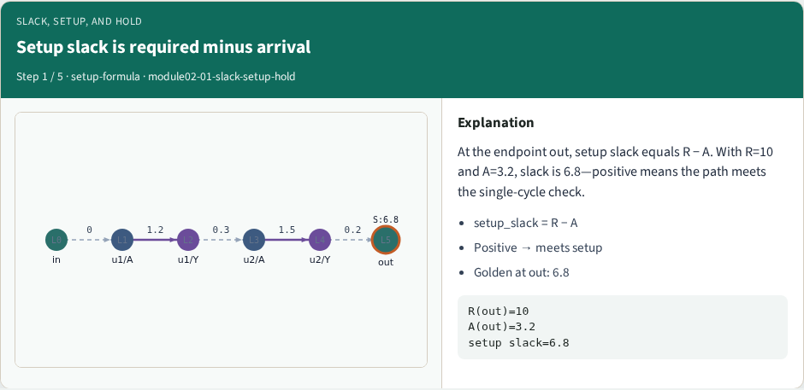
Setup slack is required minus arrival
Setup slack is required minus arrival
learn_sta — 01 slack setup hold
Notes:
At the endpoint out, setup slack equals R − A. With R=10 and A=3.2, slack is 6.8—positive means the path meets the single-cycle check.

Slide 7
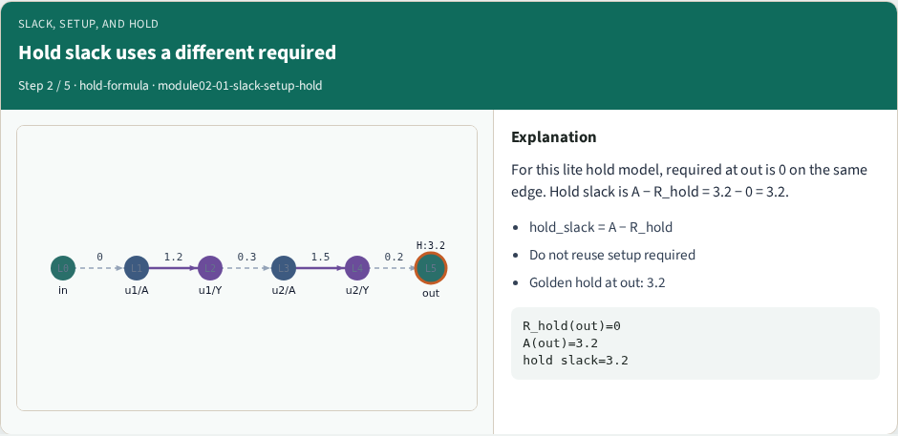
Hold slack uses a different required
Hold slack uses a different required
learn_sta — 01 slack setup hold
Notes:
For this lite hold model, required at out is 0 on the same edge. Hold slack is A − R_hold = 3.2 − 0 = 3.2.

Slide 8
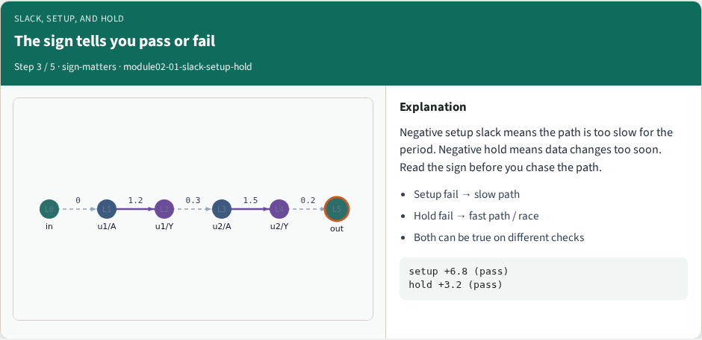
The sign tells you pass or fail
The sign tells you pass or fail
learn_sta — 01 slack setup hold
Notes:
Negative setup slack means the path is too slow for the period. Negative hold means data changes too soon. Read the sign before you chase the path.

Slide 9
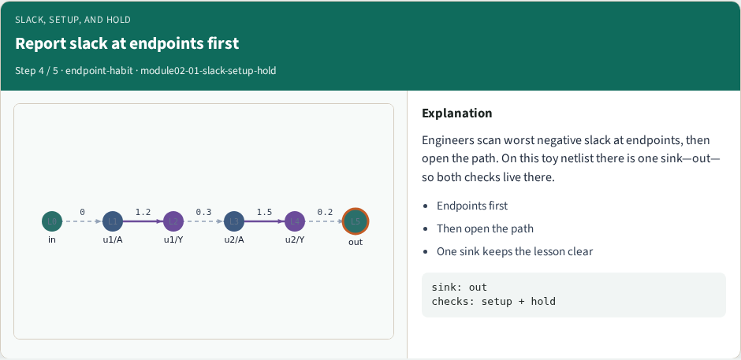
Report slack at endpoints first
Report slack at endpoints first
learn_sta — 01 slack setup hold
Notes:
Engineers scan worst negative slack at endpoints, then open the path. On this toy netlist there is one sink—out—so both checks live there.

Slide 10
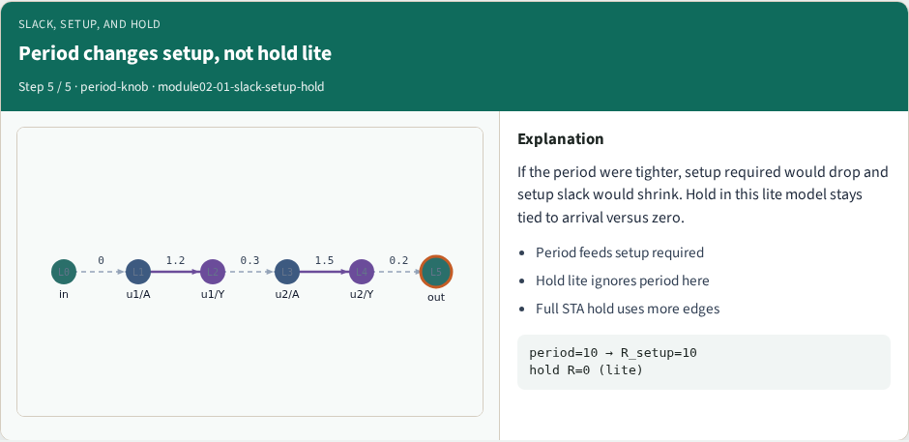
Period changes setup, not hold lite
Period changes setup, not hold lite
learn_sta — 01 slack setup hold
Notes:
If the period were tighter, setup required would drop and setup slack would shrink. Hold in this lite model stays tied to arrival versus zero.

Slide 11
Browser lab track
In the browser lab, open slack-setup-hold
Load the starter, run the analysis once, and read the metrics panel
Orient yourself, challenge panel, canvas, Check, then mirror the same goldens in code
learn_sta — 01 slack setup hold
Notes:
In the browser lab, open **slack-setup-hold**. Load the starter, run the analysis once, and read the metrics panel. Orient yourself—challenge panel, canvas, Check—then mirror the same goldens in code.

Slide 12
Implement track
In the implement track
Run `python3 common/test_propagate.py` (and the timing-graph test) until the goldens print
learn_sta — 01 slack setup hold
Notes:
In the implement track, use `common/tiny_timing.json` with the helpers in `common/graph.py` and `common/propagate.py`. Run `python3 common/test_propagate.py` (and the timing-graph test) until the goldens print ok.

Slide 13
Pitfall
Do not mix setup and hold required maps
Do not propagate before the graph is levelized
After an edit or exception, recompute, stale tags lie
learn_sta — 01 slack setup hold
Notes:
Do not mix setup and hold required maps. Do not propagate before the graph is levelized. After an edit or exception, recompute—stale tags lie.

Slide 14
Your turn
Finish the checklist on at least one track, preferably both
When your numbers match the goldens, take the quiz, then continue
learn_sta — 01 slack setup hold
Notes:
Finish the checklist on at least one track—preferably both. When your numbers match the goldens, take the quiz, then continue.

