Slide 1
Critical path
When slack is bad, or even when it is good, you still need the path
learn_sta — 03 critical path
Notes:
When slack is bad—or even when it is good—you still need the path. Trace from the worst endpoint through matching arrival tags. You will recover the golden path in → u1/A → u1/Y → u2/A → u2/Y → out.

Slide 2
Goldens to remember
Critical path has six pins
Path delay equals A(out)=3.2
Always match A(u)+d to A(v)
Keep these numbers handy, the browser challenges and Track A tests use the same instance
learn_sta — 03 critical path
Notes:
Critical path has six pins. Path delay equals A(out)=3.2. Always match A(u)+d to A(v). Keep these numbers handy—the browser challenges and Track A tests use the same instance.

Slide 3
Pseudocode
Critical path pseudocode walks backward from the sink
Breaking ties toward larger arrival
Open this module's examples file and find the Pseudocode section
That written sketch is what you implement on the implement track and what the browser
learn_sta — 03 critical path
Notes:
Critical path pseudocode walks backward from the sink. At each pin pick a predecessor arc whose arrival plus delay exactly rebuilds the pin’s arrival, breaking ties toward larger arrival.
Open this module's examples file and find the Pseudocode section. That written sketch is what you implement on the implement track and what the browser challenges measure.

Slide 4
Algorithm sketch
The golden path is six pins from in through both cells to out
Path delay must equal arrival at out, three point two on this instance
learn_sta — 03 critical path
Notes:
The golden path is six pins from in through both cells to out. Path delay must equal arrival at out—three point two on this instance.

Slide 5
Algorithm sketch — try these
INPUT: G, A[], sink
OUTPUT: pin path (source→…→sink)
path←[sink]; cur←sink
while cur has preds:
pick u→cur with A[u]+delay == A[cur]
(tie-break: largest A[u])
prepend u; cur←u
return path
GOLDEN: in→u1/A→u1/Y→u2/A→u2/Y→out
learn_sta — 03 critical path

Slide 6
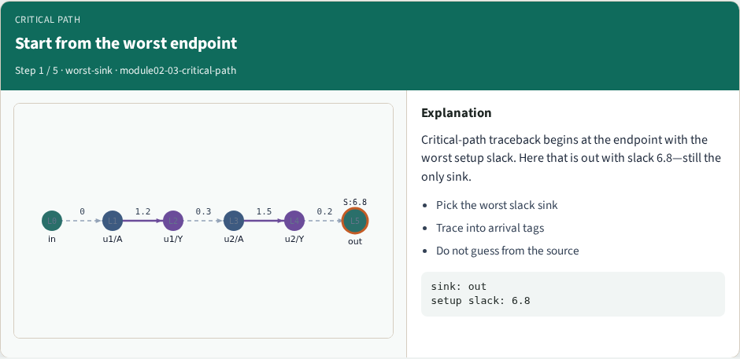
Start from the worst endpoint
Start from the worst endpoint
learn_sta — 03 critical path
Notes:
Critical-path traceback begins at the endpoint with the worst setup slack. Here that is out with slack 6.8—still the only sink.

Slide 7
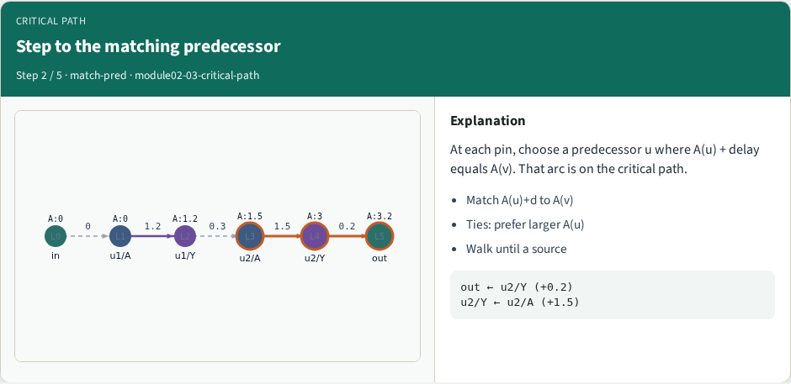
Step to the matching predecessor
Step to the matching predecessor
learn_sta — 03 critical path
Notes:
At each pin, choose a predecessor u where A(u) + delay equals A(v). That arc is on the critical path.

Slide 8
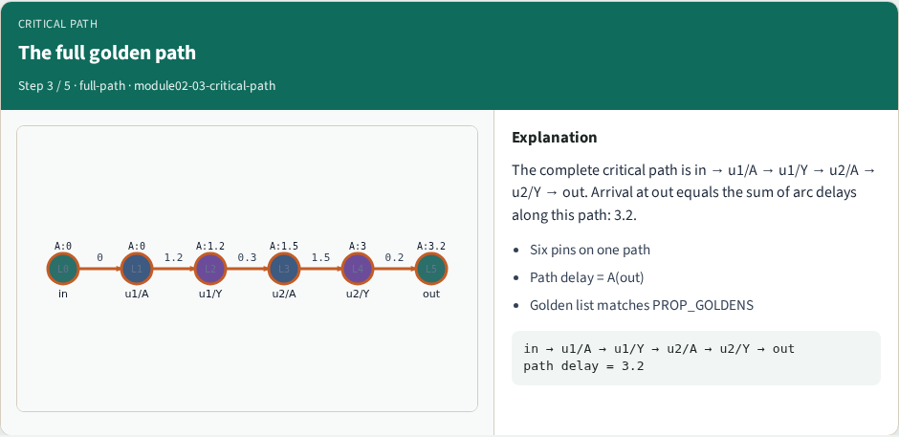
The full golden path
The full golden path
learn_sta — 03 critical path
Notes:
The complete critical path is in → u1/A → u1/Y → u2/A → u2/Y → out. Arrival at out equals the sum of arc delays along this path: 3.2.

Slide 9
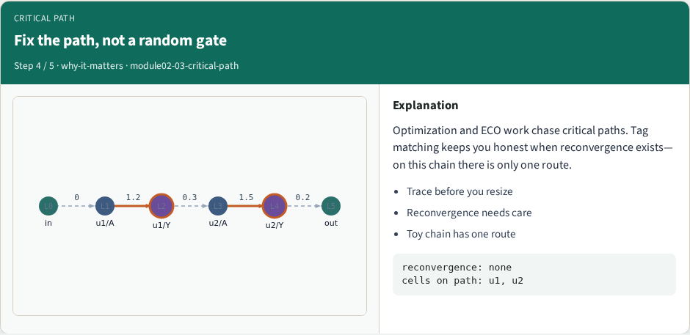
Fix the path, not a random gate
Fix the path, not a random gate
learn_sta — 03 critical path
Notes:
Optimization and ECO work chase critical paths. Tag matching keeps you honest when reconvergence exists—on this chain there is only one route.

Slide 10
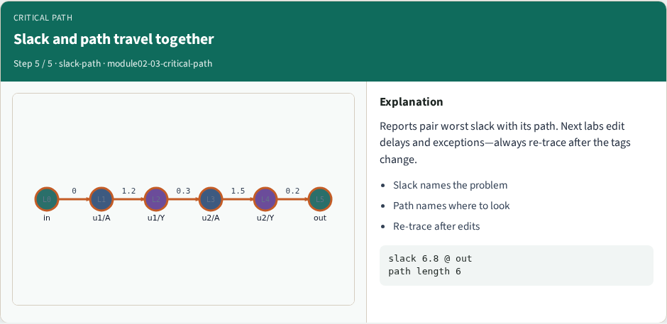
Slack and path travel together
Slack and path travel together
learn_sta — 03 critical path
Notes:
Reports pair worst slack with its path. Next labs edit delays and exceptions—always re-trace after the tags change.

Slide 11
Browser lab track
In the browser lab, open critical-path
Load the starter, run the analysis once, and read the metrics panel
Orient yourself, challenge panel, canvas, Check, then mirror the same goldens in code
learn_sta — 03 critical path
Notes:
In the browser lab, open **critical-path**. Load the starter, run the analysis once, and read the metrics panel. Orient yourself—challenge panel, canvas, Check—then mirror the same goldens in code.

Slide 12
Implement track
In the implement track
Run `python3 common/test_propagate.py` (and the timing-graph test) until the goldens print
learn_sta — 03 critical path
Notes:
In the implement track, use `common/tiny_timing.json` with the helpers in `common/graph.py` and `common/propagate.py`. Run `python3 common/test_propagate.py` (and the timing-graph test) until the goldens print ok.

Slide 13
Pitfall
Do not mix setup and hold required maps
Do not propagate before the graph is levelized
After an edit or exception, recompute, stale tags lie
learn_sta — 03 critical path
Notes:
Do not mix setup and hold required maps. Do not propagate before the graph is levelized. After an edit or exception, recompute—stale tags lie.

Slide 14
Your turn
Finish the checklist on at least one track, preferably both
When your numbers match the goldens, take the quiz, then continue
learn_sta — 03 critical path
Notes:
Finish the checklist on at least one track—preferably both. When your numbers match the goldens, take the quiz, then continue.

