Slide 1
Incremental timing update
Real timers cannot rebuild the chip after every buffer insert
learn_sta — 01 incremental update
Notes:
Real timers cannot rebuild the chip after every buffer insert. They invalidate a cone and recompute. You will bump u1’s cell delay from 1.2 to 2.0 and see A(out) move from 3.2 to 4.0 with setup slack 6.0.

Slide 2
Goldens to remember
Invalidated cone: u1/Y, u2/A, u2/Y, out
Clean: in, u1/A
ΔA(out)=+0.8
Keep these numbers handy, the browser challenges and Track A tests use the same instance
learn_sta — 01 incremental update
Notes:
Invalidated cone: u1/Y, u2/A, u2/Y, out. Clean: in, u1/A. ΔA(out)=+0.8. Keep these numbers handy—the browser challenges and Track A tests use the same instance.

Slide 3
Pseudocode
Incremental STA is cone invalidation plus selective recompute
After an arc delay edit
Open this module's examples file and find the Pseudocode section
That written sketch is what you implement on the implement track and what the browser
learn_sta — 01 incremental update
Notes:
Incremental STA is cone invalidation plus selective recompute. After an arc delay edit, BFS the fanout from the arc’s sink, clear those arrivals, then refill in topo order.
Open this module's examples file and find the Pseudocode section. That written sketch is what you implement on the implement track and what the browser challenges measure.

Slide 4
Algorithm sketch
Bump the u1 cell delay from one point two to two
The golden cone is u1/Y, u2/A, u2/Y, and out
Arrival at out becomes four and setup slack six
learn_sta — 01 incremental update
Notes:
Bump the u1 cell delay from one point two to two. The golden cone is u1/Y, u2/A, u2/Y, and out. Arrival at out becomes four and setup slack six.

Slide 5
Algorithm sketch — try these
INPUT: G, edit u→v delay:=d', A_old
OUTPUT: A_new, invalidated cone
set delay(u,v)←d'
inv ← BFS successors from v (incl. v)
delete A[p] for p in inv
recompute A in topo order for missing pins
GOLDEN edit 1.2→2.0 on u1 cell:
inv={u1/Y,u2/A,u2/Y,out}; A[out]=4.0
learn_sta — 01 incremental update

Slide 6
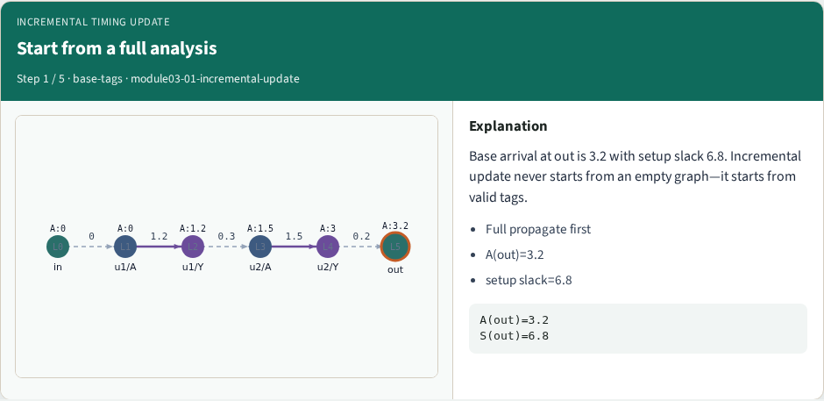
Start from a full analysis
Start from a full analysis
learn_sta — 01 incremental update
Notes:
Base arrival at out is 3.2 with setup slack 6.8. Incremental update never starts from an empty graph—it starts from valid tags.

Slide 7
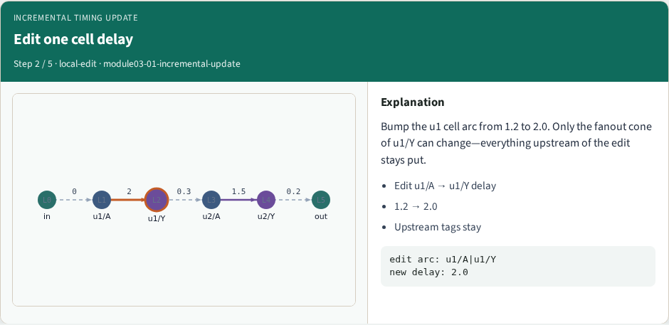
Edit one cell delay
Edit one cell delay
learn_sta — 01 incremental update
Notes:
Bump the u1 cell arc from 1.2 to 2.0. Only the fanout cone of u1/Y can change—everything upstream of the edit stays put.

Slide 8
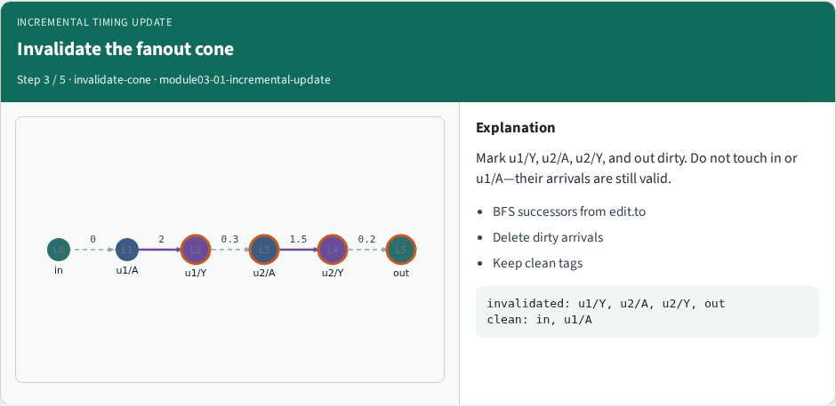
Invalidate the fanout cone
Invalidate the fanout cone
learn_sta — 01 incremental update
Notes:
Mark u1/Y, u2/A, u2/Y, and out dirty. Do not touch in or u1/A—their arrivals are still valid.

Slide 9
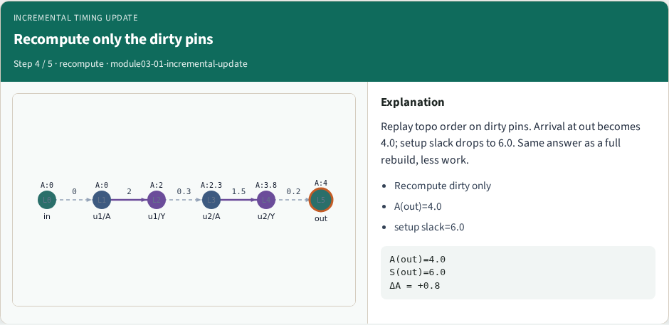
Recompute only the dirty pins
Recompute only the dirty pins
learn_sta — 01 incremental update
Notes:
Replay topo order on dirty pins. Arrival at out becomes 4.0; setup slack drops to 6.0. Same answer as a full rebuild, less work.

Slide 10
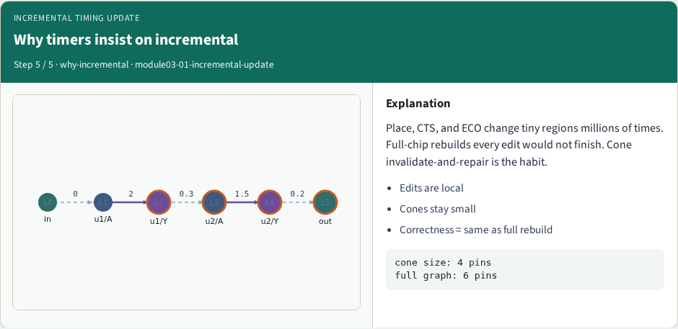
Why timers insist on incremental
Why timers insist on incremental
learn_sta — 01 incremental update
Notes:
Place, CTS, and ECO change tiny regions millions of times. Full-chip rebuilds every edit would not finish. Cone invalidate-and-repair is the habit.

Slide 11
Browser lab track
In the browser lab, open incremental-update
Load the starter, run the analysis once, and read the metrics panel
Orient yourself, challenge panel, canvas, Check, then mirror the same goldens in code
learn_sta — 01 incremental update
Notes:
In the browser lab, open **incremental-update**. Load the starter, run the analysis once, and read the metrics panel. Orient yourself—challenge panel, canvas, Check—then mirror the same goldens in code.

Slide 12
Implement track
In the implement track
Run `python3 common/test_propagate.py` (and the timing-graph test) until the goldens print
learn_sta — 01 incremental update
Notes:
In the implement track, use `common/tiny_timing.json` with the helpers in `common/graph.py` and `common/propagate.py`. Run `python3 common/test_propagate.py` (and the timing-graph test) until the goldens print ok.

Slide 13
Pitfall
Do not mix setup and hold required maps
Do not propagate before the graph is levelized
After an edit or exception, recompute, stale tags lie
learn_sta — 01 incremental update
Notes:
Do not mix setup and hold required maps. Do not propagate before the graph is levelized. After an edit or exception, recompute—stale tags lie.

Slide 14
Your turn
Finish the checklist on at least one track, preferably both
When your numbers match the goldens, take the quiz, then continue
learn_sta — 01 incremental update
Notes:
Finish the checklist on at least one track—preferably both. When your numbers match the goldens, take the quiz, then continue.

