Slide 1
False and multicycle paths (engine view)
Exceptions change which arcs propagate and how large the required window is
learn_sta — 03 false multicycle lite
Notes:
Exceptions change which arcs propagate and how large the required window is. You consume them as engine data—not as a full SDC course. You will compare normal slack 6.8, multicycle×2 slack 16.8, and a false-path that cuts the bridge net.

Slide 2
Goldens to remember
Multicycle cycles=2 → R(out)=20, slack=16.8
False-path disables u1/Y→u2/A so A(u2/A) falls to 0 in the lite model
Keep these numbers handy, the browser challenges and Track A tests use the same instance
learn_sta — 03 false multicycle lite
Notes:
Multicycle cycles=2 → R(out)=20, slack=16.8. False-path disables u1/Y→u2/A so A(u2/A) falls to 0 in the lite model. Keep these numbers handy—the browser challenges and Track A tests use the same instance.

Slide 3
Pseudocode
Exceptions enter the same propagate sketch
False paths omit disabled arcs
Multicycle setup multiplies the sink required by setup cycles times the period
Open this module's examples file and find the Pseudocode section
That written sketch is what you implement on the implement track and what the browser
learn_sta — 03 false multicycle lite
Notes:
Exceptions enter the same propagate sketch. False paths omit disabled arcs. Multicycle setup multiplies the sink required by setup cycles times the period.
Open this module's examples file and find the Pseudocode section. That written sketch is what you implement on the implement track and what the browser challenges measure.

Slide 4
Algorithm sketch
Default slack at out is six point eight
Two cycles raises required to twenty and slack to sixteen point eight
Disabling u1/Y to u2/A removes that timing path
learn_sta — 03 false multicycle lite
Notes:
Default slack at out is six point eight. Two cycles raises required to twenty and slack to sixteen point eight. Disabling u1/Y to u2/A removes that timing path.

Slide 5
Algorithm sketch — try these
INPUT: G, disable set S, setup_cycles
OUTPUT: setup slack at sink
A ← prop_arrival using arcs ∉ S
R ← prop_required; R[sink]←period×cycles
slack ← R[sink] − A[sink]
GOLDEN default: slack(out)=6.8
cycles=2 → R[out]=20, slack=16.8
disable u1/Y→u2/A breaks that path
learn_sta — 03 false multicycle lite

Slide 6
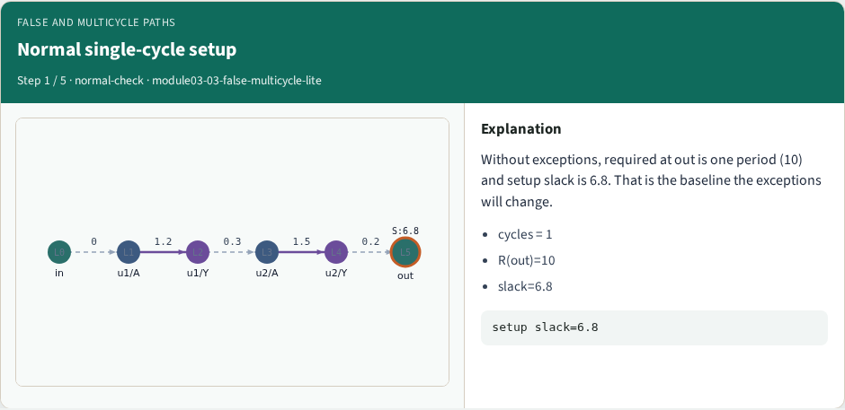
Normal single-cycle setup
Normal single-cycle setup
learn_sta — 03 false multicycle lite
Notes:
Without exceptions, required at out is one period (10) and setup slack is 6.8. That is the baseline the exceptions will change.

Slide 7
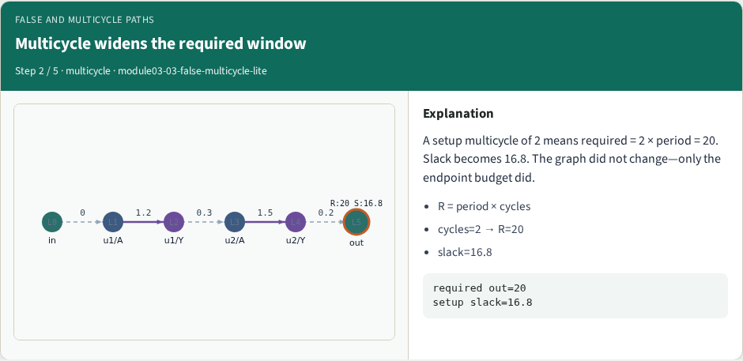
Multicycle widens the required window
Multicycle widens the required window
learn_sta — 03 false multicycle lite
Notes:
A setup multicycle of 2 means required = 2 × period = 20. Slack becomes 16.8. The graph did not change—only the endpoint budget did.

Slide 8
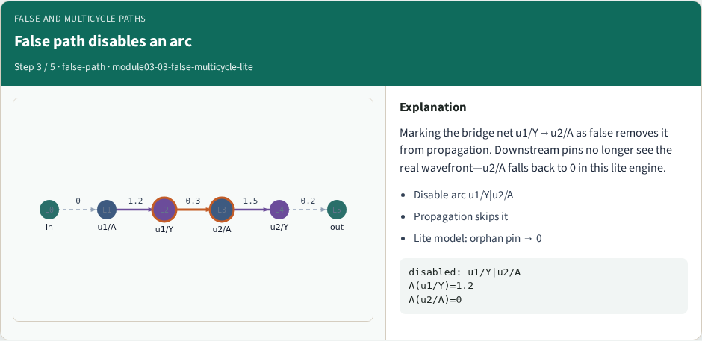
False path disables an arc
False path disables an arc
learn_sta — 03 false multicycle lite
Notes:
Marking the bridge net u1/Y→u2/A as false removes it from propagation. Downstream pins no longer see the real wavefront—u2/A falls back to 0 in this lite engine.

Slide 9
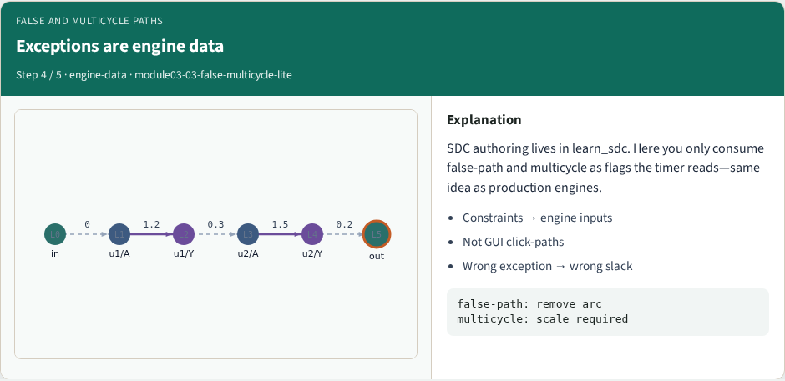
Exceptions are engine data
Exceptions are engine data
learn_sta — 03 false multicycle lite
Notes:
SDC authoring lives in learn_sdc. Here you only consume false-path and multicycle as flags the timer reads—same idea as production engines.

Slide 10
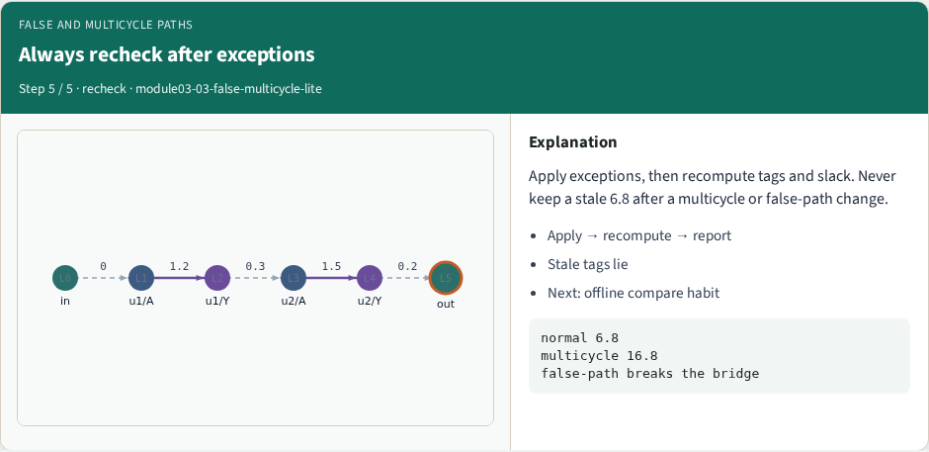
Always recheck after exceptions
Always recheck after exceptions
learn_sta — 03 false multicycle lite
Notes:
Apply exceptions, then recompute tags and slack. Never keep a stale 6.8 after a multicycle or false-path change.

Slide 11
Browser lab track
In the browser lab, open false-multicycle-lite
Load the starter, run the analysis once, and read the metrics panel
Orient yourself, challenge panel, canvas, Check, then mirror the same goldens in code
learn_sta — 03 false multicycle lite
Notes:
In the browser lab, open **false-multicycle-lite**. Load the starter, run the analysis once, and read the metrics panel. Orient yourself—challenge panel, canvas, Check—then mirror the same goldens in code.

Slide 12
Implement track
In the implement track
Run `python3 common/test_propagate.py` (and the timing-graph test) until the goldens print
learn_sta — 03 false multicycle lite
Notes:
In the implement track, use `common/tiny_timing.json` with the helpers in `common/graph.py` and `common/propagate.py`. Run `python3 common/test_propagate.py` (and the timing-graph test) until the goldens print ok.

Slide 13
Pitfall
Do not mix setup and hold required maps
Do not propagate before the graph is levelized
After an edit or exception, recompute, stale tags lie
learn_sta — 03 false multicycle lite
Notes:
Do not mix setup and hold required maps. Do not propagate before the graph is levelized. After an edit or exception, recompute—stale tags lie.

Slide 14
Your turn
Finish the checklist on at least one track, preferably both
When your numbers match the goldens, take the quiz, then continue
learn_sta — 03 false multicycle lite
Notes:
Finish the checklist on at least one track—preferably both. When your numbers match the goldens, take the quiz, then continue.

