Slide 1
Greedy pair merge
Greedy pair merge is the simplest coarsening engine that still feels like CAD
learn_clustering — 03 greedy pair merge
Notes:
Greedy pair merge is the simplest coarsening engine that still feels like CAD: repeatedly merge the most attractive pair, update the graph, and stop when you hit a cluster count. You’ll watch the full loop on the tiny graph—affinity, contraction, and cutsize moving together.

Slide 2
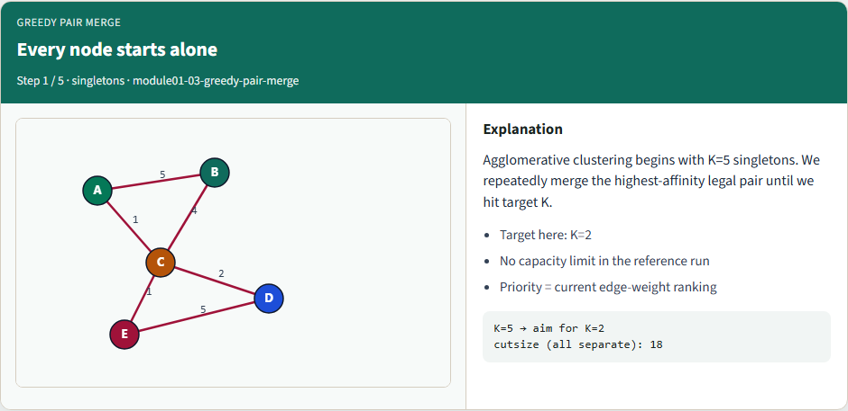
Every node starts alone
Every node starts alone
learn_clustering — 03 greedy pair merge
Notes:
Agglomerative clustering begins with five singletons. We repeatedly merge the highest-affinity legal pair until we hit target K—here, two clusters, with no capacity limit in the reference run.

Slide 3
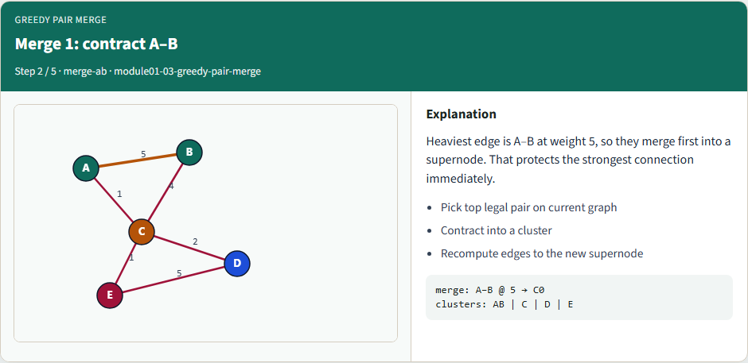
Merge 1: contract A–B
Merge 1: contract A–B
learn_clustering — 03 greedy pair merge
Notes:
Heaviest edge is A–B at weight five, so they merge first into a supernode. That protects the strongest connection immediately.

Slide 4
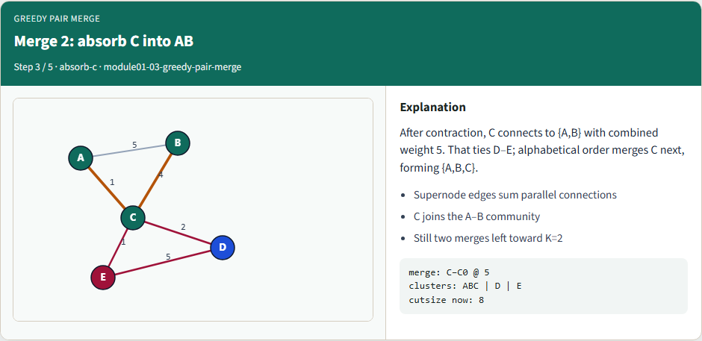
Merge 2: absorb C into AB
Merge 2: absorb C into AB
learn_clustering — 03 greedy pair merge
Notes:
After contraction, C connects to A–B with combined weight five. That ties D–E; alphabetical order merges C next, forming A–B–C.

Slide 5
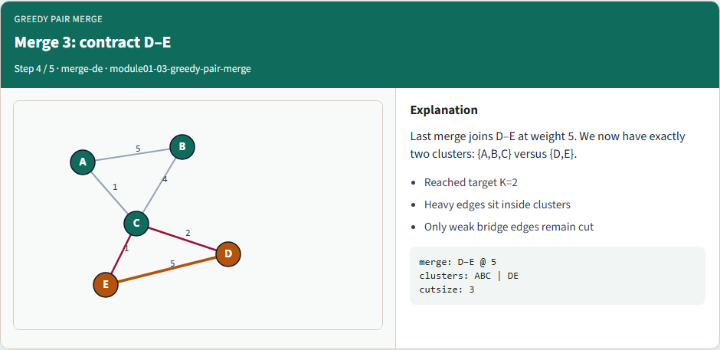
Merge 3: contract D–E
Merge 3: contract D–E
learn_clustering — 03 greedy pair merge
Notes:
Last merge joins D–E at weight five. We now have exactly two clusters: A–B–C versus D–E.

Slide 6
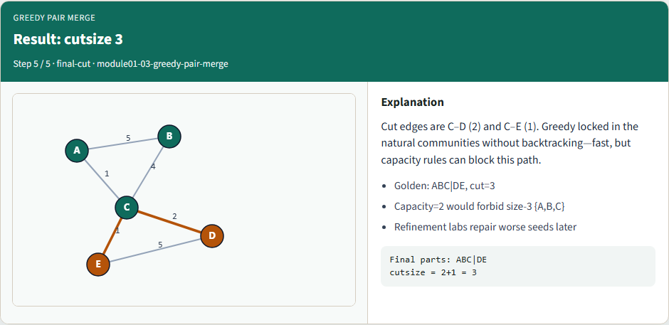
Result: cutsize 3
Result: cutsize 3
learn_clustering — 03 greedy pair merge
Notes:
Cut edges are C–D and C–E—total three. Greedy locked in the natural communities without backtracking. Capacity two would have blocked the size-three cluster.

Slide 7
Browser lab track
In the browser lab, load the starter, try the K and capacity presets, and run greedy merge
Work the challenges
learn_clustering — 03 greedy pair merge
Notes:
In the browser lab, load the starter, try the K and capacity presets, and run greedy merge. Work the challenges: unconstrained K equals two, then capacity two, then stop at K equals three.

Slide 8
Implement track
Run the reference greedy merge down to two clusters
You should land on A–B–C versus D–E with cutsize three
Re-implement contraction yourself and keep a deterministic tie-break so golden tests stay
learn_clustering — 03 greedy pair merge
Notes:
Run the reference greedy merge down to two clusters. You should land on A–B–C versus D–E with cutsize three. Re-implement contraction yourself and keep a deterministic tie-break so golden tests stay stable.

Slide 9
Implement track — try these
# pwd — print working directory
pwd
# ls examples — confirm tiny_graph.json is present
ls examples
# greedy merge to K=2 via reference solver
export PYTHONPATH=../common
python ../common/solvers.py examples/tiny_graph.json --k 2
learn_clustering — 03 greedy pair merge

Slide 10
Pitfalls to watch
Greedy is myopic, a great first merge can strand you with a bad global cut
Watch illegal merges that violate a size cap
And updating affinities incorrectly after contraction creates silent wrong clusters until
learn_clustering — 03 greedy pair merge
Notes:
Greedy is myopic—a great first merge can strand you with a bad global cut. Watch illegal merges that violate a size cap. And updating affinities incorrectly after contraction creates silent wrong clusters until you check cutsize by hand.

Slide 11
Your turn
Implement greedy pair merge end to end, hit a chosen K, and record cutsize
Complete the checklist and quiz
learn_clustering — 03 greedy pair merge
Notes:
Implement greedy pair merge end to end, hit a chosen K, and record cutsize. Complete the checklist and quiz, then continue to size-constrained agglomerative clustering—where capacity becomes a hard rule.

