Slide 1
Size-constrained agglomerative clustering
Size caps change which merges are legal
learn_clustering — 05 size constrained agglomerative
Notes:
Size caps change which merges are legal. You’ll watch greedy agglomeration with capacity two on the tiny graph—and see why A–B–C can no longer form.

Slide 2
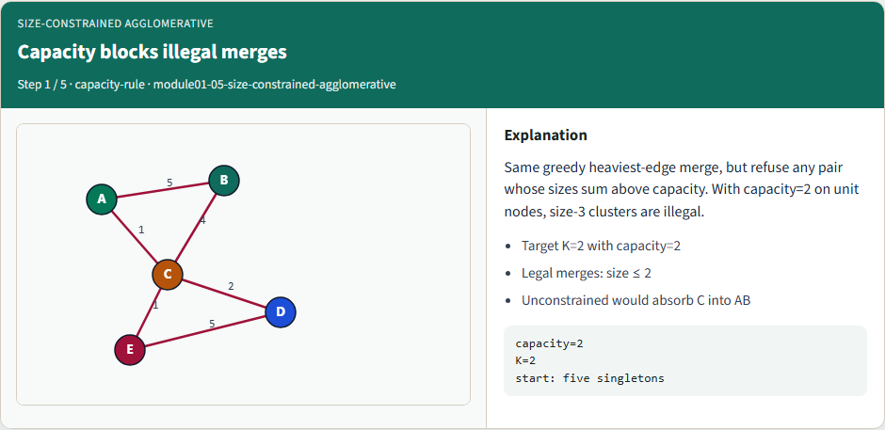
Capacity blocks illegal merges
Capacity blocks illegal merges
learn_clustering — 05 size constrained agglomerative
Notes:
Same greedy heaviest-edge merge, but refuse any pair whose sizes sum above capacity. With capacity=2 on unit nodes, size-3 clusters are illegal.

Slide 3
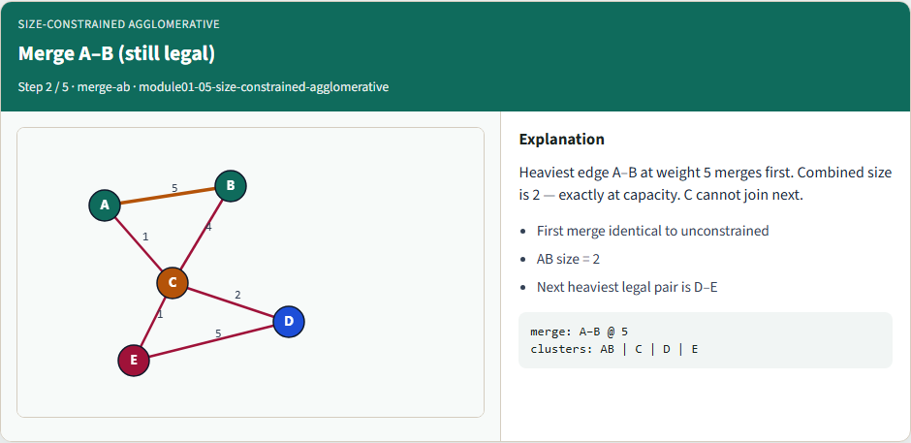
Merge A–B (still legal)
Merge A–B (still legal)
learn_clustering — 05 size constrained agglomerative
Notes:
Heaviest edge A–B at weight 5 merges first. Combined size is 2 — exactly at capacity. C cannot join next.

Slide 4
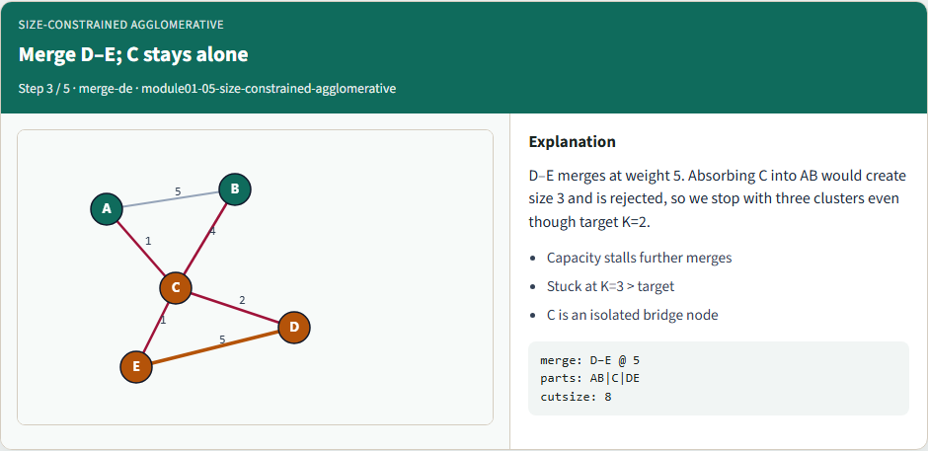
Merge D–E; C stays alone
Merge D–E; C stays alone
learn_clustering — 05 size constrained agglomerative
Notes:
D–E merges at weight 5. Absorbing C into AB would create size 3 and is rejected, so we stop with three clusters even though target K=2.

Slide 5
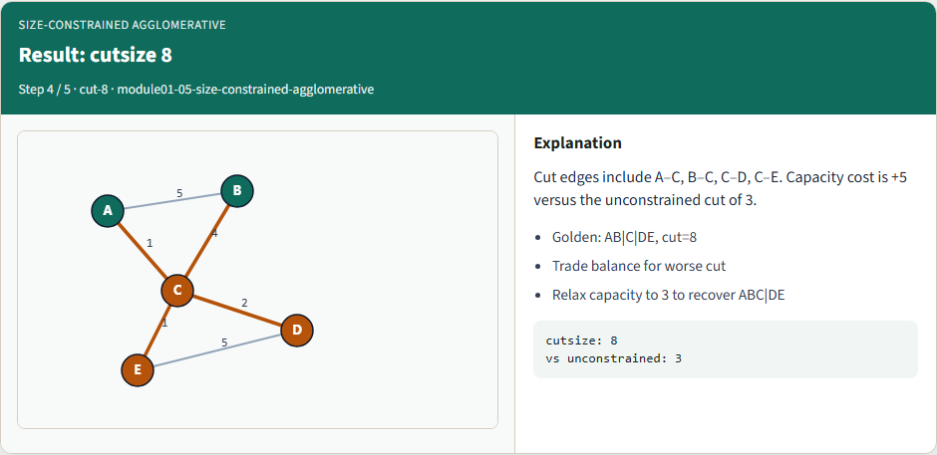
Result: cutsize 8
Result: cutsize 8
learn_clustering — 05 size constrained agglomerative
Notes:
Cut edges include A–C, B–C, C–D, C–E. Capacity cost is +5 versus the unconstrained cut of 3.

Slide 6
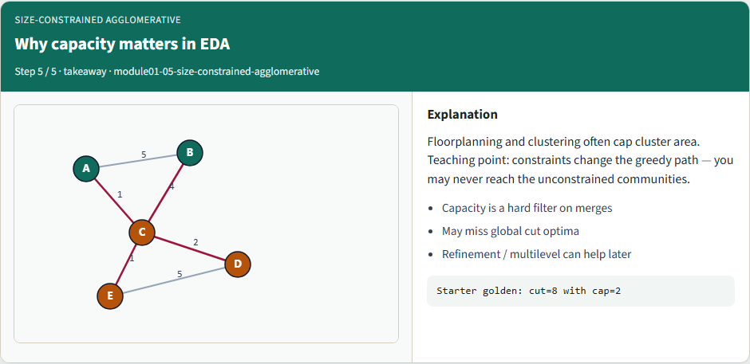
Why capacity matters in EDA
Why capacity matters in EDA
learn_clustering — 05 size constrained agglomerative
Notes:
Floorplanning and clustering often cap cluster area. Teaching point: constraints change the greedy path — you may never reach the unconstrained communities.

Slide 7
Browser lab track
In the browser lab
Clear the challenges for blocked size-three clusters and the AB|C|DE parts
learn_clustering — 05 size constrained agglomerative
Notes:
In the browser lab, load the starter with capacity two, then compare presets against unconstrained K equals two. Clear the challenges for blocked size-three clusters and the AB|C|DE parts.

Slide 8
Implement track
Run greedy merge with capacity two and confirm cutsize eight with parts AB|C|DE
Then lift capacity to three and recover the unconstrained ABC|DE cutsize three
learn_clustering — 05 size constrained agglomerative
Notes:
Run greedy merge with capacity two and confirm cutsize eight with parts AB|C|DE. Then lift capacity to three and recover the unconstrained ABC|DE cutsize three.

Slide 9
Implement track — try these
export PYTHONPATH=../common
python ../common/solvers.py examples/tiny_graph.json --k 2
--capacity 2
learn_clustering — 05 size constrained agglomerative

Slide 10
Pitfalls to watch
Forgetting to check capacity before contracting is the classic bug
Also watch stale affinities after a blocked merge candidate is skipped
learn_clustering — 05 size constrained agglomerative
Notes:
Forgetting to check capacity before contracting is the classic bug. Also watch stale affinities after a blocked merge candidate is skipped.

Slide 11
Your turn
Match the capacity-two golden
learn_clustering — 05 size constrained agglomerative
Notes:
Match the capacity-two golden, finish the checklist and quiz, then continue to label propagation.

