Slide 1
Label propagation clustering
Label propagation grows communities by letting each node adopt the strongest neighbor label
learn_clustering — 01 label propagation
Notes:
Label propagation grows communities by letting each node adopt the strongest neighbor label. You’ll watch the asynchronous update on the tiny graph, then measure iterations-to-stable and cutsize.

Slide 2
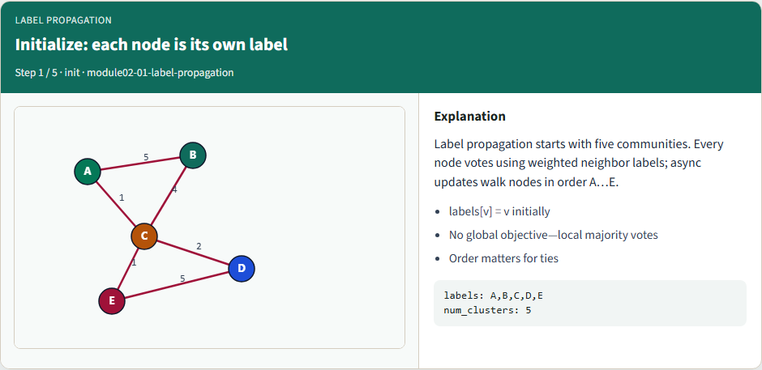
Initialize: each node is its own label
Initialize: each node is its own label
learn_clustering — 01 label propagation
Notes:
Start with five communities—each node labeled as itself. Every node will vote using weighted neighbor labels; async updates walk nodes in order A through E.

Slide 3
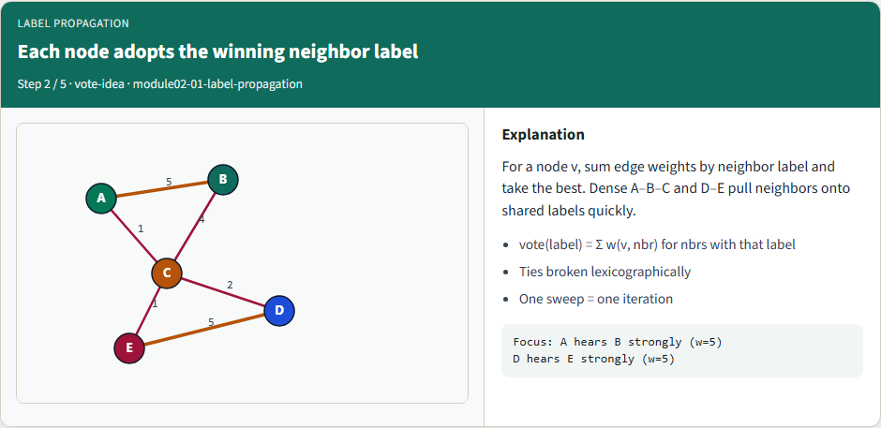
Each node adopts the winning neighbor label
Each node adopts the winning neighbor label
learn_clustering — 01 label propagation
Notes:
For a node, sum edge weights by neighbor label and take the best. Dense A–B–C and D–E pull neighbors onto shared labels quickly. Ties break lexicographically.

Slide 4
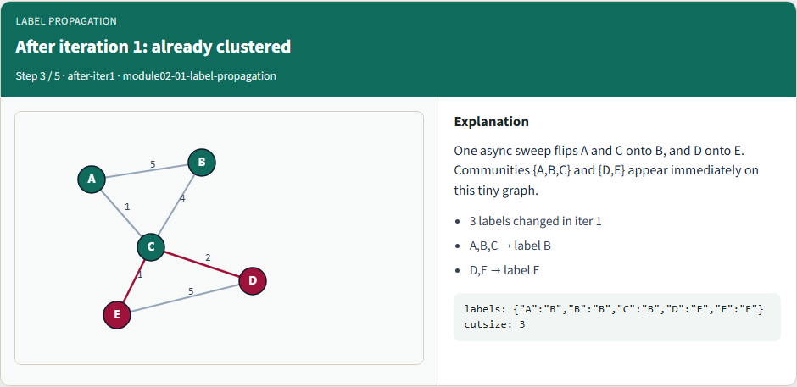
After iteration 1: already clustered
After iteration 1: already clustered
learn_clustering — 01 label propagation
Notes:
One async sweep flips A and C onto B, and D onto E. Communities A–B–C and D–E appear immediately on this tiny graph.

Slide 5
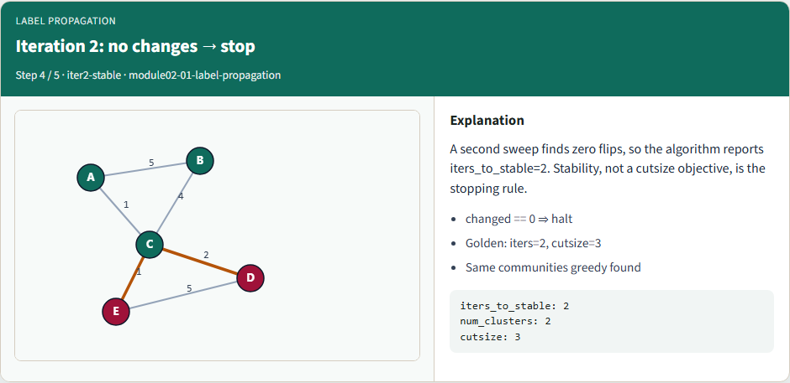
Iteration 2: no changes — stop
Iteration 2: no changes — stop
learn_clustering — 01 label propagation
Notes:
A second sweep finds zero flips, so the algorithm reports two iterations to stable. Stability—not a cutsize objective—is the stopping rule. Cutsize lands at three.

Slide 6
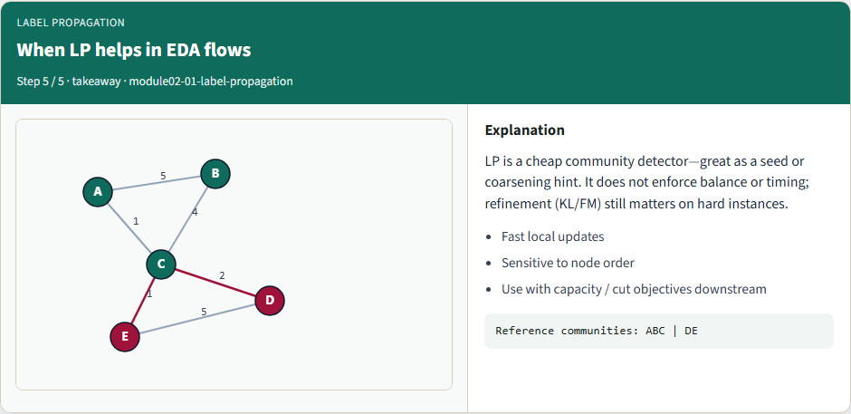
When LP helps in EDA flows
When LP helps in EDA flows
learn_clustering — 01 label propagation
Notes:
LP is a cheap community detector—great as a seed or coarsening hint. It does not enforce balance or timing; refinement still matters on hard instances.

Slide 7
Browser lab track
In the browser lab, show the initial labels, then run label propagation
Clear the challenges for two iterations, two communities, and the full golden label map
learn_clustering — 01 label propagation
Notes:
In the browser lab, show the initial labels, then run label propagation. Clear the challenges for two iterations, two communities, and the full golden label map.

Slide 8
Implement track
Load the tiny graph and run the reference label-propagation mode
Confirm two iterations, labels grouping A–B–C versus D–E, and cutsize three
Re-implement the vote and tie-break until the unit test passes
learn_clustering — 01 label propagation
Notes:
Load the tiny graph and run the reference label-propagation mode. Confirm two iterations, labels grouping A–B–C versus D–E, and cutsize three. Re-implement the vote and tie-break until the unit test passes.

Slide 9
Implement track — try these
# run async label propagation on the tiny graph
export PYTHONPATH=../common
python ../common/solvers.py examples/tiny_graph.json --mode lp
learn_clustering — 01 label propagation

Slide 10
Pitfalls to watch
Order dependence is real, document your sweep order
Without a tie-break, goldens flake
And stopping only on max iterations without checking that nothing changed hides
learn_clustering — 01 label propagation
Notes:
Order dependence is real—document your sweep order. Without a tie-break, goldens flake. And stopping only on max iterations without checking that nothing changed hides non-convergence.

Slide 11
Your turn
Match the golden table, finish the checklist and quiz, then continue to spectral bisection
learn_clustering — 01 label propagation
Notes:
Match the golden table, finish the checklist and quiz, then continue to spectral bisection.

