Slide 1
Spectral bisection
Spectral bisection uses the graph Laplacian and its Fiedler vector to propose a balanced cut
learn_clustering — 03 spectral bisection
Notes:
Spectral bisection uses the graph Laplacian and its Fiedler vector to propose a balanced cut. You’ll watch the order and the chosen split land on cutsize three.

Slide 2
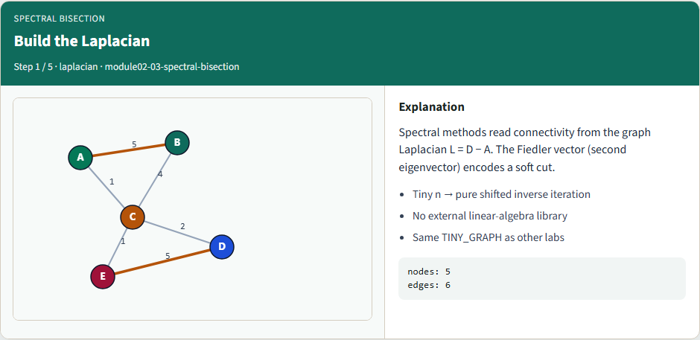
Build the Laplacian
Build the Laplacian
learn_clustering — 03 spectral bisection
Notes:
Spectral methods read connectivity from the graph Laplacian L = D − A. The Fiedler vector (second eigenvector) encodes a soft cut.

Slide 3
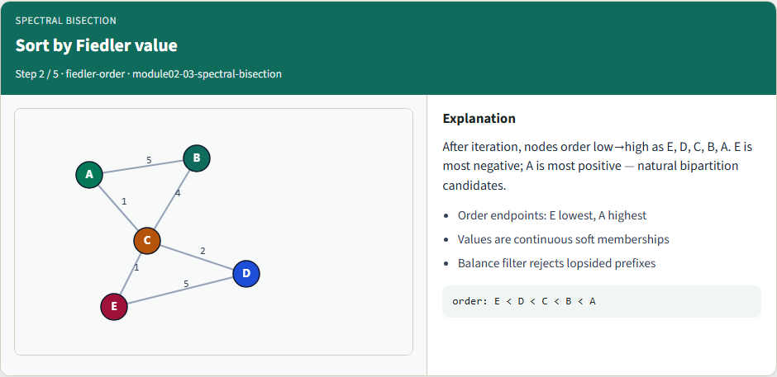
Sort by Fiedler value
Sort by Fiedler value
learn_clustering — 03 spectral bisection
Notes:
After iteration, nodes order low→high as E, D, C, B, A. E is most negative; A is most positive — natural bipartition candidates.

Slide 4
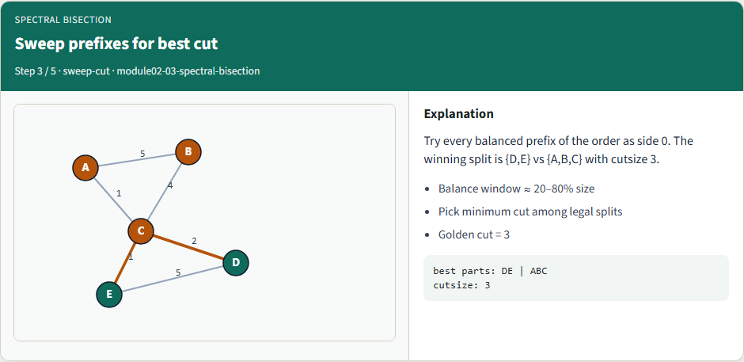
Sweep prefixes for best cut
Sweep prefixes for best cut
learn_clustering — 03 spectral bisection
Notes:
Try every balanced prefix of the order as side 0. The winning split is {D,E} vs {A,B,C} with cutsize 3.

Slide 5
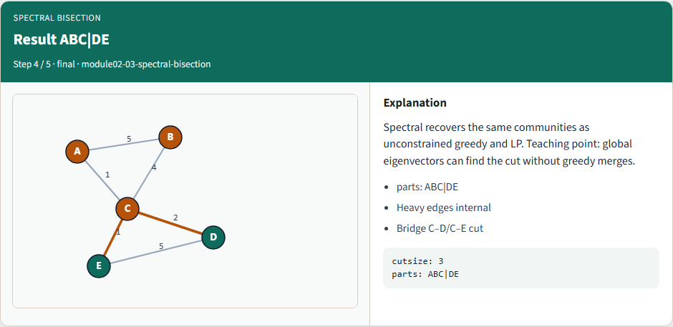
Result ABC|DE
Result ABC|DE
learn_clustering — 03 spectral bisection
Notes:
Spectral recovers the same communities as unconstrained greedy and LP. Teaching point: global eigenvectors can find the cut without greedy merges.

Slide 6
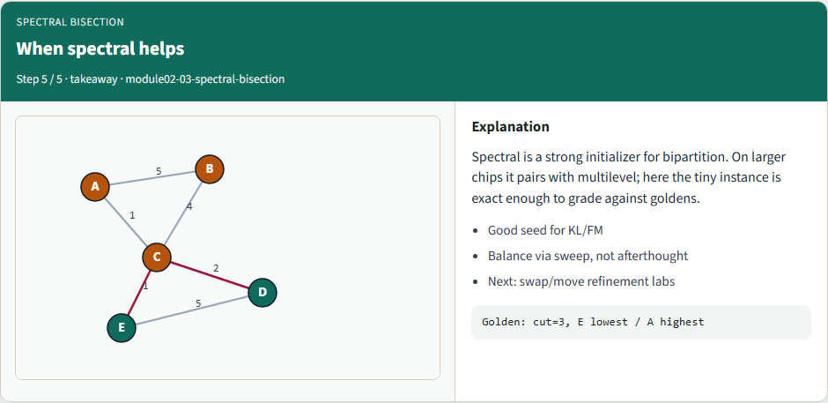
When spectral helps
When spectral helps
learn_clustering — 03 spectral bisection
Notes:
Spectral is a strong initializer for bipartition. On larger chips it pairs with multilevel; here the tiny instance is exact enough to grade against goldens.

Slide 7
Browser lab track
In the browser lab, run spectral bisection and inspect the Fiedler order
Clear challenges for cutsize three and the ABC versus DE parts
learn_clustering — 03 spectral bisection
Notes:
In the browser lab, run spectral bisection and inspect the Fiedler order. Clear challenges for cutsize three and the ABC versus DE parts.

Slide 8
Implement track
Run the spectral mode on the tiny graph
Confirm cutsize three and the natural clusters
Re-implement the sweep yourself; a dense tiny eigensolve is fine at course scale
learn_clustering — 03 spectral bisection
Notes:
Run the spectral mode on the tiny graph. Confirm cutsize three and the natural clusters. Re-implement the sweep yourself; a dense tiny eigensolve is fine at course scale.

Slide 9
Implement track — try these
export PYTHONPATH=../common
python ../common/solvers.py examples/tiny_graph.json --mode spectral
learn_clustering — 03 spectral bisection

Slide 10
Pitfalls to watch
Ignoring balance can isolate one node
Numerical noise can scramble near-ties, use a stable sort
Disconnected graphs need explicit component handling
learn_clustering — 03 spectral bisection
Notes:
Ignoring balance can isolate one node. Numerical noise can scramble near-ties—use a stable sort. Disconnected graphs need explicit component handling.

Slide 11
Your turn
Match cutsize three, finish the checklist and quiz, then continue to Kernighan–Lin
learn_clustering — 03 spectral bisection
Notes:
Match cutsize three, finish the checklist and quiz, then continue to Kernighan–Lin.

