Slide 1
Kernighan–Lin refinement
Kernighan–Lin improves an existing bipartition by swapping pairs across the cut
learn_clustering — 05 kernighan lin
Notes:
Kernighan–Lin improves an existing bipartition by swapping pairs across the cut. You’ll watch a full pass—gains, locking, a swap sequence, and rollback to the best prefix. On the starter seed that cuts both heavy edges, KL drives the cut from twelve down to three.

Slide 2
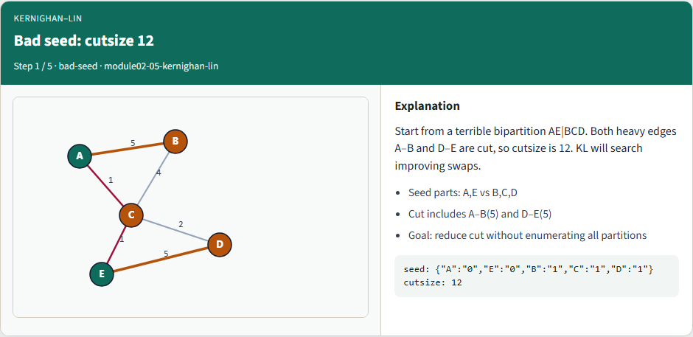
Bad seed: cutsize 12
Bad seed: cutsize 12
learn_clustering — 05 kernighan lin
Notes:
Start from a terrible bipartition: A and E versus B, C, and D. Both heavy edges A–B and D–E are cut, so cutsize is twelve. KL will search improving swaps.

Slide 3
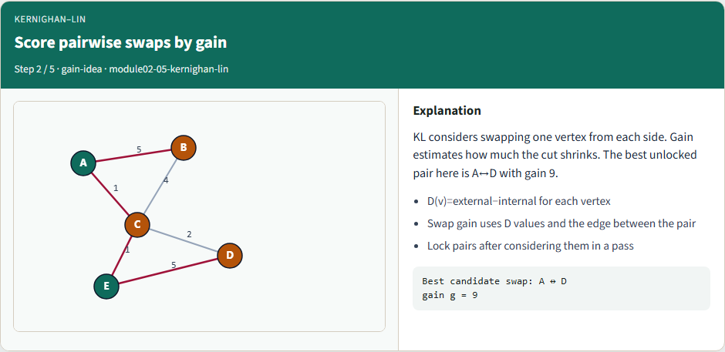
Score pairwise swaps by gain
Score pairwise swaps by gain
learn_clustering — 05 kernighan lin
Notes:
KL considers swapping one vertex from each side. Gain estimates how much the cut shrinks. The best unlocked pair here is A with D, gain nine.

Slide 4
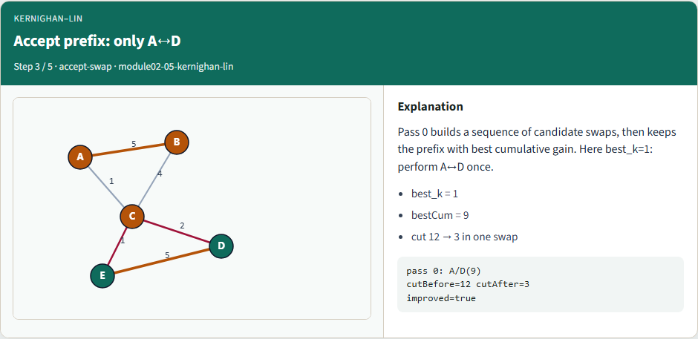
Accept prefix: only A↔D
Accept prefix: only A↔D
learn_clustering — 05 kernighan lin
Notes:
Pass zero builds a sequence of candidate swaps, then keeps the prefix with best cumulative gain. Here best k equals one: perform A↔D once, and the cut falls from twelve to three.

Slide 5
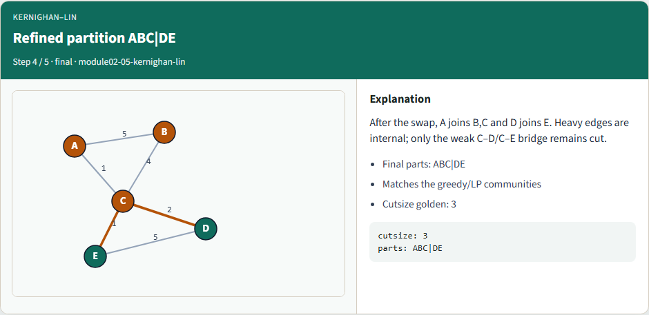
Refined partition ABC|DE
Refined partition ABC|DE
learn_clustering — 05 kernighan lin
Notes:
After the swap, A joins B and C, and D joins E. Heavy edges are internal; only the weak bridge through C remains cut. Cutsize golden: three.

Slide 6
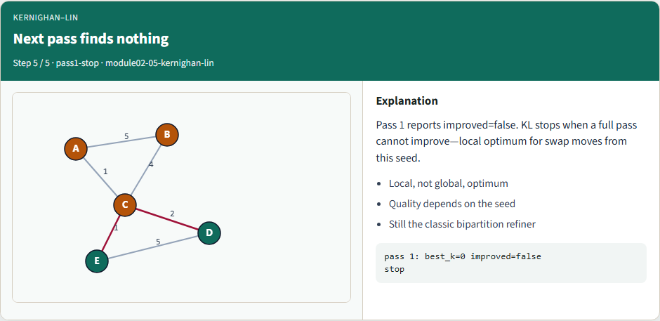
Next pass finds nothing
Next pass finds nothing
learn_clustering — 05 kernighan lin
Notes:
Pass one reports no improvement. KL stops at a local optimum for swap moves from this seed. Quality still depends on where you started.

Slide 7
Browser lab track
In the browser lab, show the seed only, then run KL
Check the challenges for cutsize twelve, the A–D swap, and the final cutsize three
learn_clustering — 05 kernighan lin
Notes:
In the browser lab, show the seed only, then run KL. Check the challenges for cutsize twelve, the A–D swap, and the final cutsize three.

Slide 8
Implement track
Load the tiny graph and the bad seed
Print cutsize twelve before you start
Run the reference KL solver and confirm it accepts A–D
learn_clustering — 05 kernighan lin
Notes:
Load the tiny graph and the bad seed. Print cutsize twelve before you start. Run the reference KL solver and confirm it accepts A–D, lands on cutsize three, then stops on the next pass.

Slide 9
Implement track — try these
# pwd — print working directory
pwd
# ls examples — graph + seed partition
ls examples
# run full KL refinement on the bad seed
export PYTHONPATH=../common
python ../common/solvers.py examples/tiny_graph.json --mode kl
--seed examples/seed_partition.json
learn_clustering — 05 kernighan lin

Slide 10
Pitfalls to watch
Forgetting rollback is the classic bug
Stale D-values after a swap pick the wrong pair next
And if your seed isn’t labeled zero and one, the gain math won’t match
learn_clustering — 05 kernighan lin
Notes:
Forgetting rollback is the classic bug—you keep the final locked state even when an earlier prefix was better. Stale D-values after a swap pick the wrong pair next. And if your seed isn’t labeled zero and one, the gain math won’t match.

Slide 11
Your turn
Reproduce cut twelve to three with the accepted A–D swap
Finish the checklist and quiz
learn_clustering — 05 kernighan lin
Notes:
Reproduce cut twelve to three with the accepted A–D swap. Finish the checklist and quiz, then continue to Fiduccia–Mattheyses—single-vertex moves instead of pairwise swaps.

