Slide 1
Fiduccia–Mattheyses refinement
FM refines a bipartition with single-vertex moves, locking
learn_clustering — 07 fiduccia mattheyses
Notes:
FM refines a bipartition with single-vertex moves, locking, and rollback—cousin to Kernighan–Lin, but one cell at a time. On the same bad seed that starts at cutsize twelve, FM reaches cutsize three.

Slide 2
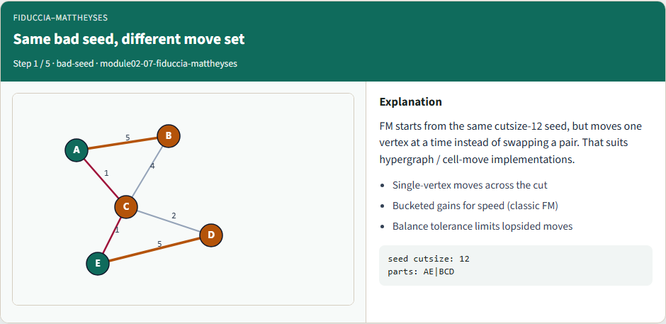
Same bad seed, different move set
Same bad seed, different move set
learn_clustering — 07 fiduccia mattheyses
Notes:
FM starts from the same cutsize-twelve seed, but moves one vertex at a time instead of swapping a pair. That suits hypergraph and cell-move implementations.

Slide 3
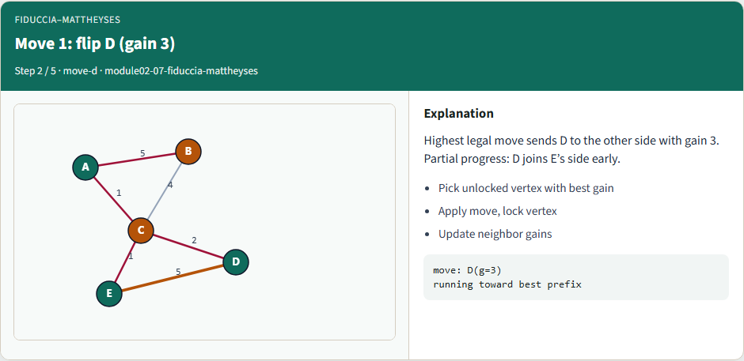
Move 1: flip D (gain 3)
Move 1: flip D (gain 3)
learn_clustering — 07 fiduccia mattheyses
Notes:
Highest legal move sends D to the other side with gain three. Partial progress: D joins E’s side early. Lock D and update neighbor gains.

Slide 4
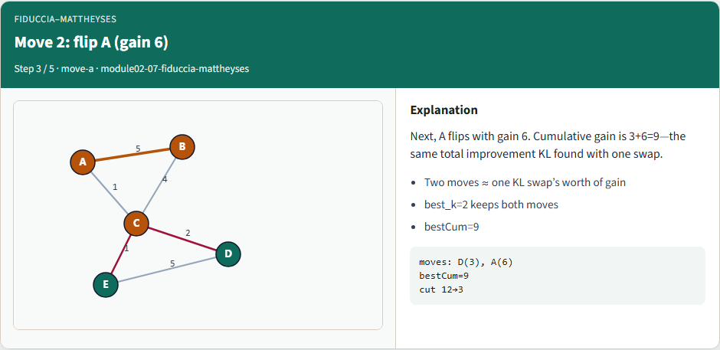
Move 2: flip A (gain 6)
Move 2: flip A (gain 6)
learn_clustering — 07 fiduccia mattheyses
Notes:
Next, A flips with gain six. Cumulative gain is three plus six—nine—the same total improvement KL found with one swap. Best k equals two keeps both moves.

Slide 5
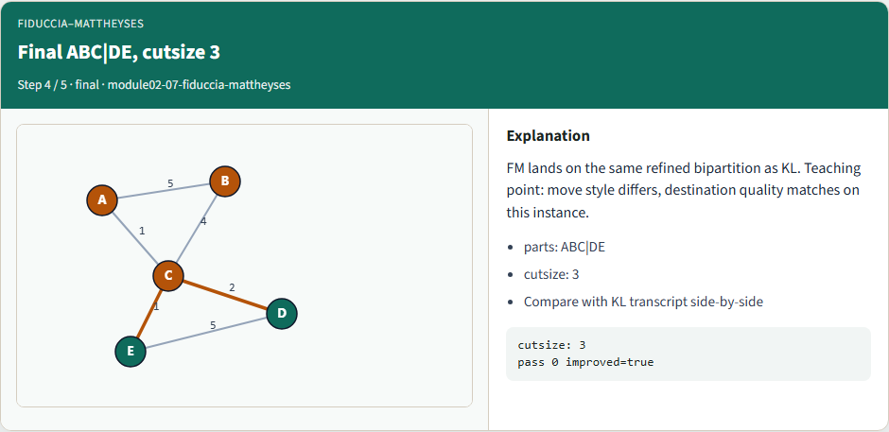
Final ABC|DE, cutsize 3
Final ABC|DE, cutsize 3
learn_clustering — 07 fiduccia mattheyses
Notes:
FM lands on the same refined bipartition as KL. Move style differs; destination quality matches on this instance. Cutsize is three.

Slide 6
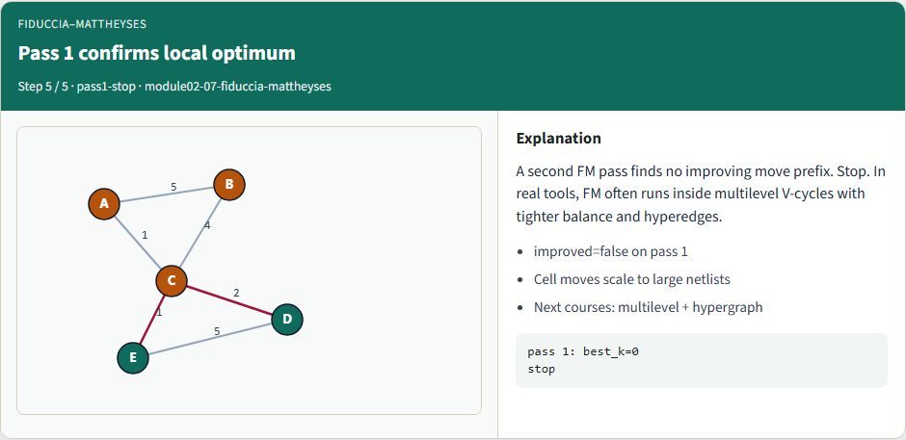
Pass 1 confirms local optimum
Pass 1 confirms local optimum
learn_clustering — 07 fiduccia mattheyses
Notes:
A second FM pass finds no improving move prefix. Stop. In real tools, FM often runs inside multilevel V-cycles with tighter balance and hyperedges.

Slide 7
Browser lab track
In the browser lab, show the seed, run FM, and compare the move list with KL’s single swap
Clear the challenges for twelve-to-three and the D-then-A prefix
learn_clustering — 07 fiduccia mattheyses
Notes:
In the browser lab, show the seed, run FM, and compare the move list with KL’s single swap. Clear the challenges for twelve-to-three and the D-then-A prefix.

Slide 8
Implement track
Run FM on the shared bad seed
Confirm moves D then A in the accepted prefix, and cut twelve to three
Re-implement selection and rollback until tests pass
learn_clustering — 07 fiduccia mattheyses
Notes:
Run FM on the shared bad seed. Confirm moves D then A in the accepted prefix, and cut twelve to three. Re-implement selection and rollback until tests pass.

Slide 9
Implement track — try these
# FM refinement on the shared bad seed
export PYTHONPATH=../common
python ../common/solvers.py examples/tiny_graph.json --mode fm
--seed ../module02-05-kernighan-lin/examples/seed_partition.json
learn_clustering — 07 fiduccia mattheyses

Slide 10
Pitfalls to watch
Skipping rollback keeps a worse locked state
Ignoring balance lets one side empty
Stale gains after a move pick the wrong cell next
learn_clustering — 07 fiduccia mattheyses
Notes:
Skipping rollback keeps a worse locked state. Ignoring balance lets one side empty. Stale gains after a move pick the wrong cell next.

Slide 11
Your turn
Reproduce twelve to three
learn_clustering — 07 fiduccia mattheyses
Notes:
Reproduce twelve to three, finish the checklist and quiz, then continue to multilevel clustering.

