Slide 1
Multilevel clustering
Multilevel clustering coarsens, partitions, then refines
learn_clustering — 01 multilevel clustering
Notes:
Multilevel clustering coarsens, partitions, then refines. You’ll watch greedy coarsening to two clusters followed by FM polish—landing on cutsize three.

Slide 2
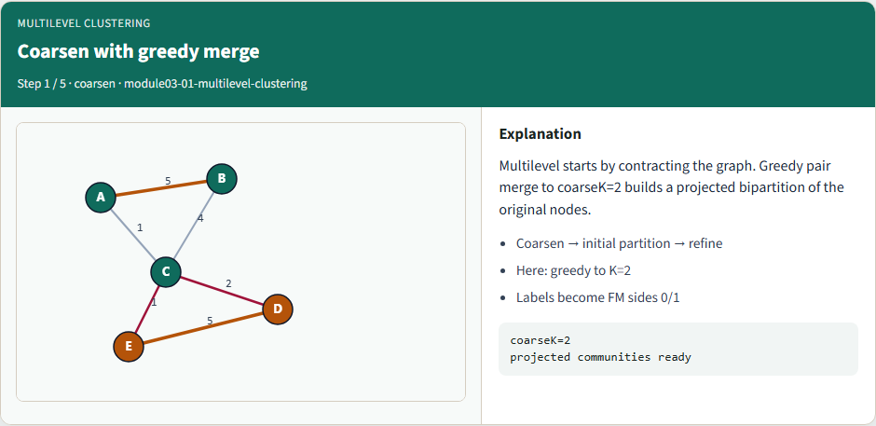
Coarsen with greedy merge
Coarsen with greedy merge
learn_clustering — 01 multilevel clustering
Notes:
Multilevel starts by contracting the graph. Greedy pair merge to coarseK=2 builds a projected bipartition of the original nodes.

Slide 3
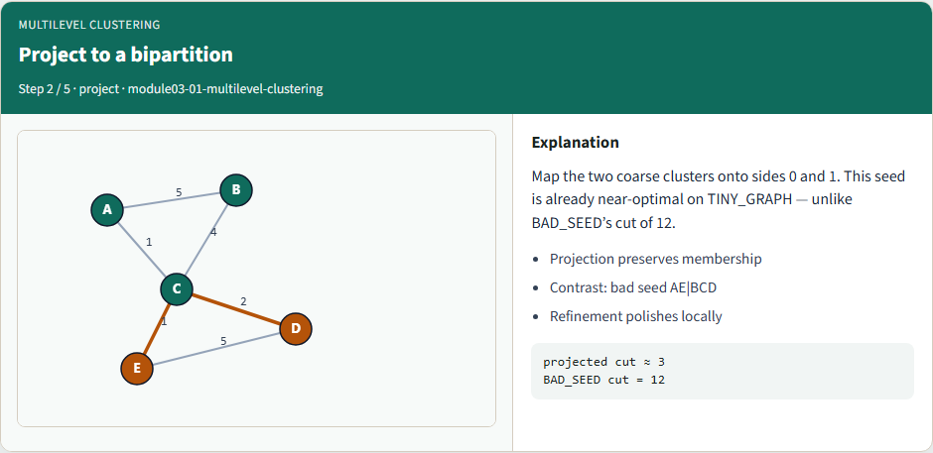
Project to a bipartition
Project to a bipartition
learn_clustering — 01 multilevel clustering
Notes:
Map the two coarse clusters onto sides 0 and 1. This seed is already near-optimal on TINY_GRAPH — unlike BAD_SEED’s cut of 12.

Slide 4
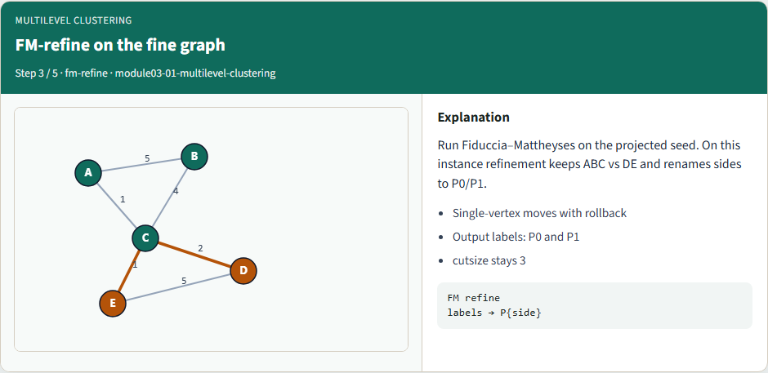
FM-refine on the fine graph
FM-refine on the fine graph
learn_clustering — 01 multilevel clustering
Notes:
Run Fiduccia–Mattheyses on the projected seed. On this instance refinement keeps ABC vs DE and renames sides to P0/P1.

Slide 5
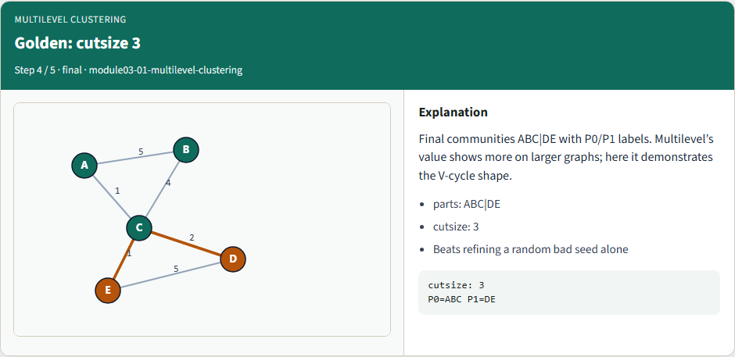
Golden: cutsize 3
Golden: cutsize 3
learn_clustering — 01 multilevel clustering
Notes:
Final communities ABC|DE with P0/P1 labels. Multilevel’s value shows more on larger graphs; here it demonstrates the V-cycle shape.

Slide 6
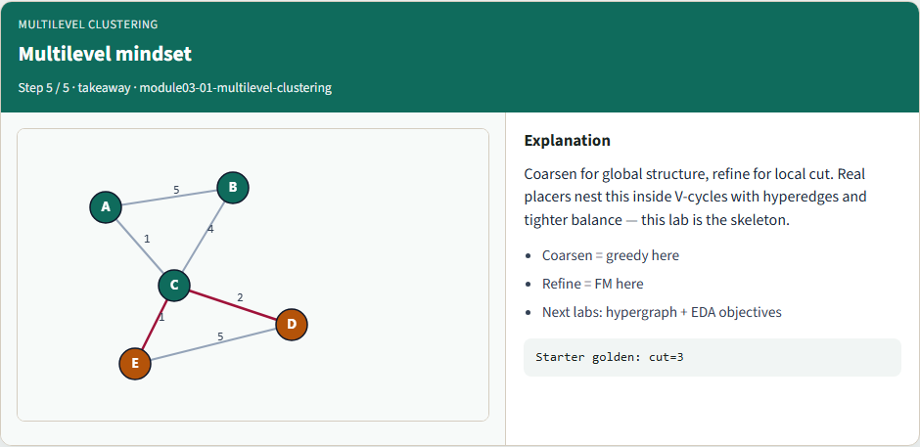
Multilevel mindset
Multilevel mindset
learn_clustering — 01 multilevel clustering
Notes:
Coarsen for global structure, refine for local cut. Real placers nest this inside V-cycles with hyperedges and tighter balance — this lab is the skeleton.

Slide 7
Browser lab track
In the browser lab, run multilevel and compare with a plain greedy seed
Clear challenges for the refined ABC|DE result
learn_clustering — 01 multilevel clustering
Notes:
In the browser lab, run multilevel and compare with a plain greedy seed. Clear challenges for the refined ABC|DE result.

Slide 8
Implement track
Run multilevel on the tiny graph and confirm cutsize three
Re-implement project-and-refine until the unit test passes
learn_clustering — 01 multilevel clustering
Notes:
Run multilevel on the tiny graph and confirm cutsize three. Re-implement project-and-refine until the unit test passes.

Slide 9
Implement track — try these
export PYTHONPATH=../common
python ../common/solvers.py examples/tiny_graph.json --mode
multilevel
learn_clustering — 01 multilevel clustering

Slide 10
Pitfalls to watch
Skipping refinement leaves coarsening artifacts
Projecting labels incorrectly scrambles the fine-level seed
Too aggressive coarsening can erase structure
learn_clustering — 01 multilevel clustering
Notes:
Skipping refinement leaves coarsening artifacts. Projecting labels incorrectly scrambles the fine-level seed. Too aggressive coarsening can erase structure.

Slide 11
Your turn
Match the golden, finish the checklist and quiz, then continue to hypergraph clustering
learn_clustering — 01 multilevel clustering
Notes:
Match the golden, finish the checklist and quiz, then continue to hypergraph clustering.

