Slide 1
Hypergraph clustering
Netlists are hypergraphs, one net can touch many pins
learn_clustering — 03 hypergraph clustering
Notes:
Netlists are hypergraphs—one net can touch many pins. You’ll watch greedy clustering on a tiny hypergraph where multi-pin net n1 pulls A–B–C together.

Slide 2
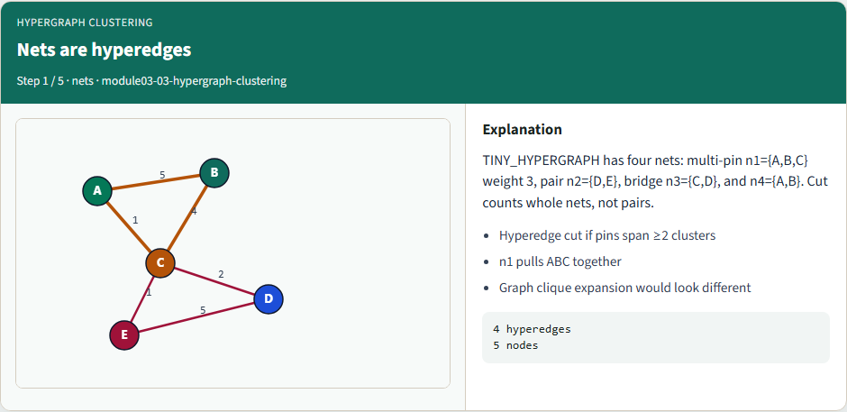
Nets are hyperedges
Nets are hyperedges
learn_clustering — 03 hypergraph clustering
Notes:
TINY_HYPERGRAPH has four nets: multi-pin n1={A,B,C} weight 3, pair n2={D,E}, bridge n3={C,D}, and n4={A,B}. Cut counts whole nets, not pairs.

Slide 3
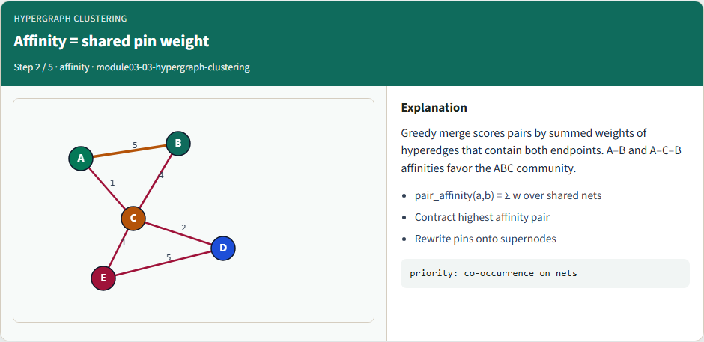
Affinity = shared pin weight
Affinity = shared pin weight
learn_clustering — 03 hypergraph clustering
Notes:
Greedy merge scores pairs by summed weights of hyperedges that contain both endpoints. A–B and A–C–B affinities favor the ABC community.

Slide 4
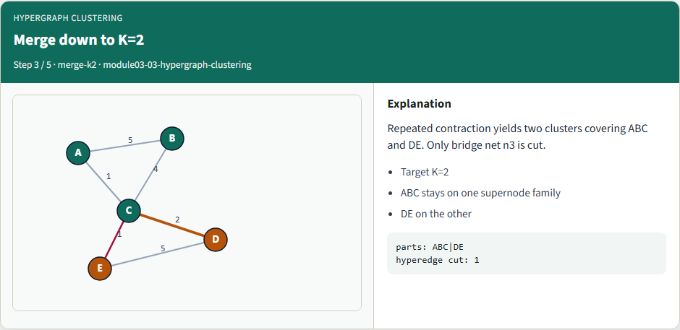
Merge down to K=2
Merge down to K=2
learn_clustering — 03 hypergraph clustering
Notes:
Repeated contraction yields two clusters covering ABC and DE. Only bridge net n3 is cut.

Slide 5
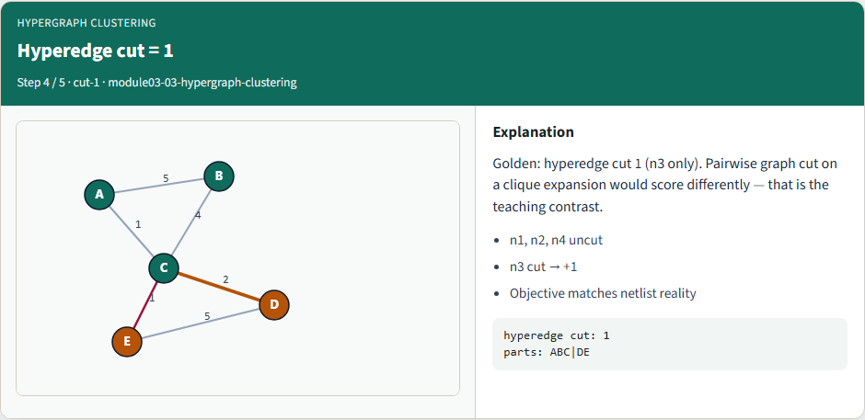
Hyperedge cut = 1
Hyperedge cut = 1
learn_clustering — 03 hypergraph clustering
Notes:
Golden: hyperedge cut 1 (n3 only). Pairwise graph cut on a clique expansion would score differently — that is the teaching contrast.

Slide 6
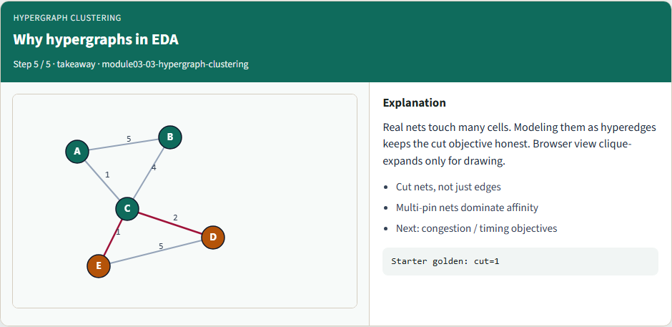
Why hypergraphs in EDA
Why hypergraphs in EDA
learn_clustering — 03 hypergraph clustering
Notes:
Real nets touch many cells. Modeling them as hyperedges keeps the cut objective honest. Browser view clique-expands only for drawing.

Slide 7
Browser lab track
In the browser lab, load the starter hypergraph and run greedy clustering to K equals two
Confirm hyperedge cut one for ABC versus DE
learn_clustering — 03 hypergraph clustering
Notes:
In the browser lab, load the starter hypergraph and run greedy clustering to K equals two. Confirm hyperedge cut one for ABC versus DE.

Slide 8
Implement track
Run hypergraph greedy to K equals two
Confirm hyperedge cut one and the natural clusters
learn_clustering — 03 hypergraph clustering
Notes:
Run hypergraph greedy to K equals two. Confirm hyperedge cut one and the natural clusters.

Slide 9
Implement track — try these
export PYTHONPATH=../common
python ../common/solvers.py examples/tiny_hypergraph.json --mode
hypergraph --k 2
learn_clustering — 03 hypergraph clustering

Slide 10
Pitfalls to watch
Clique-expanding hyperedges changes the objective
Counting a cut once per hyperedge, not per pair, is required
Empty or singleton nets must be filtered
learn_clustering — 03 hypergraph clustering
Notes:
Clique-expanding hyperedges changes the objective. Counting a cut once per hyperedge—not per pair—is required. Empty or singleton nets must be filtered.

Slide 11
Your turn
Match hyperedge cut one
learn_clustering — 03 hypergraph clustering
Notes:
Match hyperedge cut one, finish the checklist and quiz, then continue to congestion-aware clustering.

