Slide 1
Congestion-aware clustering
When bridge edges are congested, cutting them becomes expensive
learn_clustering — 01 congestion aware clustering
Notes:
When bridge edges are congested, cutting them becomes expensive. You’ll watch FM under a congestion penalty and see how lambda reshapes the partition.

Slide 2
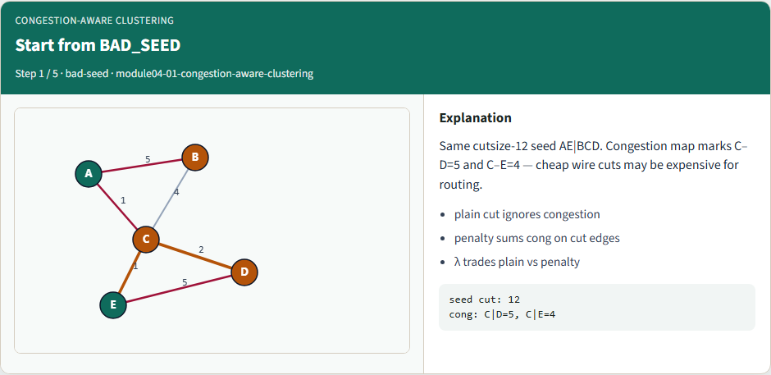
Start from BAD_SEED
Start from BAD_SEED
learn_clustering — 01 congestion aware clustering
Notes:
Same cutsize-12 seed AE|BCD. Congestion map marks C–D=5 and C–E=4 — cheap wire cuts may be expensive for routing.

Slide 3
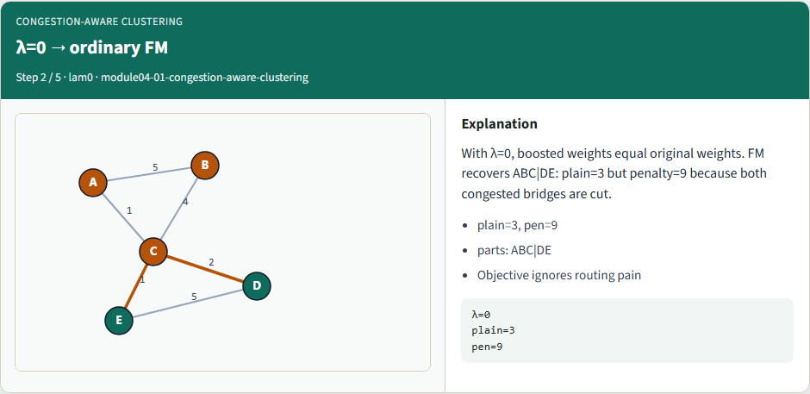
λ=0 → ordinary FM
λ=0 → ordinary FM
learn_clustering — 01 congestion aware clustering
Notes:
With λ=0, boosted weights equal original weights. FM recovers ABC|DE: plain=3 but penalty=9 because both congested bridges are cut.

Slide 4
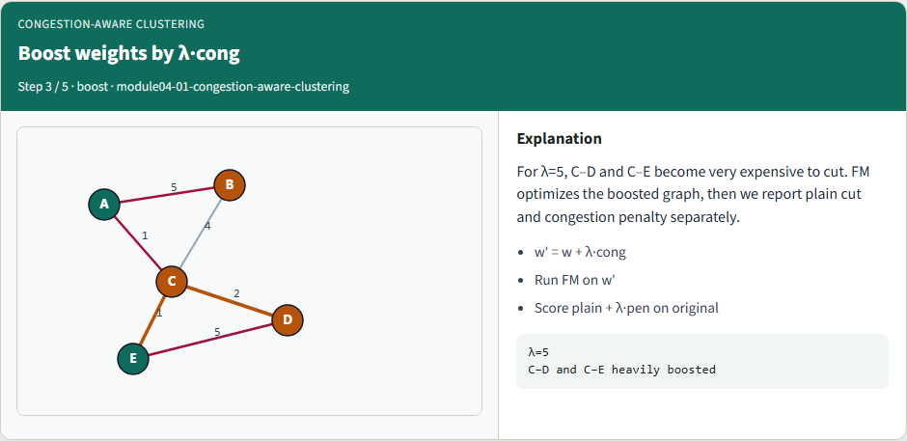
Boost weights by λ·cong
Boost weights by λ·cong
learn_clustering — 01 congestion aware clustering
Notes:
For λ=5, C–D and C–E become very expensive to cut. FM optimizes the boosted graph, then we report plain cut and congestion penalty separately.

Slide 5
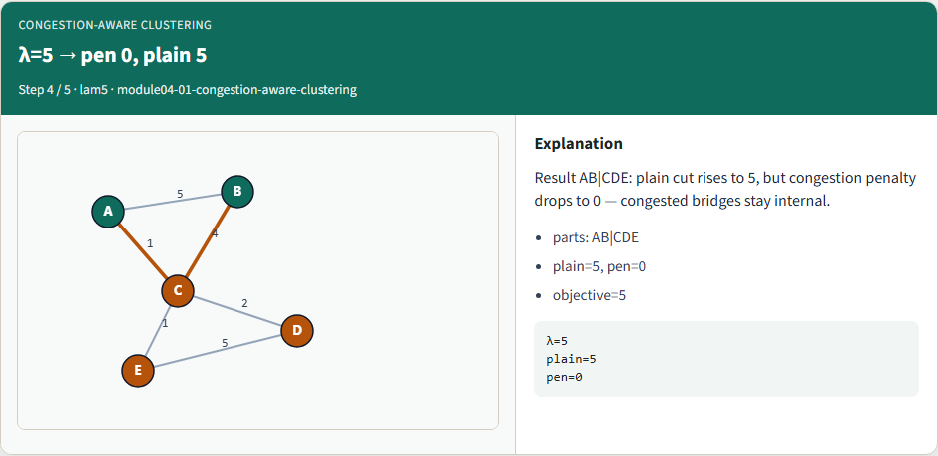
λ=5 → pen 0, plain 5
λ=5 → pen 0, plain 5
learn_clustering — 01 congestion aware clustering
Notes:
Result AB|CDE: plain cut rises to 5, but congestion penalty drops to 0 — congested bridges stay internal.

Slide 6
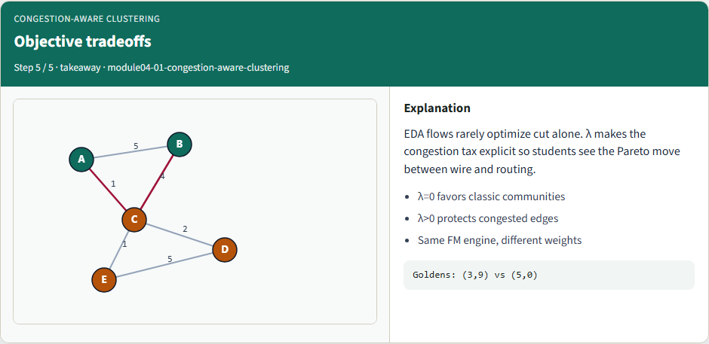
Objective tradeoffs
Objective tradeoffs
learn_clustering — 01 congestion aware clustering
Notes:
EDA flows rarely optimize cut alone. λ makes the congestion tax explicit so students see the Pareto move between wire and routing.

Slide 7
Browser lab track
In the browser lab, compare lambda zero with lambda five from the same bad seed
Watch the penalty drop to zero when the congested bridge is avoided
learn_clustering — 01 congestion aware clustering
Notes:
In the browser lab, compare lambda zero with lambda five from the same bad seed. Watch the penalty drop to zero when the congested bridge is avoided.

Slide 8
Implement track
Run congestion-aware partition at lambda zero and five
Confirm plain cut three with penalty nine at lambda zero
learn_clustering — 01 congestion aware clustering
Notes:
Run congestion-aware partition at lambda zero and five. Confirm plain cut three with penalty nine at lambda zero, and plain five with penalty zero at lambda five.

Slide 9
Implement track — try these
export PYTHONPATH=../common
python ../common/solvers.py examples/tiny_graph.json --mode
congestion --seed ../module02-05-kernighan-
lin/examples/seed_partition.json --congestion
examples/congestion.json --lambda 5
learn_clustering — 01 congestion aware clustering

Slide 10
Pitfalls to watch
Applying congestion only after FM misses the point, weights must change before moves
Huge lambda can ignore connectivity entirely
learn_clustering — 01 congestion aware clustering
Notes:
Applying congestion only after FM misses the point—weights must change before moves. Huge lambda can ignore connectivity entirely.

Slide 11
Your turn
Match both lambda goldens
learn_clustering — 01 congestion aware clustering
Notes:
Match both lambda goldens, finish the checklist and quiz, then continue to timing-aware clustering.

