Slide 1
Timing-aware clustering
Critical nets should stay uncut
learn_clustering — 03 timing aware clustering
Notes:
Critical nets should stay uncut. You’ll watch FM on criticality-weighted edges and land on cutsize three with weighted cut seven—protecting the A–B–C path.

Slide 2
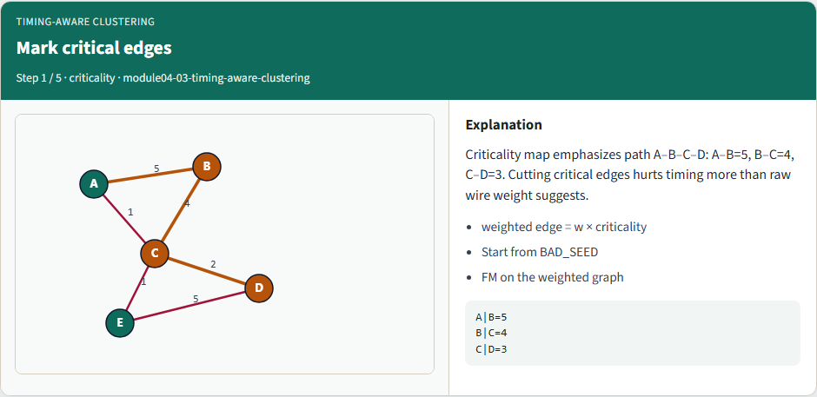
Mark critical edges
Mark critical edges
learn_clustering — 03 timing aware clustering
Notes:
Criticality map emphasizes path A–B–C–D: A–B=5, B–C=4, C–D=3. Cutting critical edges hurts timing more than raw wire weight suggests.

Slide 3
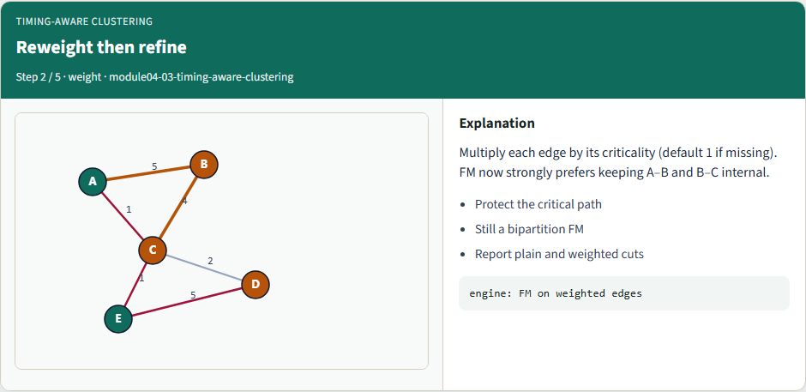
Reweight then refine
Reweight then refine
learn_clustering — 03 timing aware clustering
Notes:
Multiply each edge by its criticality (default 1 if missing). FM now strongly prefers keeping A–B and B–C internal.

Slide 4
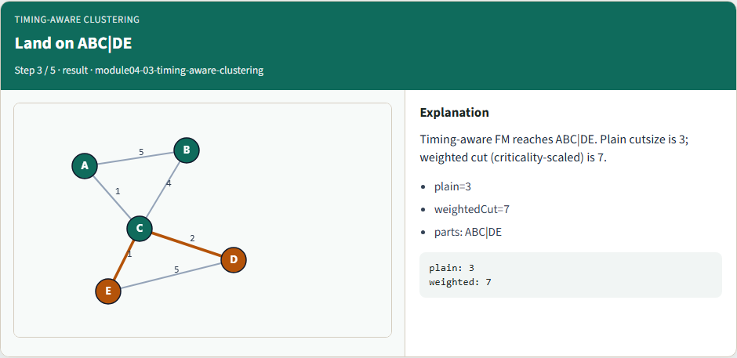
Land on ABC|DE
Land on ABC|DE
learn_clustering — 03 timing aware clustering
Notes:
Timing-aware FM reaches ABC|DE. Plain cutsize is 3; weighted cut (criticality-scaled) is 7.

Slide 5
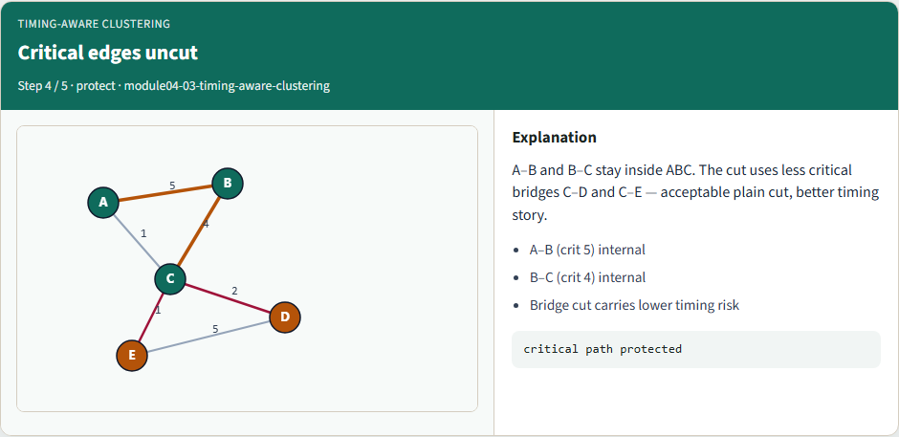
Critical edges uncut
Critical edges uncut
learn_clustering — 03 timing aware clustering
Notes:
A–B and B–C stay inside ABC. The cut uses less critical bridges C–D and C–E — acceptable plain cut, better timing story.

Slide 6
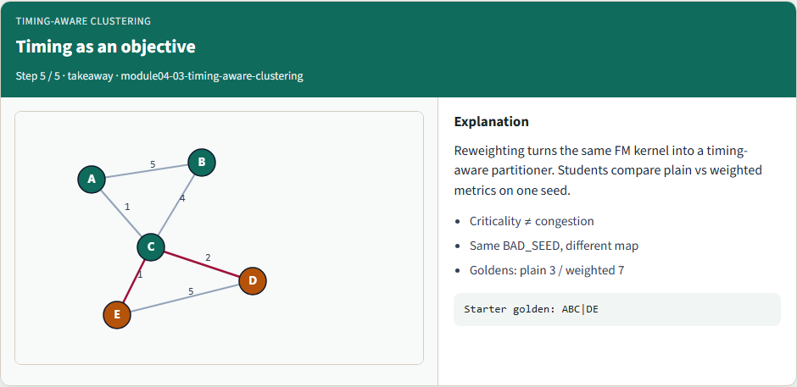
Timing as an objective
Timing as an objective
learn_clustering — 03 timing aware clustering
Notes:
Reweighting turns the same FM kernel into a timing-aware partitioner. Students compare plain vs weighted metrics on one seed.

Slide 7
Browser lab track
In the browser lab, run timing-aware refinement from the bad seed
Confirm plain cut three and weighted cut seven
learn_clustering — 03 timing aware clustering
Notes:
In the browser lab, run timing-aware refinement from the bad seed. Confirm plain cut three and weighted cut seven.

Slide 8
Implement track
Run timing-aware mode and confirm ABC versus DE, plain three, weighted seven
learn_clustering — 03 timing aware clustering
Notes:
Run timing-aware mode and confirm ABC versus DE, plain three, weighted seven.

Slide 9
Implement track — try these
export PYTHONPATH=../common
python ../common/solvers.py examples/tiny_graph.json --mode timing
--seed ../module02-05-kernighan-lin/examples/seed_partition.json
--criticality examples/criticality.json
learn_clustering — 03 timing aware clustering

Slide 10
Pitfalls to watch
Criticality of one means no boost, document defaults
Mixing plain and weighted metrics in the same table confuses compares
learn_clustering — 03 timing aware clustering
Notes:
Criticality of one means no boost—document defaults. Mixing plain and weighted metrics in the same table confuses compares.

Slide 11
Your turn
Match the golden
learn_clustering — 03 timing aware clustering
Notes:
Match the golden, finish the checklist and quiz, then continue to offline benchmark compare.

