Slide 1
Site and row model
Legalization snaps cells to a discrete grid
learn_legalization — 01 site row model
Notes:
Legalization snaps cells to a discrete grid. Our teaching chip is twelve sites wide and six high—three rows with bottoms at y zero, two, and four. Cell widths A through D are two sites; E and F are one. Total width ten fits inside twelve with room to pack.

Slide 2
The idea
Every cell sits on exactly one row with a lower-left coordinate aligned to site pitch one
Width tells you how many consecutive sites the rectangle covers
The golden packing is legal
learn_legalization — 01 site row model
Notes:
Every cell sits on exactly one row with a lower-left coordinate aligned to site pitch one. Width tells you how many consecutive sites the rectangle covers. The golden packing is legal; the overlap seed stacks A, B, and C at (4, 2) to show what illegal looks like.

Slide 3
Pseudocode
Pseudocode is the written sketch of the algorithm before you code it
For this module the sketch is the site and row model itself
Outputs are the rules every legal packing must obey
Open this module's examples file and find the Pseudocode section
That written sketch is what you implement on the implement track and what the browser
learn_legalization — 01 site row model
Notes:
Pseudocode is the written sketch of the algorithm before you code it. For this module the sketch is the site and row model itself: inputs are chip size, site pitch, row bottoms, and cell widths. Outputs are the rules every legal packing must obey.
Open this module's examples file and find the Pseudocode section. That written sketch is what you implement on the implement track and what the browser challenges measure.

Slide 4
Algorithm sketch
Read the sketch as a contract
Every cell lower-left sits on a site and a row bottom
Width tells how many consecutive sites the rectangle covers
Our teaching chip is twelve by six with three rows
learn_legalization — 01 site row model
Notes:
Read the sketch as a contract. Every cell lower-left sits on a site and a row bottom. Width tells how many consecutive sites the rectangle covers. Our teaching chip is twelve by six with three rows—that is the instance every later lab shares.

Slide 5
Algorithm sketch — try these
INPUT: chip W×H, siteW, rowH, rows Y[], widths w[c]
OUTPUT: legal coordinate rules
for each cell c:
x multiple of siteW; y in Y[]
occupies [x, x+w[c]) × [y, y+rowH)
GOLDEN: W=12 H=6 siteW=1 rowH=2 Y={0,2,4}
widths A–D=2 E–F=1 (total 10 ≤ 12)
learn_legalization — 01 site row model

Slide 6
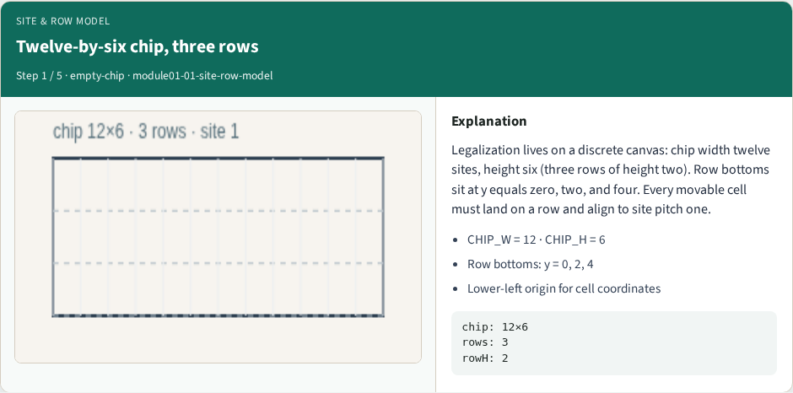
Twelve-by-six chip, three rows
Twelve-by-six chip, three rows
learn_legalization — 01 site row model
Notes:
Legalization lives on a discrete canvas: chip width twelve sites, height six (three rows of height two). Row bottoms sit at y equals zero, two, and four. Every movable cell must land on a row and align to site pitch one.

Slide 7
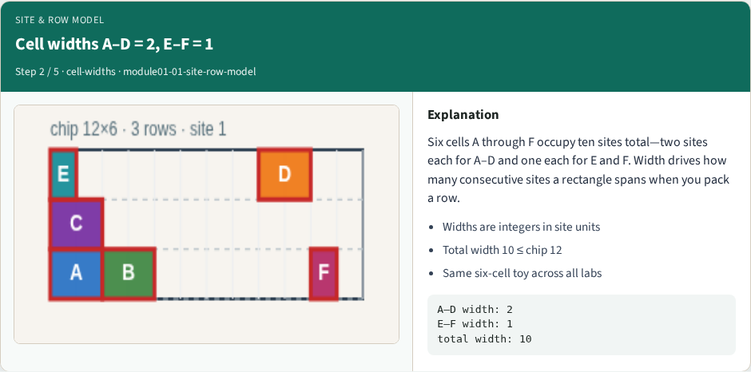
Cell widths A–D = 2, E–F = 1
Cell widths A–D = 2, E–F = 1
learn_legalization — 01 site row model
Notes:
Six cells A through F occupy ten sites total—two sites each for A–D and one each for E and F. Width drives how many consecutive sites a rectangle spans when you pack a row.

Slide 8
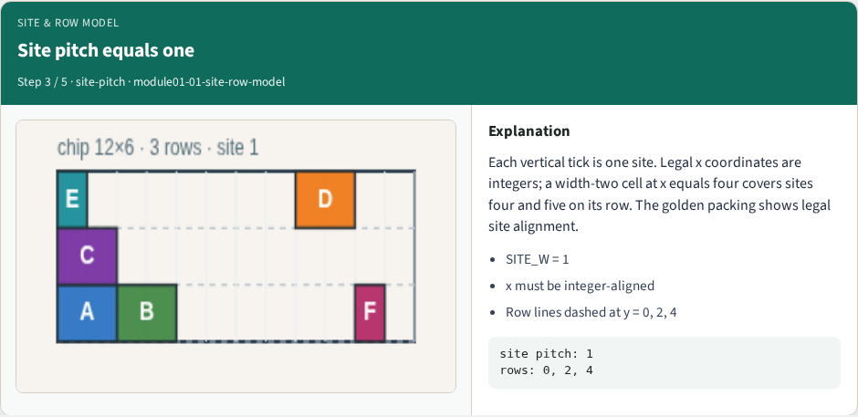
Site pitch equals one
Site pitch equals one
learn_legalization — 01 site row model
Notes:
Each vertical tick is one site. Legal x coordinates are integers; a width-two cell at x equals four covers sites four and five on its row. The golden packing shows legal site alignment.

Slide 9
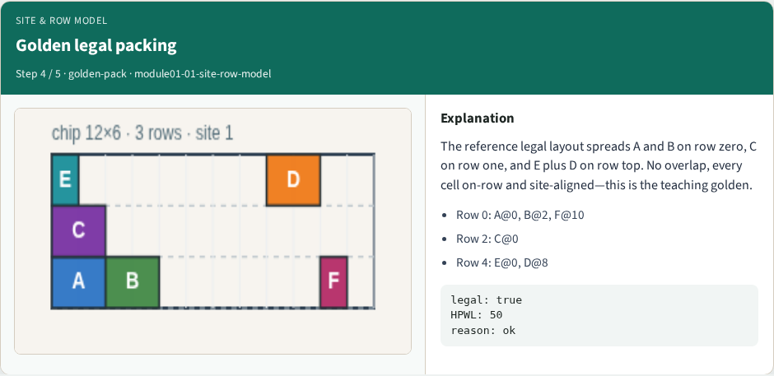
Golden legal packing
Golden legal packing
learn_legalization — 01 site row model
Notes:
The reference legal layout spreads A and B on row zero, C on row one, and E plus D on row top. No overlap, every cell on-row and site-aligned—this is the teaching golden.

Slide 10
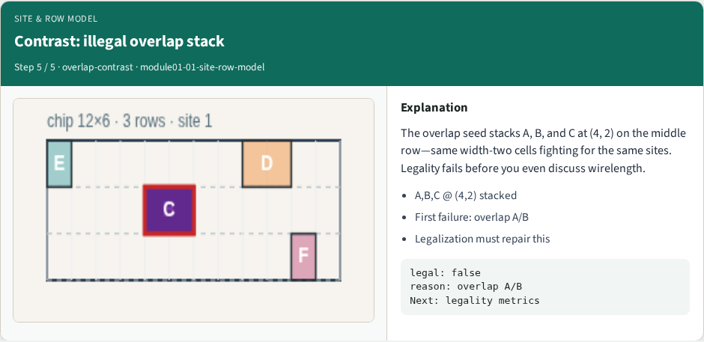
Contrast: illegal overlap stack
Contrast: illegal overlap stack
learn_legalization — 01 site row model
Notes:
The overlap seed stacks A, B, and C at (4, 2) on the middle row—same width-two cells fighting for the same sites. Legality fails before you even discuss wirelength.

Slide 11
Browser lab track
In the browser lab track, open the site-row-model lab from the tools shelf
Open the interactive lab
Reveal golden is study-only
Work the challenges that lock the goldens
learn_legalization — 01 site row model
Notes:
In the browser lab track, open the **site-row-model** lab from the tools shelf. Open the interactive lab, place or snap cells on the site and row grid—or use an Apply helper—then Check. Reveal golden is study-only. Work the challenges that lock the goldens, then come back to implement the same loop yourself.

Slide 12
Implement track
In the implement track
Parse `tiny_legal.json`, run the algorithm with deterministic coordinates
Match the browser goldens before you claim the checklist
learn_legalization — 01 site row model
Notes:
In the implement track, open this module's EXAMPLES.md Pseudocode section and the course common solvers. Parse `tiny_legal.json`, run the algorithm with deterministic coordinates, and print legality, displacement, and HPWL. Match the browser goldens before you claim the checklist.

Slide 13
Pitfalls
Common traps
learn_legalization — 01 site row model
Notes:
Common traps: assuming snap alone legalizes; forgetting site width when checking overlap; ignoring fixed macro D at (8, 4); reporting HPWL without legality; and comparing Abacus and Tetris without naming displacement versus wirelength tradeoffs.

Slide 14
Your turn
Complete the checklist for at least one track, preferably both
Implement until your metrics match the starter goldens
When you're ready, take the short quiz, then continue to the next module
learn_legalization — 01 site row model
Notes:
Complete the checklist for at least one track—preferably both. Implement until your metrics match the starter goldens. When you're ready, take the short quiz, then continue to the next module.

