Slide 1
Legality metrics
Before you celebrate wirelength, ask whether the placement is legal
learn_legalization — 03 legality metrics
Notes:
Before you celebrate wirelength, ask whether the placement is legal. On the overlap seed the checker fails with overlap A/B—three cells share the middle row at x four. The golden reference passes with reason ok.

Slide 2
The idea
Check on-row placement, site alignment, in-chip bounds, and pairwise overlap
Report displacement as L1 Manhattan distance from the origin layout
Pair legality with HPWL after legalize
learn_legalization — 03 legality metrics
Notes:
Check on-row placement, site alignment, in-chip bounds, and pairwise overlap. Report displacement as L1 Manhattan distance from the origin layout—Abacus moves four total units on this instance, overlap removal moves six. Pair legality with HPWL after legalize.

Slide 3
Pseudocode
Before you trust wirelength, write a legality checker in pseudocode
Inputs are coordinates and widths
The loop walks cells and pairs
The stop condition is the first failure reason, or ok when every check passes
Open this module's examples file and find the Pseudocode section
That written sketch is what you implement on the implement track and what the browser
learn_legalization — 03 legality metrics
Notes:
Before you trust wirelength, write a legality checker in pseudocode. Inputs are coordinates and widths. The loop walks cells and pairs. The stop condition is the first failure reason—or ok when every check passes.
Open this module's examples file and find the Pseudocode section. That written sketch is what you implement on the implement track and what the browser challenges measure.

Slide 4
Algorithm sketch
The sketch also defines the metrics you report after a legalize pass
On the overlap seed the checker fails with overlap A/B; the golden packing returns ok
learn_legalization — 03 legality metrics
Notes:
The sketch also defines the metrics you report after a legalize pass: L1 displacement from the origin layout, and HPWL from cell centers. On the overlap seed the checker fails with overlap A/B; the golden packing returns ok.

Slide 5
Algorithm sketch — try these
INPUT: positions, widths, chip, optional fixed
OUTPUT: legal?, reason, disp, HPWL
for each cell c:
fail if off-site, off-row, outside, or macro moved
for each same-row pair (a,b):
fail if [x,x+w) intervals overlap
disp = Σ|Δx|+|Δy|; HPWL = Σ net bbox (centers)
GOLDEN: overlap → "overlap A/B"; golden → "ok"
learn_legalization — 03 legality metrics

Slide 6
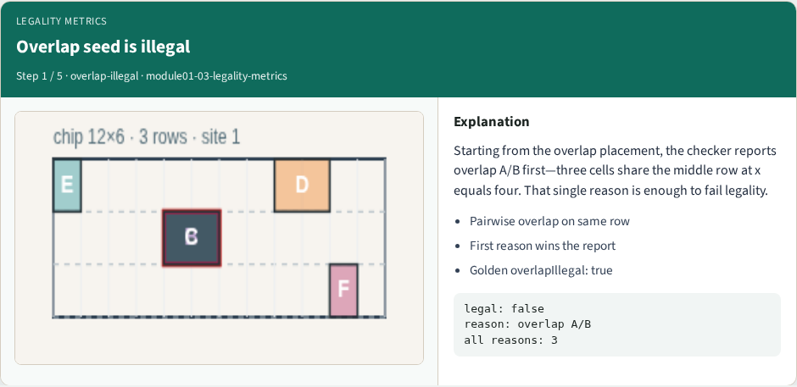
Overlap seed is illegal
Overlap seed is illegal
learn_legalization — 03 legality metrics
Notes:
Starting from the overlap placement, the checker reports overlap A/B first—three cells share the middle row at x equals four. That single reason is enough to fail legality.

Slide 7
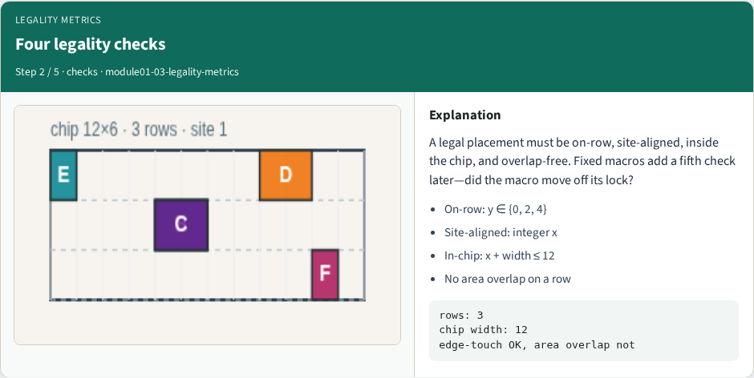
Four legality checks
Four legality checks
learn_legalization — 03 legality metrics
Notes:
A legal placement must be on-row, site-aligned, inside the chip, and overlap-free. Fixed macros add a fifth check later—did the macro move off its lock?

Slide 8
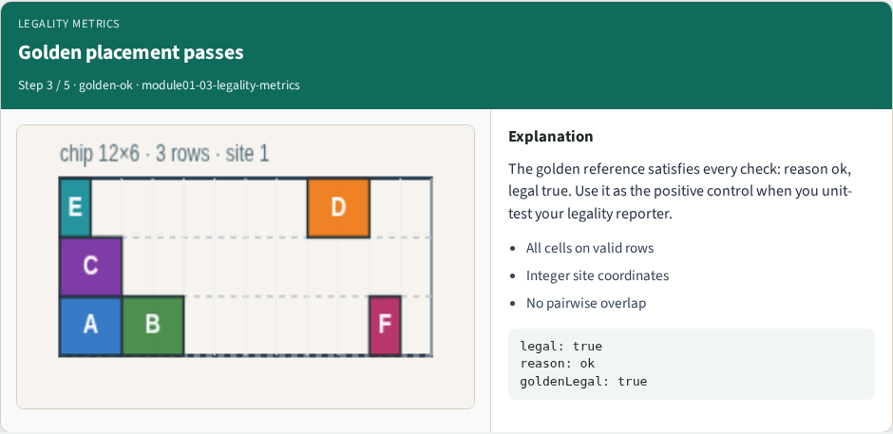
Golden placement passes
Golden placement passes
learn_legalization — 03 legality metrics
Notes:
The golden reference satisfies every check: reason ok, legal true. Use it as the positive control when you unit-test your legality reporter.

Slide 9
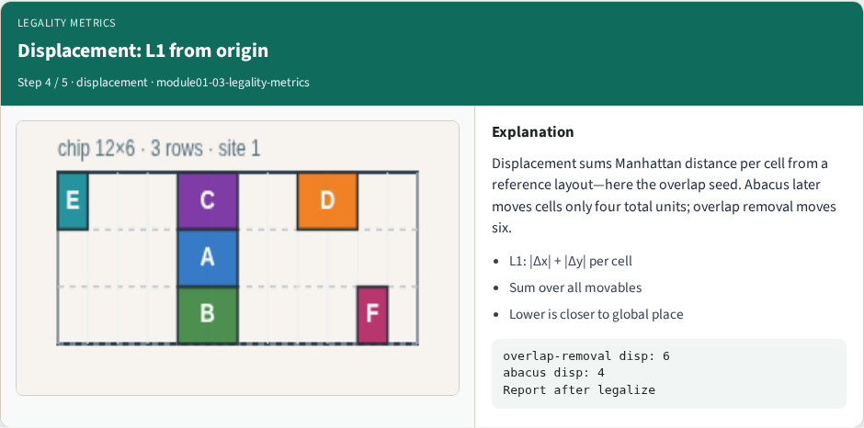
Displacement: L1 from origin
Displacement: L1 from origin
learn_legalization — 03 legality metrics
Notes:
Displacement sums Manhattan distance per cell from a reference layout—here the overlap seed. Abacus later moves cells only four total units; overlap removal moves six.

Slide 10
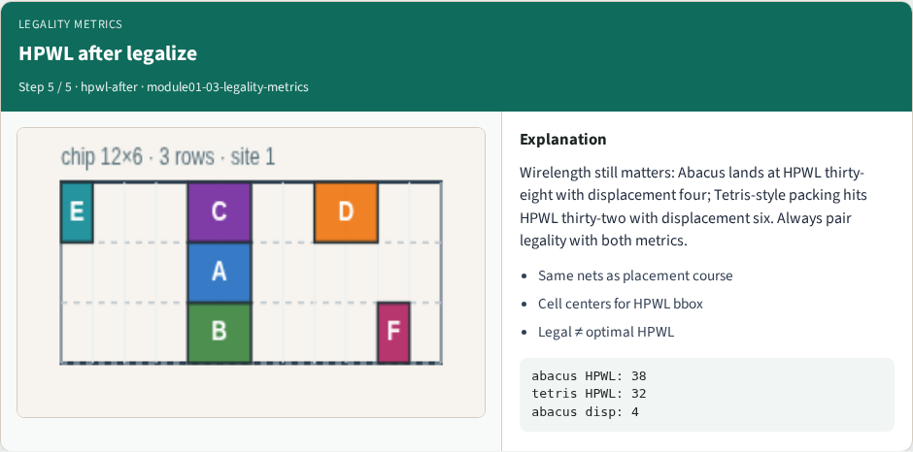
HPWL after legalize
HPWL after legalize
learn_legalization — 03 legality metrics
Notes:
Wirelength still matters: Abacus lands at HPWL thirty-eight with displacement four; Tetris-style packing hits HPWL thirty-two with displacement six. Always pair legality with both metrics.

Slide 11
Browser lab track
In the browser lab track, open the legality-metrics lab from the tools shelf
Open the interactive lab
Reveal golden is study-only
Work the challenges that lock the goldens
learn_legalization — 03 legality metrics
Notes:
In the browser lab track, open the **legality-metrics** lab from the tools shelf. Open the interactive lab, place or snap cells on the site and row grid—or use an Apply helper—then Check. Reveal golden is study-only. Work the challenges that lock the goldens, then come back to implement the same loop yourself.

Slide 12
Implement track
In the implement track
Parse `tiny_legal.json`, run the algorithm with deterministic coordinates
Match the browser goldens before you claim the checklist
learn_legalization — 03 legality metrics
Notes:
In the implement track, open this module's EXAMPLES.md Pseudocode section and the course common solvers. Parse `tiny_legal.json`, run the algorithm with deterministic coordinates, and print legality, displacement, and HPWL. Match the browser goldens before you claim the checklist.

Slide 13
Pitfalls
Common traps
learn_legalization — 03 legality metrics
Notes:
Common traps: assuming snap alone legalizes; forgetting site width when checking overlap; ignoring fixed macro D at (8, 4); reporting HPWL without legality; and comparing Abacus and Tetris without naming displacement versus wirelength tradeoffs.

Slide 14
Your turn
Complete the checklist for at least one track, preferably both
Implement until your metrics match the starter goldens
When you're ready, take the short quiz, then continue to the next module
learn_legalization — 03 legality metrics
Notes:
Complete the checklist for at least one track—preferably both. Implement until your metrics match the starter goldens. When you're ready, take the short quiz, then continue to the next module.

