Slide 1
Greedy snap
Global placement leaves fractional coordinates, the float seed puts A near (3.7, 1.2) and B near (4.1, 1.4)
learn_legalization — 01 greedy snap
Notes:
Global placement leaves fractional coordinates—the float seed puts A near (3.7, 1.2) and B near (4.1, 1.4). Greedy snap rounds x to the nearest site and y to the nearest row. A lands at (4, 2)—the same site as B.

Slide 2
The idea
Snap quantizes coordinates but does not remove overlap
After snap, A and B still fail with overlap A/B
Teaching point
learn_legalization — 01 greedy snap
Notes:
Snap quantizes coordinates but does not remove overlap. After snap, A and B still fail with overlap A/B. Teaching point: snap is necessary, not sufficient—you need overlap removal or Abacus packing next.

Slide 3
Pseudocode
Greedy snap is the first written loop after global place
Pseudocode here has one pass
Fixed macros stay put
Open this module's examples file and find the Pseudocode section
That written sketch is what you implement on the implement track and what the browser
learn_legalization — 01 greedy snap
Notes:
Greedy snap is the first written loop after global place. Pseudocode here has one pass: for each movable cell, round x to a site and y to the nearest row. Fixed macros stay put.
Open this module's examples file and find the Pseudocode section. That written sketch is what you implement on the implement track and what the browser challenges measure.

Slide 4
Algorithm sketch
The important line in the sketch is the note after the loop: snap does not remove overlap
On the float starter
learn_legalization — 01 greedy snap
Notes:
The important line in the sketch is the note after the loop: snap does not remove overlap. On the float starter, A and B both land at four comma two—so legality still fails until a packer runs.

Slide 5
Algorithm sketch — try these
INPUT: float positions, widths, rows Y[], chip W
OUTPUT: snapped positions (may still overlap)
for each movable cell c:
x ← round(x) clamped to [0, W−w[c]]
y ← nearest row in Y[]
fixed macros: keep locked (x,y)
NOTE: snap ≠ legal — A,B may share a site
GOLDEN float: A→(4,2), B→(4,2) still overlap
learn_legalization — 01 greedy snap

Slide 6
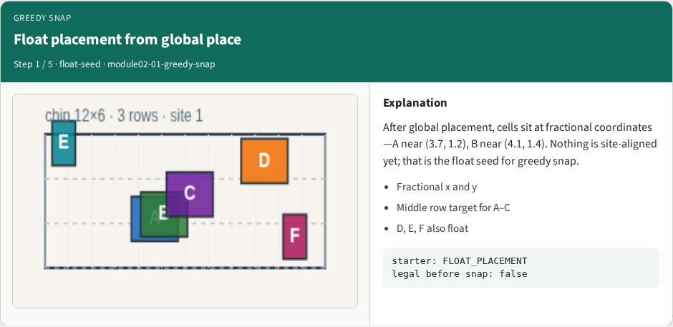
Float placement from global place
Float placement from global place
learn_legalization — 01 greedy snap
Notes:
After global placement, cells sit at fractional coordinates—A near (3.7, 1.2), B near (4.1, 1.4). Nothing is site-aligned yet; that is the float seed for greedy snap.

Slide 7
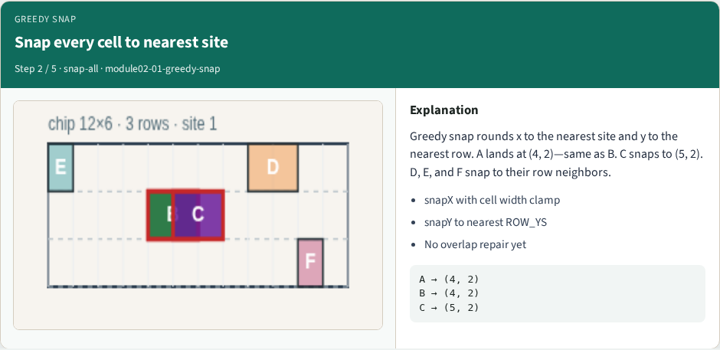
Snap every cell to nearest site
Snap every cell to nearest site
learn_legalization — 01 greedy snap
Notes:
Greedy snap rounds x to the nearest site and y to the nearest row. A lands at (4, 2)—same as B. C snaps to (5, 2). D, E, and F snap to their row neighbors.

Slide 8
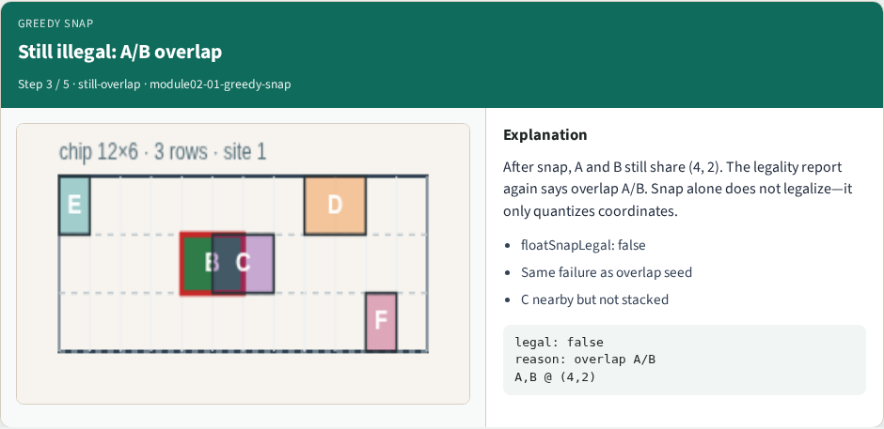
Still illegal: A/B overlap
Still illegal: A/B overlap
learn_legalization — 01 greedy snap
Notes:
After snap, A and B still share (4, 2). The legality report again says overlap A/B. Snap alone does not legalize—it only quantizes coordinates.

Slide 9
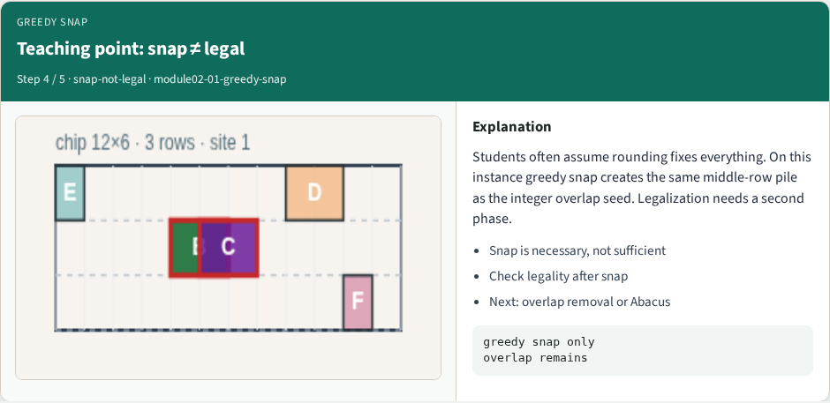
Teaching point: snap ≠ legal
Teaching point: snap ≠ legal
learn_legalization — 01 greedy snap
Notes:
Students often assume rounding fixes everything. On this instance greedy snap creates the same middle-row pile as the integer overlap seed. Legalization needs a second phase.

Slide 10
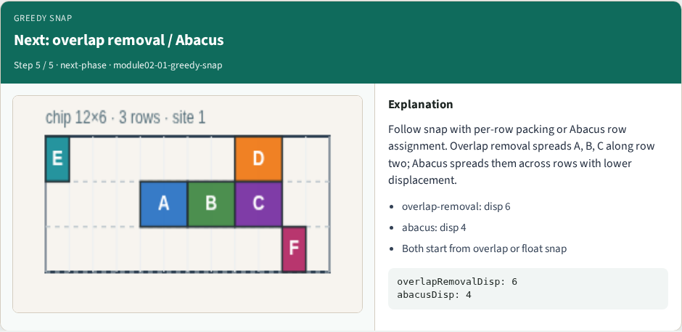
Next: overlap removal / Abacus
Next: overlap removal / Abacus
learn_legalization — 01 greedy snap
Notes:
Follow snap with per-row packing or Abacus row assignment. Overlap removal spreads A, B, C along row two; Abacus spreads them across rows with lower displacement.

Slide 11
Browser lab track
In the browser lab track, open the greedy-snap lab from the tools shelf
Open the interactive lab
Reveal golden is study-only
Work the challenges that lock the goldens
learn_legalization — 01 greedy snap
Notes:
In the browser lab track, open the **greedy-snap** lab from the tools shelf. Open the interactive lab, place or snap cells on the site and row grid—or use an Apply helper—then Check. Reveal golden is study-only. Work the challenges that lock the goldens, then come back to implement the same loop yourself.

Slide 12
Implement track
In the implement track
Parse `tiny_legal.json`, run the algorithm with deterministic coordinates
Match the browser goldens before you claim the checklist
learn_legalization — 01 greedy snap
Notes:
In the implement track, open this module's EXAMPLES.md Pseudocode section and the course common solvers. Parse `tiny_legal.json`, run the algorithm with deterministic coordinates, and print legality, displacement, and HPWL. Match the browser goldens before you claim the checklist.

Slide 13
Pitfalls
Common traps
learn_legalization — 01 greedy snap
Notes:
Common traps: assuming snap alone legalizes; forgetting site width when checking overlap; ignoring fixed macro D at (8, 4); reporting HPWL without legality; and comparing Abacus and Tetris without naming displacement versus wirelength tradeoffs.

Slide 14
Your turn
Complete the checklist for at least one track, preferably both
Implement until your metrics match the starter goldens
When you're ready, take the short quiz, then continue to the next module
learn_legalization — 01 greedy snap
Notes:
Complete the checklist for at least one track—preferably both. Implement until your metrics match the starter goldens. When you're ready, take the short quiz, then continue to the next module.

