Slide 1
Overlap removal
Overlap removal snaps first, then left-packs each row without changing row assignment
learn_legalization — 03 overlap removal
Notes:
Overlap removal snaps first, then left-packs each row without changing row assignment. From the triple stack at (4, 2), A stays at four, B moves to six, C to eight on the middle row—legal with displacement six and HPWL thirty-two.

Slide 2
The idea
Sort movables by x within each row and place left without overlap
D, E, and F keep their seed roles on other rows
This is the same shelf pack Tetris uses, simple, deterministic
learn_legalization — 03 overlap removal
Notes:
Sort movables by x within each row and place left without overlap. D, E, and F keep their seed roles on other rows. This is the same shelf pack Tetris uses—simple, deterministic, and a good global legalize baseline.

Slide 3
Pseudocode
Overlap removal is a two-phase sketch: snap first, then pack each row
Pseudocode makes the phases explicit so you do not merge them into one vague “fix
Open this module's examples file and find the Pseudocode section
That written sketch is what you implement on the implement track and what the browser
learn_legalization — 03 overlap removal
Notes:
Overlap removal is a two-phase sketch: snap first, then pack each row. Pseudocode makes the phases explicit so you do not merge them into one vague “fix overlaps” bullet.
Open this module's examples file and find the Pseudocode section. That written sketch is what you implement on the implement track and what the browser challenges measure.

Slide 4
Algorithm sketch
Inside each row
On the teaching seed that yields A at four
learn_legalization — 03 overlap removal
Notes:
Inside each row, sort by x and place left without interval overlap, skipping fixed macro blocks. On the teaching seed that yields A at four, B at six, C at eight on the middle row—displacement six, HPWL thirty-two.

Slide 5
Algorithm sketch — try these
INPUT: positions, widths, rows, fixed macros
OUTPUT: legal packing (if capacity allows)
snap all movables to sites/rows
for each row y:
sort movables by x; left-pack (skip macros)
report legal?, disp, HPWL
GOLDEN: A@4 B@6 C@8 on y=2; disp=6; HPWL=32
learn_legalization — 03 overlap removal

Slide 6
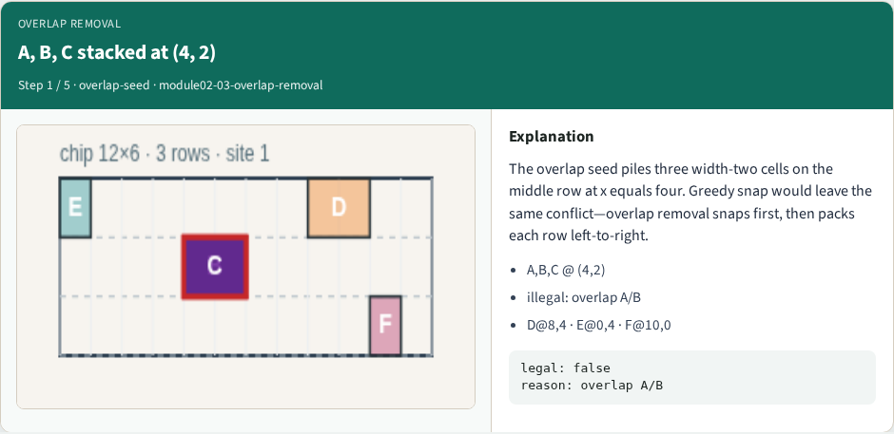
A, B, C stacked at (4, 2)
A, B, C stacked at (4, 2)
learn_legalization — 03 overlap removal
Notes:
The overlap seed piles three width-two cells on the middle row at x equals four. Greedy snap would leave the same conflict—overlap removal snaps first, then packs each row left-to-right.

Slide 7
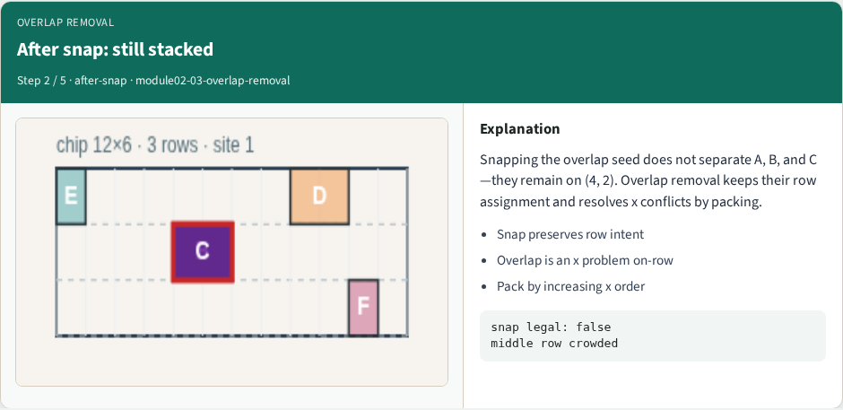
After snap: still stacked
After snap: still stacked
learn_legalization — 03 overlap removal
Notes:
Snapping the overlap seed does not separate A, B, and C—they remain on (4, 2). Overlap removal keeps their row assignment and resolves x conflicts by packing.

Slide 8
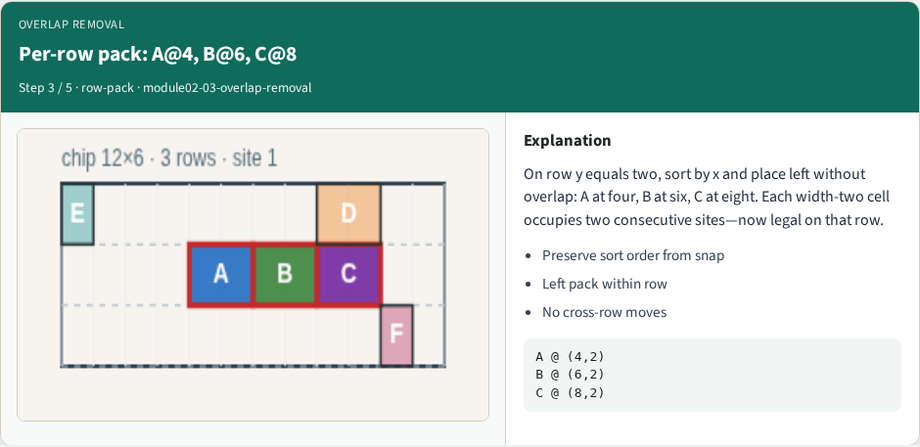
Per-row pack: A@4, B@6, C@8
Per-row pack: A@4, B@6, C@8
learn_legalization — 03 overlap removal
Notes:
On row y equals two, sort by x and place left without overlap: A at four, B at six, C at eight. Each width-two cell occupies two consecutive sites—now legal on that row.

Slide 9
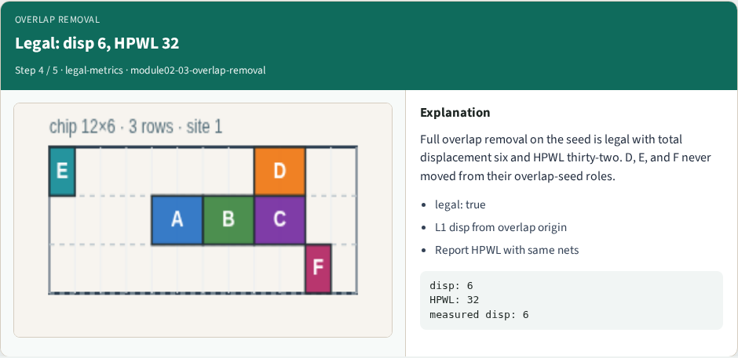
Legal: disp 6, HPWL 32
Legal: disp 6, HPWL 32
learn_legalization — 03 overlap removal
Notes:
Full overlap removal on the seed is legal with total displacement six and HPWL thirty-two. D, E, and F never moved from their overlap-seed roles.

Slide 10
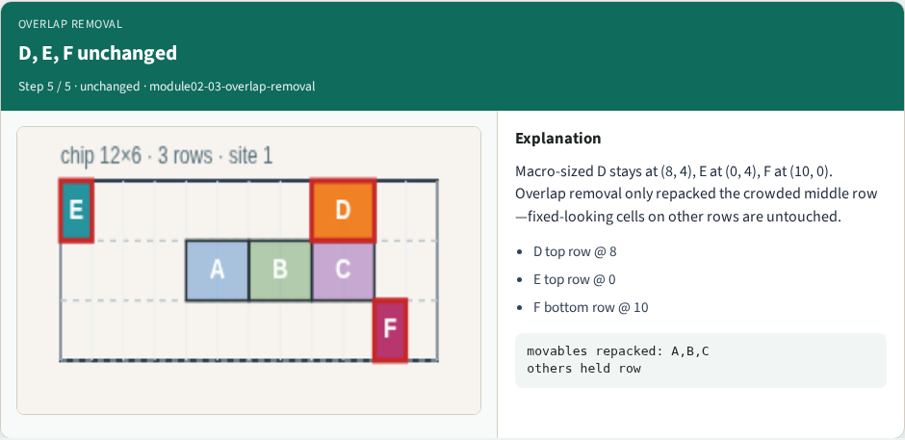
D, E, F unchanged
D, E, F unchanged
learn_legalization — 03 overlap removal
Notes:
Macro-sized D stays at (8, 4), E at (0, 4), F at (10, 0). Overlap removal only repacked the crowded middle row—fixed-looking cells on other rows are untouched.

Slide 11
Browser lab track
In the browser lab track, open the overlap-removal lab from the tools shelf
Open the interactive lab
Reveal golden is study-only
Work the challenges that lock the goldens
learn_legalization — 03 overlap removal
Notes:
In the browser lab track, open the **overlap-removal** lab from the tools shelf. Open the interactive lab, place or snap cells on the site and row grid—or use an Apply helper—then Check. Reveal golden is study-only. Work the challenges that lock the goldens, then come back to implement the same loop yourself.

Slide 12
Implement track
In the implement track
Parse `tiny_legal.json`, run the algorithm with deterministic coordinates
Match the browser goldens before you claim the checklist
learn_legalization — 03 overlap removal
Notes:
In the implement track, open this module's EXAMPLES.md Pseudocode section and the course common solvers. Parse `tiny_legal.json`, run the algorithm with deterministic coordinates, and print legality, displacement, and HPWL. Match the browser goldens before you claim the checklist.

Slide 13
Pitfalls
Common traps
learn_legalization — 03 overlap removal
Notes:
Common traps: assuming snap alone legalizes; forgetting site width when checking overlap; ignoring fixed macro D at (8, 4); reporting HPWL without legality; and comparing Abacus and Tetris without naming displacement versus wirelength tradeoffs.

Slide 14
Your turn
Complete the checklist for at least one track, preferably both
Implement until your metrics match the starter goldens
When you're ready, take the short quiz, then continue to the next module
learn_legalization — 03 overlap removal
Notes:
Complete the checklist for at least one track—preferably both. Implement until your metrics match the starter goldens. When you're ready, take the short quiz, then continue to the next module.

