Slide 1
Abacus row packing
Abacus-lite processes cells by increasing x and tries every row
learn_legalization — 05 abacus row pack
Notes:
Abacus-lite processes cells by increasing x and tries every row. For each trial it finds the leftmost legal site and picks the row with minimum L1 displacement from the origin. On the overlap seed: A at (4, 2), B at (4, 0), C at (4, 4).

Slide 2
The idea
Cross-row spread beats single-row shelf pack on displacement
Abacus is the detailed legalizer in this course: more search, less movement
learn_legalization — 05 abacus row pack
Notes:
Cross-row spread beats single-row shelf pack on displacement—four versus six here—with HPWL thirty-eight versus thirty-two for Tetris. Abacus is the detailed legalizer in this course: more search, less movement.

Slide 3
Pseudocode
Abacus needs a nested loop in pseudocode: outer cells in x order, inner trial of every row
For each trial you compute leftmost legal x and an L1 cost back to the origin
Open this module's examples file and find the Pseudocode section
That written sketch is what you implement on the implement track and what the browser
learn_legalization — 05 abacus row pack
Notes:
Abacus needs a nested loop in pseudocode: outer cells in x order, inner trial of every row. For each trial you compute leftmost legal x and an L1 cost back to the origin, then keep the cheapest row.
Open this module's examples file and find the Pseudocode section. That written sketch is what you implement on the implement track and what the browser challenges measure.

Slide 4
Algorithm sketch
Fixed macros sit first so their intervals block later trials
On the overlap seed the sketch lands A at four two
learn_legalization — 05 abacus row pack
Notes:
Fixed macros sit first so their intervals block later trials. On the overlap seed the sketch lands A at four two, B at four zero, C at four four—displacement four and HPWL thirty-eight, tighter movement than Tetris.

Slide 5
Algorithm sketch — try these
INPUT: origin, widths, rows Y[], fixed macros
OUTPUT: legal pack minimizing Σ L1 move
place fixed macros first
order ← movables by origin.x
for each cell c in order:
for each row y: trial leftmost legal x
keep (x,y) with min |Δx|+|Δy| to origin
place c at best
GOLDEN: A(4,2) B(4,0) C(4,4); disp=4; HPWL=38
learn_legalization — 05 abacus row pack

Slide 6
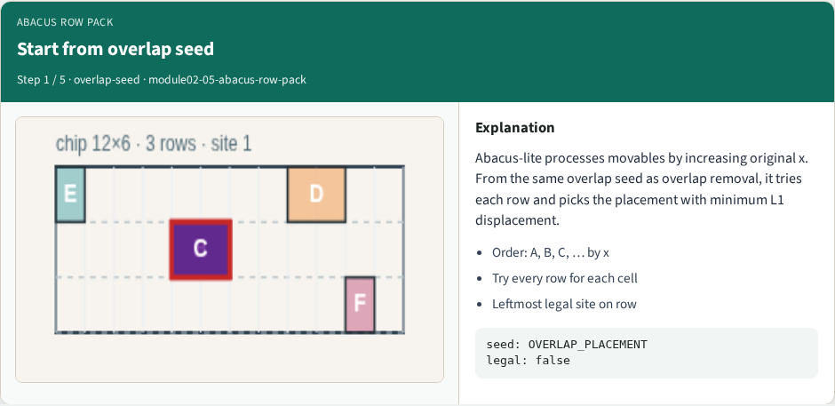
Start from overlap seed
Start from overlap seed
learn_legalization — 05 abacus row pack
Notes:
Abacus-lite processes movables by increasing original x. From the same overlap seed as overlap removal, it tries each row and picks the placement with minimum L1 displacement.

Slide 7
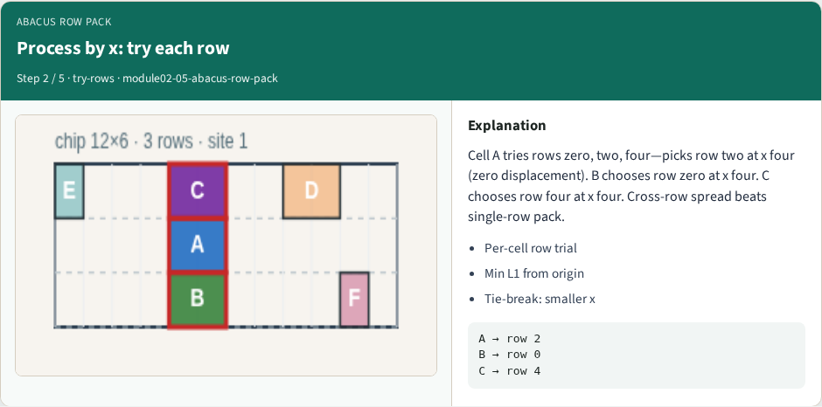
Process by x: try each row
Process by x: try each row
learn_legalization — 05 abacus row pack
Notes:
Cell A tries rows zero, two, four—picks row two at x four (zero displacement). B chooses row zero at x four. C chooses row four at x four. Cross-row spread beats single-row pack.

Slide 8
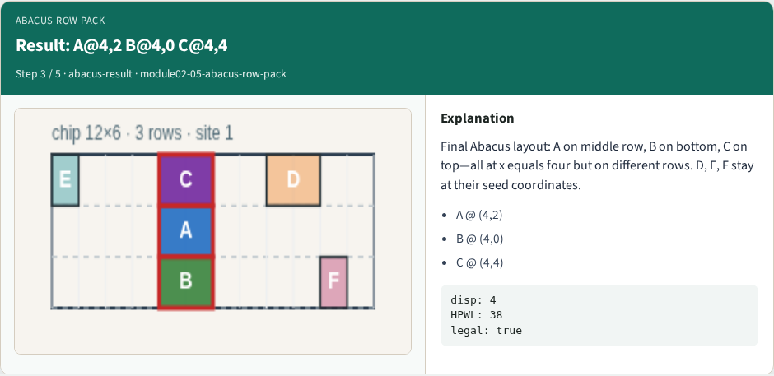
Result: A@4,2 B@4,0 C@4,4
Result: A@4,2 B@4,0 C@4,4
learn_legalization — 05 abacus row pack
Notes:
Final Abacus layout: A on middle row, B on bottom, C on top—all at x equals four but on different rows. D, E, F stay at their seed coordinates.

Slide 9
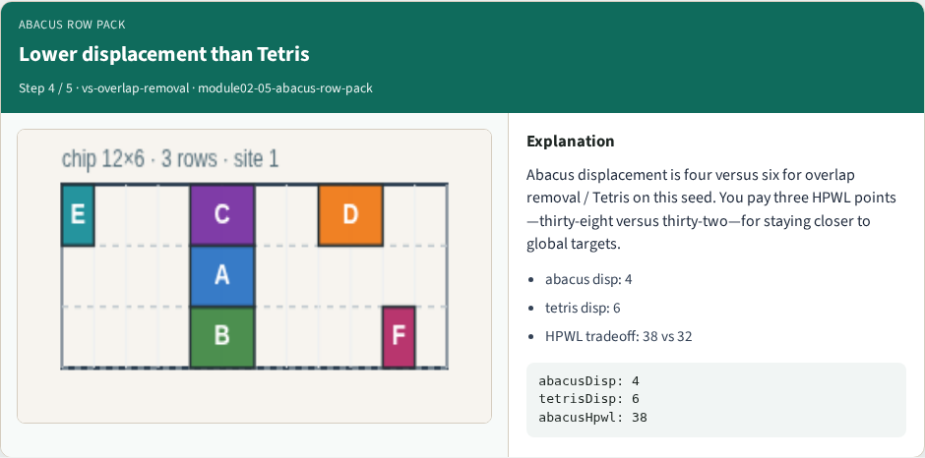
Lower displacement than Tetris
Lower displacement than Tetris
learn_legalization — 05 abacus row pack
Notes:
Abacus displacement is four versus six for overlap removal / Tetris on this seed. You pay three HPWL points—thirty-eight versus thirty-two—for staying closer to global targets.

Slide 10
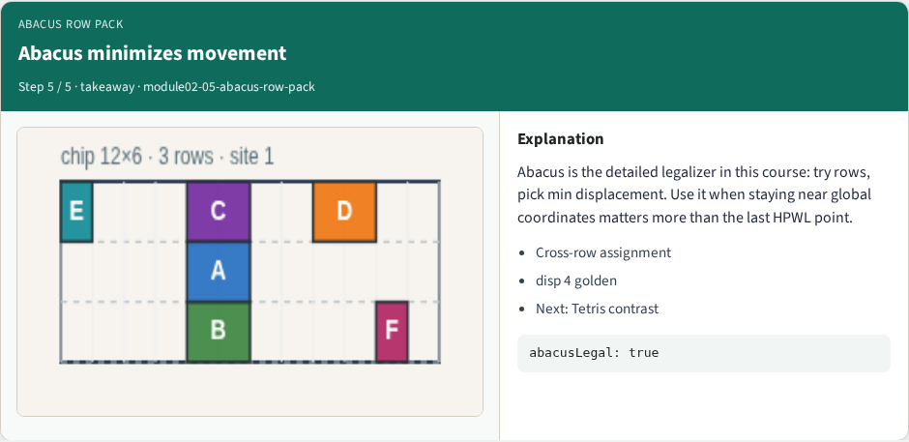
Abacus minimizes movement
Abacus minimizes movement
learn_legalization — 05 abacus row pack
Notes:
Abacus is the detailed legalizer in this course: try rows, pick min displacement. Use it when staying near global coordinates matters more than the last HPWL point.

Slide 11
Browser lab track
In the browser lab track, open the abacus-row-pack lab from the tools shelf
Open the interactive lab
Reveal golden is study-only
Work the challenges that lock the goldens
learn_legalization — 05 abacus row pack
Notes:
In the browser lab track, open the **abacus-row-pack** lab from the tools shelf. Open the interactive lab, place or snap cells on the site and row grid—or use an Apply helper—then Check. Reveal golden is study-only. Work the challenges that lock the goldens, then come back to implement the same loop yourself.

Slide 12
Implement track
In the implement track
Parse `tiny_legal.json`, run the algorithm with deterministic coordinates
Match the browser goldens before you claim the checklist
learn_legalization — 05 abacus row pack
Notes:
In the implement track, open this module's EXAMPLES.md Pseudocode section and the course common solvers. Parse `tiny_legal.json`, run the algorithm with deterministic coordinates, and print legality, displacement, and HPWL. Match the browser goldens before you claim the checklist.

Slide 13
Pitfalls
Common traps
learn_legalization — 05 abacus row pack
Notes:
Common traps: assuming snap alone legalizes; forgetting site width when checking overlap; ignoring fixed macro D at (8, 4); reporting HPWL without legality; and comparing Abacus and Tetris without naming displacement versus wirelength tradeoffs.

Slide 14
Your turn
Complete the checklist for at least one track, preferably both
Implement until your metrics match the starter goldens
When you're ready, take the short quiz, then continue to the next module
learn_legalization — 05 abacus row pack
Notes:
Complete the checklist for at least one track—preferably both. Implement until your metrics match the starter goldens. When you're ready, take the short quiz, then continue to the next module.

