Slide 1
Tetris row packing
Tetris-lite assigns each cell to its nearest row, then left-packs like overlap removal
learn_legalization — 07 tetris row pack
Notes:
Tetris-lite assigns each cell to its nearest row, then left-packs like overlap removal. On the overlap seed the result matches overlap removal: A at four, B at six, C at eight on row two—legal, displacement six, HPWL thirty-two.

Slide 2
The idea
Tetris is simpler than Abacus but moves cells farther on this toy
Contrast disp six versus Abacus disp four
Trade simpler control flow against a tighter displacement budget and slightly higher HPWL
learn_legalization — 07 tetris row pack
Notes:
Tetris is simpler than Abacus but moves cells farther on this toy. Contrast disp six versus Abacus disp four. Trade simpler control flow against a tighter displacement budget and slightly higher HPWL when Abacus wins movement.

Slide 3
Pseudocode
Tetris pseudocode is shorter than Abacus on purpose
First assign each cell to its nearest row and freeze that choice
Then reuse the per-row left pack from overlap removal
Open this module's examples file and find the Pseudocode section
That written sketch is what you implement on the implement track and what the browser
learn_legalization — 07 tetris row pack
Notes:
Tetris pseudocode is shorter than Abacus on purpose. First assign each cell to its nearest row and freeze that choice. Then reuse the per-row left pack from overlap removal.
Open this module's examples file and find the Pseudocode section. That written sketch is what you implement on the implement track and what the browser challenges measure.

Slide 4
Algorithm sketch
Same teaching seed, same numbers as overlap removal: displacement six, HPWL thirty-two
Write the compare line in the sketch so you remember Abacus spends search to cut
learn_legalization — 07 tetris row pack
Notes:
Same teaching seed, same numbers as overlap removal: displacement six, HPWL thirty-two. Write the compare line in the sketch so you remember Abacus spends search to cut displacement to four.

Slide 5
Algorithm sketch — try these
INPUT: positions, widths, rows Y[], fixed macros
OUTPUT: legal packing (shelf / Tetris-lite)
for each movable c: y ← nearest row (freeze)
then per-row left pack (see overlap removal)
GOLDEN: A@4 B@6 C@8 on y=2; disp=6; HPWL=32
COMPARE: Abacus disp=4 (more search)
learn_legalization — 07 tetris row pack

Slide 6
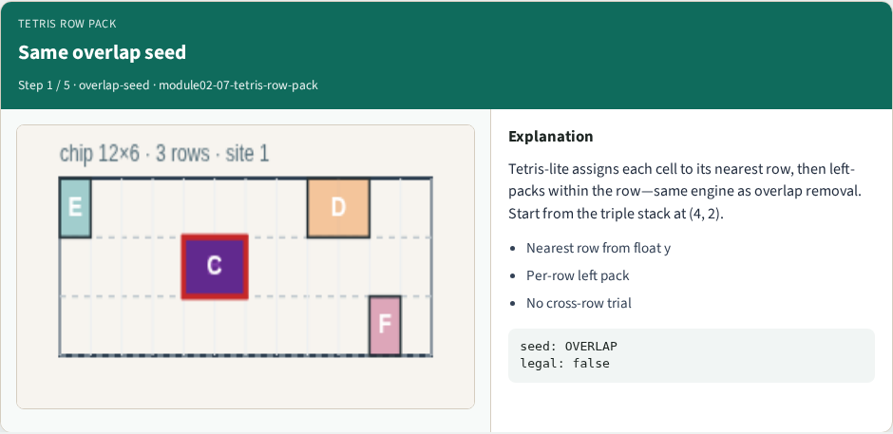
Same overlap seed
Same overlap seed
learn_legalization — 07 tetris row pack
Notes:
Tetris-lite assigns each cell to its nearest row, then left-packs within the row—same engine as overlap removal. Start from the triple stack at (4, 2).

Slide 7
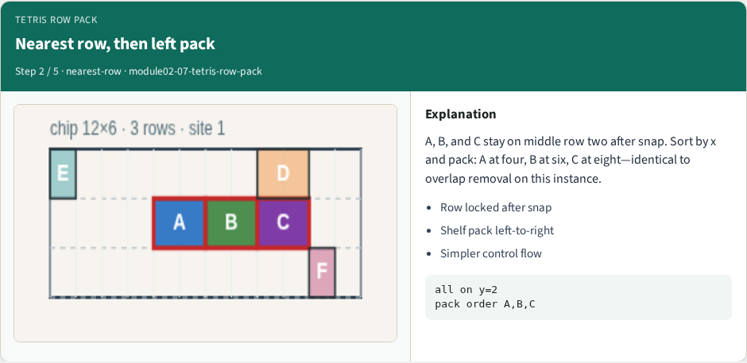
Nearest row, then left pack
Nearest row, then left pack
learn_legalization — 07 tetris row pack
Notes:
A, B, and C stay on middle row two after snap. Sort by x and pack: A at four, B at six, C at eight—identical to overlap removal on this instance.

Slide 8
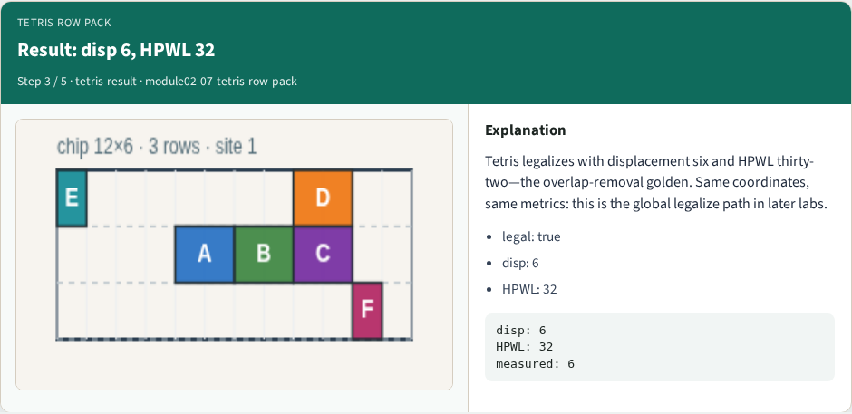
Result: disp 6, HPWL 32
Result: disp 6, HPWL 32
learn_legalization — 07 tetris row pack
Notes:
Tetris legalizes with displacement six and HPWL thirty-two—the overlap-removal golden. Same coordinates, same metrics: this is the global legalize path in later labs.

Slide 9
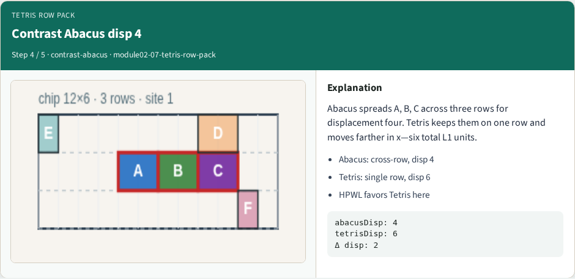
Contrast Abacus disp 4
Contrast Abacus disp 4
learn_legalization — 07 tetris row pack
Notes:
Abacus spreads A, B, C across three rows for displacement four. Tetris keeps them on one row and moves farther in x—six total L1 units.

Slide 10
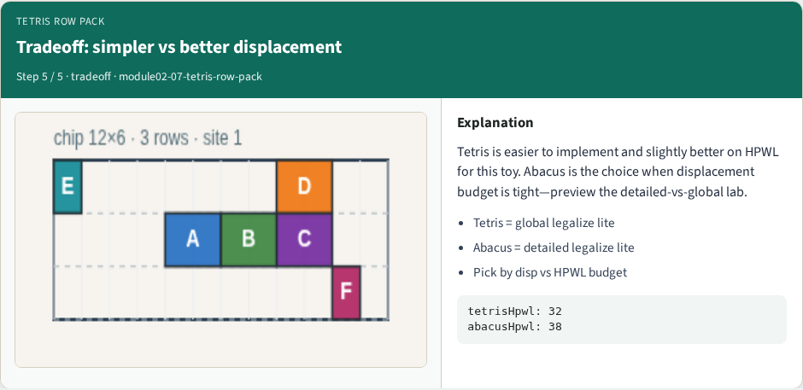
Tradeoff: simpler vs better displacement
Tradeoff: simpler vs better displacement
learn_legalization — 07 tetris row pack
Notes:
Tetris is easier to implement and slightly better on HPWL for this toy. Abacus is the choice when displacement budget is tight—preview the detailed-vs-global lab.

Slide 11
Browser lab track
In the browser lab track, open the tetris-row-pack lab from the tools shelf
Open the interactive lab
Reveal golden is study-only
Work the challenges that lock the goldens
learn_legalization — 07 tetris row pack
Notes:
In the browser lab track, open the **tetris-row-pack** lab from the tools shelf. Open the interactive lab, place or snap cells on the site and row grid—or use an Apply helper—then Check. Reveal golden is study-only. Work the challenges that lock the goldens, then come back to implement the same loop yourself.

Slide 12
Implement track
In the implement track
Parse `tiny_legal.json`, run the algorithm with deterministic coordinates
Match the browser goldens before you claim the checklist
learn_legalization — 07 tetris row pack
Notes:
In the implement track, open this module's EXAMPLES.md Pseudocode section and the course common solvers. Parse `tiny_legal.json`, run the algorithm with deterministic coordinates, and print legality, displacement, and HPWL. Match the browser goldens before you claim the checklist.

Slide 13
Pitfalls
Common traps
learn_legalization — 07 tetris row pack
Notes:
Common traps: assuming snap alone legalizes; forgetting site width when checking overlap; ignoring fixed macro D at (8, 4); reporting HPWL without legality; and comparing Abacus and Tetris without naming displacement versus wirelength tradeoffs.

Slide 14
Your turn
Complete the checklist for at least one track, preferably both
Implement until your metrics match the starter goldens
When you're ready, take the short quiz, then continue to the next module
learn_legalization — 07 tetris row pack
Notes:
Complete the checklist for at least one track—preferably both. Implement until your metrics match the starter goldens. When you're ready, take the short quiz, then continue to the next module.

