Slide 1
Fixed macros
Macro D is locked at (8, 4) on the top row, width two blocks sites eight and nine
learn_legalization — 01 fixed macros
Notes:
Macro D is locked at (8, 4) on the top row—width two blocks sites eight and nine. Run Abacus with fixed macros: D never moves, movables pack around the obstacle, and the run stays legal with displacement four on this instance.

Slide 2
The idea
Fixed cells are placed first; occupied intervals block shelf and Abacus trials on that row
Legality adds a macro check, any drift off the lock fails
Movable cells must route around macro sites, not slide through them
learn_legalization — 01 fixed macros
Notes:
Fixed cells are placed first; occupied intervals block shelf and Abacus trials on that row. Legality adds a macro check—any drift off the lock fails. Movable cells must route around macro sites, not slide through them.

Slide 3
Pseudocode
Macro legalization adds one precondition to the Abacus sketch: place locked cells first
Their site intervals become obstacles for every later try-place on that row
Open this module's examples file and find the Pseudocode section
That written sketch is what you implement on the implement track and what the browser
learn_legalization — 01 fixed macros
Notes:
Macro legalization adds one precondition to the Abacus sketch: place locked cells first. Their site intervals become obstacles for every later try-place on that row.
Open this module's examples file and find the Pseudocode section. That written sketch is what you implement on the implement track and what the browser challenges measure.

Slide 4
Algorithm sketch
The legality line in the sketch is new too
On this instance Abacus still finishes legal with displacement four
learn_legalization — 01 fixed macros
Notes:
The legality line in the sketch is new too—if D drifts off eight comma four, the packing fails even when overlaps are gone. On this instance Abacus still finishes legal with displacement four.

Slide 5
Algorithm sketch — try these
INPUT: positions, widths, fixed F (e.g. D@(8,4))
OUTPUT: legal pack; macros never move
place every f in F at locked (x,y)
run Abacus/Tetris on movables only
F intervals block try-place / left-pack
fail legality if any macro drifted
GOLDEN: D stays (8,4); Abacus disp=4; legal
learn_legalization — 01 fixed macros

Slide 6
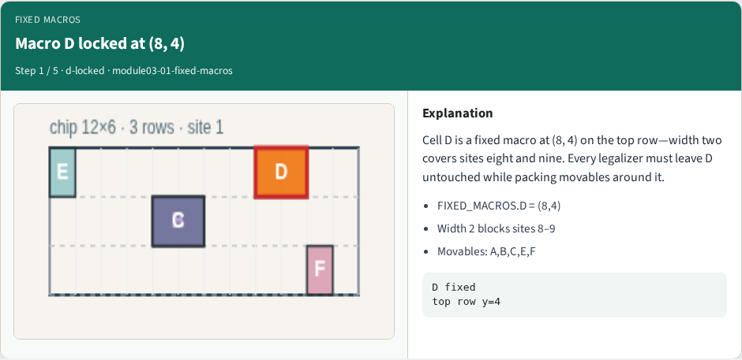
Macro D locked at (8, 4)
Macro D locked at (8, 4)
learn_legalization — 01 fixed macros
Notes:
Cell D is a fixed macro at (8, 4) on the top row—width two covers sites eight and nine. Every legalizer must leave D untouched while packing movables around it.

Slide 7
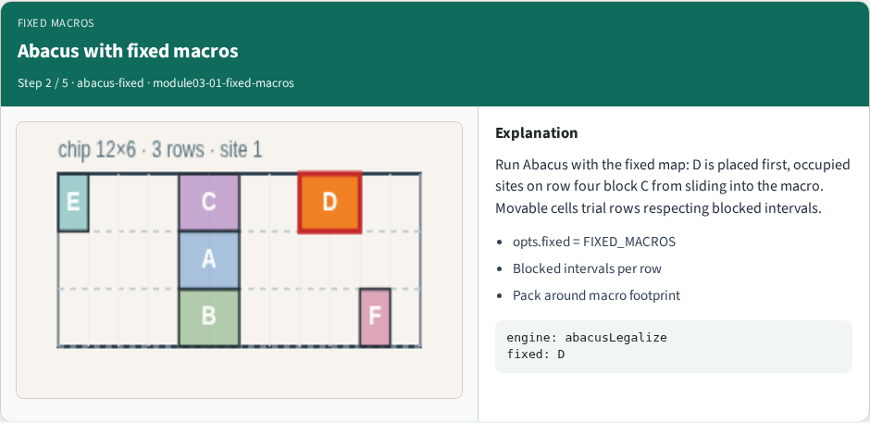
Abacus with fixed macros
Abacus with fixed macros
learn_legalization — 01 fixed macros
Notes:
Run Abacus with the fixed map: D is placed first, occupied sites on row four block C from sliding into the macro. Movable cells trial rows respecting blocked intervals.

Slide 8
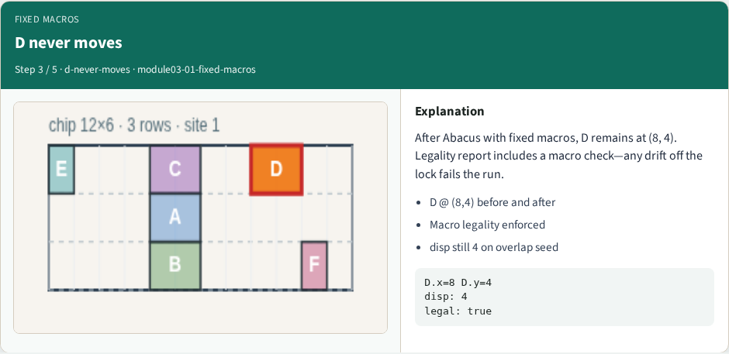
D never moves
D never moves
learn_legalization — 01 fixed macros
Notes:
After Abacus with fixed macros, D remains at (8, 4). Legality report includes a macro check—any drift off the lock fails the run.

Slide 9
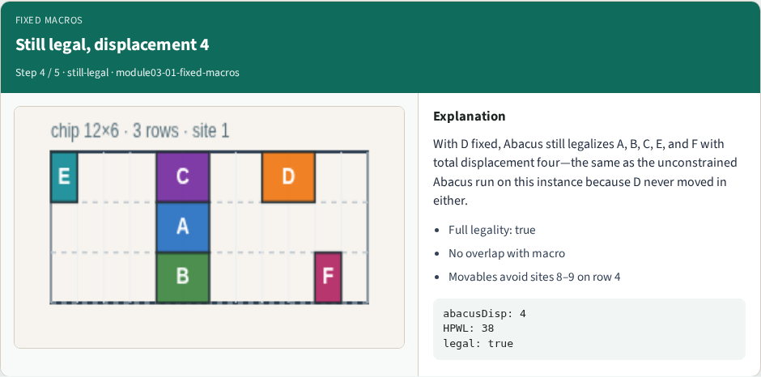
Still legal, displacement 4
Still legal, displacement 4
learn_legalization — 01 fixed macros
Notes:
With D fixed, Abacus still legalizes A, B, C, E, and F with total displacement four—the same as the unconstrained Abacus run on this instance because D never moved in either.

Slide 10
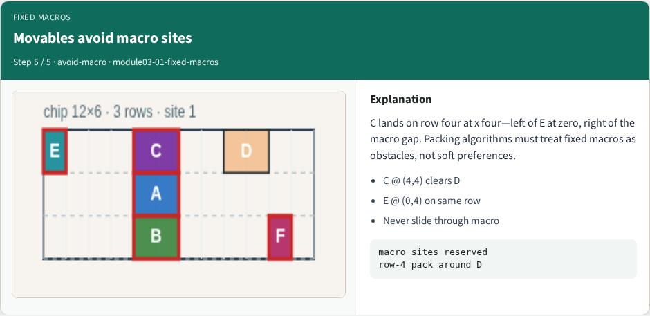
Movables avoid macro sites
Movables avoid macro sites
learn_legalization — 01 fixed macros
Notes:
C lands on row four at x four—left of E at zero, right of the macro gap. Packing algorithms must treat fixed macros as obstacles, not soft preferences.

Slide 11
Browser lab track
In the browser lab track, open the fixed-macros lab from the tools shelf
Open the interactive lab
Reveal golden is study-only
Work the challenges that lock the goldens
learn_legalization — 01 fixed macros
Notes:
In the browser lab track, open the **fixed-macros** lab from the tools shelf. Open the interactive lab, place or snap cells on the site and row grid—or use an Apply helper—then Check. Reveal golden is study-only. Work the challenges that lock the goldens, then come back to implement the same loop yourself.

Slide 12
Implement track
In the implement track
Parse `tiny_legal.json`, run the algorithm with deterministic coordinates
Match the browser goldens before you claim the checklist
learn_legalization — 01 fixed macros
Notes:
In the implement track, open this module's EXAMPLES.md Pseudocode section and the course common solvers. Parse `tiny_legal.json`, run the algorithm with deterministic coordinates, and print legality, displacement, and HPWL. Match the browser goldens before you claim the checklist.

Slide 13
Pitfalls
Common traps
learn_legalization — 01 fixed macros
Notes:
Common traps: assuming snap alone legalizes; forgetting site width when checking overlap; ignoring fixed macro D at (8, 4); reporting HPWL without legality; and comparing Abacus and Tetris without naming displacement versus wirelength tradeoffs.

Slide 14
Your turn
Complete the checklist for at least one track, preferably both
Implement until your metrics match the starter goldens
When you're ready, take the short quiz, then continue to the next module
learn_legalization — 01 fixed macros
Notes:
Complete the checklist for at least one track—preferably both. Implement until your metrics match the starter goldens. When you're ready, take the short quiz, then continue to the next module.

