Slide 1
Displacement versus HPWL
Legalization cost combines HPWL and displacement
learn_legalization — 03 displacement hpwl
Notes:
Legalization cost combines HPWL and displacement: cost equals HPWL plus lambda times displacement from the pre-legalize layout. Abacus on the overlap seed reports HPWL thirty-eight and displacement four.

Slide 2
The idea
Lambda one gives cost forty-two
Higher lambda favors staying near global placement even when wirelength could be slightly
learn_legalization — 03 displacement hpwl
Notes:
Lambda one gives cost forty-two; lambda five gives cost fifty-eight on the same legal Abacus result. Higher lambda favors staying near global placement even when wirelength could be slightly better under a different packer.

Slide 3
Pseudocode
This module’s pseudocode is a cost function, not a packer
After you have a legal layout
Open this module's examples file and find the Pseudocode section
That written sketch is what you implement on the implement track and what the browser
learn_legalization — 03 displacement hpwl
Notes:
This module’s pseudocode is a cost function, not a packer. After you have a legal layout, compute displacement and HPWL, then combine them with lambda.
Open this module's examples file and find the Pseudocode section. That written sketch is what you implement on the implement track and what the browser challenges measure.

Slide 4
Algorithm sketch
Plug in the Abacus goldens: thirty-eight plus lambda times four
Lambda one costs forty-two; lambda five costs fifty-eight
Higher lambda means the sketch favors staying near the global place
learn_legalization — 03 displacement hpwl
Notes:
Plug in the Abacus goldens: thirty-eight plus lambda times four. Lambda one costs forty-two; lambda five costs fifty-eight. Higher lambda means the sketch favors staying near the global place.

Slide 5
Algorithm sketch — try these
INPUT: legal positions, origin, nets, λ≥0
OUTPUT: cost, HPWL, disp
disp ← Σ|Δx|+|Δy| vs origin
HPWL ← Σ net bbox (cell centers)
cost ← HPWL + λ · disp
GOLDEN Abacus: HPWL=38 disp=4
λ=1 → 42; λ=5 → 58
learn_legalization — 03 displacement hpwl

Slide 6
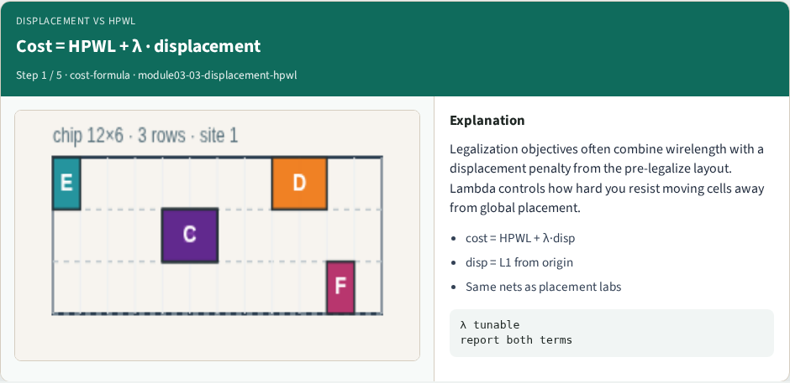
Cost = HPWL + λ · displacement
Cost = HPWL + λ · displacement
learn_legalization — 03 displacement hpwl
Notes:
Legalization objectives often combine wirelength with a displacement penalty from the pre-legalize layout. Lambda controls how hard you resist moving cells away from global placement.

Slide 7
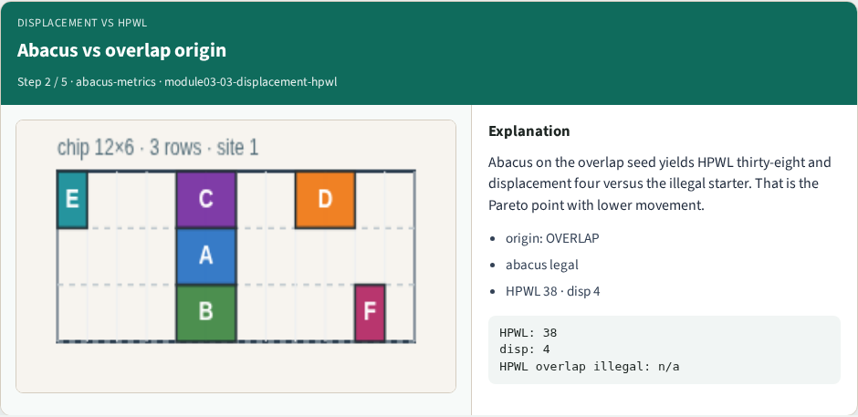
Abacus vs overlap origin
Abacus vs overlap origin
learn_legalization — 03 displacement hpwl
Notes:
Abacus on the overlap seed yields HPWL thirty-eight and displacement four versus the illegal starter. That is the Pareto point with lower movement.

Slide 8
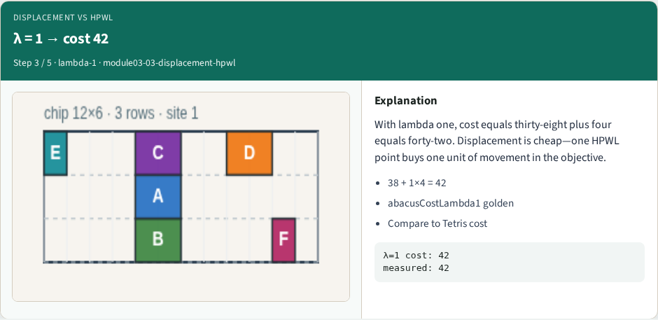
λ = 1 → cost 42
λ = 1 → cost 42
learn_legalization — 03 displacement hpwl
Notes:
With lambda one, cost equals thirty-eight plus four equals forty-two. Displacement is cheap—one HPWL point buys one unit of movement in the objective.

Slide 9

λ = 5 → cost 58
λ = 5 → cost 58
learn_legalization — 03 displacement hpwl
Notes:
Raise lambda to five: cost becomes thirty-eight plus five times four equals fifty-eight. The same legal layout looks expensive when you punish displacement heavily.

Slide 10
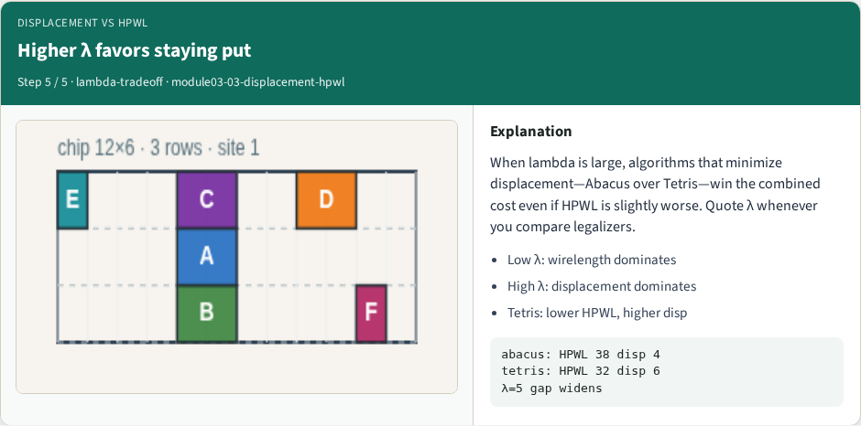
Higher λ favors staying put
Higher λ favors staying put
learn_legalization — 03 displacement hpwl
Notes:
When lambda is large, algorithms that minimize displacement—Abacus over Tetris—win the combined cost even if HPWL is slightly worse. Quote λ whenever you compare legalizers.

Slide 11
Browser lab track
In the browser lab track, open the displacement-hpwl lab from the tools shelf
Open the interactive lab
Reveal golden is study-only
Work the challenges that lock the goldens
learn_legalization — 03 displacement hpwl
Notes:
In the browser lab track, open the **displacement-hpwl** lab from the tools shelf. Open the interactive lab, place or snap cells on the site and row grid—or use an Apply helper—then Check. Reveal golden is study-only. Work the challenges that lock the goldens, then come back to implement the same loop yourself.

Slide 12
Implement track
In the implement track
Parse `tiny_legal.json`, run the algorithm with deterministic coordinates
Match the browser goldens before you claim the checklist
learn_legalization — 03 displacement hpwl
Notes:
In the implement track, open this module's EXAMPLES.md Pseudocode section and the course common solvers. Parse `tiny_legal.json`, run the algorithm with deterministic coordinates, and print legality, displacement, and HPWL. Match the browser goldens before you claim the checklist.

Slide 13
Pitfalls
Common traps
learn_legalization — 03 displacement hpwl
Notes:
Common traps: assuming snap alone legalizes; forgetting site width when checking overlap; ignoring fixed macro D at (8, 4); reporting HPWL without legality; and comparing Abacus and Tetris without naming displacement versus wirelength tradeoffs.

Slide 14
Your turn
Complete the checklist for at least one track, preferably both
Implement until your metrics match the starter goldens
When you're ready, take the short quiz, then continue to the next module
learn_legalization — 03 displacement hpwl
Notes:
Complete the checklist for at least one track—preferably both. Implement until your metrics match the starter goldens. When you're ready, take the short quiz, then continue to the next module.

